Slide 1

What is new in
SQL 2025

Slide 2




Said Salomon
Said Salomon has over 40 years of experience as an Information Technology Professional. He has a vast array of abilities in the field in the areas of Network, Desktop Support, DBA, Staff Project Management, Application Software Development, Business Analysis and Quality Assurance. He is an AWS Certified Solutions Architect – Associate and has certifications from the Insurance Institute of America.
Database Administrator
https://www.linkedin.com/in/saidsalomonii
SQLBouncer@SQLBouncer.com
@SQLBouncer

Slide 3
Agenda
What is new in SQL 2025 brief overview
New JSON data type
New Vector Data type
  What is a Vector in SQL 2025
  Using Vector with LLM / AI
    New Functions for Vectors
  Basic Demo
  Advanced Demo
    Setup LLM for demo
Sources and extras

Slide 4
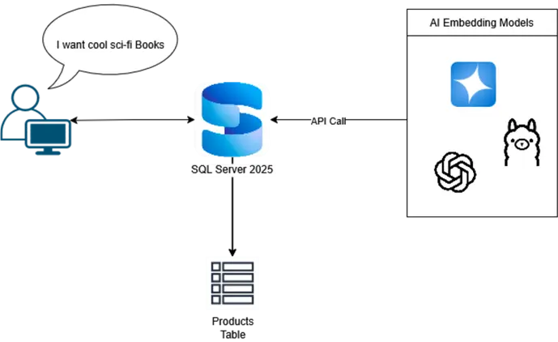

Slide 5
What is a Vector
A vector is a mathematical and physical object that has both magnitude and direction.
In SQL 2025:
  In SQL Server 2025, a vector refers to a new data type designed to store and manage numerical representations of data, particularly for AI and machine learning applications. These numerical representations are often called embeddings. Used to do similarity search and or logical distance.

Slide 6
Vector Data type
  Stored as a varbinary
  Looks like an array of floating point (float32 or float16)
  JSON format used
  Limitations
    Holds up to 1998 dimensions
    Check and Default constraints nor not support for Vector columns
    Foreign key and primary key constraints not supported
    Most function other than the new Vector type functions will not work correctly
    Memory-Optimized table not support
    Always Encrypted not support
    No indexes expect for new vector index type on vector columns
  New Vector index using DiskANN

Slide 7
Demo Setup
SQL 2025 Developer Edition
SQL Server Management Studio version 22
Ollama (local model)
OpenSSL (generate certificate)
NGINX (HTTPS service)
POSTMAN (test https post)
SP_CONFIGURE
external rest endpoint enabled
Create External Model
AI_GENERATE_EMBEDDINGS (test model)

Slide 8
Basic
Vector Demo

Slide 9
LLM SETUP
Vector Demo

Slide 10
Advance
Vector Demo

Slide 11
Resources
Name | URL
Github | https://github.com/sqlbouncer/PSSUG_202512
What New in SQL 2025 | https://learn.microsoft.com/en-us/sql/sql-server/what-s-new-in-sql-server-2025?view=sql-server-ver17
Ollama | https://ollama.com/download
OpenSSL | https://slproweb.com/products/Win32OpenSSL.html
Nginx | https://nginx.org/en/download.html
Postman | https://www.postman.com/downloads/
Demo2 | https://www.mssqltips.com/sqlservertip/8285/sql-server-semantic-search-using-ai-features/
Demo1 / functions | https://www.mssqltips.com/sqlservertip/8299/vector-search-in-sql-server/
DiskAnn | https://www.microsoft.com/en-us/research/publication/diskann-fast-accurate-billion-point-nearest-neighbor-search-on-a-single-node/

Slide 12
THANK YOU
Said Salomon
sqlbouncer@sqlbouncer.com
https://www.linkedin.com/in/saidsalomonii
X: @SQLBouncer

