Slide 1
An Introduction to Data Catalogs

Slide 2

Josh Smith
Database Administrator
Friend of Redgate
SQLSaturday Spokane Organizer
Spokane SQL Users Group Leader
josh@accitentionaldba.com
@sqldeployhelmet
www.linkedin.com/in/joshsmithdba/
This developer refuses to stop using nolock hints.

Slide 3
Agenda
Why Data Catalog?
Who Data Catalogs?
Where Data Catalog?
How Data Catalog?
Catalog Demo!
Questions?

Slide 4

Voyage of Discovery
Where does your data live?
Data that can’t be found has no value.
Susan in the back office has a wealth of knowledge about your core system but:
She’s only one person,
Helping the data analysts is a low priority,
She’s 2 years out from retirement.
Notes:
To get value from your data you need to be able to locate it when you need it
Analysts don’t want to spend their time hunting for the piece of data they need.
You received a data dictionary from the vendor when you deployed 5 years ago but it wasn’t complete then and you’ve received no updates.
Data catalog capture meta-data that currently only exists in the heads of subject matter experts and puts it in a place where it is discoverable.

Slide 5

Data Breaches Are Just A Thing Now
14,717,618,286 Records lost or stolen since 2013¹
Approximately 72 records per second!
Only 4% of breaches were considered “secure” where the data stolen was encrypted.
In 2018 only half of these were caused by an outside hack.
1/3 were the result of accidental loss or exposure.
Notes:
[1] Breachlevelindex.com
Records are lost at a rate of about 72/second!
The rate of breaches will only increase over time.
Data professionals and organizations are working to mitigate risk (and fallout) from data breaches.
Laws like General Data Protection Regulation (GDPR), California Consumer Privacy Act (CCPA) and Washington Privacy Act (WPA) are going to potentially provide extra “incentive” for adopting best practices around data protection.
Image www.gunshowcomic.com/648 (KC Green)

Slide 6
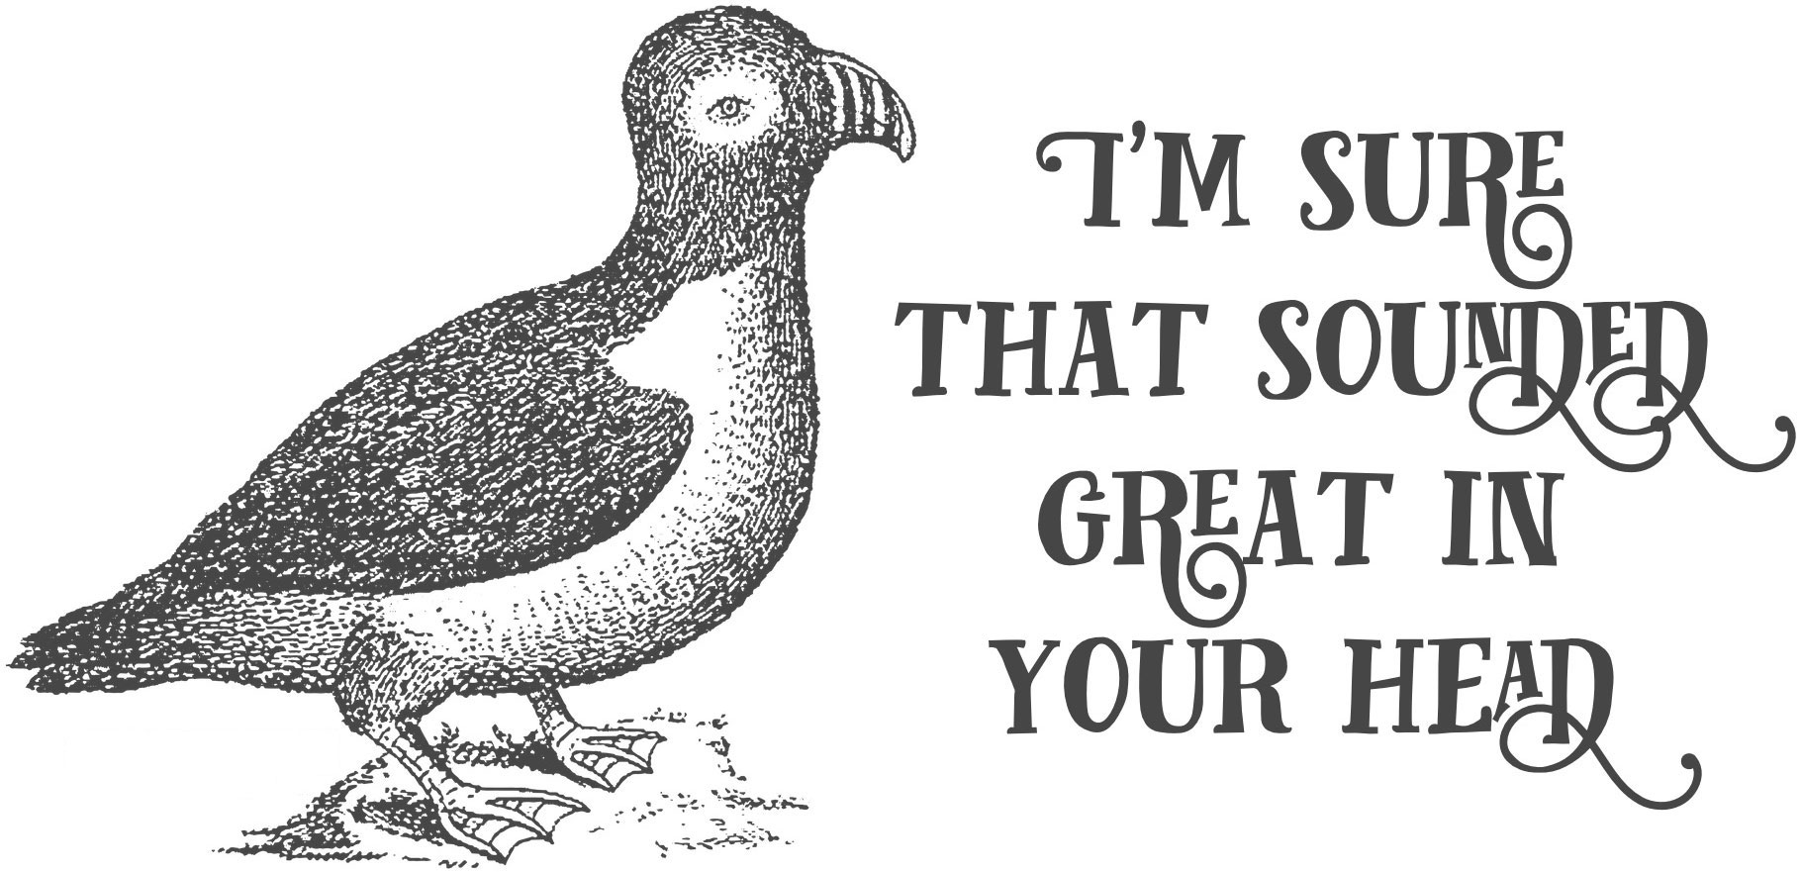
Let’s Have More Meetings!
Increased focus on Data Governance has been the response to new legislation, the increased pace of data breaches as well as internal demands to sensitive data.
Notes:
More formal oversight and guidance over data, data access and data processes.
Organizations are most interested in determining and mitigating RISK
To do so requires an *accurate* idea of the data in their care
We know a database might have sensitive data but
how much?
Where exactly in the db is it?
How long is it retained?
Particularly vexing: vendor databases, we didn’t design it so we don’t “know” how it’s organized.
Additionally: Orgs need a way to capture and expose tribal metadata to the organization.
Image via: https://www.effinbirds.com (NSFW)

Slide 7
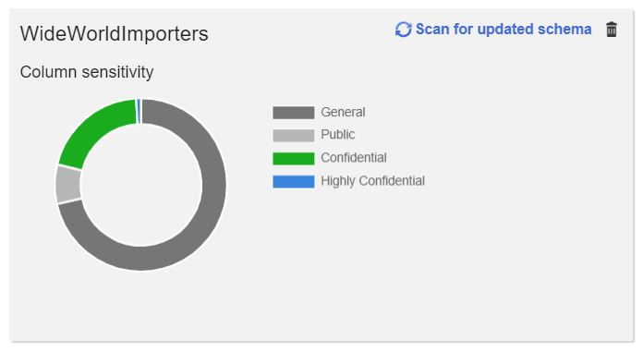
So: What Use is the Data Catalog?
A data catalog provides a way to make data’s metadata observable to your organization.
Notes:
Expose structural metadata (format)
If possible: data profile (max, min, average values, how many are distinct?)
Data sensitivity
Is it sensitive?
How/why?
What is the data used for? Who is responsible for it?

Slide 8
Registered Assets
Azure Data Catalog*
SQL Server (table or view)
Structural meta data (table, schema)
Type, row count, size, recent update, more.
Cosmos DB Collection
Many more: https://docs.microsoft.com/en-us/azure/data-catalog/data-catalog-dsr
SQL Data Catalog (Redgate)
SQL Server (instance, database, columns)
Structural meta data (table, schema)
Type, row count
Notes:
*Azure data catalog as of V1
ADS: probably better for data discovery (built around a business glossary, very collaborative)
Built around business glossary
Many different data sources can be cataloged
Azure
SDC: better at risk assessment (SQL Server Only)
Built with an infosec first mindest (data type and sensitivity)
PS module (any web task can be performed via PS)
On prem

Slide 9
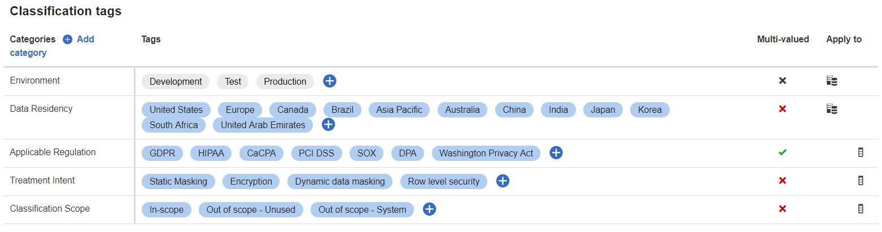
Death & Taxonomies
Azure Data Catalog/SQL Data Catalog allow you to create a collection of metadata tags to apply to your data.
Information Type
Data Sensitivity level
Business terms
Treatment intent
Environment
SLA
Data Stewards
Free text
Notes:
You need a basic taxonomy to get started but these can be developed over time: they are not all or nothing.
Should be developed as a collaboration with others in the business (info mgmt./data governance etc)
Gives them a stake in the catalog
Makes cataloged data instantly usable as business has determined the vocabulary.

Slide 10
Demo Time!
IMMA LET YOU FINISH…
Notes:
Interface
Taxonomy dashboard – add a category and description (Project Scoping | Descoped: Empty Table)
SQL Instance Tiles
Database tiles → partially cataloged db (WW Importers)
PS
Script to catalog columns with “flag” in the name (other data, general sensitivity)
Script to catalog/descope empty tables (0 rows)

Slide 11
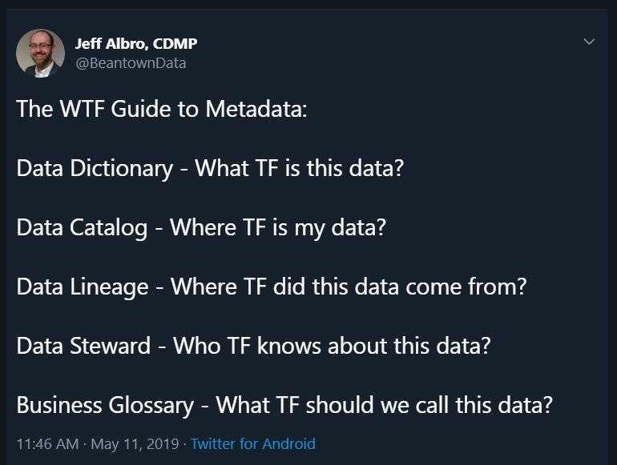
Questions?
A data catalog should start to answer common questions users have about your data:
Notes:
This slide (& questions) if time allows
A data catalog collects and exposes meta data that starts to answer important questions about the data we are keeping.

