Slide 1
AN INTRODUCTION TO SQL
with your host:
Josh Smith
Senior DBA
9 years working with SQL Server
I started working with SQL with just a theater degree: anyone can do it!

Slide 2
What Are We Learning?
What is SQL Server/RDBMS?
What is SSMS?
How to use Azure Data Studio to access SQL Server?
How do I Query?
Filtering Data
Aggregating Data
Joining & Subqueries
Changing Data and Transactions
SQL Tips
Further resources

Slide 3

What Are We Not Learning?
Database Design
SQL Administration

Slide 4
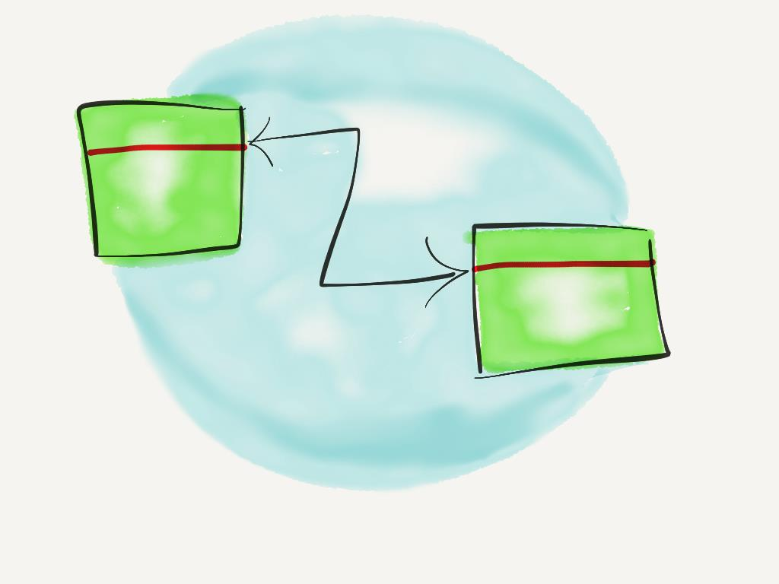
So, What’s an RDBMS?
Relational Database Management System
Data that has a relationship to other data.
Data is stored in tables and a RDBMS tracks and manages the relationship between multiple tables. A database is simply a collection of tables.

Slide 5

So, What’s SQL Then?
Structured Query Language
A programming language written to easily ask questions and get answers from databases.
Queries can be broken down
into three* parts:
A list of the things you want
from a collection of things
that meet certain criteria
Sorted in a specific way. (Optional)

Slide 6

So Tell Me What You Want
SELECT girls
FROM spice
SELECT statements return data from tables.
SELECT *
FROM spice
Tip: Only return the columns you want (this is more efficient and queries will return results faster).

Slide 7
Demo Time
Let’s connect to SQL Server and return some data.

Slide 8

No, What You Really, Really Want
Filters keep data you don’t want from reaching you:
=, >, <, <>, IN, LIKE, EXISTS
SELECT girls
FROM spice
WHERE name <> ‘sporty’

Slide 9
Demo Time
Maybe let’s return a little less data.

Slide 10
I Don’t Know About NULL
Filtering on NULLS is special
NULLS are SQL’s way of saying:
¯\_(ツ)_/¯
SQL stores NULLs where explicit values were not provided (and are not required). Programmers and other designers sometimes then assign meaning to NULL results but SQL Server won’t know anything about it. If NULLs exist on columns you are evaluating they must be dealt with explicitly in your code or SQL will not evaluate those values: they could be anything!

Slide 11
Demo Time
What is NULL? Can we tell?

Slide 12

Run It Again Sam
You may end up with scripts you want to run on a schedule or with slightly different search criteria.
Variables are the answer! Variables are place holder for a value that you can determine elsewhere.
Must be declared
Must start with @
Do not set value after midnight!
DECLARE @myvariablename AS
SELECT @myvariablename =

Slide 13
Demo Time
Let’s reuse some SQL.

Slide 14

The Sum of All Our Parts
Many times you’ll want to analyze data by grouping your data together. This is aggregation. SQL provides a number of ways to manipulate data in groups.
Common aggregation functions:
COUNT
SUM
AVG
MIN
MAX
SELECT *
FROM table
GROUP BY

Slide 15

The Sum of Some of Our Parts
Sometimes you only want information for groups where the group aggregate meets a certain threshold. HAVING is a WHERE clause for groups.
SELECT *
FROM table
GROUP BY grouping set
HAVING

Slide 16
Demo Time
Let’s Aggregate!

Slide 17
You Can’t Always Get What You Want
(From Just One Table)
Often our data exists in multiple tables that we need to bring together to find what we want. This is the relational part of a RDBMS. Relationships are defined by keys. There are two kinds of keys in a SQL Database:
Primary Keys:
Uniquely defines a row of data in a table.
Usually a number in a single column, but not necessarily.
Can be enforced by SQL Server or conceptual.
Foreign Keys:
Foreign keys are keys that point to primary key in another table.
FKs can be enforced by SQL Server or conceptual.

Slide 18
Come Together Now
SQL has a number of different ways to join table data together:
(INNER) JOIN
INNER JOIN returns rows from both tables where the JOIN match condition is met. INNER is optional and is assumed if omitted.
LEFT JOIN
A LEFT JOIN returns all the records from the “left” table whether there are matching records in the “right” table or not. Values in columns for the “right” will be NULL for rows in the “left” table with nothing to join on.
RIGHT JOIN
A RIGHT JOIN returns all the records from the “right” table whether there are matching records in the “left” table or not. Values in columns for the “left” will be NULL for rows in the “right” table with nothing to join on.
FULL JOIN
A FULL JOIN returns all records from both tables. Columns on either side of the join where no join was possible will have NULL values.
CROSS JOIN
JOINS every row in one table to the other table.
JOIN criteria can be specified in the WHERE clause (effectively and INNER JOIN).

Slide 19
Demo Time
Join me for this demo.

Slide 20
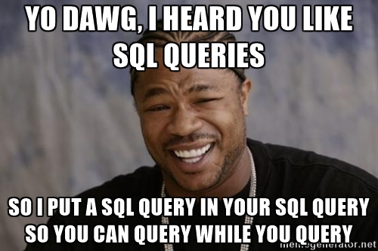
Yo Dawg: I Heard You Like Joins
Additionally we also have self joins and sub-queries.
Self Joins are possible when you have a key that is self referential.
For Example: Employees may have column for their manager that contains their manager’s employee number.
Sub-Queries are not necessarily a join but they are close enough to include here.
A sub-query is a query inside a query that the outer query is dependent on in some way.

Slide 21
Demo Time
So let’s query inside some other queries.

Slide 22
Notorious DML
Data Manipulation Language
SQL statements is divided into two classifications: DDL & DML
Data Definition Language (DDL) consists of creating or changing database objects: tables, stored procedures, functions etc.
DML Is manipulation of data in or with those objects:
Inserting Data
Updating Data
Deleting Data
Selecting Data
I’ve secretly replaced all our previous queries with DML

Slide 23

Insert, Update, Delete: Oh My!
With DML we can add rows to a table;
update values in a row (or rows);
or delete rows from a table.
INSERT INTO table (columns)
VALUES (value list)
UPDATE table
SET column = value
WHERE …
DELETE FROM table
WHERE …
WHERE clauses are very important with
update/delete statements!

Slide 24
Begin Transactions
Transactions are how SQL Server breaks down work to maintain database consistency.
ACID
Atomicity: Transactions are all or nothing. A partially committed transaction leaves the database in an unknown state.
Consistency: Transactions must be valid according to database defined rules.
Isolation: Transactions cannot depend on other transactions.
Durability: Committed transactions will remain committed (changes made to the files on the disk).

Slide 25
Commit Transactions
If you are doing work that could potentially have issues you explicitly define a transaction.
BEGIN TRANSACTION
This signals to SQL that we are starting a series of commands that will comprise a transaction.
COMMIT TRANSACTION
This signals to SQL that the work done previously by the thread is ready to be committed to the database permanently.
ROLLBACK TRANSACTION
This signals to SQL that the work done previously by the thread should be abandoned and the database left in its original state.

Slide 26
Demo Time
Hello sir, I would like to conduct a transaction.

Slide 27
Readability, A Common Problem
Common Table Expressions: Making SQL more readable
CTE can help you organize and read complex SQL queries more easily by nesting queries and re-using the results.
Syntax:
WITH <CTE NAME> AS ( subquery )
SELECT *
FROM <CTE NAME>

Slide 28
Demo Time
This demo is far from common.

Slide 29
A Little Help From Your Friend
Making Queries faster: Indexes are your best friend for speeding up queries.
An Index is a sorted list of the data (or a subset) from a table.
Heaps: digging through the laundry pile to find one sock.
Indexes: you know your socks are kept in the sock drawer.
Primary key is the table on the disk.
Index is a second copy of the table.
A covering index means never touching the table.

Slide 30
Help You Can Do Without
You might read about or have had the query hint NOLOCK recommended to you by a friend. (Also see READ_UNCOMMITTED.)
SQL Server maintains data integrity by taking out locks on data that it is reading or modifying.
Read Update Insert Delete | Row Page Table
NOLOCK instructs SQL to ignore locks taken out by other processes and just return everything it finds.
If your system is transactional you’ll get bad data as it is inserted or updated.
If your system is not transactional (such as a reporting database) it won’t matter but you’ll get no benefit.

Slide 31
Demo Time
I learned NOLOCK from watching YOU!

Slide 32
More Resources
SQL Headfirst: Intro to SQL book (Check out from DBA Team)
Pros
Clear, simple examples
Presented in a way geared towards skill retention
Cons
Book is kind of heavy?
PluralSight (www.pluralsight.com)
Pros
Deep technical dives
Presented by industry experts
Lightweight
Cons
Costs money
May assume a certain level of technical proficiency
SQLPASS (www.pass.org)
Pros
Local SQL Server user group.
Friendly, local SQL Server professionals from around Spokane
SQL Saturday March 10, 2018!
Cons
May lead to further SQL learning

Slide 33
Even More Resources
StackOverflow (Google will probably lead you here)
Pros
Specific, detailed questions
Crowd sourced to industry experts
Cons
Crowd sourced to industry experts (who don’t always agree)
Answers may assume a certain level of technical proficiency
Your friendly local DBAs
Pros
Unique knowledge of STCU data (sometimes).
Face to face contact.
Cons
Might not know or may not be able to respond in time.
Sometimes cranky.

Slide 34
Thanks!
It’s over now.

Slide 35

You’re Still Here?
It’s over. Go home.
Go.

