Slide 1
Parameter Sensitive Plan Optimization and Query Store
Jared Poche
Database Engineer\Architect

Slide 2

About the Author
Database Engineer\Architect
@sqljared
/jared-poche
Sqljared.com
Former community college teacher
10-year veteran of Microsoft CSS
SQL Saturday speaker
Group By and PASS Summit speaker
Blogging since 2019

Slide 3
Parameter Sniffing
SQL Server normally caches procedure plans
Sniffing uses the cardinality of parameters provided to generate the best plan
Best plan for the provided parameters
May be a poor plan for other parameter values
Especially problematic when data is skewed

Slide 4
Parameter Sensitive Plan Optimization - Basics
Provides option to have multiple plans based on skewed parameters
Checks the cardinality of the provided parameter
Plans based on a small\medium\large number of rows
Sets two boundary values (100 and 100K\1M)

Slide 5
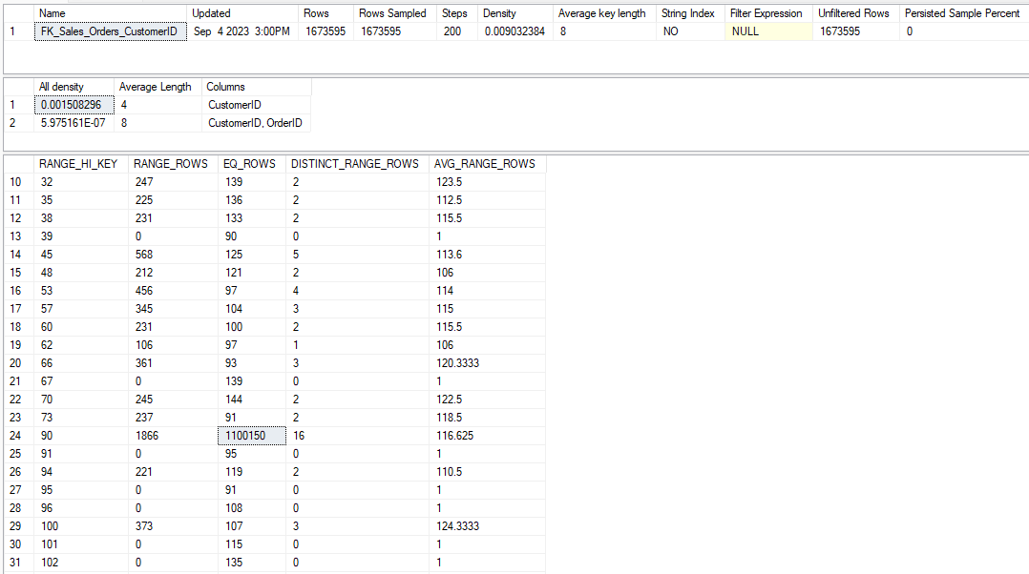
Histograms

Slide 6
Cardinality and Ranges
Creates three ranges for a parameter
Based on two boundaries
Low boundary is 100; any parameter value with a cardinality <=100 gets the “low” plan
High boundary is either 100,000 or 1,000,000
Middle range is between the boundaries
Ranges based on cardinality, not value

Slide 7
Is PSPO enabled?
Is compatability level >= 160?
SELECT @c_level = db.compatibility_level
FROM sys.databases db
WHERE db.database_id = DB_ID();
database_scoped_configurations:
SELECT @i_out = CONVERT(bit,dsc.value)
FROM sys.database_scoped_configurations dsc
WHERE dsc.name = 'PARAMETER_SENSITIVE_PLAN_OPTIMIZATION'

Slide 8
PSPO Queries and Plans
Dispatch Plan
Variant Plan 1
Variant Plan 2
Parent Query
Variant Queries
Variant Plan 3

Slide 9
Dispatcher Plan
Relate to parent query
Stubs: little info
Never execute; no query_store_runtime_stats
See Plan XML Additions
Redirects to the variant plans
Contains <Dispatcher> block

Slide 10
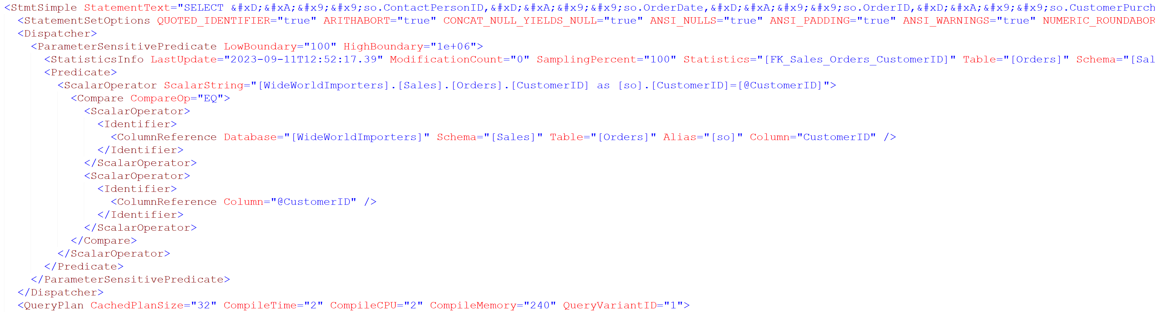
Plan XML Additions

Slide 11

sys.query_store_query_variant
Relates the parent_query_id and dispatcher_plan_id to a query_variant_query_id

Slide 12
New columns in sys.query_store_plan
plan_type:
INT values for plan types: 0 for compiled plans, 1 for dispatcher plans, 2 for variant plans
plan_type_desc:
Text term for each

Slide 13
Query Hint Updates
Additional clauses visible in Query Store
(@CustomerID int)SELECT so.ContactPersonID, so.OrderDate, so.OrderID, so.CustomerPurchaseOrderNumber, so.ExpectedDeliveryDate FROM Sales.Orders so WHERE so.CustomerID = @CustomerID option (PLAN PER VALUE(ObjectID = 1867153697, QueryVariantID = 1, predicate_range([WideWorldImporters].[Sales].[Orders].[CustomerID] = @CustomerID, 100.0, 1000000.0)))
Invalid syntax for users

Slide 14
Variant Queries
Actually execute
Have query_store_runtime_stats results
Up to 3 variants per parameter
Up to 27 if 3 parameters are varying
Object_ID = 0
May break your Query Store scripts!

Slide 15
Multiple parameters
Can consider up to 3 parameters with skew
“only the most skewed predicate will be evaluated” for each table
Under Remarks
UNIONs treated as separate tables

Slide 16
A Few Issues
Access violations!
May occur every 15 minutes
Resolved in CU5, CU6, and CU7
query_store_query.object_id = 0
Like an ad-hoc query
Filters on object_id or object_name will return incorrect results

Slide 17
The Fundamental Question
Does it solve parameter sniffing?
Short Answer: No
Should reduce its effects
The middle bucket diverges a lot
Could boundaries change over time?

Slide 18
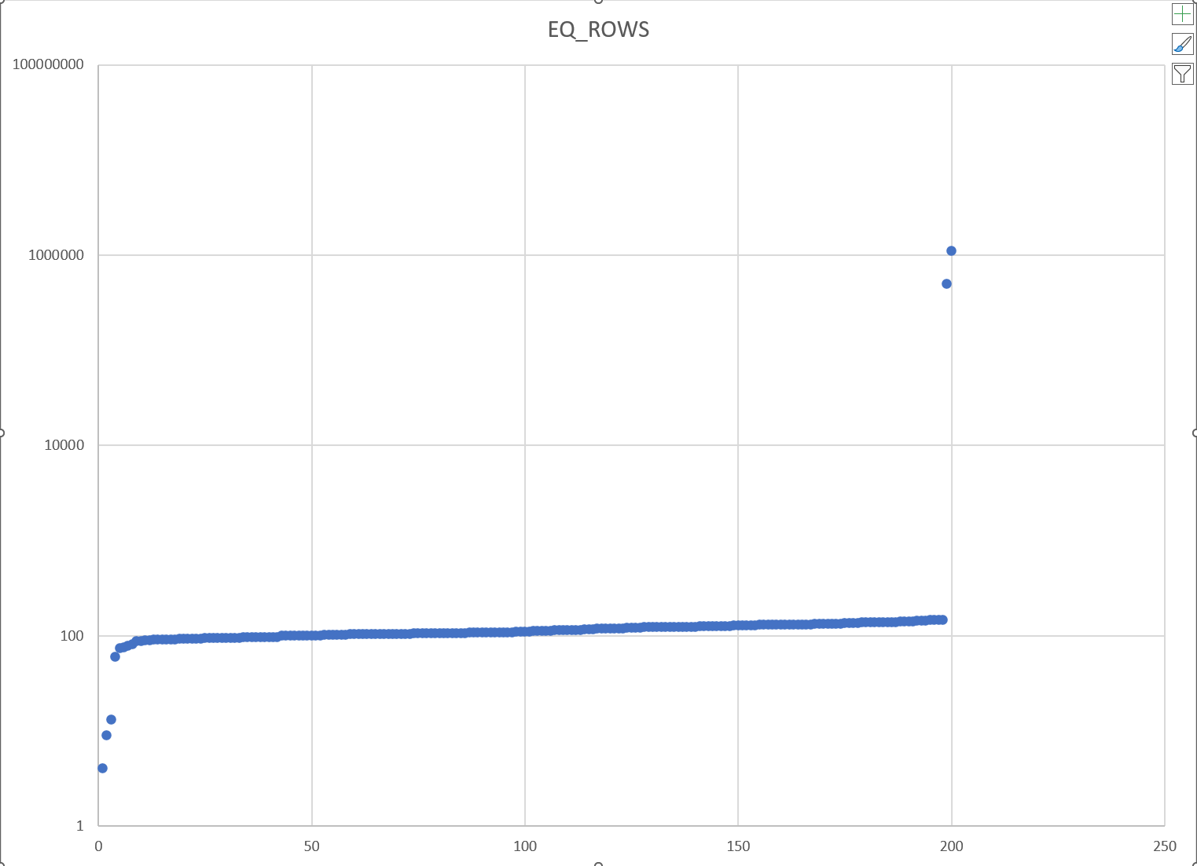
CustomerID Distribution

Slide 19
The object_id issue
Incorrect results
Silent failure
Update scripts if filtering on object_id or returning object_name
See update in sp_BlitzQueryStore

Slide 20
One object_id solution
Return any query_id matching the object_id
LEFT JOIN sys. query_store_query_variant
Return variant details if they exist
Otherwise, return the query_id matching the object_id

Slide 21
Another object_id approach
Return queries:
That match object_id (compiled plan)
OR object_id = 0, if sys. query_store_query_variant record exists (variant plan) and the parent query matches object_id
This approach used in sp_BlitzQueryStore

Slide 22
No parameter is an island
Uses PSPO with normal parameters
Plan considers normal and skewed parameters
A more precise parameter may reduce need for PSPO

Slide 23
Links
My blogs on PSPO
Query Store Feedback
PSPO documentation
sys.query_store_query_variant
First Responder’s Kit
Known Issues: CU5, CU6, CU7

Slide 24


