Slide 1
I would like to acknowledge the Jagera people who are traditional custodians of this land. I would also like to pay my respects to Elders past and present of the Turrbal nation, and to emerging community leaders.
I also extend my respect to all Native Australian and Torres Strait Islander people present here today.

Slide 2



Exploring Azure Cosmos DB
Arjun Sivadasan
linkedin.com/in/arjunsivadasan
http://www.sqlroadie.com
Image Courtesy: Microsoft

Slide 3
About me
Started career as .NET programmer in 2007
Focused on data soon afterwards
Works for Minor Hotels ANZ as Data Team – Manager
Blogs at SQLRoadie.com

Slide 4
Agenda
Introduction to Cosmos DB
Best practices to ensure high performance and scalability
APIs supported [1830]
Demo 1
Using Change Feed and Migration Tool
Understanding nuances to avoid common pitfalls [1900]
Demo 2
Use cases
Q&A
Next steps [1930]

Slide 5
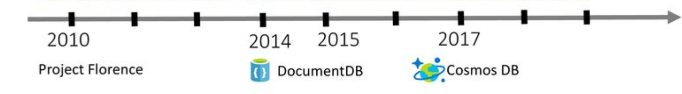
Introduction to Azure Cosmos DB
Started inhouse as Project Florence
Built ground up for the cloud
Previously known as Document DB - SQL API
More APIs added regularly

Slide 6
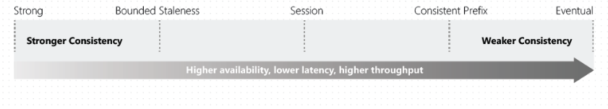
Introduction to Azure Cosmos DB
Multi-model and fully managed database service
Automatic and elastic scaling of throughput and storage
Global distribution to Azure regions
Multi-master replication
5 well-defined consistency models

Slide 7
Partitioning
Containers are horizontally partitioned
Containers are logical entities that could be stored across multiple physical partitions
Physical: fixed amount of storage + variable compute power
Logical: Logical grouping of items with the same partition key
Storage limit of 10 GB per logical partition
Key space of partition key hashes allocated evenly
Physical partition split: on hitting storage limit / increasing throughput

Slide 8
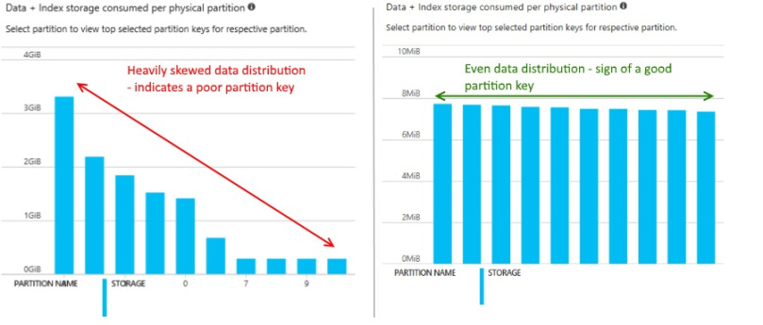

Slide 9
Throughput / Request Unit (RU)
RU – rate based currency.
RU/s – unit of throughput
1 RU/s serves a get by self-link or id of a 1 KB item having 10 unique property values
Container with unlimited capacity potentially has no max throughput limit
Initial throughput determines no. of physical partitions
Scale down during hours of low request rates and save $$
% CPU
% Memory
% IOPS

Slide 10
Partitioning & Throughput – what can go wrong?
Performance
Hot partitions
Throttling / Http 429 response code
High cost for compute
Cross-partition queries / fan-out
Storage
Data with same partition key form a logical partition
Low cardinality partition keys cause skewed storage distribution
If logical partition becomes full, new items cannot be added

Slide 11
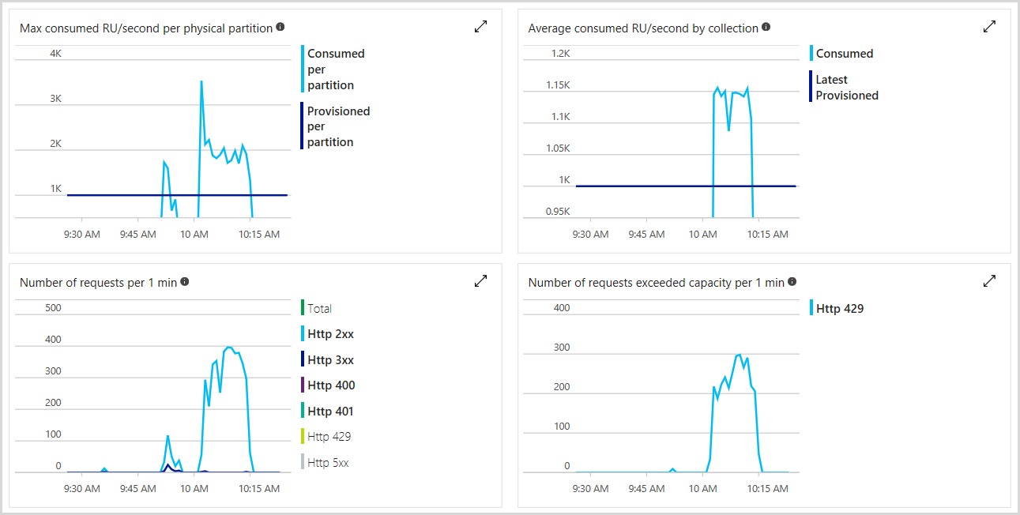

Slide 12
Time To Live (TTL)
Delete items automatically ‘n’ seconds after last modification. -1 = no expiry
Set at container or item level
Takes effect only if TTL of container is not null
Item-level TTL overrides that of parent container
No additional RU cost for deletion as TTL uses leftover RU

Slide 13
Multi-master
Every region is writable, a master
Single digit latency for R/W
Writes automatically replicated to all regions
Tuneable consistency models
Flexible conflict resolution:
Example last writer wins uses _ts default (user defined property)
Custom SP with exactly-once resolution, CRUD on any item within the same partition key
Conflicts feed

Slide 14
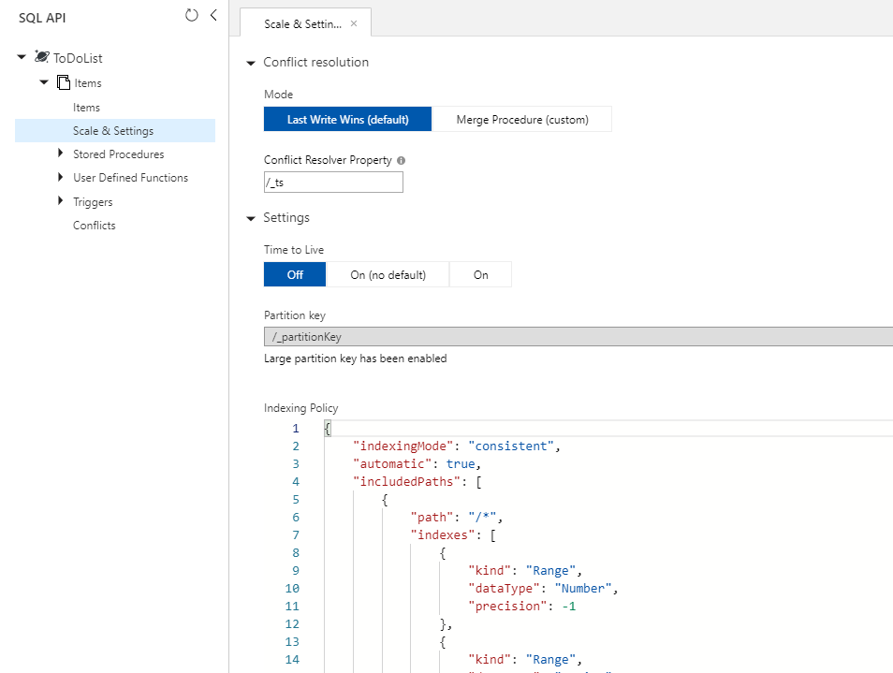

Slide 15
Cosmos DB Emulator
Cosmos DB Emulator
Local environment that emulates Cosmos DB service for dev
Develop and test locally without creating a subscription
Limited support for certain aspects
Refer to MS documentation

Slide 16
Capacity Calculator
Capacity Calculator
Estimate suggested RU/s and cost
Basic and advanced modes
Sign in to use advanced mode – more fields available
Shared/reserved throughput could reduce cost

Slide 17
APIs supported
Core SQL
Table
Mongo DB
Gremlin API for Graph
Cassandra
Etcd (preview)

Slide 18
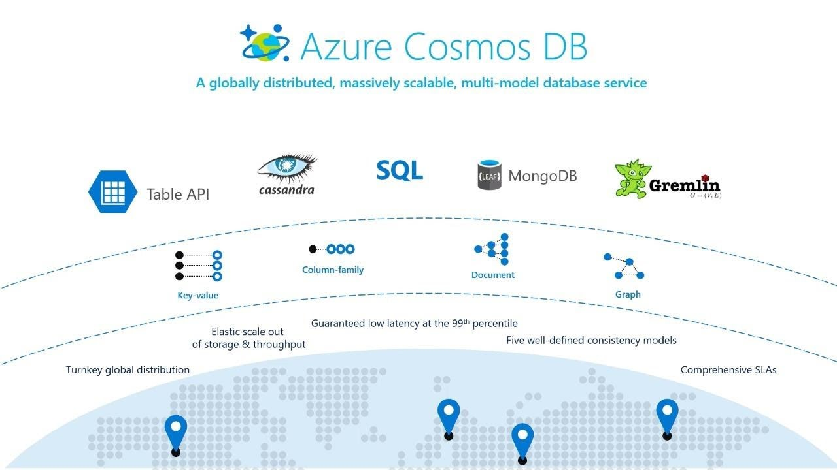

Slide 19
Demo 1

Slide 20
Cosmos DB Change Feed
Change Feed listens to containers for changes
Outputs list of items in the chronological order of mod
Use Change Feed for
Triggering a notification or calling an API
Real-time stream processing
Downstream data movement or archiving
Deletes are not tracked. Set TTL to enable soft-delete
Set Change Feed start time to read previous changes

Slide 21
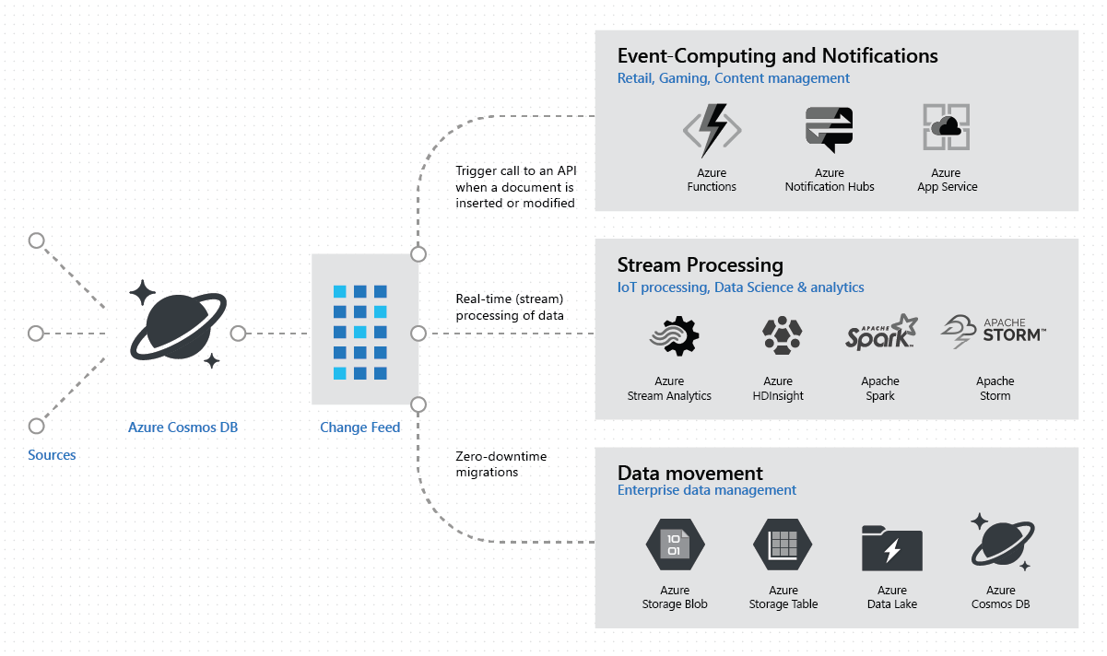

Slide 22
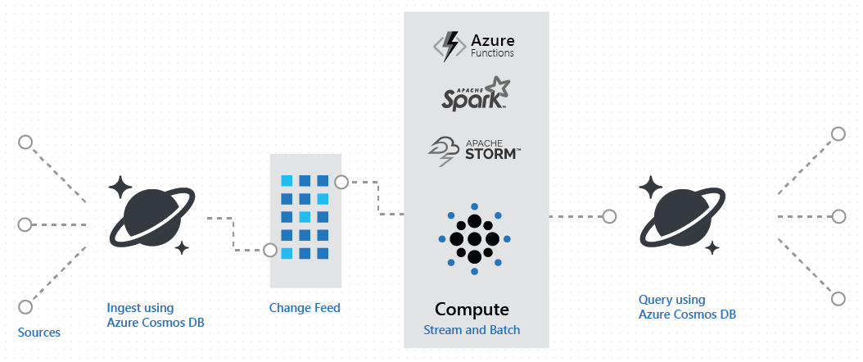

Slide 23
Cosmos DB Migration Tool
Mode to migrate data to/from Cosmos DB containers
Supports a variety of sources, including Emulator
Limited support for newer APIs
Increase throughput, parallel threads for faster migration
Use nesting separator to control structure

Slide 24
Cosmos DB - Nuances
Case sensitive
Status 429 - request rate too large/throttling
No updates, only upserts possible
Storage is data + index
RU charged by the hour
Change feed doesn’t track deletes
No renaming of databases/containers

Slide 25
Cosmos DB – worth mentioning
Shared throughput
Reserved capacity
Non-partitioned containers (legacy)
Triggers, Stored Procedures and UDF
Indexing
Power BI connector
Spark Analytics

Slide 26
Demo 2

Slide 27
Cosmos DB – Use cases
Serverless applications that need to scale rapidly and globally
IOT and telematics
Retail
Gaming
Web and mobile applications
Personalization

Slide 28
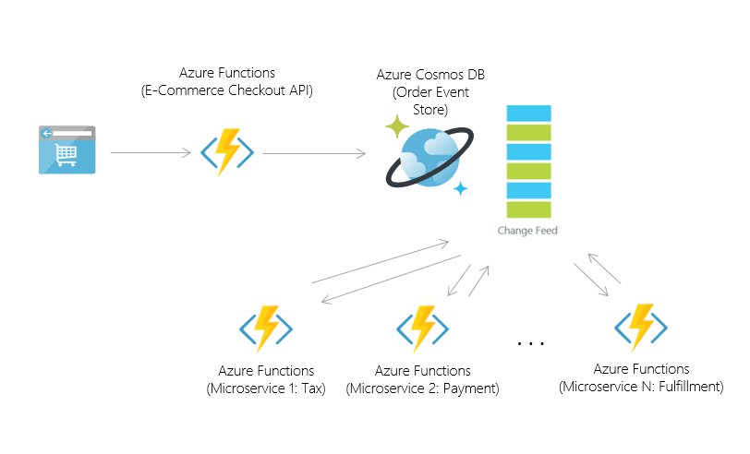
Retail

Slide 29
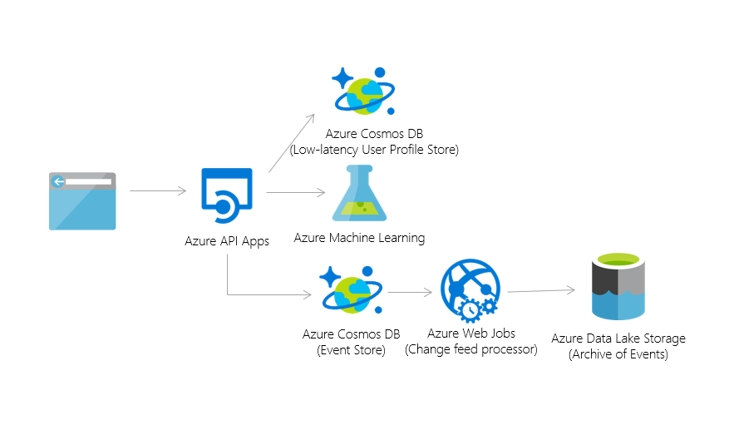
Personalization

Slide 30


Slide 31
What next?
Try Cosmos DB for free
Refer to cheat sheet
Hang out at the playground
Use MS Learn for Cosmos DB
Watch Cosmos DB videos
Nominate for Cosmos DB Bootstrap
Present next Cosmos DB session ☺

Slide 32
References
https://azure.microsoft.com/try/cosmosdb/
https://azurecosmosdb.github.io/CosmosBootstrap/
https://www.documentdb.com/sql/demo
https://docs.microsoft.com/en-us/azure/cosmos-db/query-cheat-sheet
https://docs.microsoft.com/en-us/azure/cosmos-db/local-emulator
https://docs.microsoft.com/en-us/azure/cosmos-db/estimate-ru-with-capacity-planner
https://sqlroadie.wordpress.com/2019/07/21/azure-cosmos-db-real-time-data-movement-using-change-feed-and-azure-functions/
https://docs.microsoft.com/en-us/azure/cosmos-db/how-to-configure-change-feed-start-time
https://www.youtube.com/watch?v=kYX6UrY_ooA
https://www.youtube.com/watch?v=S5Z-RYOwW6M
https://www.youtube.com/watch?v=uPYmacs2nlw
https://aka.ms/tla
https://azure.microsoft.com/en-au/blog/azure-cosmos-db-pushing-the-frontier-of-globally-distributed-databases/
https://cosmosdb.github.io/labs/
https://gotcosmos.com/presentations
https://azure.microsoft.com/en-au/solutions/architecture/personalization-using-cosmos-db/

