Slide 1
I would like to acknowledge the Jagera people who are the traditional custodians of this land. I would also like to pay my respects to Elders past and present of the Turrbal nation, and to emerging community leaders.
I also extend my respect to all Native Australian and Torres Strait Islander people present here today.

Slide 2


Predictive Modeling using SQL Server Machine Learning Services
Arjun Sivadasan
linkedin.com/in/arjunsivadasan
http://www.sqlroadie.com

Slide 3
Assumptions
NOT a Machine Learning crash course
Knowledge of R/Python to follow demo
Machine Learning is vast. Learn more to do more

Slide 4
Agenda
Introduction to SQL Server Machine Learning Services
Components
Features
Use cases [1830]
Demo
Native Scoring
Q&A
Latest developments [1930]

Slide 5
SQL Server Machine Learning Services
R Services introduced as add on to SQL Server 2016 database instance
Execute R code and functions in SQL Server
Packages like RevoScaleR and MicrosoftML are available
R Services renamed in SQL Server 2017 to SQL Server Machine Learning Services, reflecting the addition of Python
Execute R and Python code in SQL Server in Stored Procedures / Scripts

Slide 6
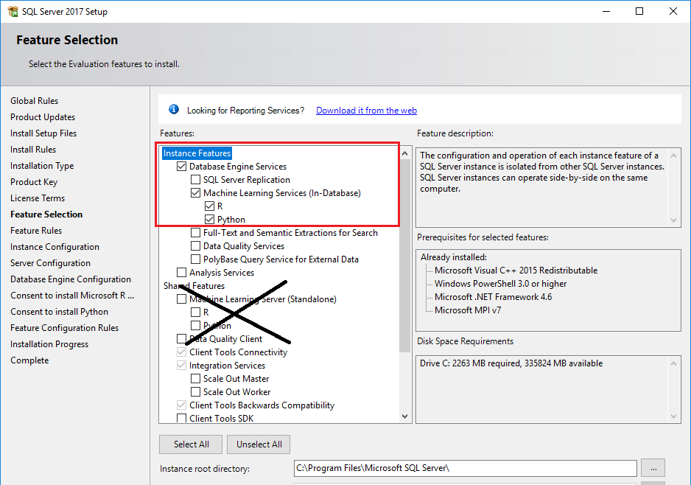

Slide 7
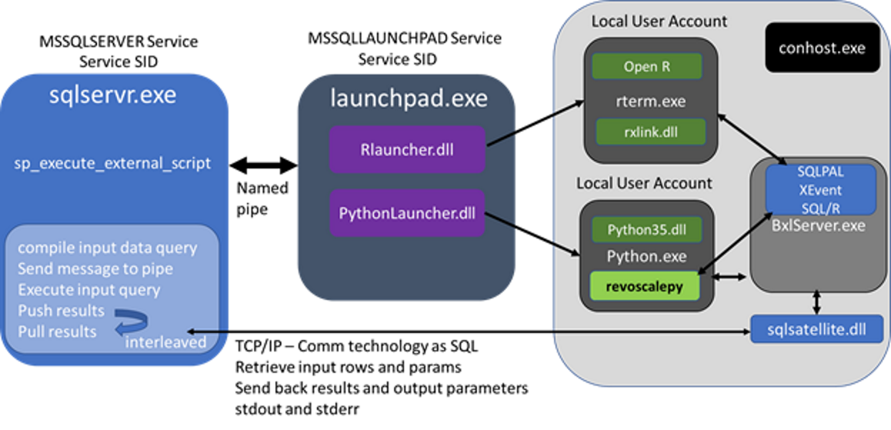
Components

Slide 8
Components
SQL Server Launchpad
Launchpad fires the relevant launcher – R/Python
R and Python exists outside of SQL PAL (Platform Abstraction Layer)
BxlServer.exe component fires the SQL Satellite component to communicate results back to SQL Server
R and Python packages
RevoScaleR/RevoScalePy
MicrosoftML
R/Python tools
Pretrained models for specific use cases

Slide 9
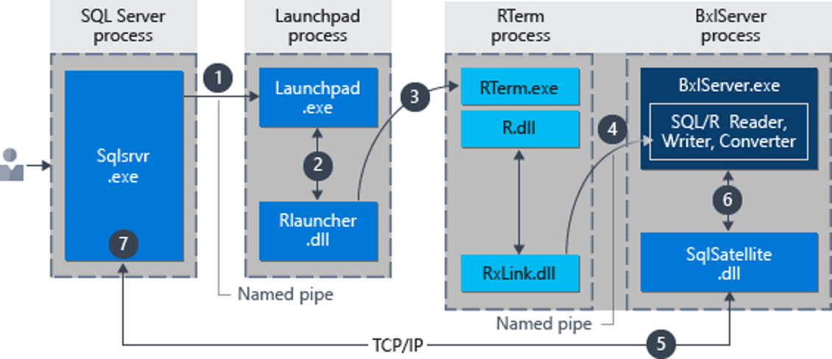
Components: Executing R scripts in SQL Server

Slide 10
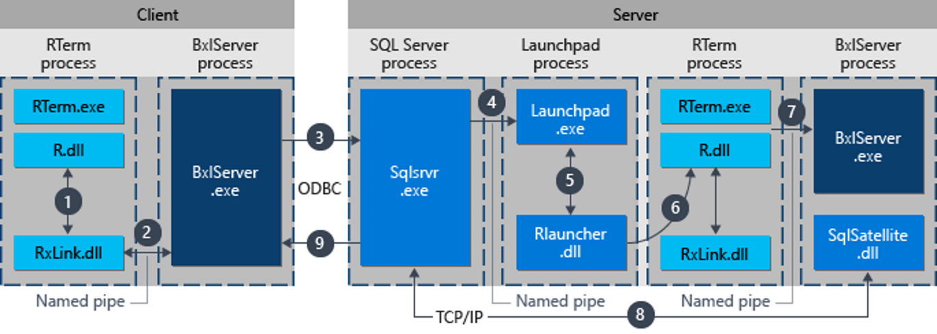
Components: Executing R scripts in remote client

Slide 11
Features
Wrap R/Python scripts in Stored Procedures
Store models in SQL Server tables
Parallelism and scale
Remote Compute Context
Deploy R/Python models as webservice using mrsdeploy/azureml-model-management-sdk package

Slide 12
Bringing compute power to data
Data Security
Speed
Data Validity
Analysis made easier
Schedule jobs using SQL Server Agent

Slide 13
Some Use Cases
Recommendation engine
Customer sentiment analysis
Pricing optimisation through forecasting
Personalised offers
Healthcare – disease / readmission prediction

Slide 14
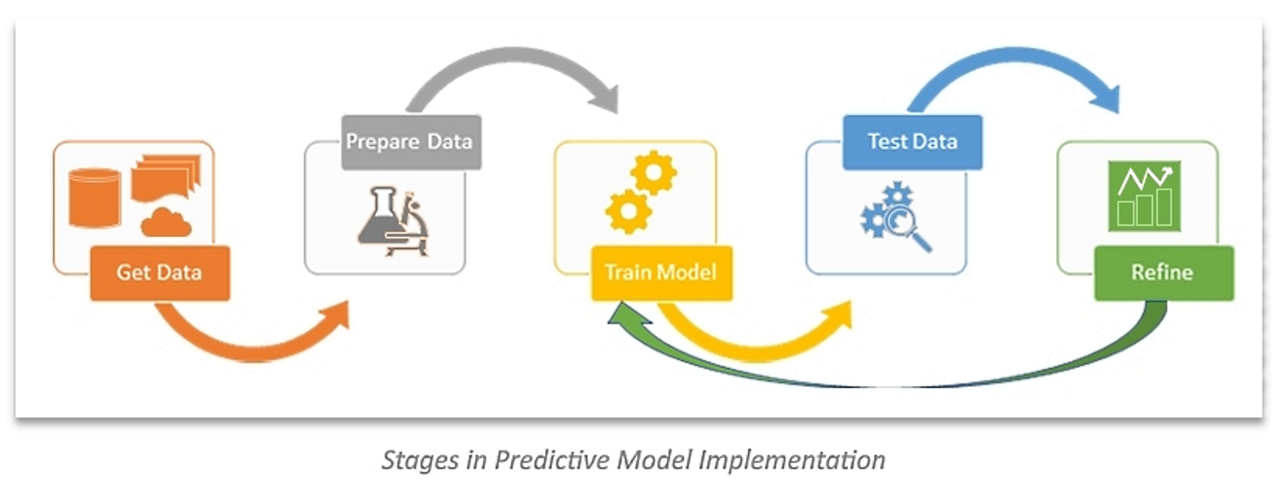
Demo
Heart disease prediction using UCI dataset
Diagnosis of heart disease (angiographic disease status) NUM
Value 0: < 50% diameter narrowing
Value 1: > 50% diameter narrowing

Slide 15
Native Scoring
Native scoring using PREDICT T-SQL function
Fastest processing speed
Only works with RevoScaleR and revoscalepy functions
Use Serialized model stored in SQL Server tables
No need to call R/Python interpreter
Just need compatible model and input data

Slide 16

Q&A

Slide 17
Latest Developments
R/Python script can call Azure ML web service in SQL Server
Integrated Machine Learning with SQL Server 2019 Big Data clusters
Machine Learning Services with R available in Azure SQL
Publish trained model to Azure ML web services

Slide 18
References
https://docs.microsoft.com/en-us/sql/advanced-analytics/r/sql-server-r-services?view=sql-server-2017
https://docs.microsoft.com/en-us/sql/advanced-analytics/what-is-sql-server-machine-learning?view=sql-server-2017
https://docs.microsoft.com/en-us/sql/advanced-analytics/what-s-new-in-sql-server-machine-learning-services?view=sql-server-2017
https://blog.revolutionanalytics.com/2019/03/real-time-scoring-with-r.html
https://blog.revolutionanalytics.com/2018/02/what-does-microsoft-do-with-r.html
https://docs.microsoft.com/en-us/sql/advanced-analytics/concepts/extension-r?view=sql-server-2017
https://docs.microsoft.com/en-us/sql/advanced-analytics/concepts/extensibility-framework?view=sql-server-2017
https://docs.microsoft.com/en-us/machine-learning-server/operationalize/quickstart-publish-r-web-service
https://docs.microsoft.com/en-us/machine-learning-server/operationalize/python/quickstart-deploy-python-web-service
https://azure.microsoft.com/en-au/blog/current-use-cases-for-machine-learning-in-retail-and-consumer-goods/
https://docs.microsoft.com/en-us/sql/advanced-analytics/sql-native-scoring?view=sql-server-2017
https://docs.microsoft.com/en-us/azure/sql-database/sql-database-machine-learning-services-overview
https://docs.microsoft.com/en-us/sql/big-data-cluster/big-data-cluster-overview?view=sqlallproducts-allversions
https://www.sqlshack.com/integrate-sql-server-azure-machine-learning/
https://docs.microsoft.com/en-us/sql/advanced-analytics/tutorials/sqldev-py6-operationalize-the-model?view=sql-server-2017
https://docs.microsoft.com/en-us/sql/advanced-analytics/tutorials/machine-learning-services-tutorials?view=sql-server-2017
https://docs.microsoft.com/en-us/sql/advanced-analytics/r/creating-workflows-that-use-r-in-sql-server?view=sql-server-2017
https://medium.com/microsoftazure/how-to-deploy-externally-generated-r-models-to-azure-machine-learning-studio-web-services-41a1a5ba9df

