Slide 1
I would like to acknowledge the Gadigal people who are traditional custodians of this land. I would also like to pay my respects to Elders past and present of the Eora Nation, and to emerging community leaders.
I also extend my respect to all Native Australian and Torres Strait Islander people present here today.
Notes:
Any native Australian or Islander people present?

Slide 2


Predictive Modeling using R/Python & SQL Server Machine Learning Services
Arjun Sivadasan
linkedin.com/in/arjunsivadasan
http://www.sqlroadie.com

Slide 3
About me
Started career as .NET programmer in 2007
Shifted focus to data soon and worked in various data-centric roles
Presently working as Data Solutions Manager for a hospitality group
Blogs at SQLRoadie.com
Enjoys cooking and cycling
Smiles more often when on 2 wheels
Notes:
Audience – background (show of hands)
Any cyclists?

Slide 4
Before we start..
This is NOT a Machine Learning crash course
Knowledge of R/Python will help to understand the demo
Machine Learning is vast. Learn more to do more
Walk away with an understanding of Machine Learning Services (MLS)
Develop and deploy an ML solution in SQL Server
Notes:
Ask questions whenever – if timelines will be disrupted, will defer

Slide 5
Agenda
Introduction to SQL Server Machine Learning Services
Components
Features
Use cases [1830]
Demo
Native Scoring
Q&A
Latest developments [1930]

Slide 6
SQL Server Machine Learning Services
R Services introduced as add on to SQL Server 2016 database instance
Execute R code and functions in SQL Server
Packages like RevoScaleR and MicrosoftML are available
R Services renamed in SQL Server 2017 to SQL Server Machine Learning Services, reflecting the addition of Python
Execute R and Python code in SQL Server in Stored Procedures / Scripts

Slide 7
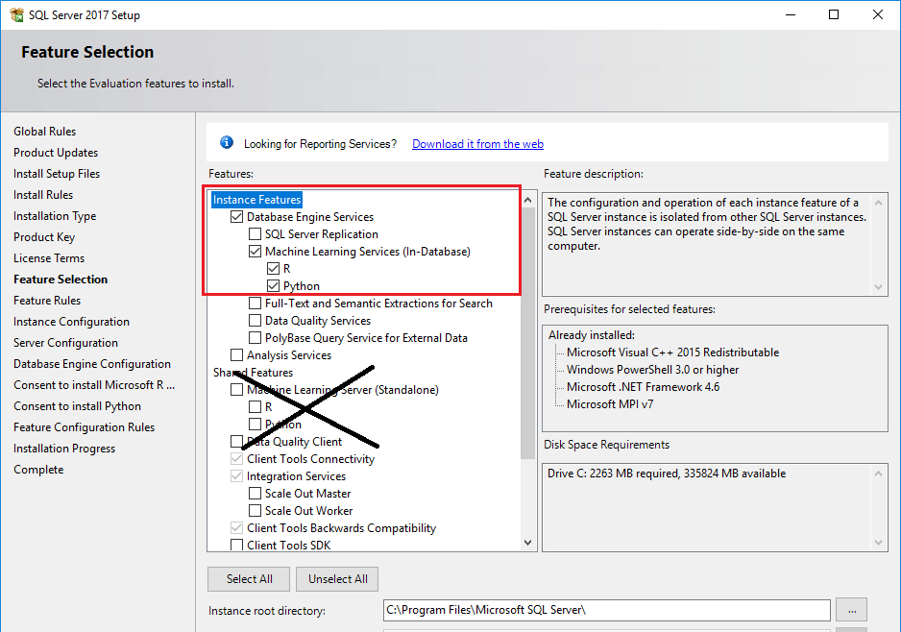

Slide 8
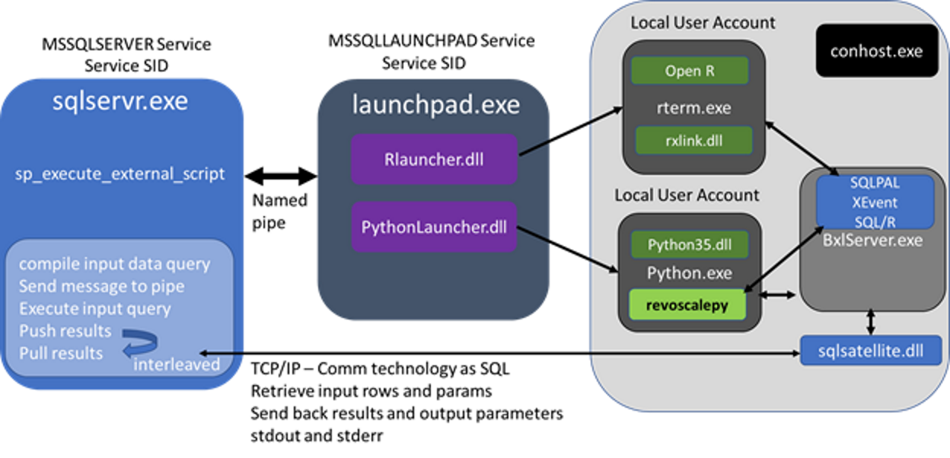
Components
Notes:
--Extensibility Framework
Interface between SQL Server and R/Python
Column-store indexes, multi thread
Launchpad service - one per db instance
BxlServer (Binary Exchange language) is an executable that manages data transfer
SQL Satellite is an extensibility API - supports external code or runtimes
Can monitor SQL Satellite using X events

Slide 9
Components
SQL Server Launchpad
Launchpad fires the relevant launcher – R/Python
R and Python exists outside of SQL PAL (Platform Abstraction Layer)
BxlServer.exe component fires the SQL Satellite component to communicate results back to SQL Server
R and Python packages
RevoScaleR/RevoScalePy
MicrosoftML
R/Python tools
Pretrained models for specific use cases

Slide 10
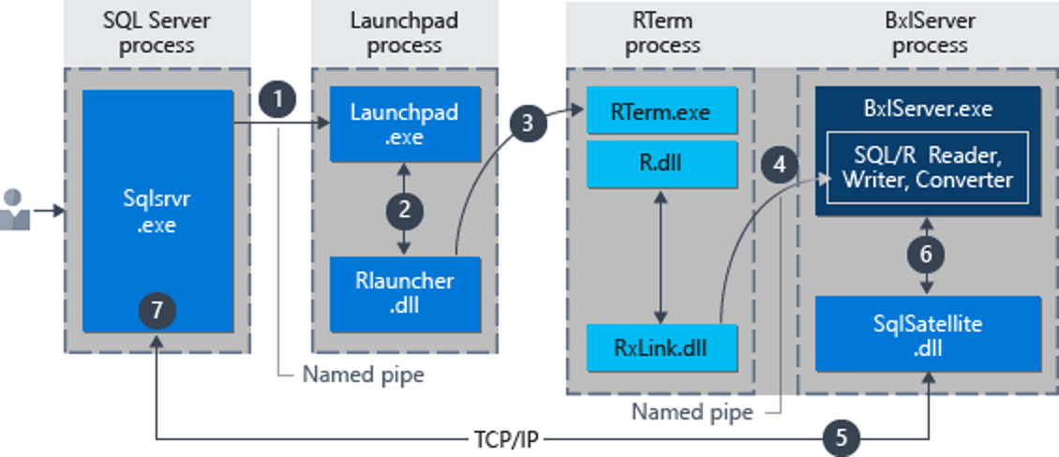
Components: Executing R scripts in SQL Server
Notes:
--Extensibility Framework
Interface between SQL Server and R/Python
Column-store indexes, multi thread
Launchpad service - one per db instance
BxlServer (Binary Exchange language) is an executable that manages data transfer
SQL Satellite is an extensibility API - supports external code or runtimes
Can monitor SQL Satellite using X events

Slide 11
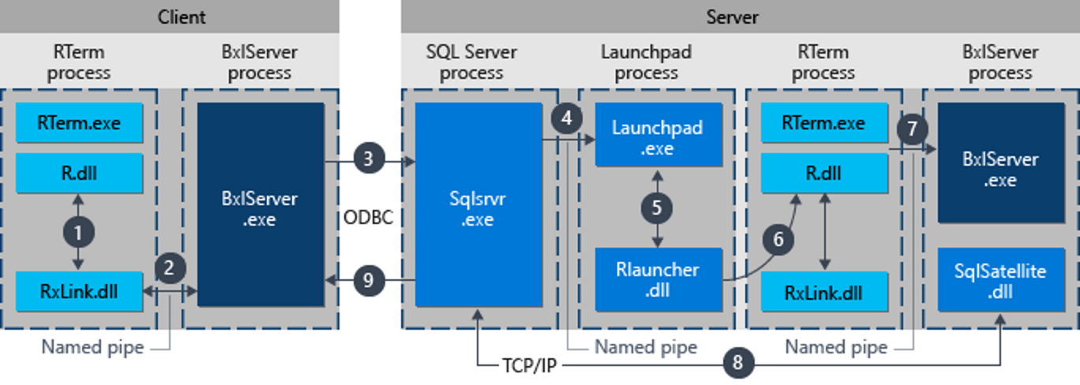
Components: Executing R scripts in remote client

Slide 12
Features
Wrap R/Python scripts in Stored Procedures
Store models in SQL Server tables
Parallelism and scale
Remote Compute Context
Deploy R/Python models as webservice using mrsdeploy/azureml-model-management-sdk package

Slide 13
Bringing compute power to data
Data Security – data stays in the Database Server
Speed – take advantage of server firepower and parallelism
Data Validity – reduce copies and point to source of truth
Analysis made easier – retain models as you refine, compare later
SQL Server Agent – use Agent jobs to schedule execution

Slide 14
Some Use Cases
Recommendation engine
Customer sentiment analysis
Pricing optimisation through forecasting
Personalised offers
Healthcare – disease / readmission prediction
Notes:
Hobbies – audience

Slide 15
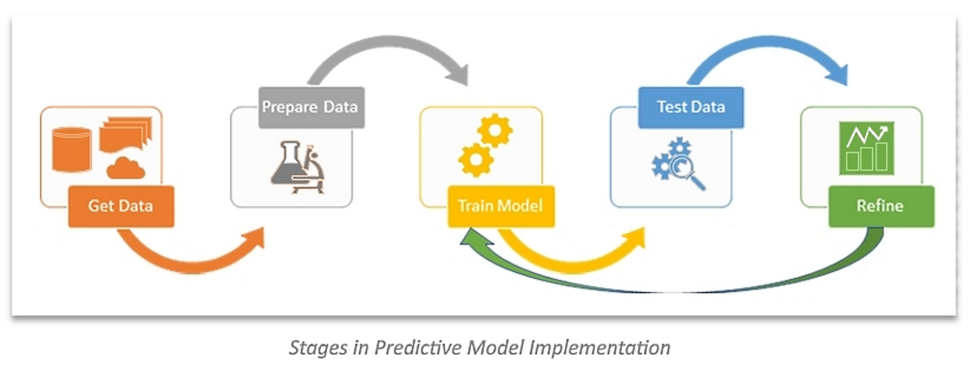
Demo
Heart disease prediction using UCI dataset
Diagnosis of heart disease (angiographic disease status) NUM
Value 0: < 50% diameter narrowing
Value 1: > 50% diameter narrowing
Notes:
R Demo:
Import heart disease data from SQL Server
Data Preparation
Splitting data into training (70%) and testing (30%)
Build model using training data
Predict using the generated models and compare Accuracy, Sensitivity and Specificity
complete.cases
caret - createDataPartition
confusionMatrix
SQL Demo:
1. Import data from file to SQL Server table - dbo.HeartDiseaseObservation
2. Create table to store model
3. Perform data cleanup
4. Split dataset into training and testing
5. Generate model using training dataset
6. Use trained model to predict heart disease for testing dataset
Predicted attribute is num - diagnosis of heart disease (angiographic disease status)
num
-- Value 0: < 50% diameter narrowing
-- Value 1: > 50% diameter narrowing

Slide 16
Native Scoring
Native scoring using PREDICT T-SQL function
Fastest processing speed
Only works with RevoScaleR and revoscalepy functions
Use Serialized model stored in SQL Server tables
No need to call R/Python interpreter
Just need compatible model and input data to score

Slide 17


Slide 18
Latest Developments
R/Python script can invoke Azure ML web service in SQL Server
Publish trained model to Azure ML web services
Machine Learning Services with R available in Azure SQL (preview)
Integrated Machine Learning with SQL Server 2019 Big Data clusters
Windows and Linux
Loopback connection to SQL Server from a Python or R script
CREATE EXTERNAL LIBRARY (Transact-SQL) for R and Python
Two new parameters in sp_execute_external_script to generate multiple models from partitioned data
Failover cluster support, assuming SQL Server Launchpad service is started on all nodes
Linux platform support for R and Python machine learning
Notes:
SQL Server 2019 Setup changes the isolation mechanism for external processes, to replace local worker accounts with AppContainers
^ code executed from sp_execute_external_script
^ Local user accounts (SQLRUserGroup) no longer created

Slide 19
References
https://docs.microsoft.com/en-us/sql/advanced-analytics/r/sql-server-r-services?view=sql-server-2017
https://docs.microsoft.com/en-us/sql/advanced-analytics/what-is-sql-server-machine-learning?view=sql-server-2017
https://docs.microsoft.com/en-us/sql/advanced-analytics/what-s-new-in-sql-server-machine-learning-services?view=sql-server-2017
https://blog.revolutionanalytics.com/2019/03/real-time-scoring-with-r.html
https://blog.revolutionanalytics.com/2018/02/what-does-microsoft-do-with-r.html
https://docs.microsoft.com/en-us/sql/advanced-analytics/concepts/extension-r?view=sql-server-2017
https://docs.microsoft.com/en-us/sql/advanced-analytics/concepts/extensibility-framework?view=sql-server-2017
https://docs.microsoft.com/en-us/machine-learning-server/operationalize/quickstart-publish-r-web-service
https://docs.microsoft.com/en-us/machine-learning-server/operationalize/python/quickstart-deploy-python-web-service
https://azure.microsoft.com/en-au/blog/current-use-cases-for-machine-learning-in-retail-and-consumer-goods/
https://docs.microsoft.com/en-us/sql/advanced-analytics/sql-native-scoring?view=sql-server-2017
https://docs.microsoft.com/en-us/azure/sql-database/sql-database-machine-learning-services-overview
https://docs.microsoft.com/en-us/sql/big-data-cluster/big-data-cluster-overview?view=sqlallproducts-allversions
https://www.sqlshack.com/integrate-sql-server-azure-machine-learning/
https://docs.microsoft.com/en-us/sql/advanced-analytics/tutorials/sqldev-py6-operationalize-the-model?view=sql-server-2017
https://docs.microsoft.com/en-us/sql/advanced-analytics/tutorials/machine-learning-services-tutorials?view=sql-server-2017
https://docs.microsoft.com/en-us/sql/advanced-analytics/r/creating-workflows-that-use-r-in-sql-server?view=sql-server-2017
https://medium.com/microsoftazure/how-to-deploy-externally-generated-r-models-to-azure-machine-learning-studio-web-services-41a1a5ba9df
https://docs.microsoft.com/en-us/sql/advanced-analytics/tutorials/r-tutorial-create-models-per-partition?view=sql-server-ver15

