Slide 1

Data Analytics Project
By: Alex Cheung, Steven Pham, Nicholas Tang

Slide 2
Table of contents
01
02
03
Proposal
Research Questions
Results

Slide 3

01
Project Proposal

Slide 4
Proposal
Background
Purpose
The data analysis project uses data from 1000 students across various demographic groups and academic backgrounds.
The dataset includes information such as age, gender, year in school, major, monthly income, financial aid received, and expenses in different spending categories.
Spending categories include tuition, housing, food, transportation, books & supplies, entertainment, personal care, technology, health & wellness, and miscellaneous expenses.
The purpose of this analysis is to analyze student spending habits to determine levels of financial literacy and to determine what factors may influence their financial health and budgeting strategies. Through key demographic and statistical metrics, this analysis can assist financial planners, lending institutions and loan officers to better assess the needs and risk of student borrowers.

Slide 5
Data Dictionary
String/Object
Integers/Floats
Boolean
gender
year_in_school
major
Preferred_payment_method
Econ Major?
Upperclassmen?
Financial Status*
High/Low Aid*
Entertainment spender*
monthly_income
financial_aid
tuition
housing
food
transportation
books_supplies
entertainment
personal_care
technology
health_wellness
miscellaneous
Debt-Ratio*
Positive Budget?*
* Flag Variable

Slide 6
02
Research Questions

Slide 7
Research Questions
Question 1
Question 2
Question 3
Do students with an Economics major have greater levels of financial literacy? (IE. Saving more/Spending less)
For Students receiving financial aid, are students with less total aid more financially literate?
Does a student's college year affect spending habits (Do upperclassmen spend more than underclassmen for leisure ex: entertainment)?

Slide 8
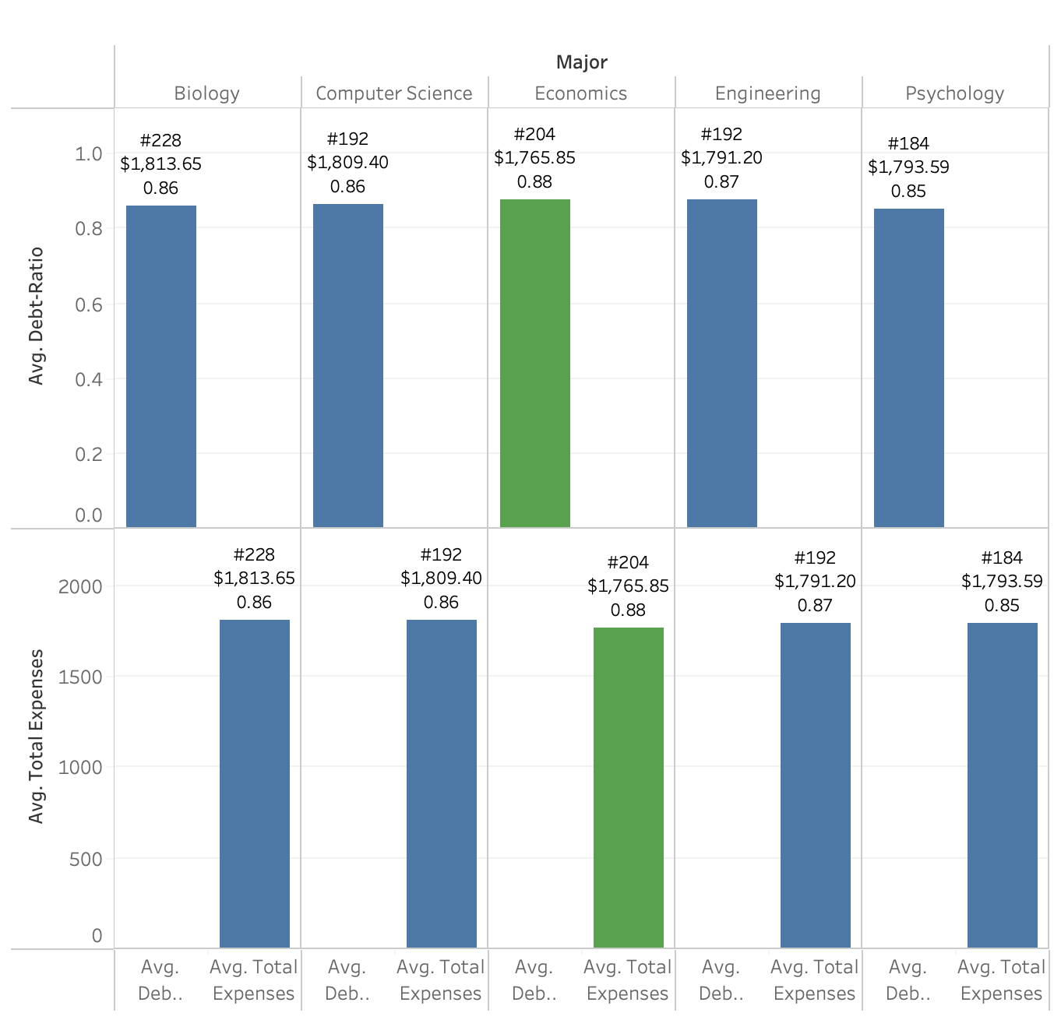
Do students with an Economics major have greater levels of financial literacy? (IE. Saving more/Spending less)
Insights
Economics Students exhibit higher levels of financial literacy
Highest Debt Ratio among all majors
Economics majors' average total expenses was approximately $20 lower than the Engineering majors (2nd lowest)
Notes:
steven

Slide 9
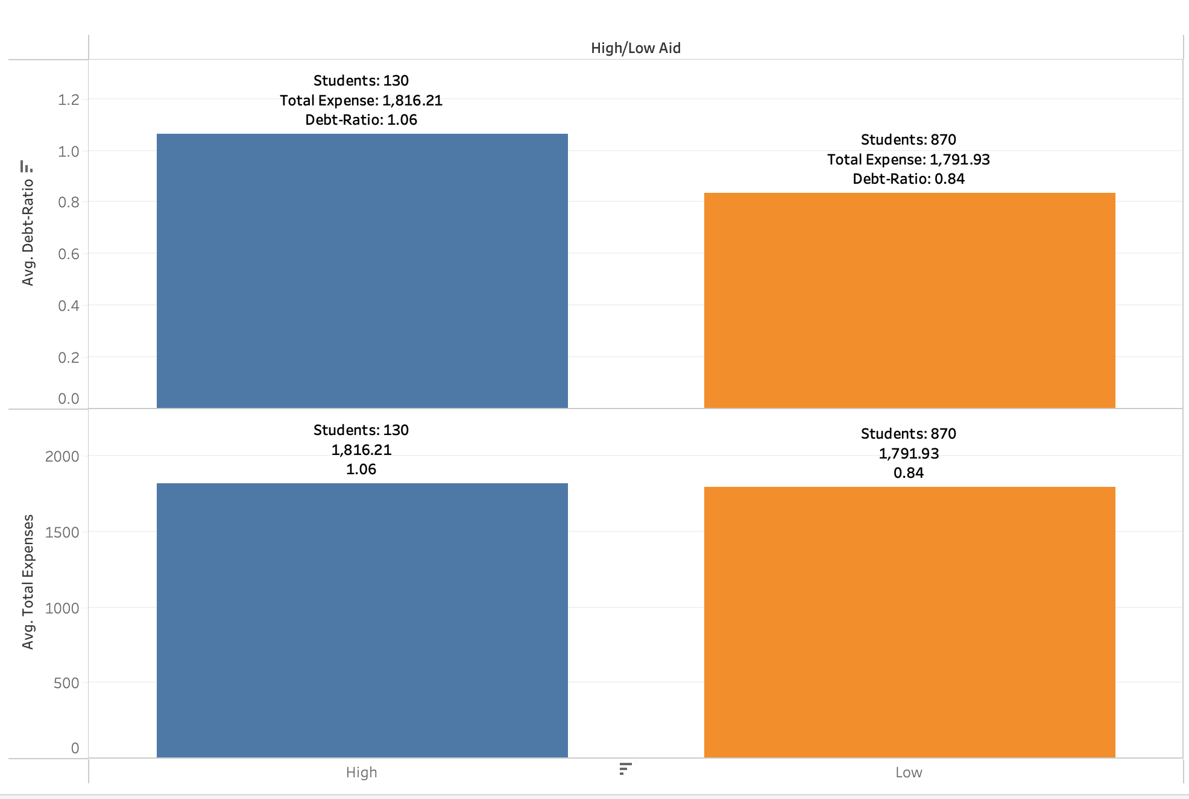
For students receiving financial aid, are students with less total financial aid, more financially literate?
Insights
Students that receive more financial aid:
Higher Debt Ratio
More income than expenses
Slightly higher in Total Average Expenses
Students that receive less financial aid:
Less income
Similar in Total Average Expenses.
Lower than average by major
Notes:
steven

Slide 10
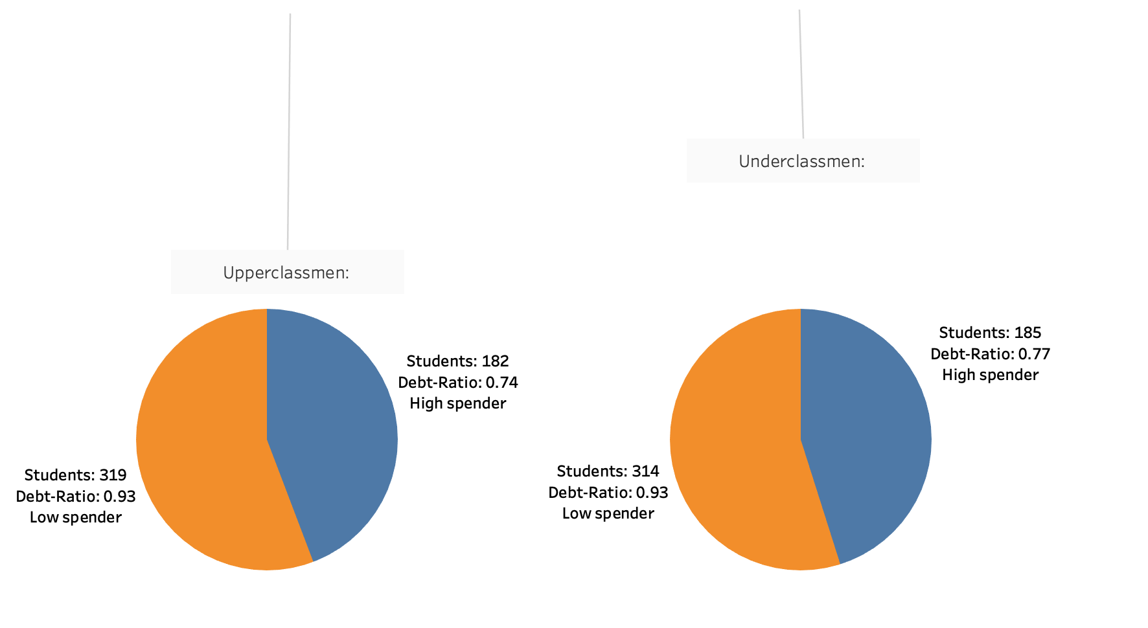
Does a student's college year affect spending habits (Do upperclassmen spend more than underclassmen for leisure? (ex: entertainment)
Insights
Upperclassmen spending
Comparatively very similar between all 4 classified groups.
Debt-Ratio is slightly higher for underclassmen, high spenders
Takeaway:
Upperclassmen spend more
Notes:
steven

Slide 11
03
Results
And Recommendations

Slide 12
Results
Major, and amount of financial aid is useful in determining financial literacy levels of students. College Year is not a useful indicator of financial literacy and budgeting.
Economics/Business majors have the greatest level of financial literacy with the highest income/expense ratio and the lowest Average Total Expenditure.
Students that received less financial aid were slightly more financially responsible than grouped by major, but were still disadvantaged compared to those who received aid.

Slide 13
Recommendations
Recommend future analysts to look further into depth at key demographic variables such as expanding to include other major fields and extracurriculars.
This dataset only included 5 major fields which simplified the overall understanding of our research questions. If this dataset had included more majors and other key variables it would have better explained some expense categories and would have improved the visualization of our current data.

Slide 14
Thank you

