Slide 1
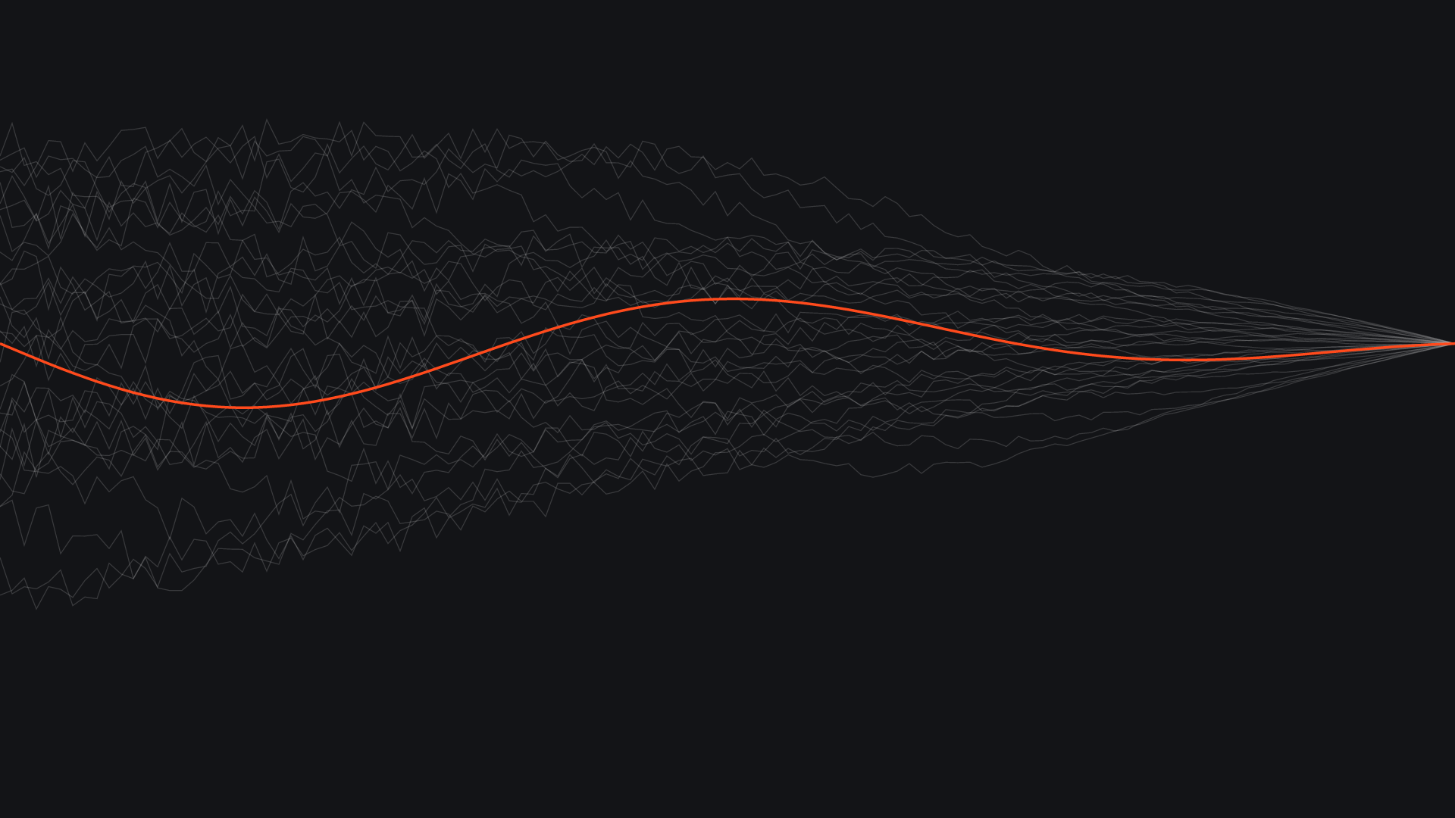

BRAND GUIDELINES · 2026
Better with every layer.
The identity of TekRevol, an AI-first software development company.

Slide 2
CONTENTS
Inside this guide
01
02
03
The TekRevolution
Logo and color
Typography
Story, positioning, idea, personality
Logo, palette, accessibility
Typefaces, scale, hierarchy
04
05
06
Graphic language
Imagery and voice
In use and tested
Patterns, diagrams, layers, icons
Image direction, prompts, tone
Applications, checks, files
TekRevol Brand Guidelines
02

Slide 3
THE TEKREVOLUTION
THEN
It all started with a vision.
A mobile app studio built on structured chaos: learn, ideate, iterate, incubate and scale, in a constant state of flux.
NOW
The same spirit, applied to AI. TekRevol adopts new technology early, experiments fast and keeps rebuilding until it works, then ships software enterprises can rely on.
“TekRevol was created to give our people a platform where they are free to think critically and innovate, to create a better world.”
Young in approach.
Enterprise in output.
TekRevol Brand Guidelines
03

Slide 4
THE TEKREVOLUTION
WHAT TEKREVOL IS
TekRevol builds the AI-native software other vendors, and other AI tools, couldn’t finish.
Category
What we do
What backs it
AI-first software development company. Software development stays the parent category; AI leads.
AI-native products from scratch, and AI-built prototypes taken the rest of the way to production.
Ten years of mobile, web, cloud and custom software engineering, and 800+ products delivered.
TekRevol Brand Guidelines
04

Slide 5
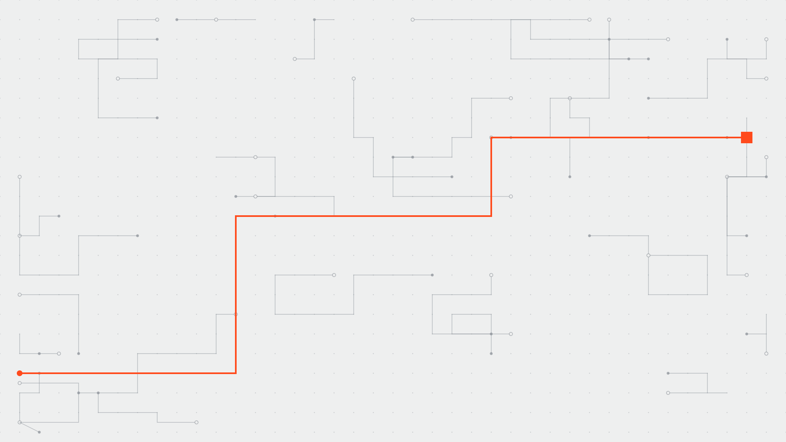
THE TEKREVOLUTION
THE BRAND IDEA
Structured chaos.
TekRevol tries more paths than most teams would dare, faster than most teams can. Most attempts teach something; one ships. That is how a young, curious team produces enterprise-grade work.
Grey paths: experiments, ideas, prototypes
The orange path: what ships, reliably
Better with every layer.
TekRevol Brand Guidelines
05

Slide 6





THE TEKREVOLUTION
HOW WE WORK
Learn. Ideate. Iterate.
Incubate. Scale.
01
02
03
04
05
Learn
Ideate
Iterate
Incubate
Scale
Learn, unlearn and relearn. There is no end to it.
Seek better ideas and practices in everything we do.
Test and evolve everything: people, products, services.
Work hard and be patient on the way to success.
Grow efficiency through trusted systems and procedures.
The TekRevol cycle, from the original handbook. Still how the team works, now with AI in every step.
TekRevol Brand Guidelines
06

Slide 7
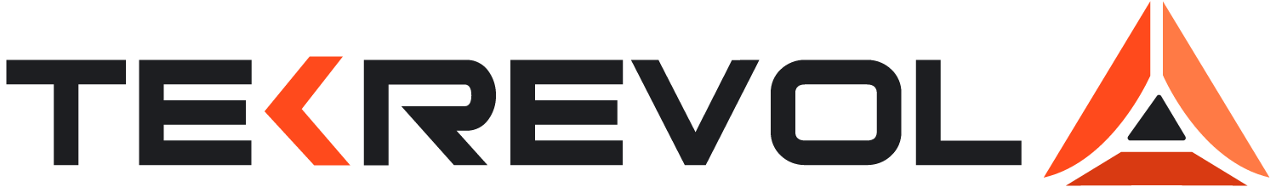
01
02
03
Built
Quick
Evolving
Engineered, precise, specific.
Moves early, ships on schedule.
Every version better than the last.
PERSONALITY
Traits that
shape the work.
04
05
06
Six traits, drawn from the original TekRevol values and still true today.
Candid
Warm
Curious
Says what is true, plainly.
Human-centered and real.
Questions everything, learns fast.
07

Slide 8
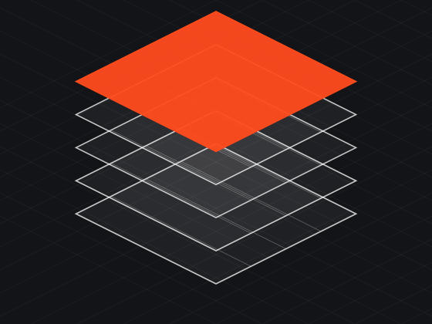
02
Logo
and color
The fixed parts of every TekRevol layout.
TekRevol Brand Guidelines
08

Slide 9
LOGO
PRIMARY LOGO
One mark. Same geometry,
brighter color.
Charcoal ink on white and light backgrounds
White ink on charcoal and dark backgrounds
Left plane #FF4A1C
Right plane #FF7A45
Base bar #D93A12
Wordmark #1D1E21
TekRevol Brand Guidelines
09

Slide 10

LOGO
RULES
Space, size and misuse.
DON’T
X
Stretch or distort
Recolor
Clear space on every side = X, the height of the letter T.
Minimum size
Full logo 120 px on screen, 30 mm in print. Mark alone 20 px, 6 mm.
Use full color on orange
Add shadows or effects
TekRevol Brand Guidelines
10

Slide 11
COLOR
CORE PALETTE
Clean neutrals, one bright accent.
TekRevol Orange
Charcoal
White
#FF4A1C RGB 255 74 28
#1D1E21 RGB 29 30 33
#FFFFFF RGB 255 255 255
The only accent: CTAs, the highlight, what ships
Headlines, body text, dark sections
Primary background
Mist
Silver
Steel
Muted
Flare
Ember
Orange Ink
#EEEFEF
#C9CCCF
#8A9097
#5E6166
#FF7A45
#D93A12
#C2340E
TekRevol Brand Guidelines
11

Slide 12
COLOR
WHY ORANGE
The category is a blue wall.
Orange is the signal.
TekRevol
Charcoal
LeewayHertz
Azumo
ScienceSoft
Cheesecake Labs
HatchWorks
One warm accent against a wall of cool blues: the most recognizable position in the category.
TekRevol Brand Guidelines
12

Slide 13
COLOR
PROPORTION AND DARK MODE
How much of each.
White and mist 55%
Charcoal 23%
Metal 10%
Orange 12%
One orange focal point per view; the primary button is functional and doesn’t count.
Deep Charcoal
Dark Surface
Dark Border
Dark Control
Dark Muted
#131417 · Page background
#1A1B1E · Cards, panels
#2A2C30 · Dividers only
#6E727A · Input outlines
#8B8E94 · Secondary text
TekRevol Brand Guidelines
13

Slide 14
COLOR
ACCESSIBILITY, TESTED
Every text pair checked
against WCAG 2.2.
Aa
Charcoal on White
16.7:1
Aa
Muted on White
6.2:1
#1D1E21 on #FFFFFF
AAA
#5E6166 on #FFFFFF
AA
Aa
Charcoal on Orange
5.0:1
Aa
Orange Ink on White
5.9:1
#1D1E21 on #FF4A1C
AA
#C2340E on #FFFFFF
AA
Aa
White on Deep Charcoal
18.4:1
Aa
Flare on Deep Charcoal
7.0:1
#FFFFFF on #131417
AAA
#FF7A45 on #131417
AAA
Aa
Dark Muted on Deep Charcoal
5.6:1
Aa
Orange on White
3.4:1
#8B8E94 on #131417
AA
#FF4A1C on #FFFFFF
LARGE
Orange as text on white is for headlines 24 px and up; use Orange Ink for smaller text.
TekRevol Brand Guidelines
14

Slide 15
Aa
03
Typography
Headlines with personality. Everything else calm.
TekRevol Brand Guidelines
15

Slide 16
TYPOGRAPHY
TYPEFACES
Funnel Display
Wix Madefor Text
Headlines. SemiBold and Bold.
Body copy, subheads and UI. Regular, Medium, SemiBold.
Same team from kickoff to launch. Compliance built in from the first sprint.
ABCDEFGHIJKLMNOPQRSTUVWXYZ
abcdefghijklmnopqrstuvwxyz
0123456789 & ? ! @ %
JetBrains Mono
Labels, node labels, code and proof numbers. Uppercase, +8% tracking.
AI-FIRST SOFTWARE DEVELOPMENT
800+
All three are free under the SIL Open Font License. Install them from the fonts folder before editing this file.
TekRevol Brand Guidelines
16

Slide 17
TYPOGRAPHY
SCALE AND HIERARCHY
One clear order on every page.
STYLE
TYPEFACE
DESKTOP
MOBILE
Display
Funnel Bold
88 px
44 px
AI-FIRST SOFTWARE DEVELOPMENT
H1
Funnel Bold
56 px
34 px
Finish what the
last team started.
H2
Funnel SemiBold
40 px
28 px
Pull quote
Funnel SemiBold
32 px
24 px
H3
Funnel SemiBold
28 px
22 px
Lead
Wix Regular
20 px
18 px
Stalled build or an AI prototype that hit a wall. One team takes it to launch.
Body
Wix Regular
16 px
16 px
Button
Wix SemiBold
15 px
15 px
Label
JetBrains Mono, caps
12 px
12 px
Talk to an engineer
See our work
Data large
JetBrains Mono
48 px
32 px
TekRevol Brand Guidelines
17

Slide 18
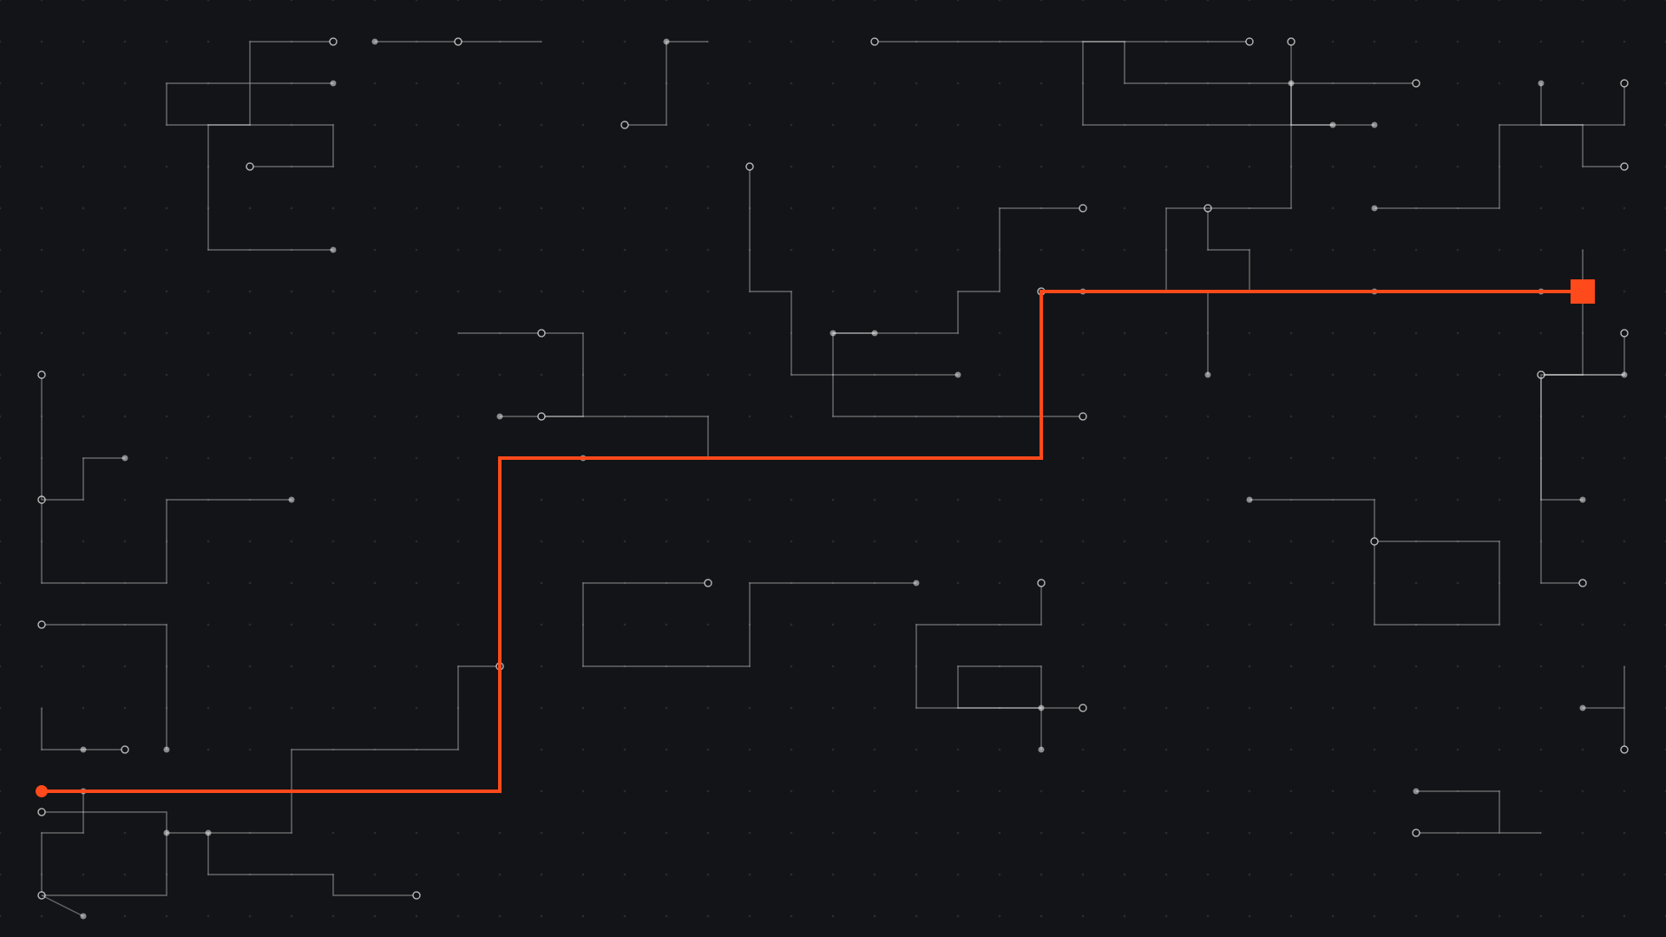
04
Graphic
language
Structured chaos, drawn: many attempts, one path that ships.
TekRevol Brand Guidelines
18

Slide 19
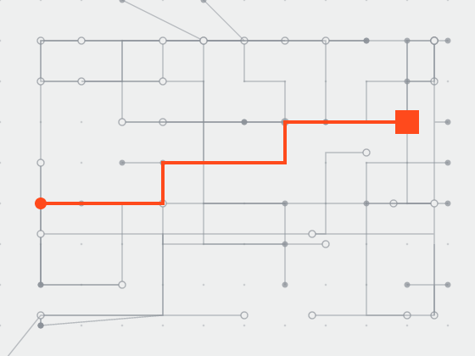
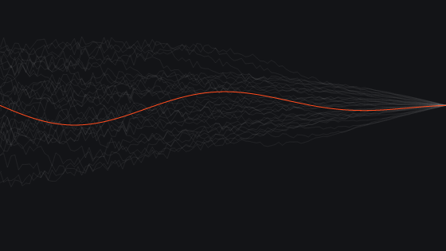
GRAPHIC LANGUAGE
THREE PATTERNS, ONE IDEA
Never the same background twice.
Experiment field
Iteration lines
Layer planes
Many tries, one path through. For covers of strategy, process and case-study pages.
Rough attempts that settle into one clean line. For covers and campaign visuals.
Stacked layers, the newest lit orange. For architecture and section openers.
TekRevol Brand Guidelines
19

Slide 20



GRAPHIC LANGUAGE
DIAGRAMS
Grey explores. Orange ships.
Explore
PROTOTYPE
Steel dashed lines and outlined nodes for experiments, options and spikes
SPIKE A
Ship
One orange solid path, 3 px, from start to the filled orange result
SPIKE B
HARDEN
Shape
Right angles only; notched nodes with a line icon and a mono label
SPIKE C
Keep it short
SHIP
4 to 7 nodes; label with verbs or real components
TekRevol Brand Guidelines
20

Slide 21

GRAPHIC LANGUAGE
SIGNATURE GRAPHIC
The layer stack.
The real layers of AI-native software, stacked bottom to top. It is “better with every layer” made literal.
04
Product
Web, mobile, API
03
Agents
Planning, tools, memory
02
Models
LLMs, embeddings, evals
01
Data
Warehouse, APIs, events
TekRevol Brand Guidelines
21

Slide 22
GRAPHIC LANGUAGE
SHAPE AND SPACE
Square, with one signature corner.
SPACING
GRID
4 px
THE NOTCH
8 px
45° cut taken from the logo. 8 px buttons, 16 px cards, 32 px hero panels. One per view.
12 px
16 px
24 px
32 px
48 px
Primary button
64 px
96 px
12 columns, 24 px gutters, 1280 px max
Sections, images and large cards stay square. Pills only for status dots and avatars.
TekRevol Brand Guidelines
22

Slide 23










GRAPHIC LANGUAGE
ICONS AND DATA
Thin lines, honest charts.
ILLUSTRATIVE CHART
TekRevol in orange, comparison in dashed steel. No 3D, no gradients on bars.
Lucide, 1.5 px stroke, charcoal. One active icon may sit on orange.
TekRevol Brand Guidelines
23

Slide 24
IMAGERY
IMAGE DIRECTION
Show the build, then the builders.
Patterns first
Real people, real work
Product on screen
Experiment fields, iteration lines and layer planes lead covers, slides and social posts.
Documentary photos of the team: whiteboards, code reviews, launches. One orange detail per frame.
Real TekRevol interfaces on devices on light surfaces. Screens are always real UI, never generated.
AI IMAGE PROMPT, PASTE AFTER YOUR SUBJECT
Style: TekRevol brand. Clean, bright, modern workspace in white and light grey, charcoal details, one bright red-orange accent (#FF4A1C). Documentary photography, real people and devices, soft daylight, shallow depth of field, generous negative space, editorial quality. Avoid: robots, glowing brains, holograms, purple light, neon, text, logos, clutter.
TekRevol Brand Guidelines
24

Slide 25
VOICE
TONE OF VOICE
Young in approach.
Enterprise in output.
SAY THIS
NOT THIS
Clear
Finish what the last team started.
Revolutionary AI-powered solutions.
Short, active sentences. One idea each.
Specific
Built for HIPAA from the first sprint.
Cutting-edge, robust, seamless security.
Real numbers, named standards, real work.
Candid
Name the situation, never the vendor.
Your AI prototype got you 80% of the way.
Unleash the power of AI today.
No em dashes. No invented statistics. US spelling. Sentence case.
TekRevol Brand Guidelines
25

Slide 26
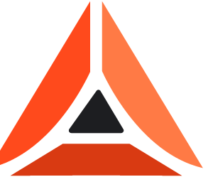
IN USE
APPLICATIONS
The system at work.
tekrevol.com
Name Surname
AI-NATIVE SOFTWARE
HOW WE WORK
Your AI prototype got you 80% of the way.
Every stage builds on the last.
Job title
name@tekrevol.com
+1 000 000 0000
LinkedIn post, 4:5
Carousel cover, dark
Business card, front and back
TekRevol Brand Guidelines
26

Slide 27

TESTED
HOW THIS SYSTEM WAS TESTED
Checked before it ships.
Contrast
Every text pair measured against WCAG 2.2; body text passes AA, most pairs AAA
Legibility
Type scale checked from 12 px labels to 88 px display, desktop and mobile
Dark mode
Every color has a dark equivalent; control outlines meet 3:1
Color blindness
Orange, and charcoal differ in lightness, so meaning never relies on hue alone
Fonts
Free under the SIL Open Font License; files included
Editable
Every text box and diagram in this file is native and editable in PowerPoint
Applied
Tested on social, presentation, business card and web layouts
TekRevol Brand Guidelines
27

Slide 28
Learn. Build. Ship.
Then do it better.
Files: logos, fonts, tokens and patterns in Projects / TekRevol / 01-brand-system
TekRevol Brand Guidelines · 2026

