Slide 1
Marketing: Q2–Q3
Plan period: October 2026 – March 2027

Slide 2
What’s Changing
Services
Sales deck
xCelerate & events
People & brand
Repositioned from "AI and digital engineering" to Data & AI working together
AI Security push: NEPRA landing page and website banner
NEPRA case study: ACT Wind
New company intro
Leadership team
3 new case studies
Our agentic AI process
Mari campaign: 1,500+ applications
Mari Cohort I graduation
Geshidocon
HR brand video, ready for approval
Full application form on the careers page (for HR)
New client testimonials
Notes:
Mari: paid Meta campaign for xCelerate, target 1,000 applications. Testimonials came through Jafri. The careers form was added at Hunaina's request. The NEPRA case study (ACT Wind) is named here for internal use; publicly it stays 'a 30 MW wind IPP' unless the client approves.

Slide 3
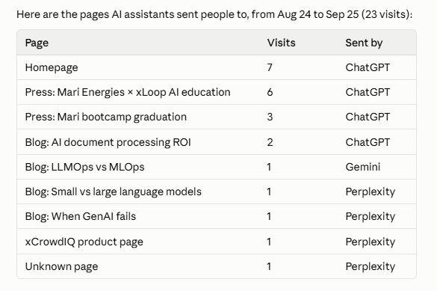
Website: what's new, and how search and AI find us
Homepage now leads with data and AI
Search and AI: last 3 months
+30%
Google clicks vs the previous 3 months (1.9K vs 1.46K)
Services
NEW
Industries
NEW
Case studies
NEW
4 service groups: Data & AI Consulting, Applied Data & AI Solutions, AI Security, Digital Transformation
Mining page replacing the Manufacturing industry page
Updated case study cards
(Majidul, Futtaim, Wefi tech and HBL Asset Management, Huda Beauty)
2.5×
Click-through rate from Google (7.8% vs 3.1%)
Tools
Locations
3
AI assistants sending visitors: ChatGPT, Perplexity, Gemini
NEW
NEW
Insights
AI Security and Data & AI Readiness assessments
Qatar, Hungary, South Africa
82 articles
Top 5
Google rank for questions AI assistants ask, e.g. document processing ROI, small vs large language models, AI stuck in pilot
Notes:
Search Console, company account, Jun 21–Sep 20 vs Mar 22–Jun 20: clicks 1.9K vs about 1.46K; CTR 7.8% vs about 3.1%; 124 pages indexed. AI assistants in GA4 Aug 24–Sep 23: ChatGPT 18, Perplexity 4, Gemini 1 visits. Many long, persona-style queries (for example 'I work at a company with 250–1k employees. What is the ROI of intelligent document processing?') are how AI assistants search Google for answers; our articles rank in the top 5 for several. GA4 missed Jul 28–Aug 24 because a code change removed the tracking script (dev team confirmed, now fixed); ask devs to add GA annotations for both dates. One website link points to an old LinkedIn page (linkedin.com/company/xloop-digital) instead of the main page.

Slide 4
LinkedIn: last 90 days, and where ad spend should go
LinkedIn performance, all organic
The gap
39.4K
1,277
622
All paid promotion so far has been for training (Mari)
So our audience skews local and career-focused: 6 in 10 LinkedIn followers are in Pakistan, and Careers is one of our most visited page
Services, case studies and the new tools have had no paid push
impressions
new followers (14.6K total)
reactions
What works: real people
Islamabad team strategy session
118%
Townhall 2026 highlights
52%
Proposal: a small services ad budget
Data engineering explainer video
8%
$300–600 a month
Engagement rate, recent posts
about PKR 85K–170K
LinkedIn (about 70%) + Meta (about 30%)
Promote the 2 tools, case studies and services
3-month test from mid-October, review in January
Going forward: real faces, case studies and more motion content
Notes:
LinkedIn page analytics, Jun 25–Sep 22: 39,350 impressions, all organic; 1,277 new followers, all organic; 622 reactions; 14,564 followers. Pakistan share: the top Pakistani cities alone add up to about 61% of followers. Engagement rates are LinkedIn's figures for posts from Sep 9–23. Ad benchmarks: LinkedIn Sponsored Content CPC is typically $6–16 in 2026, so $300–600 a month is a test budget, not a scale budget. PKR at about 280 to the dollar.

Slide 5
Events for sales: Q2–Q3 shortlist
Data, AI and security events. Marketing supplies the deck, one-pagers and case studies for each
Event | When | Where | Focus | Why
AI Expo Africa | Oct 28–29 | Johannesburg | Enterprise AI | Supports our South Africa presence
Securetech Pakistan | Nov (dates to confirm) | Islamabad | Security | NEPRA and AI security buyers
Black Hat MEA | Dec 1–3 | Riyadh | Security | Top regional security event
GITEX Global | Dec 7–11 | Dubai | AI, data, security | Biggest tech show in the region
Indus AI Week | Feb (to confirm) | Pakistan | AI | National AI week, first held Feb 2026
LEAP | Apr 12–15, 2027 | Riyadh | AI, tech | Decide in Q3
GISEC Global | May 4–6, 2027 | Dubai | Cybersecurity | Decide in Q3
Notes:
Dates checked 24 Sep 2026: GITEX Global Dec 7–11 at Dubai Exhibition Centre (moved from October); Black Hat MEA Dec 1–3, Riyadh; AI Expo Africa Oct 28–29, Sandton Convention Centre; LEAP 2027 Apr 12–15, Riyadh; GISEC Global May 4–6, 2027. Securetech Pakistan and Indus AI Week 2027 dates are not confirmed. ITCN Asia ran Sep 22–24, so it's already past.

Slide 6
How we work moving forward
Sana
Web content, social media and reporting
2–3 hours a day, mornings
Omais
Design, video, social creative
Contact directly for design
Rafay
Website and tools. On 2 client projects
Contact directly for UI/UX
Irfan
Articles and technical accuracy
Technical content
Production devs
Releases and fixes
Website build
Lead times
A good design needs at least 2 working days of focused time
Content requests: 2 working days' notice
Same-day requests need a day-to-day marketing resource

