Slide 1
Recognizing RSA Vulns

Slide 2
Basics
There are some standard vulnerabilities
https://github.com/RsaCtfTool/RsaCtfTool covers many of them
Better to recognize them

Slide 3
Standard RSA
Just n,e,c
2 prime factors
e = 65537
If e is too small or big it can be cracked, so this is the most commonly used one
No ciphertext or partial keys provided
Relatively n, e, c
Generation issues
Suspicious generation of p and q
Primes too close
Smooth primes

Slide 4
Fermat’s factorization
Python file shows that the two generated primes are very close together
Bruteforce using Fermat’s
n = pq
p = x-y, and q = x+y
n = x² - y²

Slide 5
Hastad’s Broadcast Attack
The same message was encrypted and sent 3 different times with different N
e = 3
a = m³ mod N_{a}
b = m³ mod N_{b}
c = m³ mod N_{c}
chinese remainder theorem → C = m³ mod N_{a}N_{b}N_{c}
m³ < N_{a}N_{b}N_{c}, so m³ = C

Slide 6
Wiener’s Attack
Small d is insecure and crackable
However, you don’t know d (because d is private key), but a large e likely means that there will be a small d
https://cryptohack.gitbook.io/cryptobook/untitled/low-private-component-attacks/wieners-attack

Slide 7
Coppersmith’s Attack
Short e or short m
Will cause a large d
Recovers d
Hastad’s Attack is a basic version of this

Slide 8
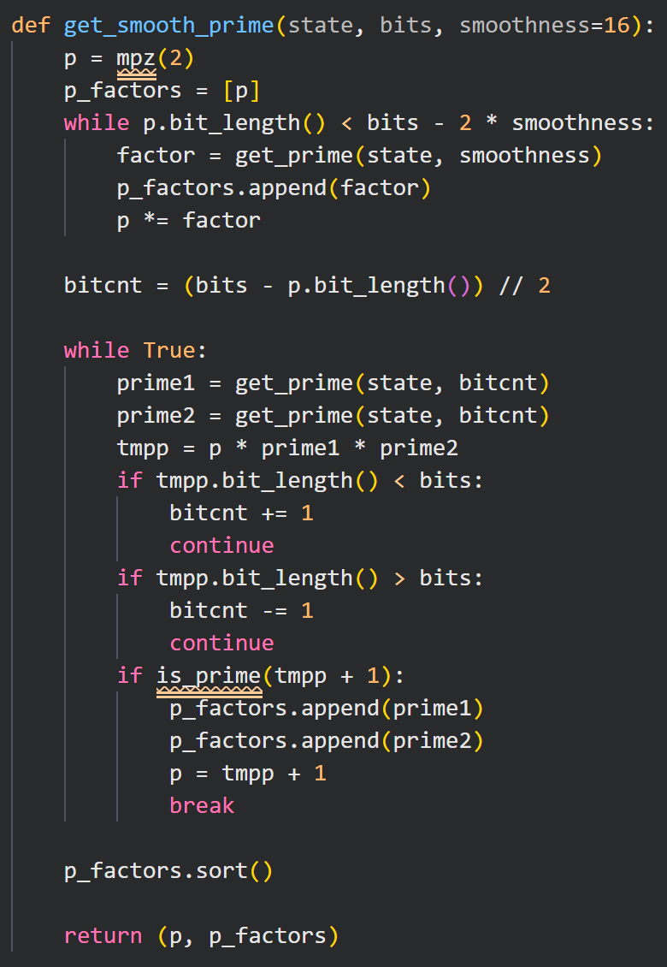
Pollard’s p-1
Uncommon
File shows smooth p-1
all prime powers are less than a certain number
n can be factored

