Slide 1
Module 1: Modular Arithmetic and an Intro to Asymmetric Cryptography
Joshua Turner, Evelyn Zhang

Slide 2
Install sagemath
It’s literally just
$ sudo apt-get install sagemath
If you have any technical problems (skill diff), I am but a simple MechE major, ask someone more educated

Slide 3
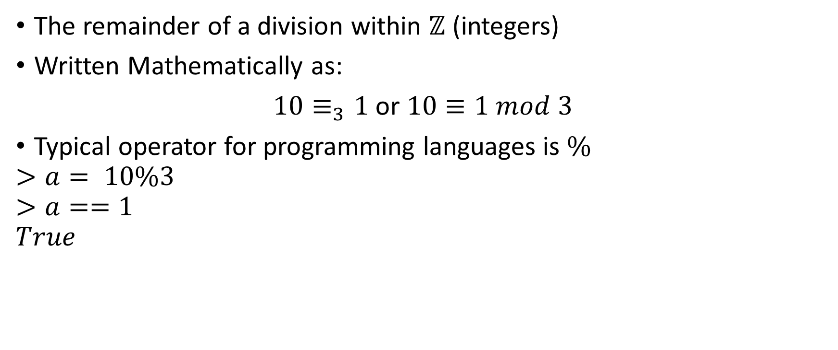
Modular Division
The remainder of a division within $ℤ$ (integers)
Written Mathematically as:
$10≡_{3}1$ or $10≡1 mod 3$
Typical operator for programming languages is $\%$
$$>a= 10\%3$$
$$>a==1$$
$$True$$

Slide 4
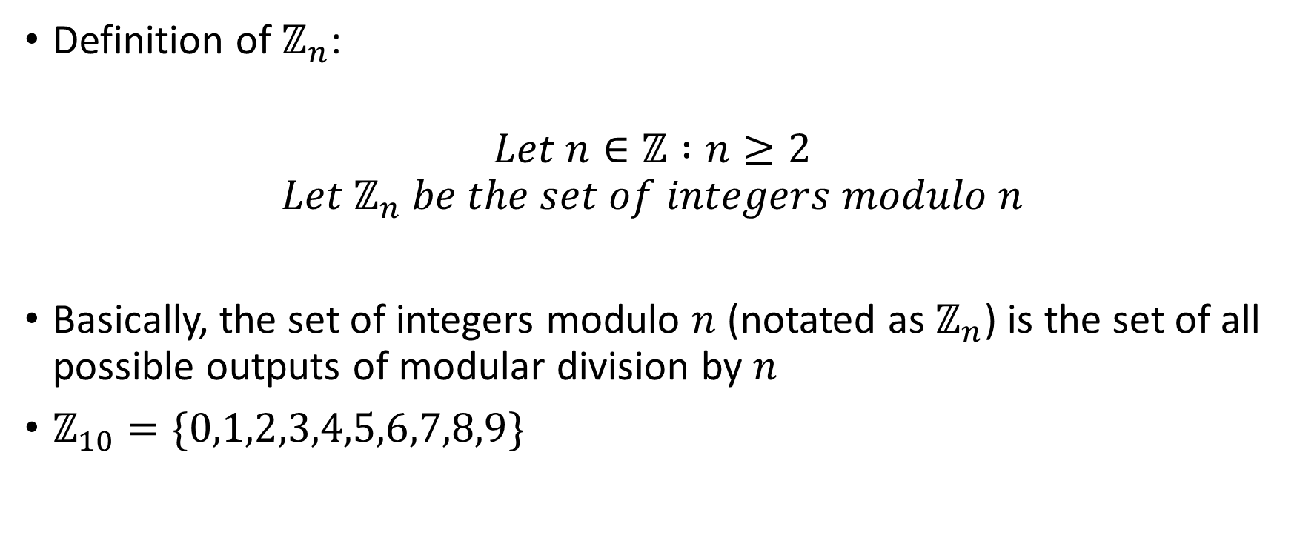
Set of Integers Modulo n
Definition of $ℤ_{n}$:
$$Let n∈ℤ :n≥2$$
$$Let ℤ_{n} be the set of integers modulo n$$
Basically, the set of integers modulo $n$ (notated as $ℤ_{n}$) is the set of all possible outputs of modular division by $n$
$ℤ_{10}=\{0,1,2,3,4,5,6,7,8,9\}$

Slide 5
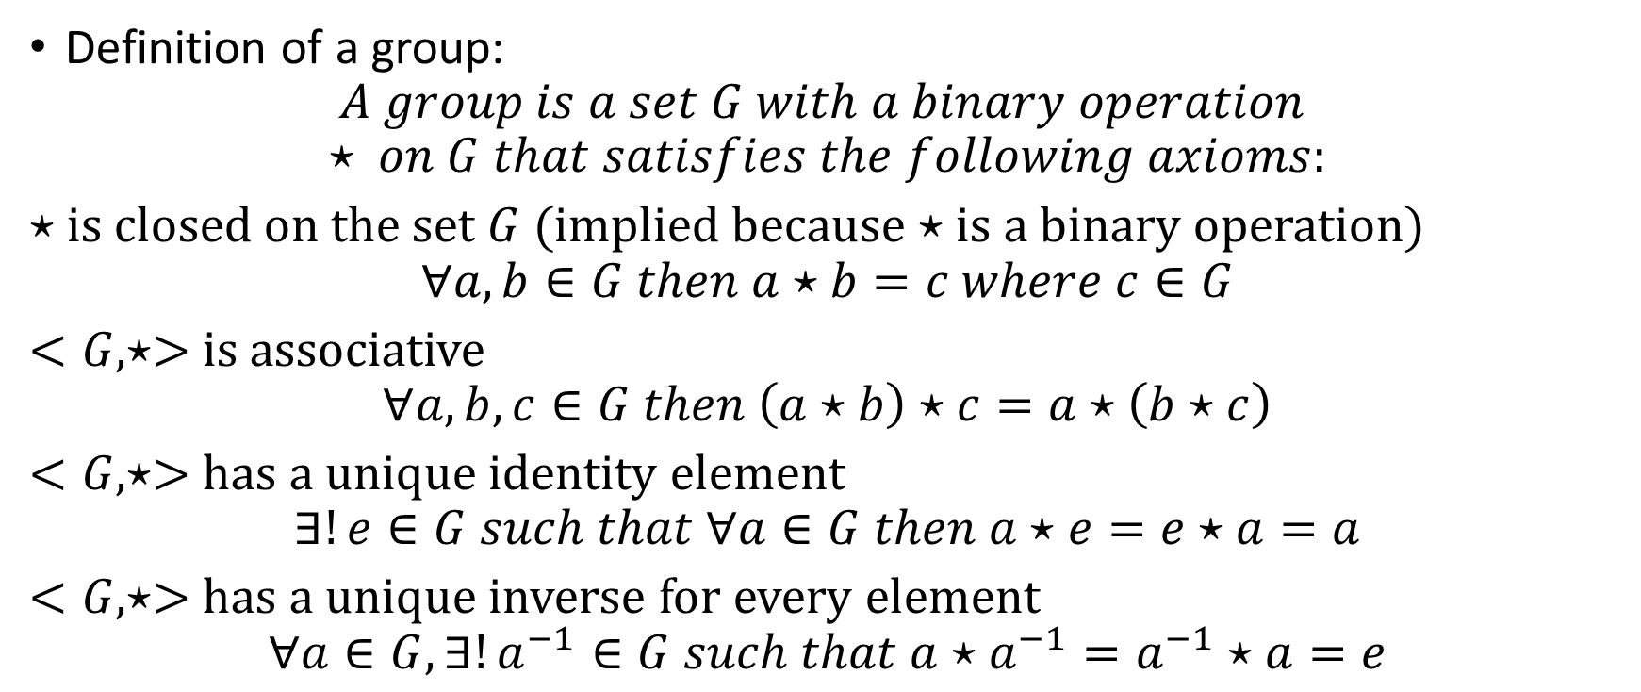
Groups
Definition of a group:
$$A group is a set G with a binary operation ⋆ on G that satisfies the following axioms:$$
$⋆$ is closed on the set $G$ (implied because $⋆$ is a binary operation)
$$∀a,b∈G then a⋆b=c where c∈G$$
$<G,⋆>$ is associative
$$∀a,b,c∈G then \left(a⋆b\right)⋆c=a⋆\left(b⋆c\right)$$
$<G,⋆>$ has a unique identity element
$$∃!e∈G such that ∀a∈G then a⋆e=e⋆a=a$$
$<G,⋆>$ has a unique inverse for every element
$$∀a∈G, ∃!a^{−1}∈G such that a⋆a^{−1}=a^{−1}⋆a=e$$

Slide 6
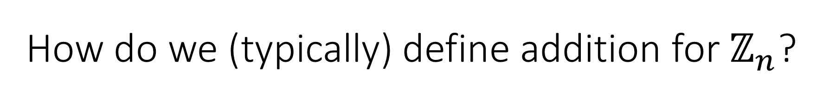
How do we (typically) define addition for $ℤ_{n}$?

Slide 7
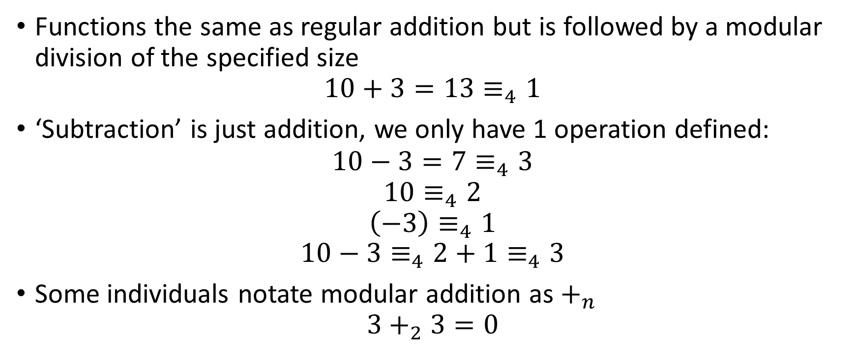
Modular Addition
Functions the same as regular addition but is followed by a modular division of the specified size
$$10+3=13≡_{4}1$$
‘Subtraction’ is just addition, we only have 1 operation defined:
$$10−3=7≡_{4}3$$
$$10≡_{4}2$$
$$\left(−3\right)≡_{4}1$$
$$10−3≡_{4}2+1≡_{4}3$$
Some individuals notate modular addition as $+_{n}$
$$3+_{2}3=0$$

Slide 8
What if we want 2 operations?

Slide 9

Rings
$$A ring is a set R that has two binary operations:$$
$$+\left(addition\right) and⋅\left(multiplication\right)$$
$$that satisfy the following 3 main axioms$$

Slide 10
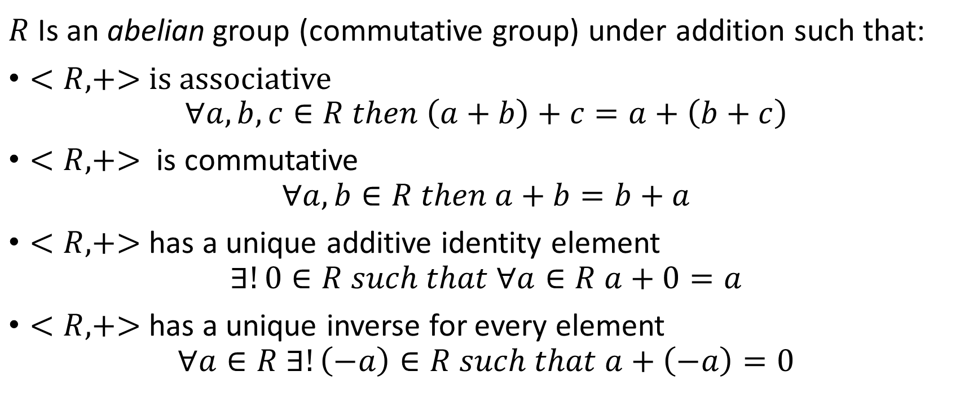
Ring Axiom 1
$R$ Is an abelian group (commutative group) under addition such that:
$<R,+>$ is associative
$$∀a,b,c∈R then \left(a+b\right)+c=a+\left(b+c\right)$$
$<R, +>$ is commutative
$$∀a,b∈R then a+b=b+a$$
$<R,+>$ has a unique additive identity element
$$∃!0∈R such that ∀a∈R a+0=a$$
$<R, +>$ has a unique inverse for every element
$$∀a∈R ∃!\left(−a\right)∈R such that a+\left(−a\right)=0$$

Slide 11
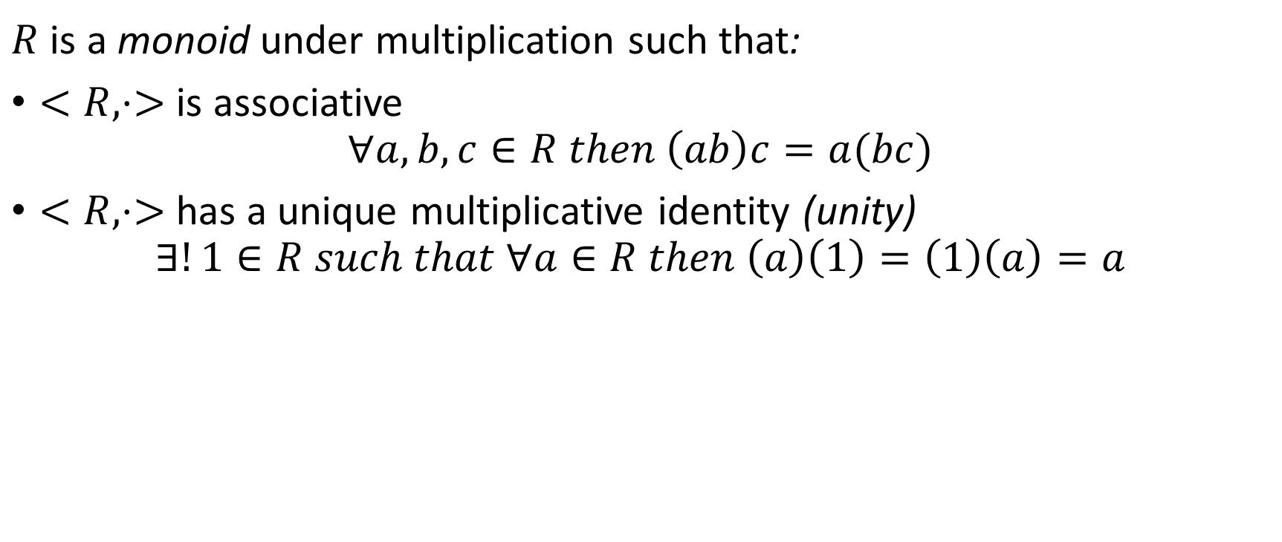
Ring Axiom 2
$R$ is a monoid under multiplication such that:
$<R,⋅>$ is associative
$$∀a,b,c∈R then \left(ab\right)c=a(bc)$$
$<R,⋅>$ has a unique multiplicative identity (unity)
$$∃!1∈R such that ∀a∈R then \left(a\right)\left(1\right)=\left(1\right)\left(a\right)=a$$

Slide 12

Ring Axiom 3
$<R, +,⋅>$ is distributive w.r.t addition
Left distributive
$$∀a,b,c∈R then a\left(b+c\right)=ab+ac$$
Right distributive
$$∀a,b,c∈R then \left(a+b\right)c=ac+bc$$

Slide 13

How do we (typically) define multiplication for $ℤ_{n}$?

Slide 14
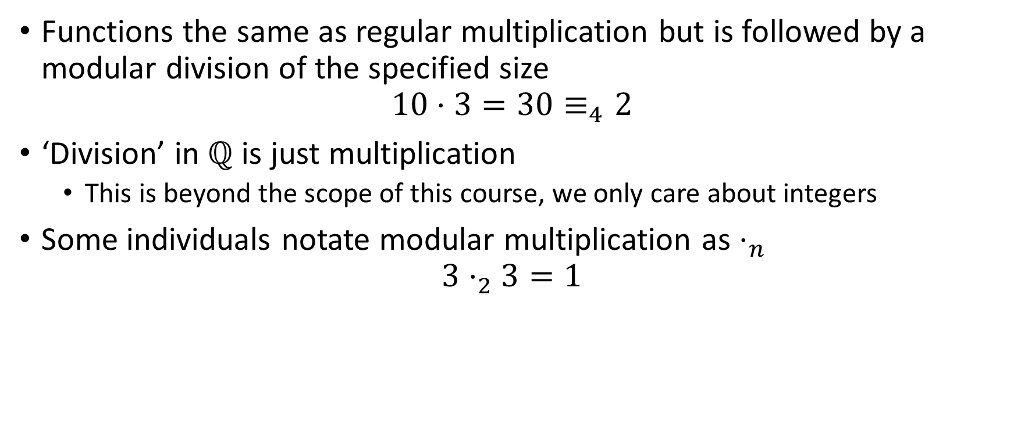
Modular Multiplication
Functions the same as regular multiplication but is followed by a modular division of the specified size
$$10⋅3=30≡_{4}2$$
‘Division’ in $ℚ$ is just multiplication
This is beyond the scope of this course, we only care about integers
Some individuals notate modular multiplication as $⋅_{n}$
$$3⋅_{2}3=1$$

Slide 15
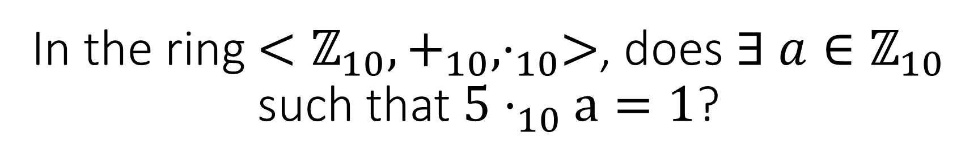
In the ring $<ℤ_{10},+_{10},⋅_{10}>$, does $∃ a∈ℤ_{10}$ such that $5⋅_{10}a=1$?

Slide 16
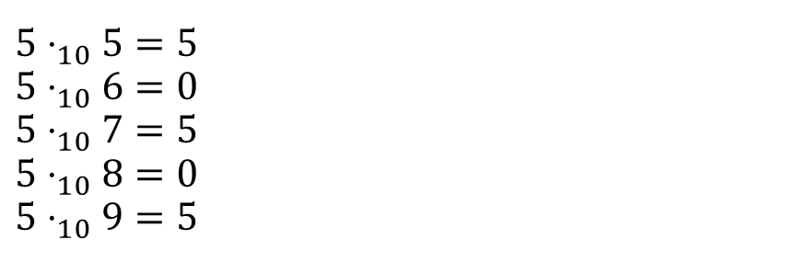

The answer is no, not all elements in a standardly defined ring have inverses
$$5⋅_{10}0=0$$
$$5⋅_{10}1=5$$
$$5⋅_{10}2=0$$
$$5⋅_{10}3=5$$
$$5⋅_{10}4=0$$
$$5⋅_{10}5=5$$
$$5⋅_{10}6=0$$
$$5⋅_{10}7=5$$
$$5⋅_{10}8=0$$
$$5⋅_{10}9=5$$

Slide 17

Fields
There are other further classifications of Rings (Division Rings, Integral Domains, etc.)
A field is a set of numbers $F$ with two binary operations $+, ⋅$ where $F$ under either operation forms a field and under both operations forms a field with left and right distributivity

Slide 18

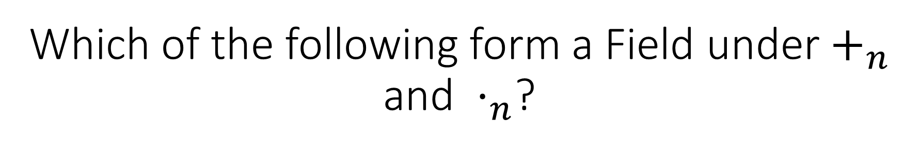
Which of the following form a Field under $+_{n}$ and $⋅_{n}$?
$$ℤ_{3},ℤ_{4},ℤ_{9},ℤ_{97}$$

Slide 19
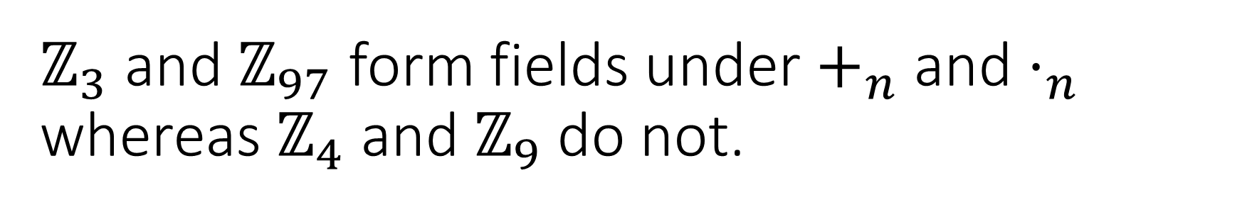
$ℤ_{3}$ and $ℤ_{97}$ form fields under $+_{n}$ and $⋅_{n}$ whereas $ℤ_{4}$ and $ℤ_{9}$ do not.
Why? What makes 3 and 97 special?

Slide 20

Finite Fields
Finite meaning non-infinite
Any set $ℤ_{p}$ where $p$ is prime forms a finite field under $+_{p}$ and $⋅_{p}$
This is used constantly in cryptography

Slide 21

Fermat’s Little Theorem (FLT)
$$Let a∈ℤ_{p} where p is prime$$
$$a^{p}≡_{p}a$$
and
$$a^{p−1}≡_{p}1$$

Slide 22
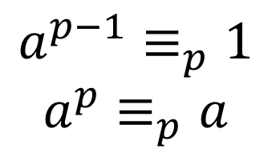

$$a^{p−1}≡_{p}1$$
$$a^{p}≡_{p}a$$
Using FLT, what is ${128}^{129}≡_{17}x$?

Slide 23

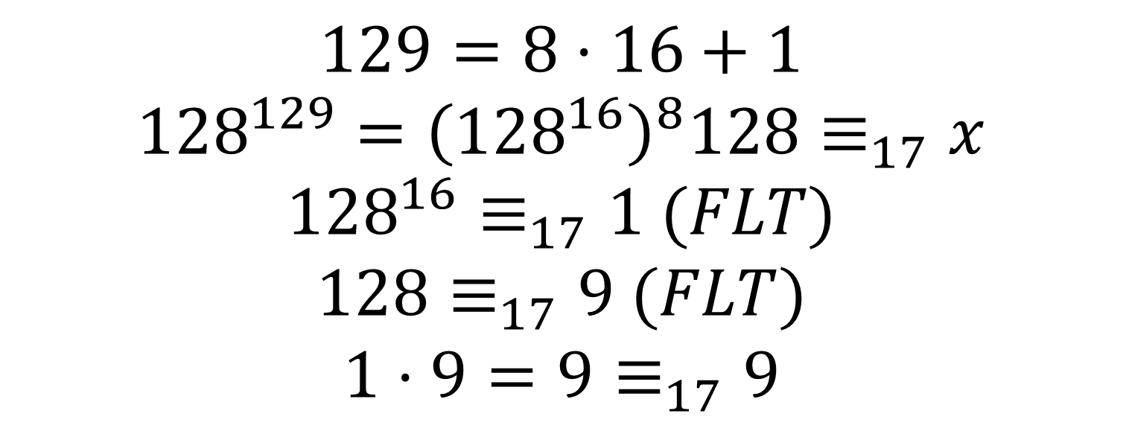
Using FLT, what is ${128}^{129}≡_{17}x$?
$$a^{p−1}≡_{p}1$$
$$a^{p}≡_{p}a$$
$$129=8⋅16+1$$
$${128}^{129}={\left({128}^{16}\right)}^{8}128≡_{17}x$$
$${128}^{16}≡_{17}1 (FLT)$$
$$128≡_{17}9 (FLT)$$
$$1⋅9=9≡_{17}9$$

Slide 24
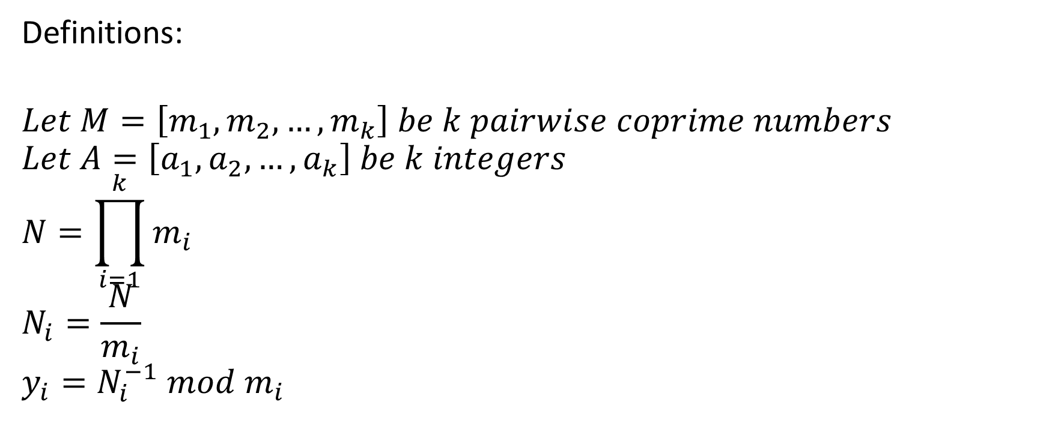
Chinese Remainder Theorem (CRT)
Definitions:
$$Let M=\left[m_{1},m_{2},…,m_{k}\right] be k pairwise coprime numbers$$
$$Let A=\left[a_{1},a_{2},…,a_{k}\right] be k integers$$
$$N=\prod_{i=1}^{k}{m_{i}}$$
$$N_{i}=\frac{N}{m_{i}}$$
$$y_{i}=N_{i}^{−1} mod m_{i}$$

Slide 25

Chinese Remainder Theorem (CRT)
The function:
$$crt\left(A,M\right)=\left(\sum_{i=1}^{k}{a_{i}N_{i}y_{i}}\right)\%N$$
Such that
$$\left(∀i,x≡_{m_{i}}a_{i}\right)⟺x≡_{N}crt(A,M)$$
That’s a lot to take in, let’s do an example

Slide 26

Chinese Remainder Theorem (CRT)
Consider the equations:
$$x≡_{5}2 \\ x≡_{11}3 \\ x≡_{17}5$$
$$M=\left[5, 11, 17\right]$$
$$A=[2, 3, 5]$$
$$N=\prod_{i=1}^{k}{m_{i}}=\left(5\right)\left(11\right)\left(17\right)=935$$
$$N_{i}=\frac{N}{m_{i}}⇒N_{i−list}=\left[\frac{935}{5},\frac{935}{11},\frac{935}{17}\right]=[187, 85, 55]$$
$$y_{i}≡_{m_{i}}N_{i}^{−1}⇒y_{i−list}=[3, 7, 13]$$
$$\sum_{i=1}^{k}{a_{i}N_{i}y_{i}}=∑\left[1122, 1785, 3575\right]=6482$$
$$6482≡_{N}872$$

Slide 27
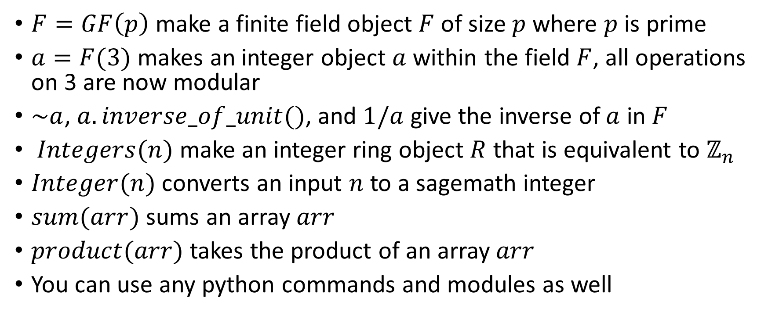
Useful Commands
$F=GF\left(p\right)$ make a finite field object $F$ of size $p$where $p$ is prime
$a=F(3)$ makes an integer object $a$ within the field $F$, all operations on 3 are now modular
$\sim a$, $a.inverse_of_unit()$, and $1/a$ give the inverse of $a$ in $F$
$Integers(n)$ make an integer ring object $R$ that is equivalent to $ℤ_{n}$
$Integer(n)$ converts an input $n$ to a sagemath integer
$sum(arr)$ sums an array $arr$
$product(arr)$ takes the product of an array $arr$
You can use any python commands and modules as well

Slide 28
Let’s manually do CRT in sagemath

Slide 29
Introduction to RSA

Slide 30
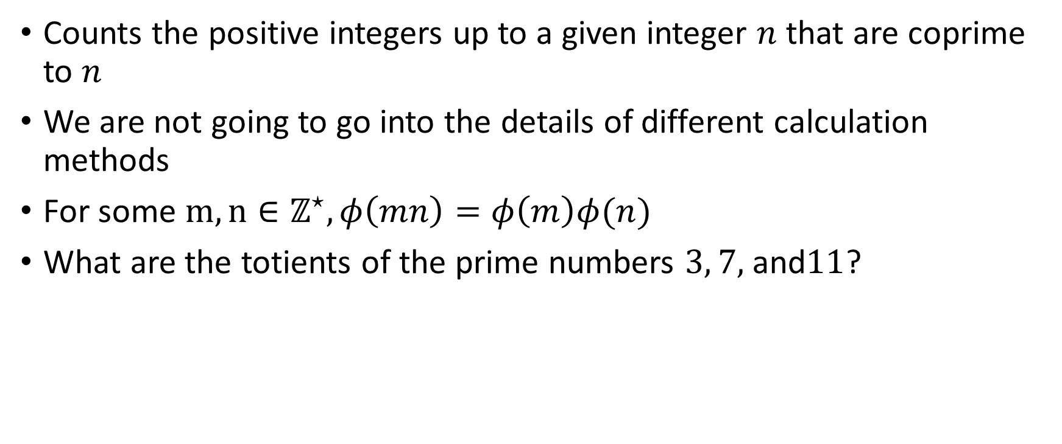

Euler’s Totient ($φ$) Function
Counts the positive integers up to a given integer $n$ that are coprime to $n$
We are not going to go into the details of different calculation methods
For some $m,n∈ℤ^{⋆}, φ\left(mn\right)=φ\left(m\right)φ(n)$
What are the totients of the prime numbers $3, 7,$and$11$?

Slide 31

$$a^{p−1}≡_{p}1$$
$$a^{p}≡_{p}a$$
$∀ p∈ℤ^{⋆}$where $p$is a prime then:
$φ\left(p\right)=(p−1)$

Slide 32

Euler’s Theorem (one of them)
If $m,n∈ℤ^{⋆}$ and $\gcd\left(m,n\right)=1$ then:
$$m^{φ\left(n\right)}≡_{n}1$$

Slide 33
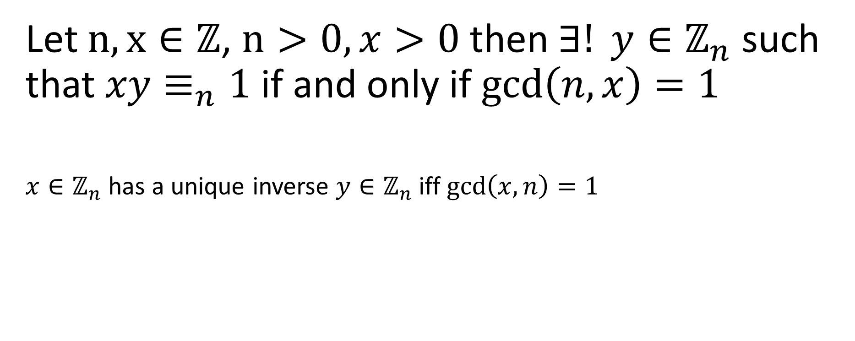
Multiplicative Inverse Theorem
Let $n,x∈ℤ$, $n>0, x>0$then $∃! y∈ℤ_{n}$such that $xy≡_{n}1$ if and only if $\gcd\left(n,x\right)=1$
$x∈ℤ_{n}$ has a unique inverse $y∈ℤ_{n}$ iff $\gcd\left(x,n\right)=1$

Slide 34
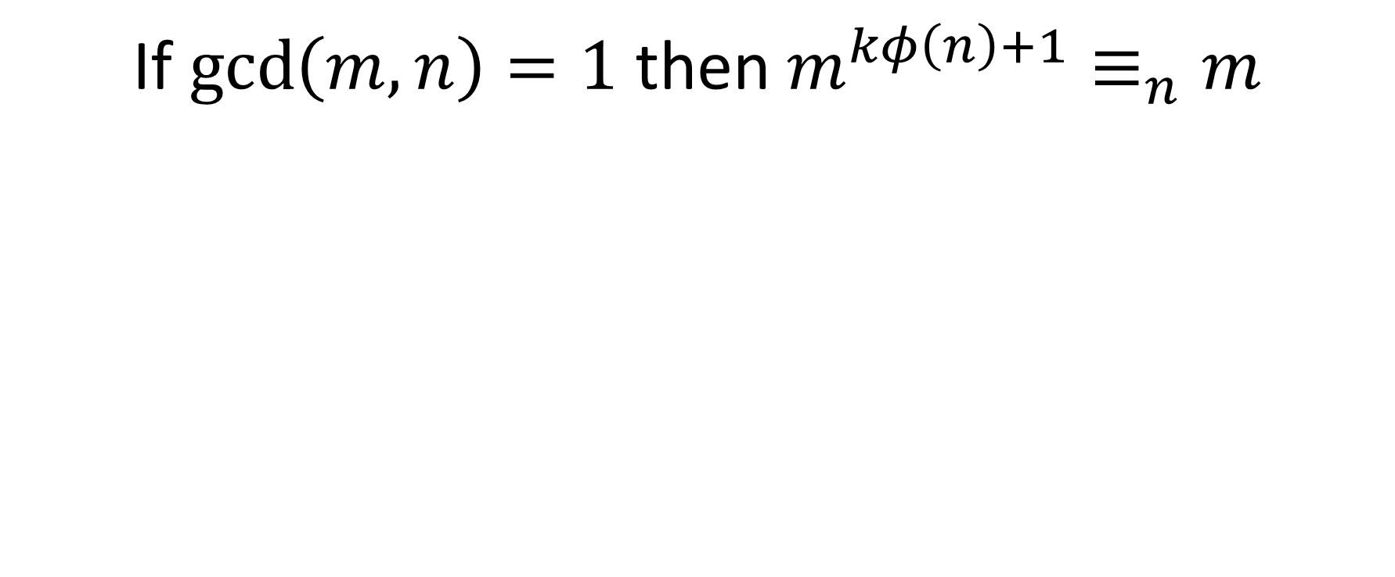
A Lemma
If $\gcd\left(m,n\right)=1$ then $m^{kφ\left(n\right)+1}≡_{n}m$

Slide 35
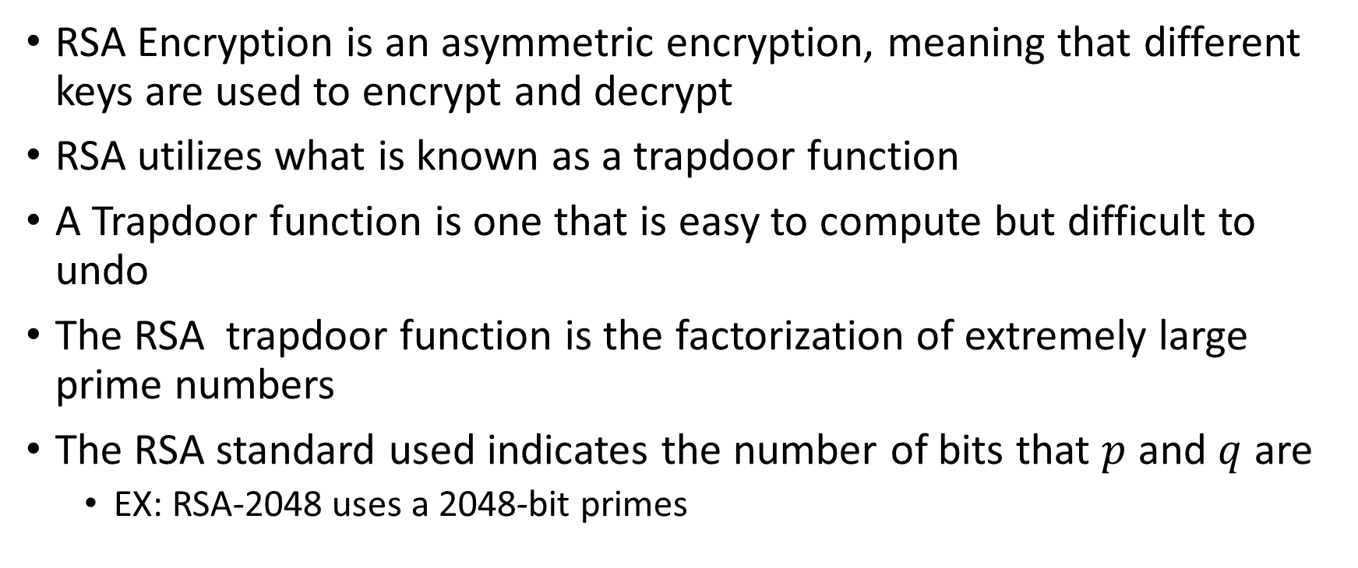
Rivest-Shamir-Adleman (RSA) Encryption
RSA Encryption is an asymmetric encryption, meaning that different keys are used to encrypt and decrypt
RSA utilizes what is known as a trapdoor function
A Trapdoor function is one that is easy to compute but difficult to undo
The RSA trapdoor function is the factorization of extremely large prime numbers
The RSA standard used indicates the number of bits that $p$ and $q$ are
EX: RSA-2048 uses a 2048-bit primes

Slide 36
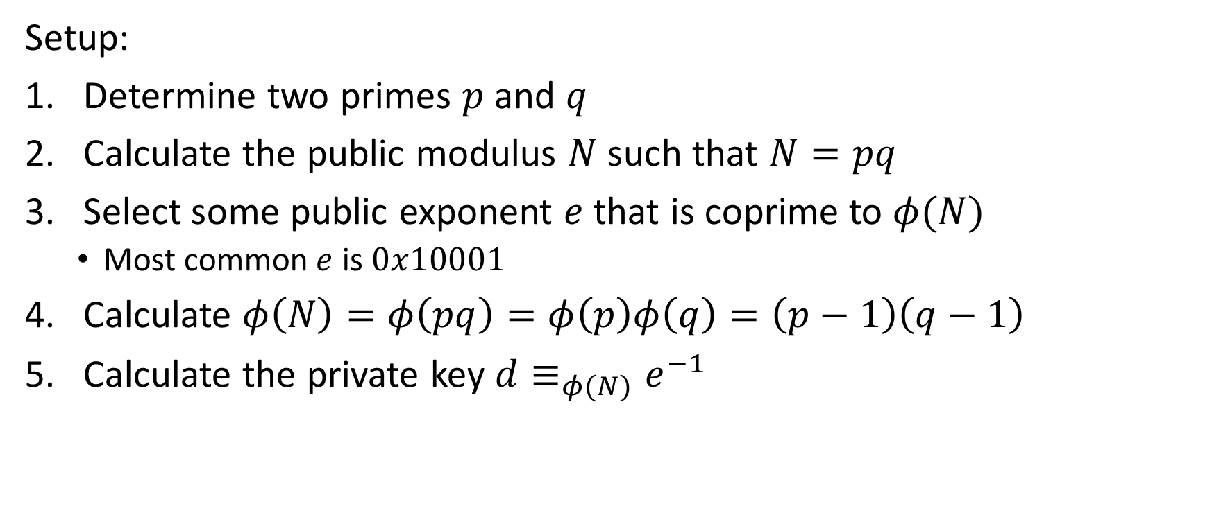
The RSA Algorithm
Setup:
Determine two primes $p$ and $q$
Calculate the public modulus $N$ such that $N=pq$
Select some public exponent $e$ that is coprime to $φ(N)$
Most common $e$ is $0x10001$
Calculate $φ\left(N\right)=φ\left(pq\right)=φ\left(p\right)φ\left(q\right)=\left(p−1\right)\left(q−1\right)$
Calculate the private key $d≡_{φ(N)}e^{−1}$

Slide 37

The RSA Algorithm
Encryption:
Let $m$ be the message to encrypt and define $c$ as the cipher of $m$
$$c≡_{N}m^{e}$$
Decryption:
$$m≡_{N}c^{d}$$

Slide 38
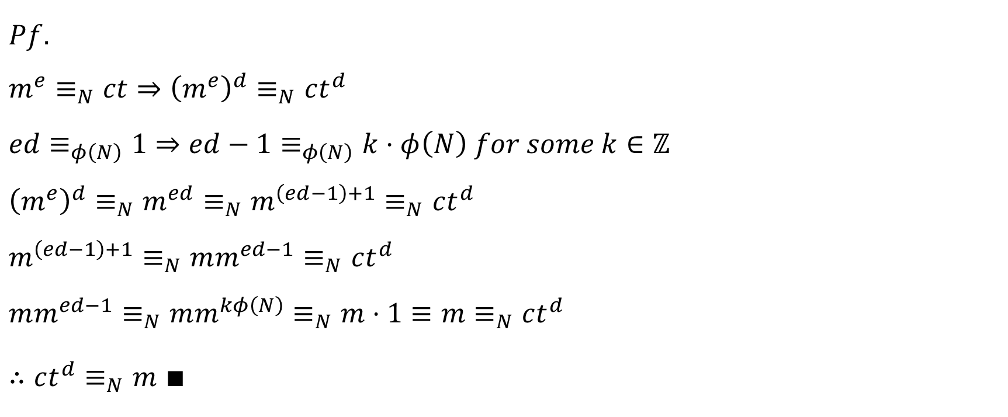
RSA Decryption Proof
$$Pf.$$
$${m^{e}≡_{N}ct⇒\left(m^{e}\right)}^{d}≡_{N}ct^{d}$$
$$ed≡_{φ\left(N\right)}1⇒ed−1≡_{φ\left(N\right)}k⋅φ\left(N\right) for some k∈ℤ$$
$${{{\left(m^{e}\right)}^{d}≡_{N}m}^{ed}≡_{N}m}^{\left(ed−1\right)+1}≡_{N}ct^{d}$$
$$m^{\left(ed−1\right)+1}≡_{N}mm^{ed−1}≡_{N}ct^{d}$$
$$mm^{ed−1}≡_{N}mm^{kφ\left(N\right)}≡_{N}m⋅1≡m≡_{N}ct^{d}$$
$∴ct^{d}≡_{N}m$ $∎$

Slide 39
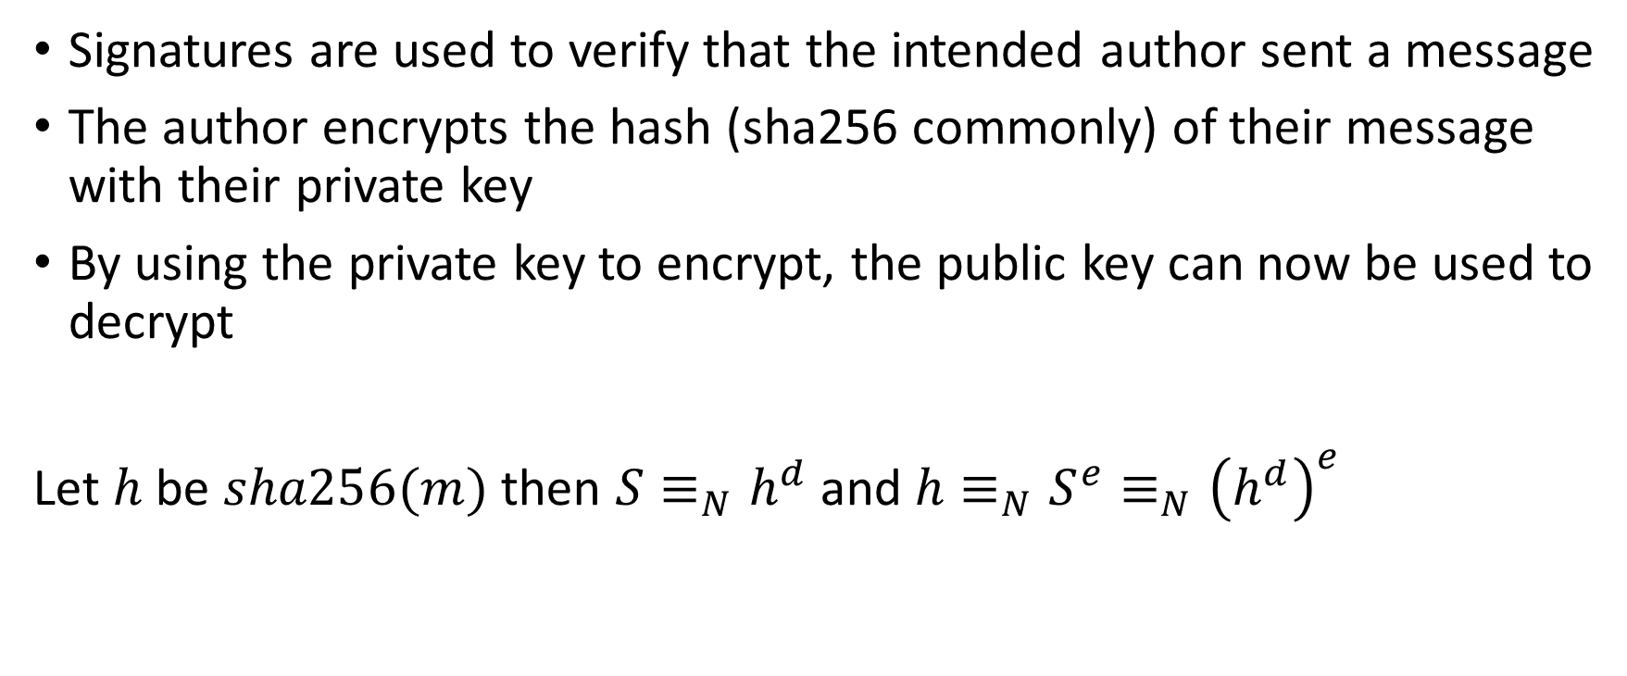
RSA Signatures
Signatures are used to verify that the intended author sent a message
The author encrypts the hash (sha256 commonly) of their message with their private key
By using the private key to encrypt, the public key can now be used to decrypt
Let $h$ be $sha256(m)$ then $S≡_{N}h^{d}$ and $h≡_{N}S^{e}≡_{N}{\left(h^{d}\right)}^{e}$

Slide 40
It’s finally time to do some easy RSA Vulnerabilities
Clone the crypto-workshop GitHub repository

