Slide 1

brew-devops-dynamics the branch of devops, concerned with the motion of pipeline; under the action of code commits
Squad # 12
Members
Deepika Vaidhya Sriram (1883537)
SandEep Mohanthy (181671)
Vinodh T (515766)
Smruti Ranjan Dash (35O957)
Puneet Arora (694136)
Sudeshna Sarkar (496857)
TCS internal

Slide 2
What was done as part of case Study​
Declarative Scripted Pipeline
Created VM’s (Deploy/Test/Prod) using Teraform​
Tools installation using Ansible/Teraform​
Parallel execution using bule ocean workflow
Integrated GIT, Slack, Jira and Jenkins
Containerize the app – Build => Push => Run​
Monitoring the Deploy VM for CPU Performance (ELK)​

Slide 3
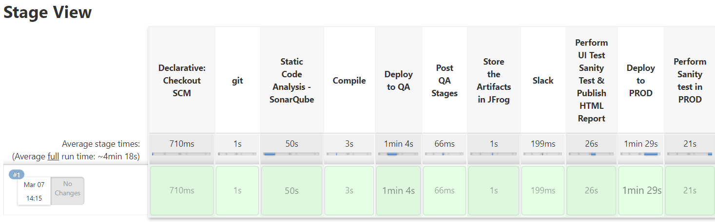
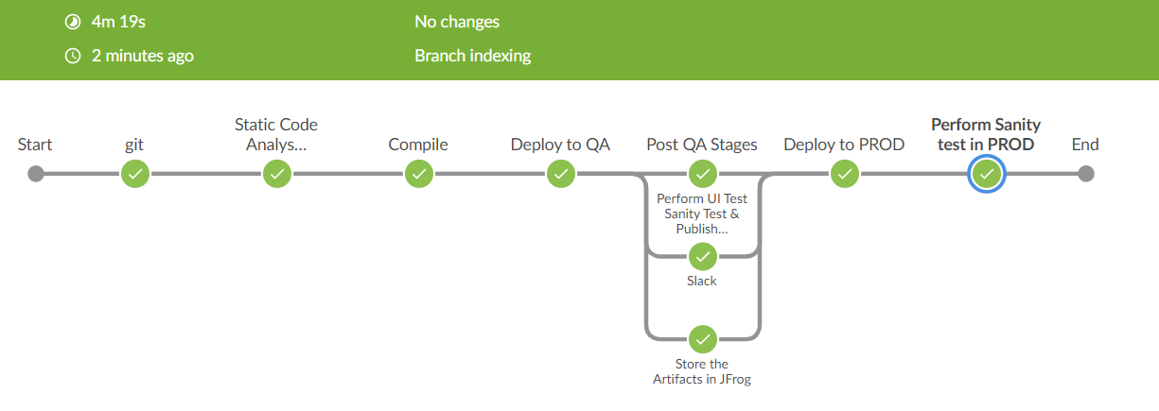
CI /CD Pipeline

Slide 4









Architecture
LOCAL
AWS
TEST Server
PROD Server
Jenkins Image
Deployment Server
Docker File

Slide 5







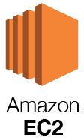
Links
Jira https://devopsbc.atlassian.net/
GitHub https://github.com/squad12-devops/case-study (Jenkins file link)
Jenkins http://34.68.44.171:8080/manage (User: Jenkins | Pass: Jenkins)
SonarQube http://35.224.54.238/projects (User: sonar | Pass: sonar)
Slack https://app.slack.com/client/T010XSBFZDL/C010QCLBY9X
Jfrog https://devopsbc.jfrog.io/ui/login/
Blazemeter https://a.blazemeter.com/app/#/accounts/469976/workspaces/470553/dashboard
Test Server http://18.217.15.48:8080/QAWebapp/ (User: tomcat| Pass: tomcat)
Prod Server http://3.14.10.76:8080/ProdWebapp/ (User: tomcat| Pass: tomcat)

Slide 6
