Slide 1
New_Condo-2017-2024
File created on: 2025-01-18 5:15:46 p.m. EST

Slide 2
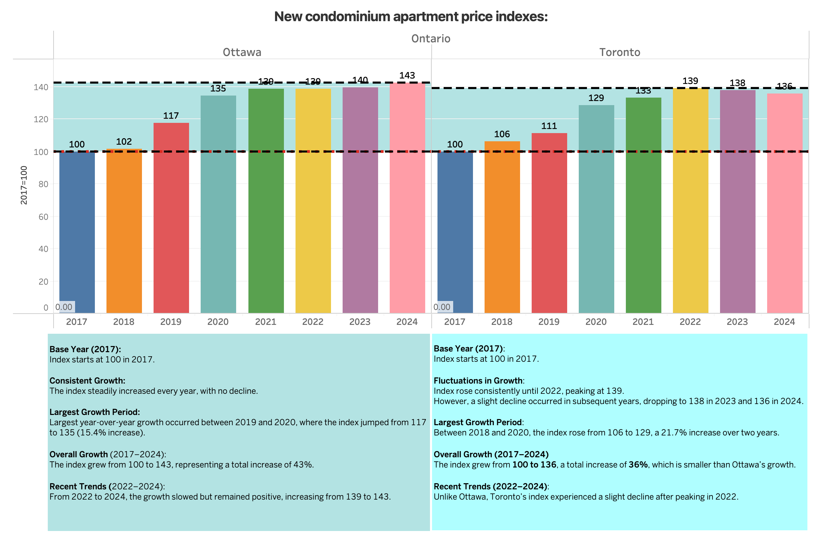

Slide 3
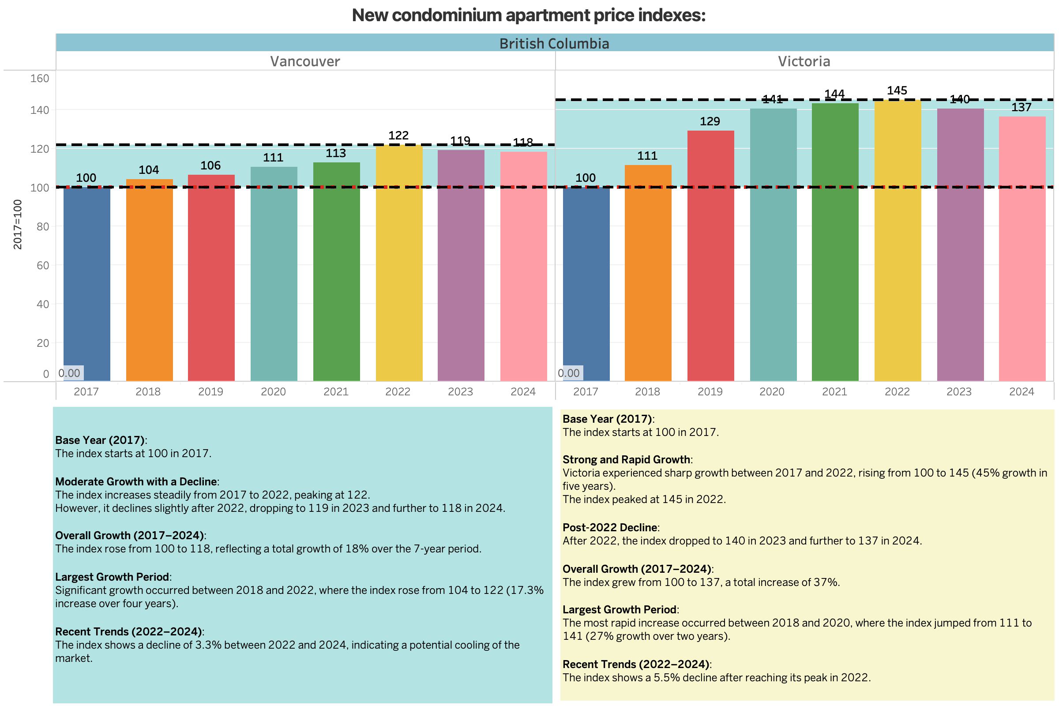

Slide 4
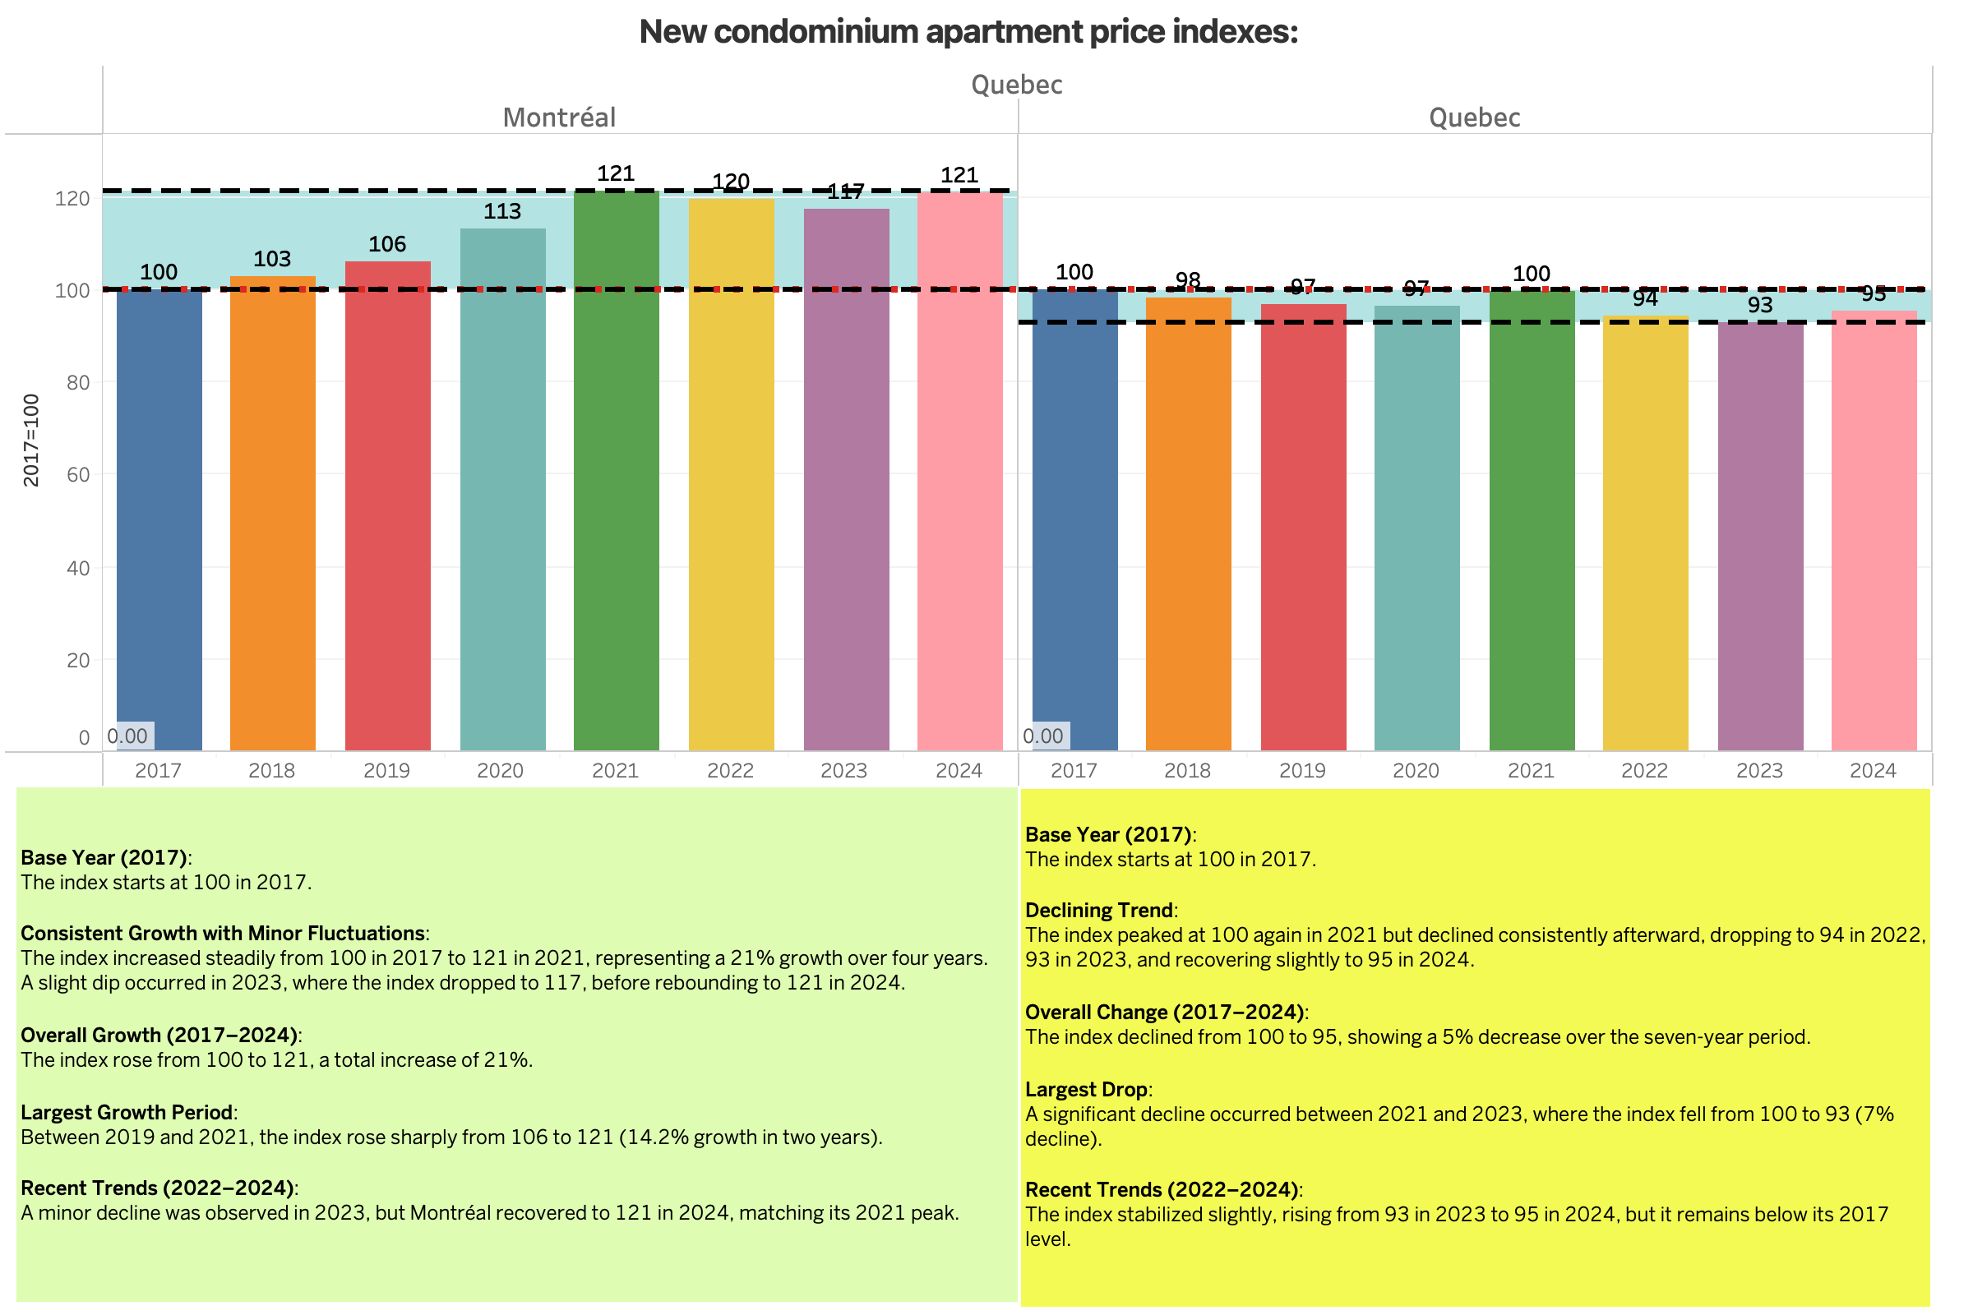

Slide 5
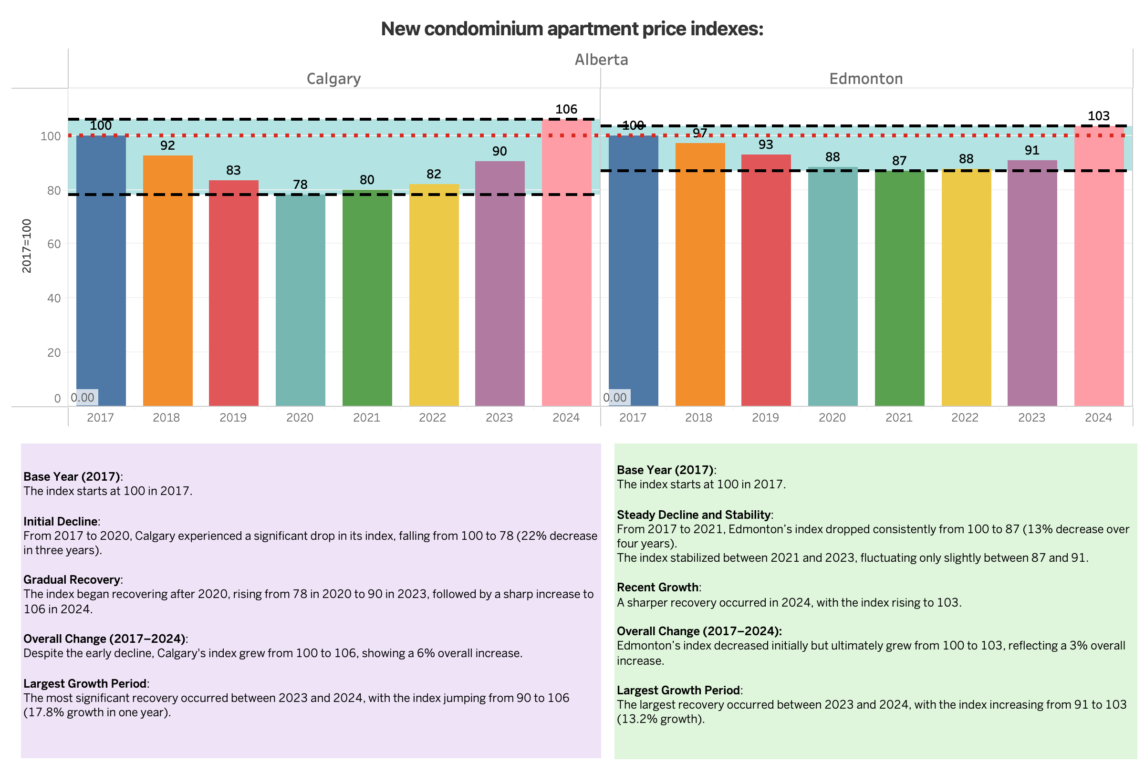

Slide 6
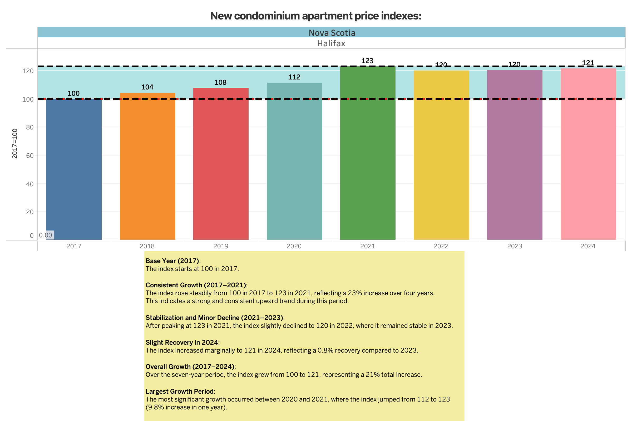

Slide 7
