Slide 1
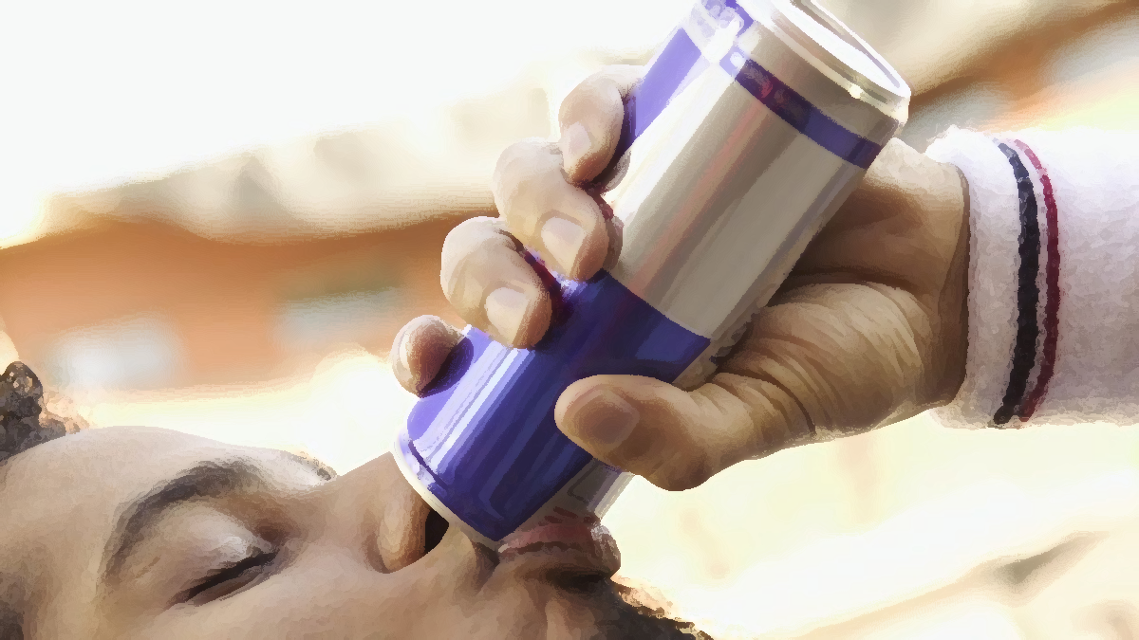
Marketing Insights for Codex
Pooja Gupta

Slide 2
Objectives
CodeX is a German beverage company that is aiming to make its mark in the Indian market. A few months ago, they launched their energy drink in 10 cities of India.
The Marketing team is responsible for increasing brand awareness, market share, and product development. They conducted a survey in those 10 cities and received results from 10k respondents.
I would like to present to you a comprehensive analysis and insights derived from our recent survey on energy drink preferences. These insights will help us gain a better understanding of our target market and guide our strategic decision-making process.

Slide 3
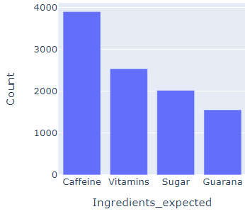
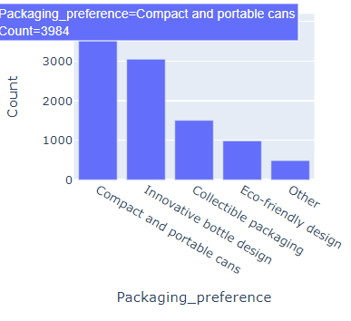
Consumer Preferences Analysis
preferred ingredients of energy drinks Caffeine is the preferred ingredient among respondents
Packaging preferences:
Respondents showed a preference
for compact and portable cans

Slide 4
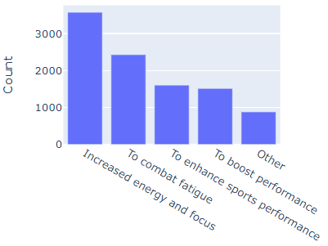
Consumer Preferences Analysis
Main reason behind drinking energy drinks- taste or energy boost? Highlight the key ingredient, caffeine, and emphasize its benefits in our marketing campaigns.
Optimize packaging for compact and portable cans to enhance convenience for on-the-go consumers.

Slide 5
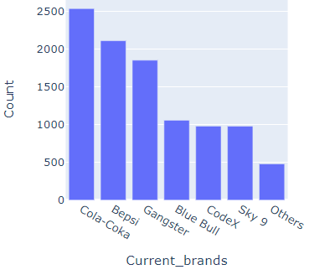
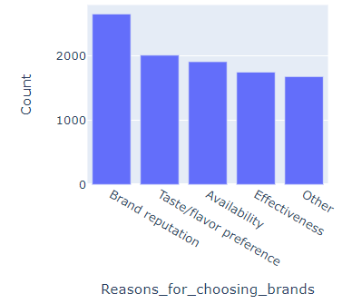
Competitive Analysis
Current brands- Cola-Coka, Bepsi, Gangster, and Blue Bull are the leading brands in the market.
Reasons for choosing brands brand reputation, taste/flavor preference, and availability

Slide 6
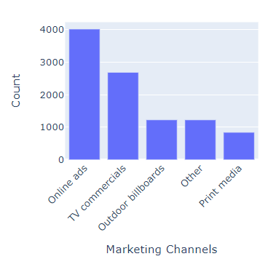
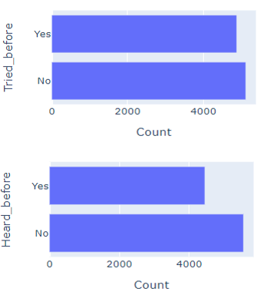
Marketing Channels and Brand Awareness
Online ads marketing channels have shown the potential to reach a wider customer base
More than 50% of respondents have never heard of our energy drinks or tried them before.

Slide 7
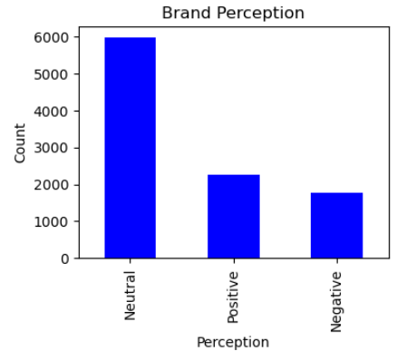
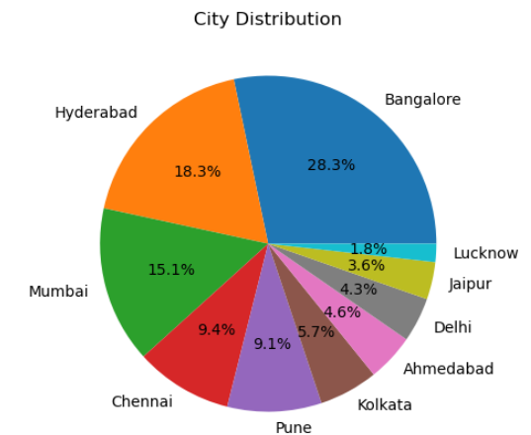
Brand Penetration and Geo targeting
What do people think about our brand?
Which cities do we need to focus more on?

Slide 8
Cities to focus on: To increase brand penetration, we should focus on Lucknow, Jaipur, Delhi, Ahmedabad, and Kolkata, which are a mix of tier 1 and tier 2 cities.
Brand Perception Distribution: The majority of respondents (5974 out of 10,000) have a neutral perception of the brand. This indicates that the brand's image is neither strongly positive nor negative for a significant portion of the target audience.
Positive Brand Perception: Approximately 2257 respondents reported having a positive perception of the brand. This suggests that there is a segment of the market that views the brand favorably, which can be a valuable asset for CodeX in building brand loyalty and attracting new customers.
Negative Brand Perception: Around 1769 respondents expressed a negative perception of the brand. This signifies that there is room for improvement in addressing the concerns or issues raised by this segment of the market. Analyzing the reasons behind their negative perception can help CodeX identify areas for improvement and take corrective actions.
Focus on Neutral Perception: Since the majority of respondents have a neutral perception of the brand, it is crucial for CodeX to understand the factors influencing this neutrality. Conducting further research or follow-up surveys to delve deeper into the reasons behind this perception can provide valuable insights. Identifying the key drivers that contribute to neutrality can help CodeX shape their marketing strategies to build a more positive brand image.

Slide 9
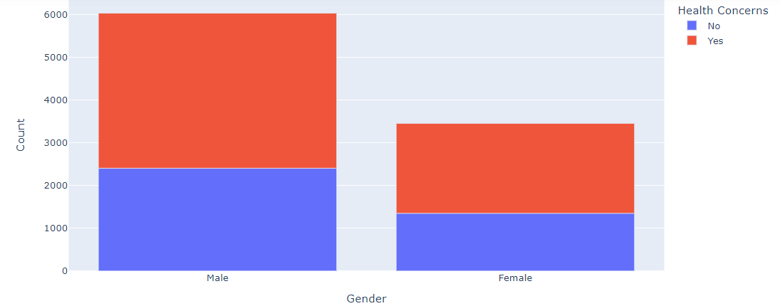
Correlation between Gender and Health Concerns
Since females are less convinced by the benefits of energy drinks than males, there is also the potential opportunity for brands to focus on improving the perception of their product there. An increased focus on minimising any negative health connotations and improving general well-being may well lead to a re-energised female consumer-base — and stronger sales.

Slide 10
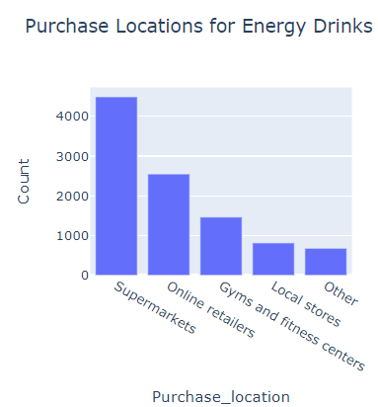
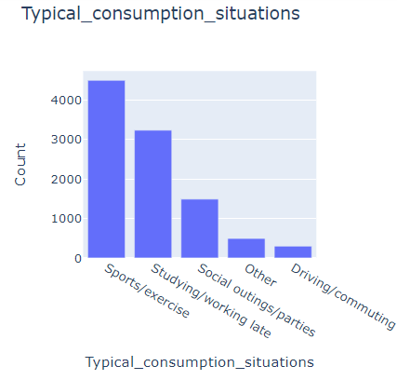
Purchase Behavior
Purchase location
Typical consumption situations

Slide 11
Insights Report
Demographic Insights: a. Our survey indicates that mostly males showed a preference for energy drinks. b. The dominant age group that prefers energy drinks is between 19-30 years old. c. Online ads marketing channels have proven to be effective in reaching young individuals aged 15-30.
Consumer Preferences: a. Caffeine is the preferred ingredient among respondents. b. Respondents showed a preference for compact and portable cans.
Competition Analysis: a. Cola-Coka, Bepsi, Gangster, and Blue Bull are the leading brands in the market. b. The primary reasons consumers prefer these brands are brand reputation, taste/flavor preference, and availability.

Slide 12
Marketing Channels and Brand Awareness: a. Marketing channel to reach more customers: Online ads marketing channels have shown the potential to reach a wider customer base. b. Brand awareness: More than 50% of respondents have never heard of our energy drinks or tried them before.
Brand Penetration: a. Cities to focus on: To increase brand penetration, we should focus on Lucknow, Jaipur, Delhi, Ahmedabad, and Kolkata, which are a mix of tier 1 and tier 2 cities.
Purchase Behavior: a. Supermarkets are the preferred choice for purchasing energy drinks. b. Sports/exercise activities are the most common situations where energy drinks are consumed. c. Factors such as price range (specifically the 50-99 category) and limited edition packaging influence respondents' purchase decisions.
Product Development: a. Areas to focus on for product development: Brand reputation and taste/flavor preference are the key areas that require attention.

