Slide 1
Predicting the quality of wine through machine learning
By:Pooja Gupta

Slide 2
INTRODUCTION
The wine industry shows a recent exponential growth as social drinking is on the rise. Nowadays, industry players are using product quality certifications to promote their products. This is a time-consuming process and requires the assessment given by human experts, which makes this process very expensive. Also, the price of wine depends on a rather abstract concept of wine appreciation by wine tasters, opinion among whom may have a high degree of variability. Another vital factor in wine certification and quality assessment is physicochemical tests, which are laboratory-based and consider factors like acidity, pH level, sugar, and other chemical properties. The wine market would be of interest if the human quality of tasting can be related to wine’s chemical properties so that certification and quality assessment and assurance processes are more controlled. This project aims to determine which features are the best quality red wine indicators and generate insights into each of the factors to our model’s wine quality.

Slide 3
Data Cleaning
My first step was to clean and prepare the data for analysis. I went through different steps of data cleaning. First, I checked the data types focusing on numerical and categorical to simplify the correlation’s computation and visualization. Second, I tried to identify any missing values existing in our data set. Last, I researched each column/feature’s statistical summary to detect any problem like outliers and abnormal distributions.

Slide 4
The first step to analyze the data was to create density plots visualizing the spread of the data . It can be seen that most red wines’ pH levels are always between 3–4 and chlorides — the amount of salt is most prevalent at level 0.1. After analyzing the density plots, I plotted the interaction between our numeric variables of interest and our dependent variable of quality.

Slide 5
Three different patterns can be observed. First, there are positive relationships between quality and critic.acid, alcohol, and sulphates. Even though wines with a higher level of alcohol may make them less popular, they should be highly rated in quality. Second, there are negative relationships between quality and volatile.acidity, density, and pH. It is reasonable that less sweet wines and a lower level of acidity are favored in quality testings. Last, these independent variables show no significant relationship with quality: residual.sugar, chlorides, and total.sulfur.dioxide.

Slide 6
Data Exploration and Transformation
To see which variables are likely to affect the quality of wine the most, I ran a correlation analysis of our independent variables against our dependent variable, quality. This analysis ended up with a list of variables of interest that had the highest correlations with quality.
In order of highest correlation, these variables are:
1. Alcohol: the amount of alcohol in wine
2. Volatile acidity: are high acetic acid in wine which leads to an unpleasant vinegar taste
3. Sulphates: a wine additive that contributes to SO2 levels and acts as an antimicrobial and antioxidant
4. Citric Acid: acts as a preservative to increase acidity (small quantities add freshness and flavor to wines)
5. Total Sulfur Dioxide: is the amount of free + bound forms

Slide 7
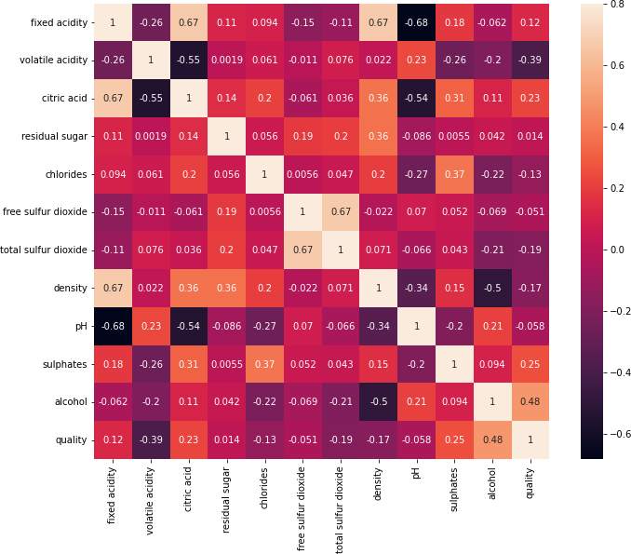
Correlation heatmap

Slide 8
6. Density: sweeter wines have a higher density
7. Chlorides: the amount of salt in the wine
8. Fixed acidity: are non-volatile acids that do not evaporate readily
9. pH: the level of acidity
10. Free Sulfur Dioxide: it prevents microbial growth and the oxidation of wine
11. Residual sugar: is the amount of sugar remaining after fermentation stops. The key is to have a perfect balance between — sweetness and sourness (wines > 45g/ltrs are sweet)

Slide 9
Modelling
Based on the EDA and correlation analysis, potential model used was RANDOM FOREST.
This helps to create a random sample of multiple decision trees and merges them to obtain a more stable and accurate prediction through cross-validation.

Slide 10
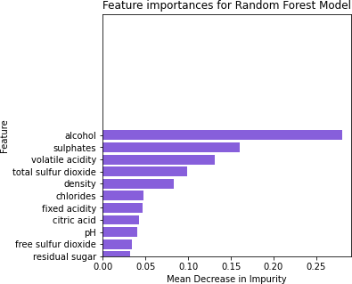
Variable Importance

Slide 11
Diving deep into variable selection, we have the top 10 predictors most important to the model. It is done by using MDI (Gini Importance or Mean Decrease in Impurity) that calculates each feature’s importance as the sum over the number of splits (across all trees) that include the feature, proportionally to the number of samples it splits.

Slide 12
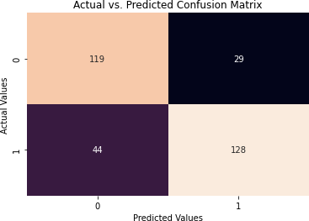
Confusion Matrix

Slide 13
Accuracy
Overall the model gives 77% accuracy. In order to improve our predictive model, we need more balanced data. Another limitation worth mentioned from the data set was it only had 12 attributes, which can narrow down the accuracy of our predicting quality of red wine. The solution for this is to include more relevant data features, like the year of harvest, brew time, location, or wine type. In the future, we also can try other performance measures and other machine learning techniques for better performance and comparison of results. This analysis will help wine businesses predict the wines’ quality based on certain attributes and make and sell good associated products.

