Slide 1
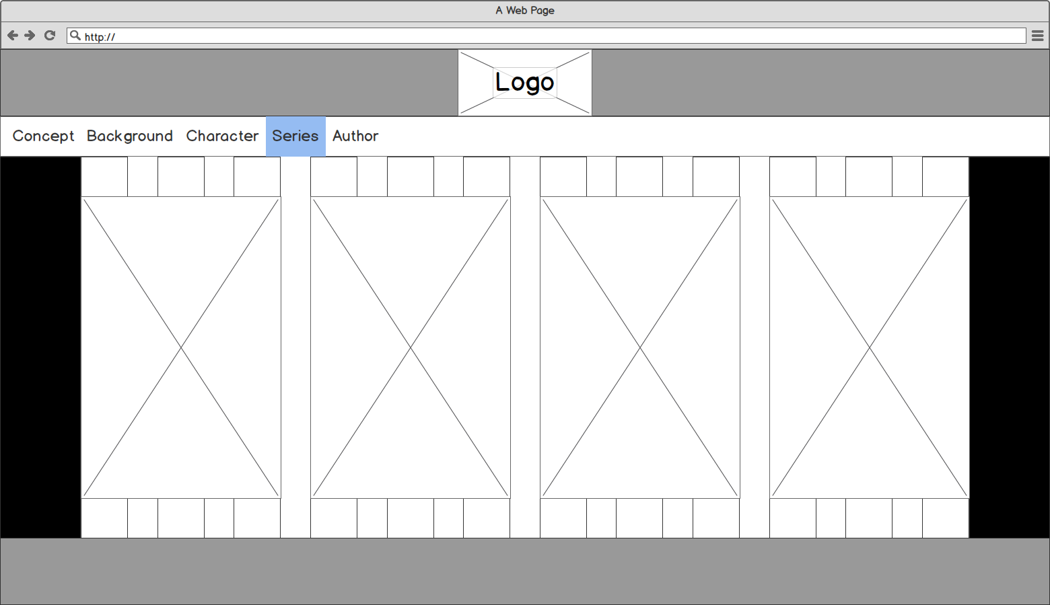

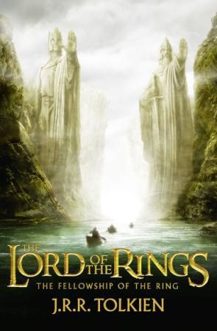
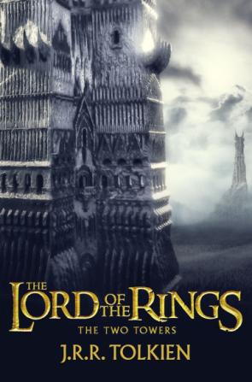
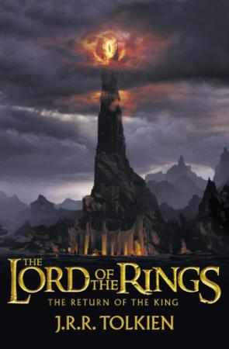
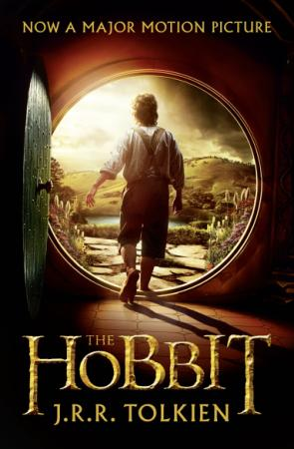
Concept World Characters Race Movie Author Series Influence Reference
Copyright @ created by BJ in 20170422 QAQ

Slide 2

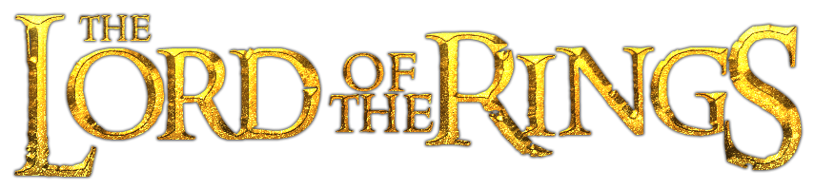
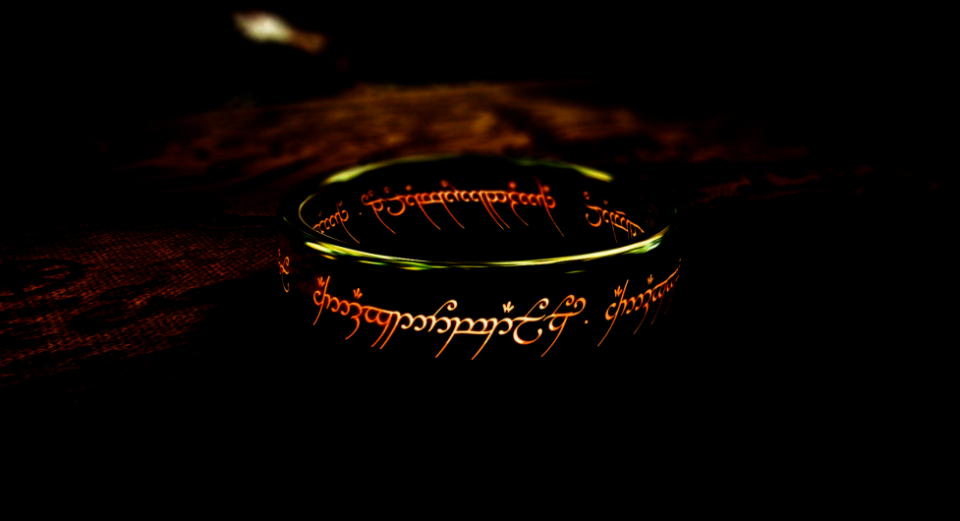
Press any Buttons

Slide 3
Press any Buttons

Slide 4
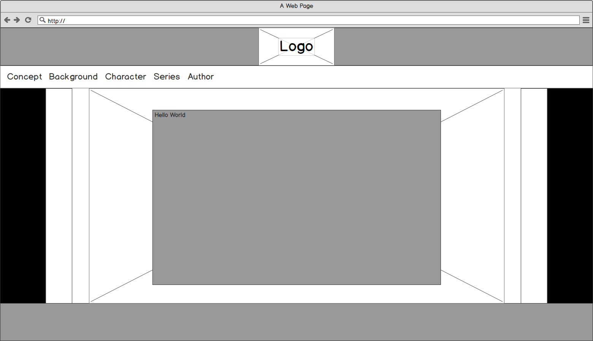
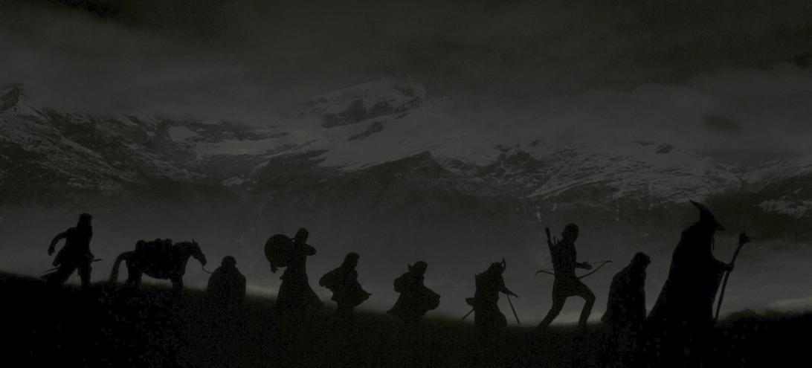
Concept World Characters Race Movie Author Series Influence Reference
Concept
The Dark Lord Sauron,who had in an earlier age created the One Ring to rule the other Rings of Power as the ultimate weapon in his campaign to conquer and rule all of Middle-earth. From quiet beginnings in the Shire, a hobbit land, the story ranges across Middle-earth, following the course of the War of the Ring through the eyes of its characters, the hobbits Frodo Baggins, Samwise "Sam" Gamgee, Meriadoc "Merry" Brandybuck and Peregrin "Pippin" Took, and travelling companions: the Men Aragorn son of Arathorn, a Ranger of the North, and Boromir, a Captain of Gondor; Gimli son of Glóin, a Dwarf warrior; Legolas Greenleaf, an Elven prince; and Gandalf, a Wizard.
Copyright @ created by BJ in 20170422 QAQ

Slide 5
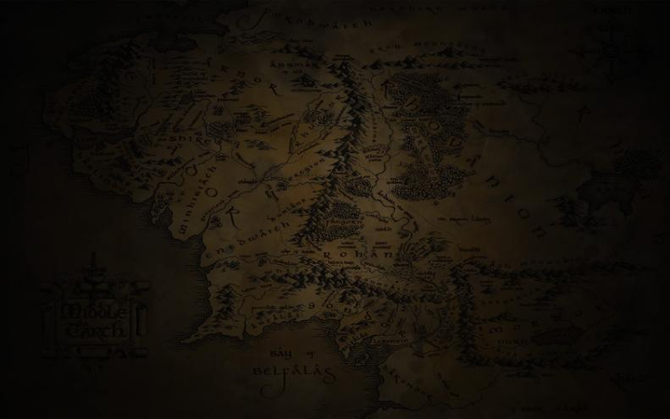
Concept World Characters Race Movie Author Series Influence Reference
World
The Lord of the Rings is set in Middle-earth, a fictional world created by Tolkien. Mystical creatures such as hobbits, orcs, trolls, ents, elves, wangs, wizards, dragons, dwarves and men inhabit middle-earth. Middle-earth is a magical world in which imagination rules, but it exists very much like "real" society, with political and economic problems and power struggles. Each of the races that inhabit this world have their own territories and are distinct from one another.
Copyright @ created by BJ in 20170422 QAQ

Slide 6
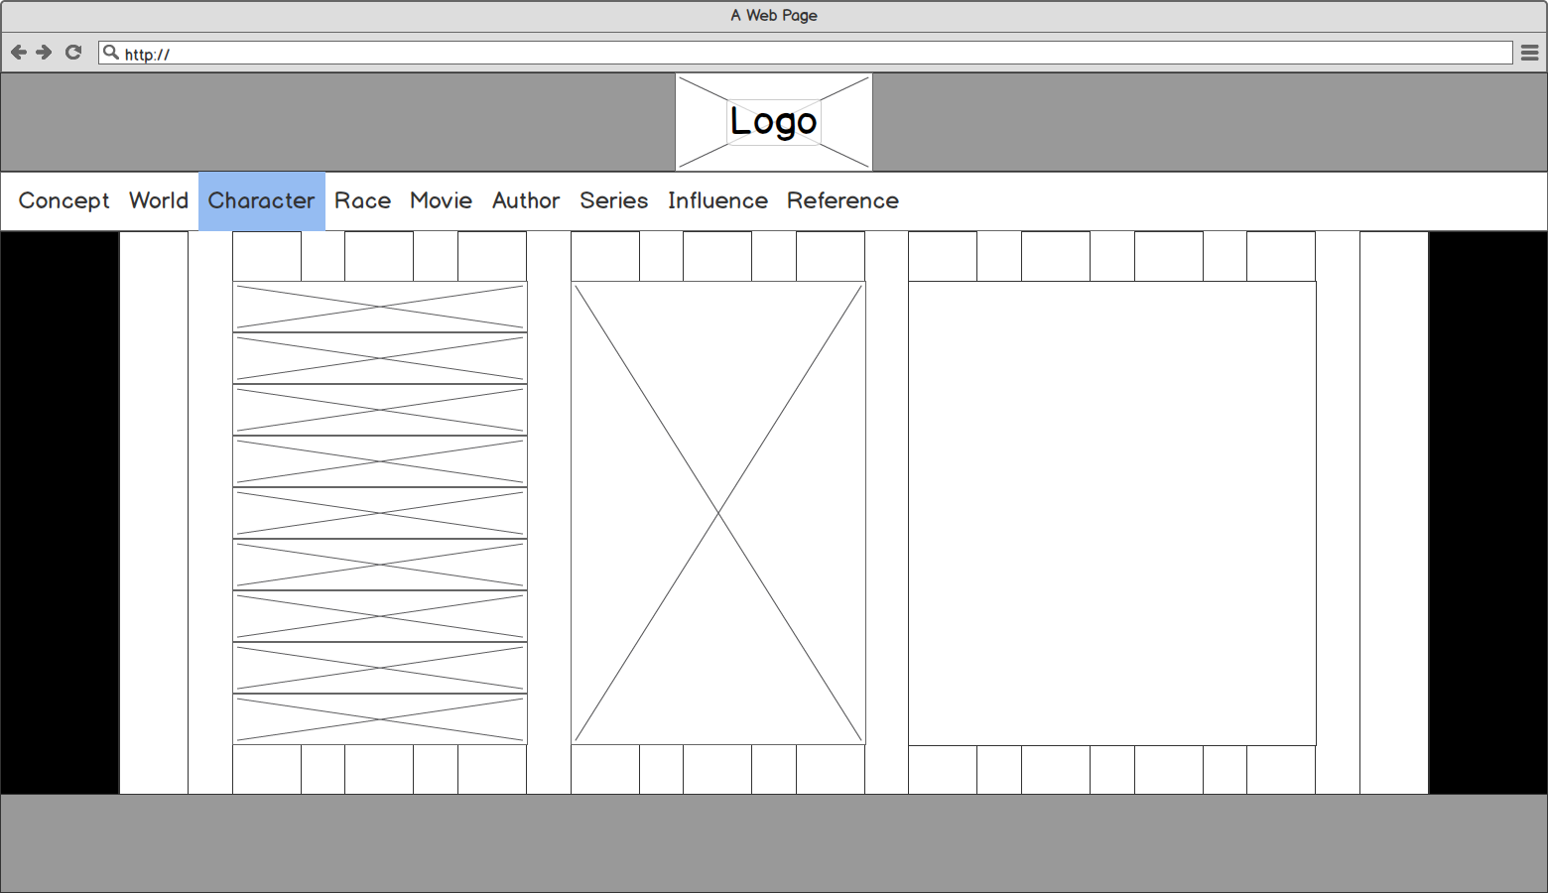

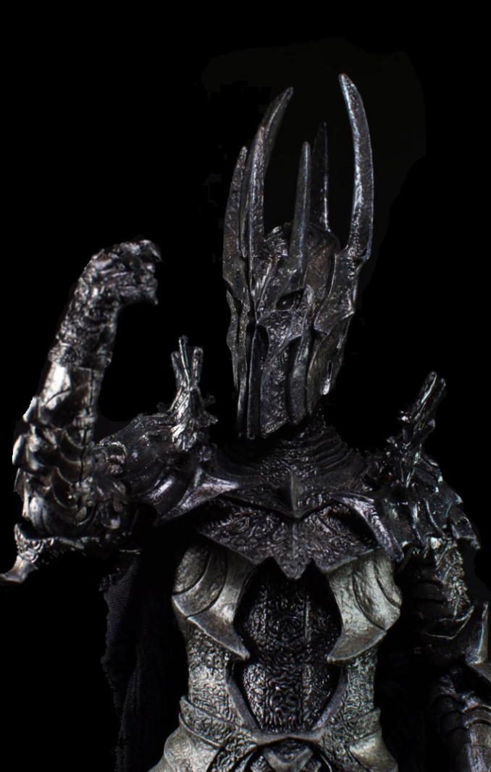








Concept World Characters Race Movie Author Series Influence Reference
Sauron
the reorganizing and rehabilitation of Middle-earth, 'neglected by the gods,' Sauron becomes a reincarnation of Evil, and a thing lusting for Complete Power", eventually rising to become "master and god of Men".
Gandalf deduced that the ring that Bilbo had found in Gollum's cave was indeed Sauron's lost Master-ring. He informed Frodo about the true nature of the heirloom Bilbo had left for him, and its terrible potential if Sauron should ever regain it: "The Enemy still lacks one thing to give him strength and knowledge to beat down all resistance, break the last defences, and cover all the lands in a second darkness. He lacks the One Ring... So he is seeking it, seeking it, and all his thought is bent on it."
Copyright @ created by BJ in 20170422 QAQ

Slide 7
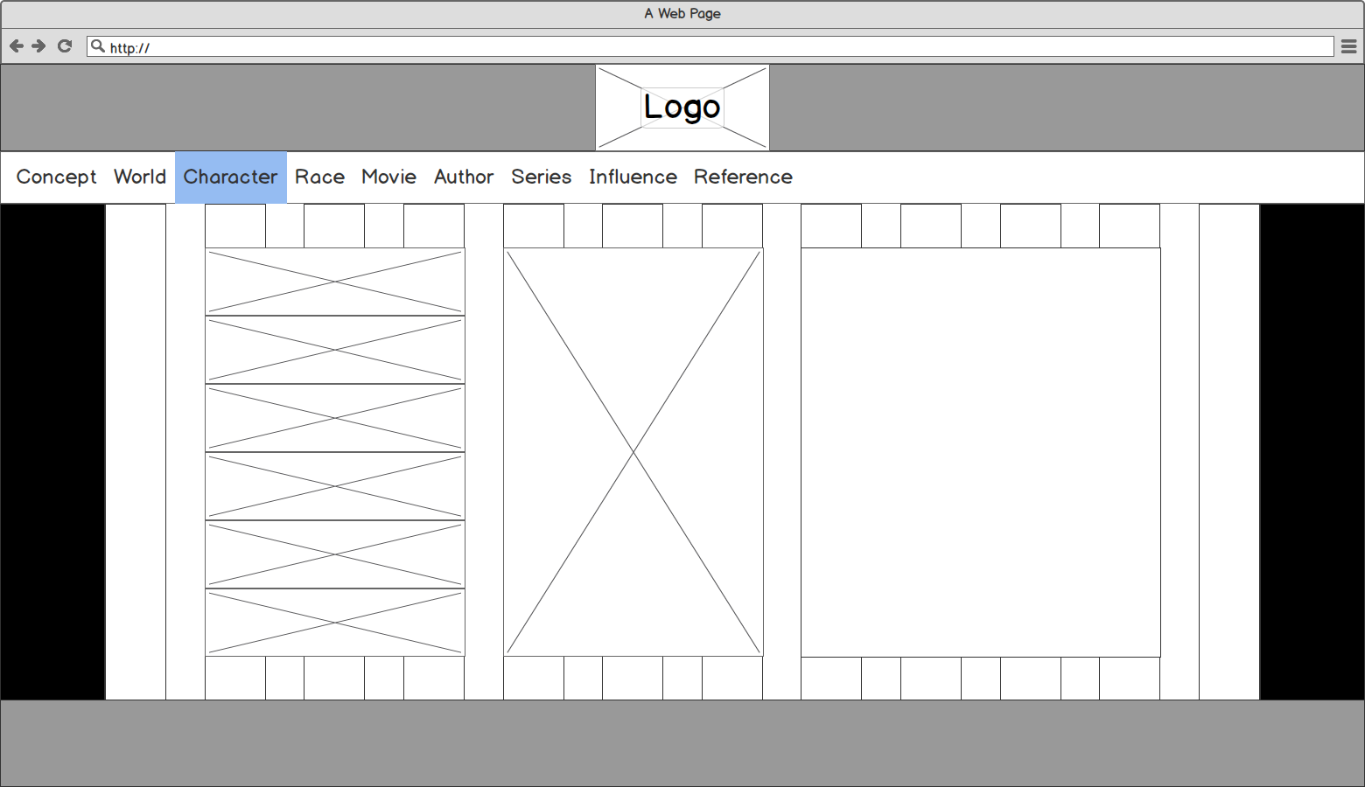

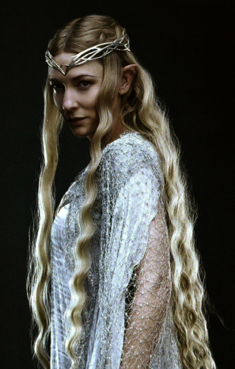
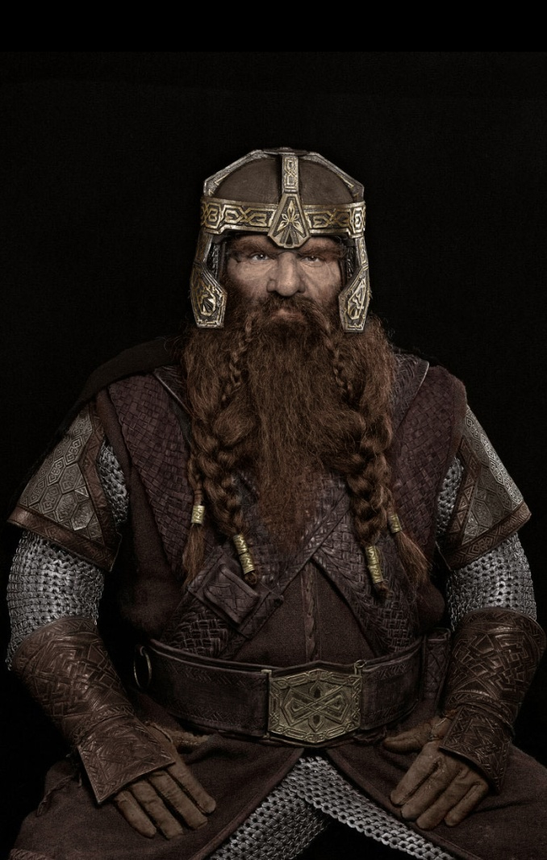





Concept World Characters Race Movie Author Series Influence Reference
Dwarves
The Dwarves are a race inhabiting Middle-earth. They are based on the dwarfs of Germanic myths: small humanoids that dwell in mountains, and are associated with mining, metal-craft and jewelry.
The Dwarves are described as shorter and stockier than Elves and Men, able to withstand both heat and cold. Though they are mortal, Dwarves have an average lifespan of 250 years.They breed slowly, for no more than a third of them are female, and not all marry; also, female Dwarves look and sound (and dress, if journeying—which is rare) so alike to Dwarf-males that other folk cannot distinguish them, and thus others wrongly believe Dwarves grow out of stone.Dwarves are great metalworkers, smiths and stoneworkers.
Copyright @ created by BJ in 20170422 QAQ

Slide 8
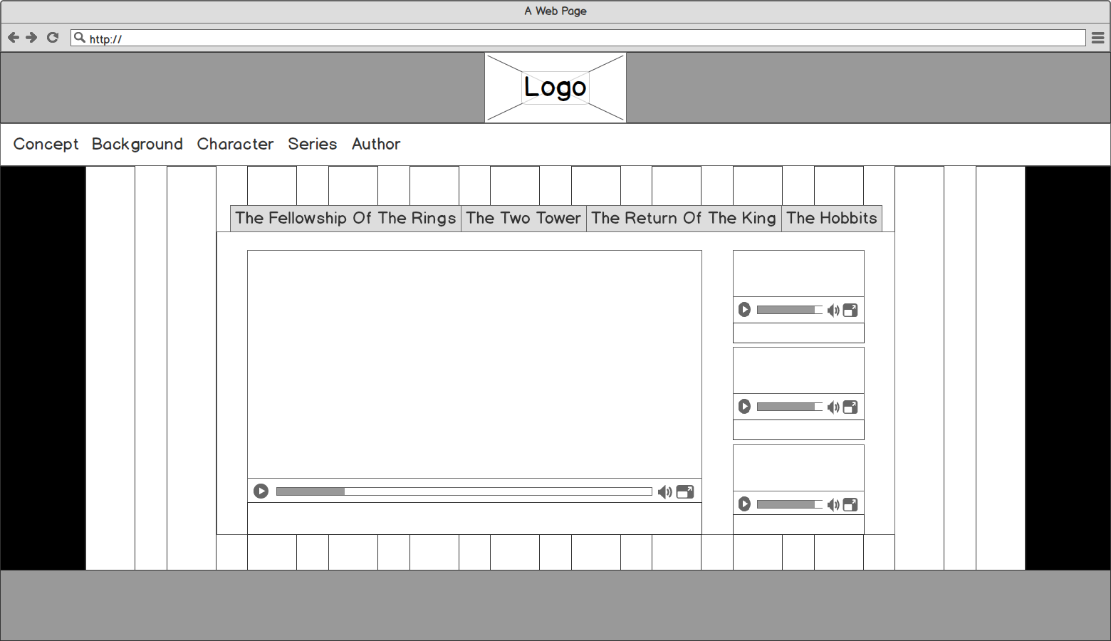
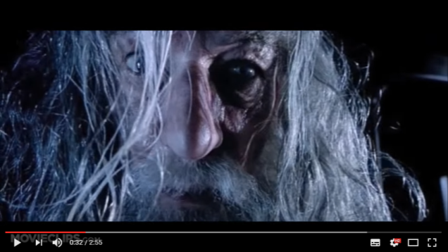


Concept World Characters Race Movie Author Series Influence Reference
The Fellowship Of The Ring
The Two Towers
The Return Of The King
The Hobbits
The Lord of the Rings: The Fellowship of the Ring Official Trailer #1 - (2001) HD
The Lord of the Rings: The Fellowship of the Ring Official Trailer #1 - (2001) HD
The Lord of the Rings: The Fellowship of the Ring Official Trailer #1 - (2001) HD
The Lord of the Rings: The Fellowship of the Ring Official Trailer #1 - (2001) HD
Copyright @ created by BJ in 20170422 QAQ

Slide 9
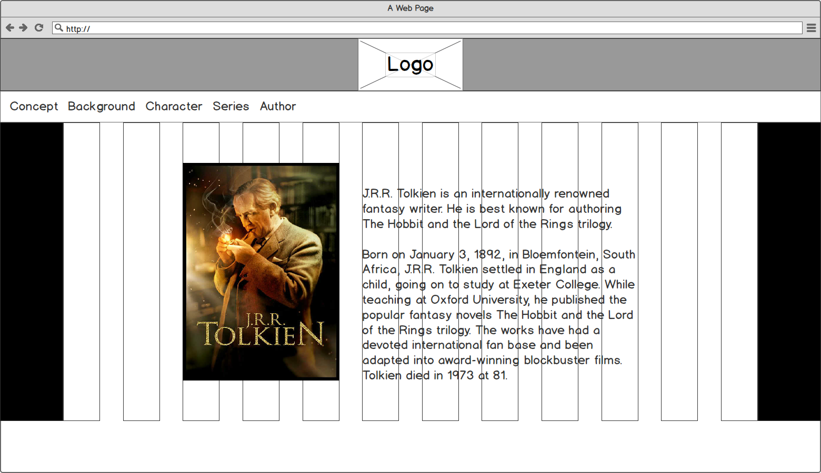
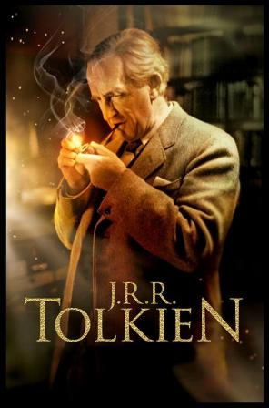
Concept World Characters Race Movie Author Series Influence Reference
John Ronald Reuel Tolkien
J.R.R. Tolkien is an internationally renowned fantasy writer. He is best known for authoring The Hobbit and the Lord of the Rings trilogy.
Born on January 3, 1892, in Bloemfontein, South Africa, J.R.R. Tolkien settled in England as a child, going on to study at Exeter College. While teaching at Oxford University, he published the popular fantasy novels The Hobbit and the Lord of the Rings trilogy. The works have had a devoted international fan base and been adapted into award-winning blockbuster films. Tolkien died in 1973 at 81.
Copyright @ created by BJ in 20170422 QAQ

Slide 10
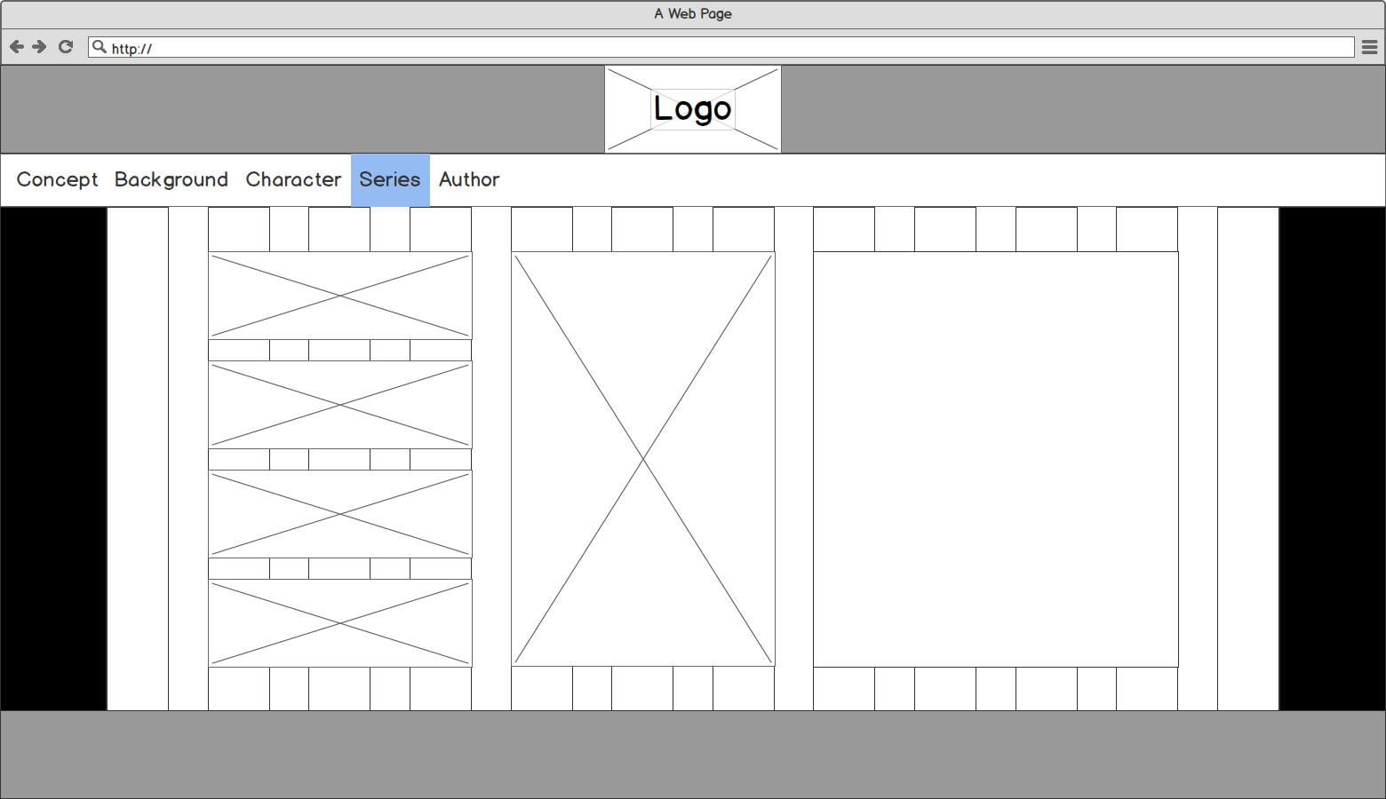
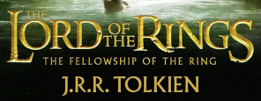
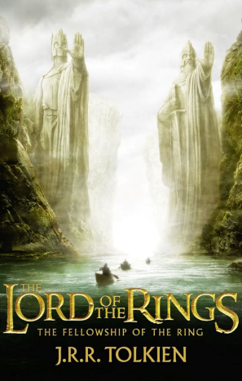
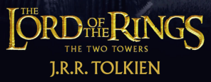
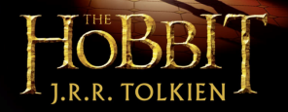
Concept World Characters Race Movie Author Series Influence Reference
The Fellowship Of The Ring
In the Second Age of Middle-earth, the Dark Lord Sauron forges the One Ring in Mount Doom to conquer all, abandoning a great part of his power to it in order to dominate, through it, at a distance, the other Rings of Power, which had been granted to lords of Elves, Dwarves and Men. An army of men and elves battle Sauron’s forces in Mordor, where Prince Isildur of Gondor cuts the One Ring off of Sauron's finger, thereby temporarily destroying his physical shape, and decides to take care of the Ring himself, but the evil influence of the Ring corrupts Isildur, preventing him from destroying it in Mount Doom. Isildur is later killed by Orcs, and the Ring is lost for 2,500 years, found and owned by Gollum for five centuries. The Ring is then found by a Hobbit named Bilbo Baggins.
Copyright @ created by BJ in 20170422 QAQ

Slide 11
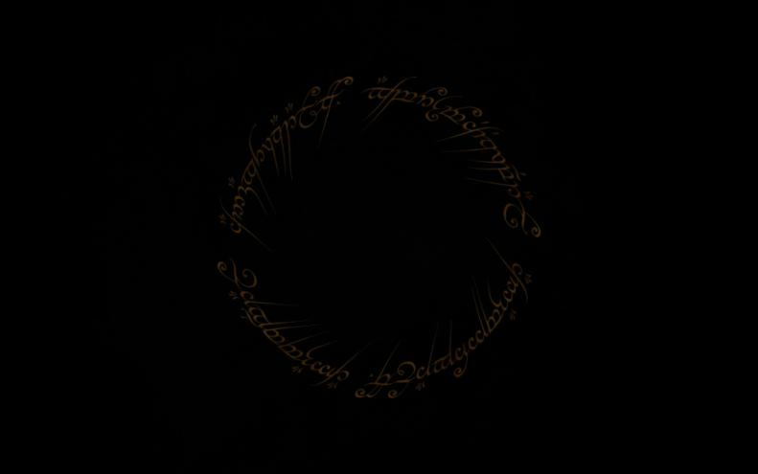
Concept World Characters Race Movie Author Series Influence Reference
Influence
The Lord of the Rings developed as a personal exploration by Tolkien of his interests in philology, religion (particularly Roman Catholicism), fairy tales, Norse and general Germanic mythology, and also Celtic,[better source needed] Slavic, Persian, Greek, and Finnish mythology. Tolkien acknowledged, and external critics have verified, the influences of George MacDonald and William Morris and the Anglo-Saxon poem Beowulf.The question of a direct influence of Wagner's The Nibelung's Ring on Tolkien's work is debated by critics.
Copyright @ created by BJ in 20170422 QAQ

