Slide 1
Introduce idea of recommender system – Matrix factorization
DATSET introduction
LABEL ENCODING
BASELINE MODDEL Walkthrough
Initial experimentation-Imbalance dataset, pseudo user, hyperparameter selection
Prediction based recommendation
Embedder based calculated recommendation
RNN sequential advance model and related story
Notes:
How many baseline users to skip
(Stabilizing the imbalance ratio)
Adding pseudo user
Formulation of recommender system
Trained Embedder matrix used
Cosine similarity- to determine association between users and items
User similarity based weights multiplied with item based weights to recommend new items to user

Slide 2

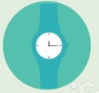


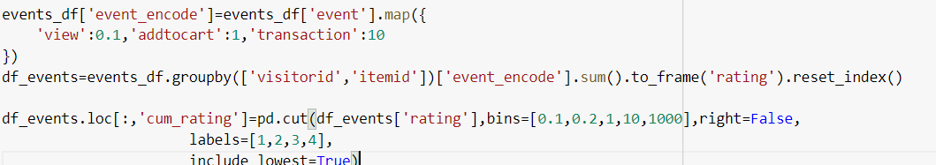


Experimentally determined encoding of combination/multiplicity of these events helped us formulate our target/objective
Cannot burden my customer with direct feedbacks
SO # of events is low
View, add_to_cart, transaction
Need to capture this behavioural trend

Slide 3
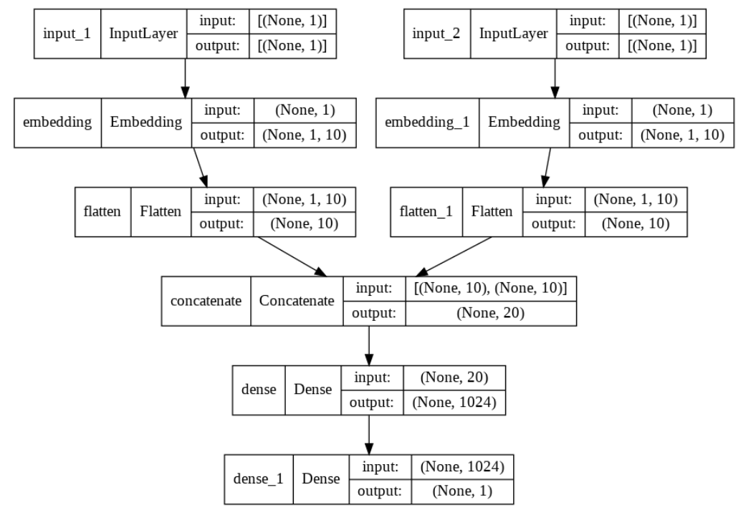

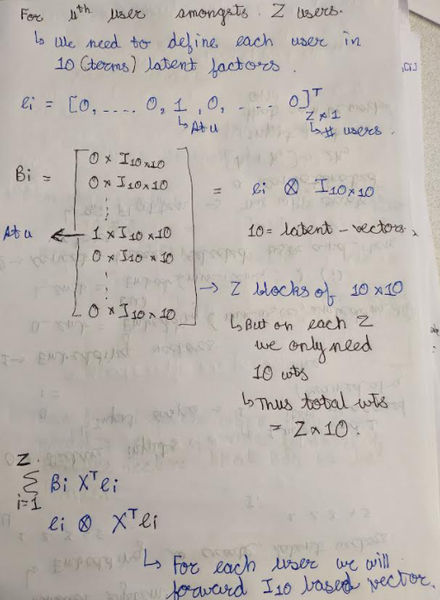
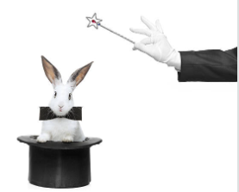
ARCHITECTURE of OUR BASIC MODEL
ITEM ID
- We will consider 1 item at a time
USER ID
Principles of matrix vectorization and Kronecker product employed
Idea of sequential vector strike
Creation of feature space
Pass on different set of vectors on each iteration but cache its updated value
Dense layer addition for training purposes
Output Value

Slide 4
EXPERIMENTATION

Slide 5
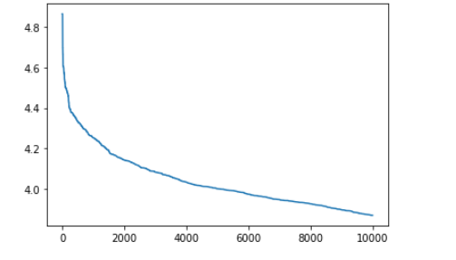
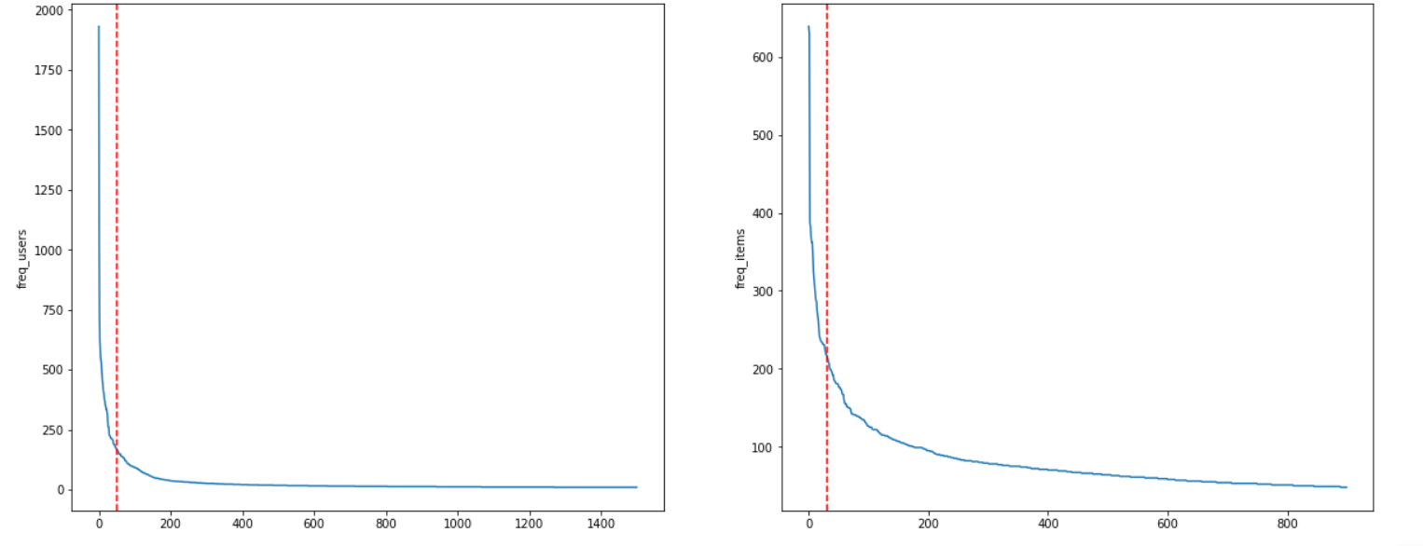
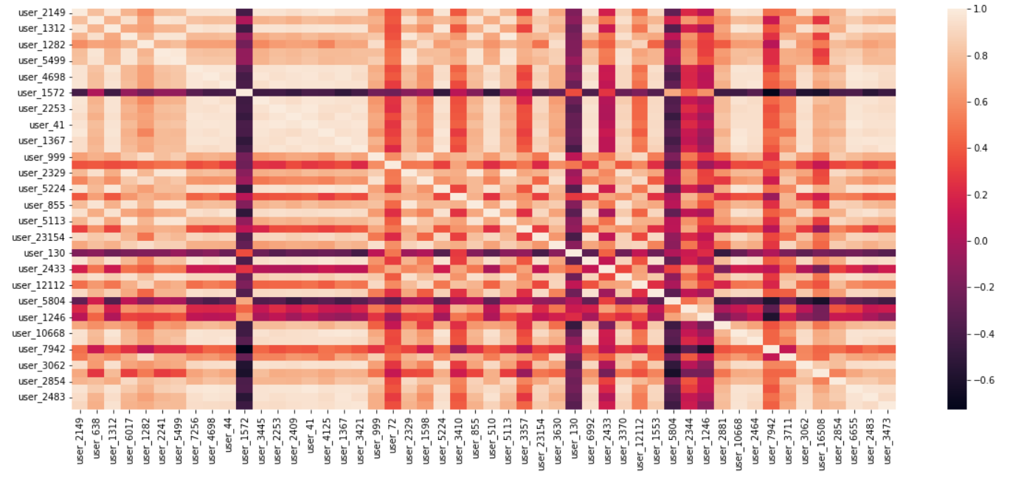
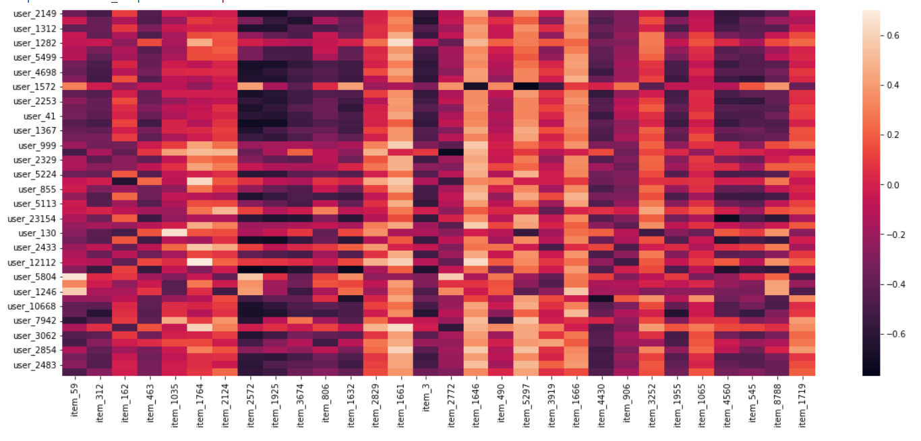
One straightforward way of user based prediction is to evaluate ratings for each item and then select from the sorted values
MANIPULATION OF EMBEDDER MATRIX
Sample set of 50 most active users along with 30 most used products
Can use more robust selection criterion
Each entity is explained in terms of 10 latent factors
A magnitude invariant cosine similarity score is computed for all pairs
Weighted multiplication of user-user and user-item similarity can help to formulate basic recommender system
Cosine similarity between users
-Determine un/associated users
-Encode similarity in behaviour to capture information about more indirect products
-Helps in determination of weights for upcoming item selection

Slide 6
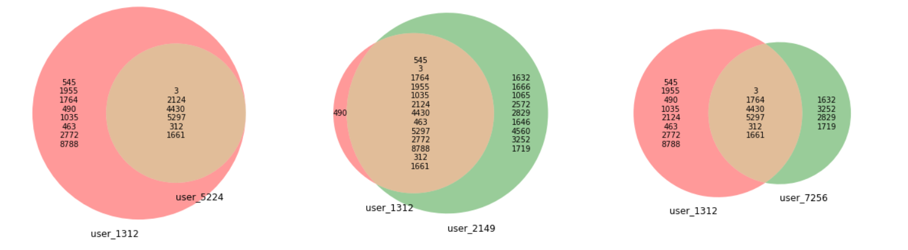
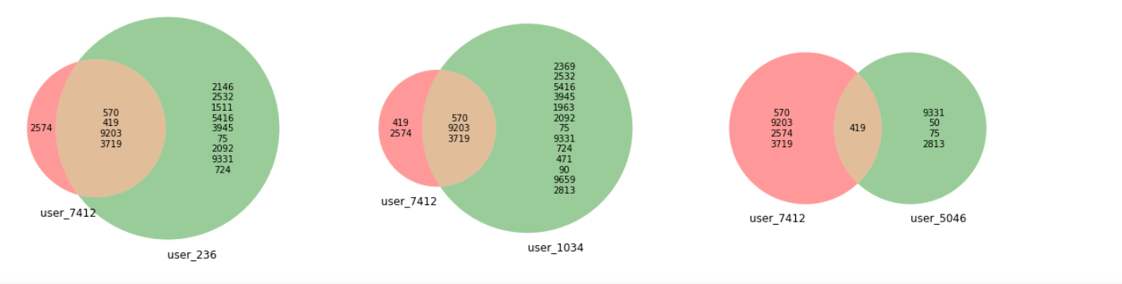
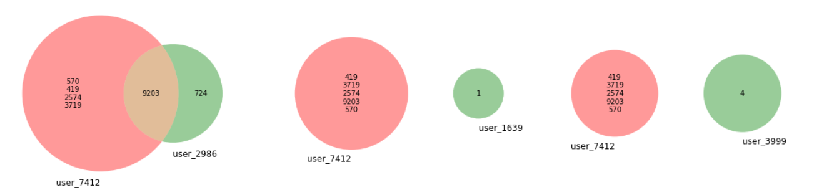
Item list of three most correlated users to user_1312
Every item will have degree of association with each other
Every user will have some affinity towards item
Combination of weights of two in a controlled manner can help us generate powerful recommender system
Item list of three most correlated users to user_7412
strongly Recommend product 75 and related products
AVOID recommending 1,4 and products related to them
Item list of three most non-correlated users to user_7412

