Slide 1

Group 8, Batch 2
Air Quality Prediction Using ML
Group Members:
Shravani Divate
Yash Gangamwar
Janhavi Gattani
Harshwardhan Singh Bhogal

Slide 2
Introduction
Air quality is a major concern in urban areas due to industrialization, population growth, and rising vehicle numbers.
Harmful pollutants like PM2.5, PM10, NO₂, and CO are increasing, impacting human health, especially in densely populated cities.
Real-time AQI monitoring and prediction help governments and individuals take proactive steps to reduce health risks.
Traditional AQI monitoring uses physical sensors and stations-accurate but costly, with limited coverage and no predictive capability.
Machine Learning (ML) offers a solution by modeling current air quality and forecasting future AQI using historical and environmental data.
This project explores various ML regression models to predict AQI values.

Slide 3
Problem Statement
Context: Air quality is a critical environmental factor affecting public health and urban planning. Accurate prediction of the Air Quality Index (AQI) is essential for timely interventions and public awareness.
Challenge: Traditional methods of AQI prediction may not account for the complex relationships between climate conditions and air quality, leading to less accurate predictions.
Solution: This project aims to leverage machine learning techniques to predict the AQI for the Mumbai region by analyzing historical climate data. By developing a robust predictive model, the project seeks to provide a reliable tool for monitoring and forecasting air quality, ultimately contributing to better environmental management and public health outcomes.

Slide 4
Project Objectives
Primary Goal: Develop a web application that accurately predicts the Air Quality Index (AQI) for the Mumbai region based on climate conditions.
Key Objectives:
Data Collection: Gather comprehensive climate data from 2013 to 2018 using web scraping techniques.
Data Preprocessing: Integrate scraped climate data with existing AQI data to create a unified dataset.
Data Cleaning: Ensure data quality by removing null values and improper data entries.
Model Development: Explore and implement various machine learning algorithms to find the best predictive model for AQI.
Model Deployment: Deploy the final model as a user-friendly web application using Flask and Heroku, allowing users to input climate conditions and receive AQI predictions.

Slide 5
The Data
Web Scraped data from https://en.tutiempo.net/ for climate data from 2013 to 2018.
The data that was scraped was then cleaned and combined into a new CSV file
Across all models, the preprocessing pipeline involved:
Handling missing values using imputation techniques.
Feature scaling and normalization where applicable.
One-hot encoding for categorical features like station names or cities
Splitting data into training and test sets (typically 80/20 or 70/30).
Environmental features like:
PM2.5, PM10
NO₂, CO, SO₂, NH₃, Benzene
Temperature, Humidity, Wind speed
were selected as predictors

Slide 6

The Data
T: Average temperature for a given period.
TM: Maximum temperature recorded during the period.
Tm: Minimum temperature recorded during the period.
SLP: Sea Level Pressure, indicating the atmospheric pressure at sea level.
H: Humidity, representing the amount of water vapor in the air.
VV: Visibility, indicating how far one can see clearly.
V: Wind speed, indicating how fast the wind is blowing.
VM: Maximum wind speed recorded during the period.

Slide 7
Different Models Tested
Linear Regression: A simple model that assumes a linear relationship between the input features and the target variable (AQI). It was used as a baseline to compare the performance of more complex models.
Lasso Regression: An extension of linear regression that includes a regularization term to prevent overfitting. It helps in feature selection by penalizing the absolute size of the regression coefficients.
Ridge Regression: Similar to Lasso, Ridge regression also includes a regularization term but penalizes the squared size of the coefficients. It is useful for dealing with multicollinearity in the data.
Decision Tree Regressor: A non-linear model that splits the data into subsets based on the value of input features. It is easy to interpret and can capture complex relationships in the data.
Random Forest Regressor: An ensemble learning method that constructs multiple decision trees and outputs the mean prediction of the individual trees. It improves accuracy and helps in reducing overfitting.
XGBoost Regressor: A gradient boosting framework that is known for its performance and speed. It builds trees sequentially, where each new tree corrects the errors made by the previous ones, leading to a robust model.

Slide 8
Model Evaluation
Mean Squared Error (MSE): Measures the average squared difference between the predicted and actual values. Lower values indicate better model performance.
A lower MSE indicates better model performance. It helps to penalize large errors more heavily, which is useful when you want to minimize large mistakes.
Root Mean Squared Error (RMSE): The square root of MSE, providing an interpretable measure of the average error in the same units as the target variable.
RMSE gives you a sense of how far, on average, the model’s predictions are from the actual values. Like MSE, it penalizes larger errors but in the same units as the target.
R-squared (R²): Indicates the proportion of variance in the dependent variable that is predictable from the independent variable(s). Higher values (closer to 1) indicate a better fit.

Slide 9
Model Performance Summary
MODEL | R2 SCORE | MEAN ABSOLUTE ERROR | RMSE
LINEAR REGRESSION | ~0.78 | MODERATE | HIGH
DECISION TREE | ~0.88 | LOWER THAN LR | MEDIUM
RANDOM FOREST | ~0.95 | LOWEST | LOWEST
XGBOOST | 0.93 | VERY LOW | LOW
RIDGE/LASSO | 0.80 | SLIGHTLY BETTER THAN LR | HIGH

Slide 10
Web Application
User Interface: The web application features a clean and intuitive user interface designed to facilitate easy interaction. It includes input fields for users to enter climate conditions such as temperature, humidity, wind speed, and other relevant parameters.
Input Data:
Temperature (T): Average temperature for the period.
Maximum Temperature (TM): Highest temperature recorded.
Minimum Temperature (Tm): Lowest temperature recorded.
Sea Level Pressure (SLP): Atmospheric pressure at sea level.
Humidity (H): Amount of water vapor in the air.
Visibility (VV): How far one can see clearly.
Wind Speed (V): Speed of the wind.
Maximum Wind Speed (VM): Highest wind speed recorded.
Users can click the "Submit" button to receive the predicted Air Quality Index (AQI).

Slide 11
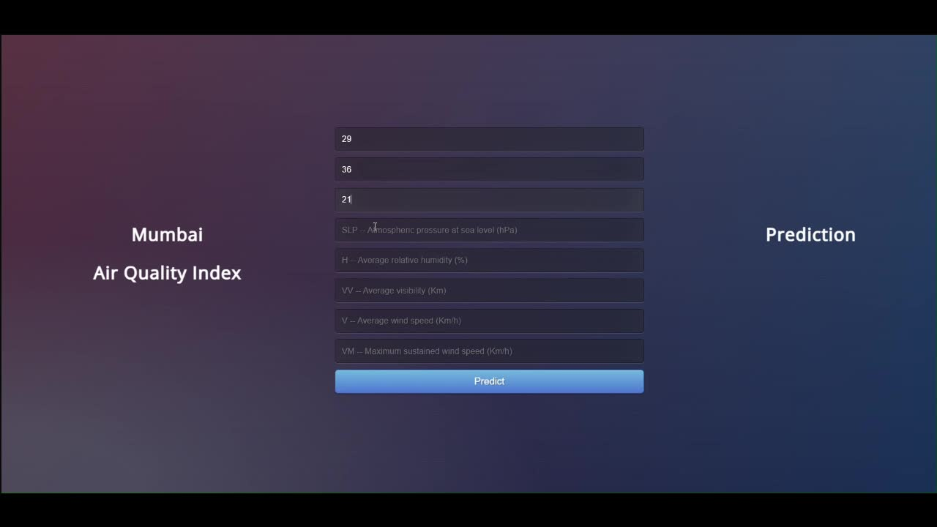
Web Application (demo)

Slide 12
Conclusion
Key Points of the Project:
The project successfully developed a web application to predict the Air Quality Index (AQI) for the Mumbai region using climate data.
Various machine learning models were explored, with the Random Forest Regressor emerging as the most effective in terms of accuracy and performance.
The application provides a user-friendly interface for inputting climate conditions and receiving immediate AQI predictions, making it accessible to a wide audience.
Importance of the Work:
Accurate AQI predictions are crucial for public health and environmental management, allowing for timely interventions and informed decision-making.
This project contributes to the broader goal of improving air quality monitoring and awareness, ultimately leading to better health outcomes for the community.

Slide 13
Thank you

