Slide 1




Behavior Metrics For Prioritizing Investigations of Exceptions
Zack Coker, Kostadin Damevski, Claire Le Goues, Nicholas A. Kraft,
David Shepherd, and Lori Pollock

Slide 2
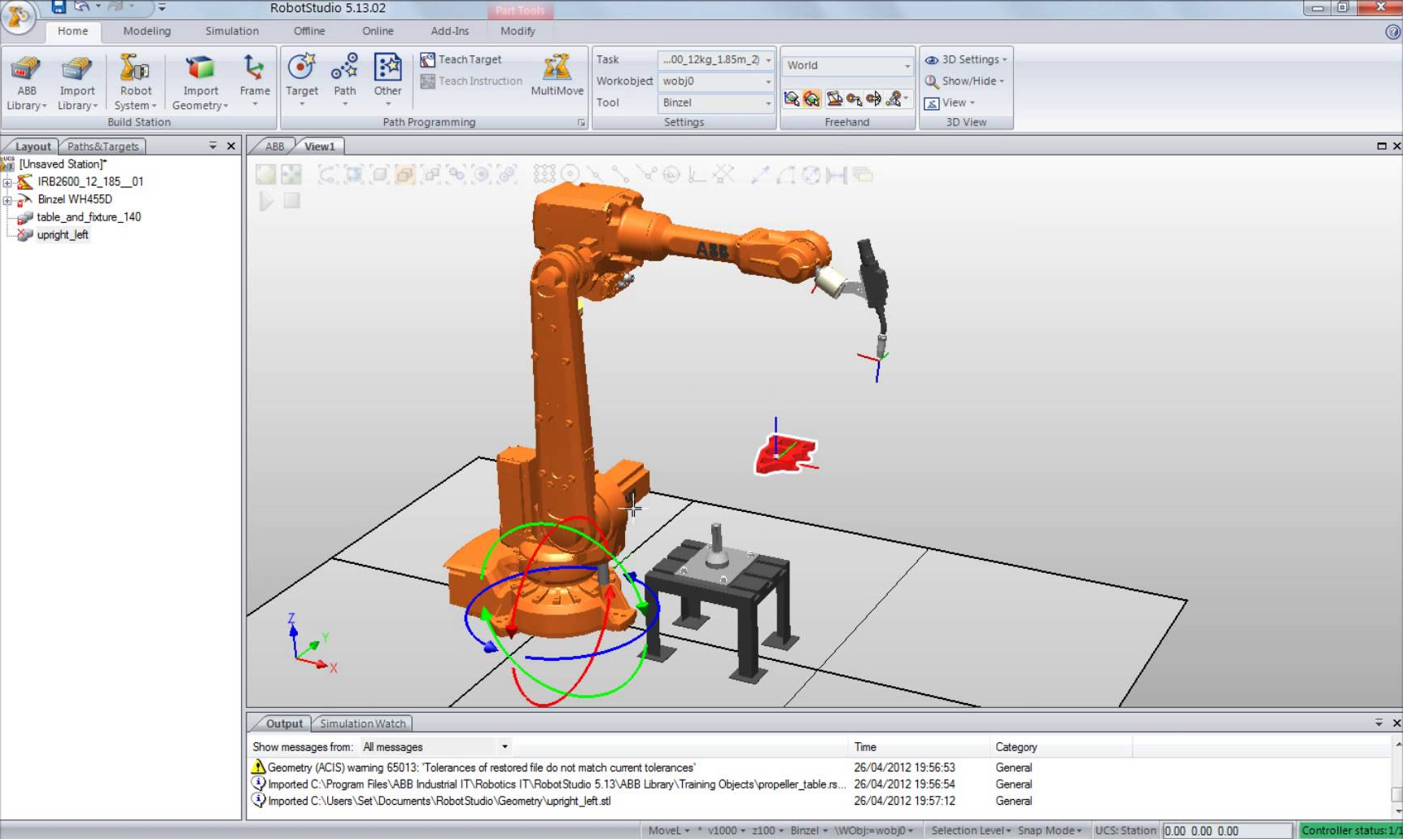
RobotStudio

Slide 3
Sample log file with an exception
OnlineControllerRemove
AddVirtualController
Exception|Services.RobApi.RobApiException
----EXCEPTION BEGIN----
at System.Runtime.CompilerServices.CompilerServices.TaskAwaiter
.ThrowForNonSuccess(Task task)
----EXCEPTION END----
AddedController
VirturalFlexPendant
RapidEditorShow

Slide 4
ABB developers previously prioritized exceptions using measures of exception frequency
Number of exception instances
Number of users affected

Slide 5
The old metrics do not take into account the user inconvenience caused by an exception
‘Input string not in the correct format’ exception may affect many users but many not have a significant effect on user experience

Slide 6
The old metrics do not take into account the user inconvenience caused by an exception
‘Input string not in the correct format’ exception may affect many users but many not have a significant effect on user experience
We created behavior metrics, which are designed to estimate user inconvenience caused by exceptions.

Slide 7
Behavior patterns in the study
Single Restart
Multiple Restarts
Repeat Action
Repeat Exception
Similar Exceptions

Slide 8
Behavior patterns in the study
Single Restart
Single Restart
Multiple Restarts
Repeat Action
Repeat Exception
Similar Exceptions
ResetConveyor
Exception|TargetInvocationException
----BEGIN EXCEPTION----
System.invokeMethod(Method m)
----END EXCEPTION----
----LOG END----

Slide 9
Behavior patterns in the study
Single Restart
Multiple Restarts
Repeat Action
Repeat Exception
Similar Exceptions
ResetConveyor
Exception|TargetInvocationException
----BEGIN EXCEPTION----
System.invokeMethod(Method m)
----END EXCEPTION----
----LOG END----
----LOG BEGIN----
----LOG END----
Multiple Restarts

Slide 10
Behavior patterns in the study
Single Restart
Multiple Restarts
Repeat Actions
Repeat Exception
Similar Exceptions
ResetConveyor
Exception|TargetInvocationException
----BEGIN EXCEPTION----
System.invokeMethod(Method m)
----END EXCEPTION----
ResetConveyor
Repeat Action

Slide 11
Behavior patterns in the study
Single Restart
Multiple Restarts
Repeat Actions
Repeat Exception
Similar Exceptions
ResetConveyor
Exception|TargetInvocationException
----BEGIN EXCEPTION----
System.invokeMethod(Method m)
----END EXCEPTION----
ControllerRequestWriteAccess
Exception|TargetInvocationException
----BEGIN EXCEPTION----
System.invokeMethod(Method m)
----END EXCEPTION----
Repeat Exception

Slide 12
Behavior patterns in the study
Single Restart
Multiple Restarts
Repeat Actions
Repeat Exception
Similar Exceptions
ResetConveyor
Exception|TargetInvocationException
----BEGIN EXCEPTION----
System.invokeMethod(Method m)
----END EXCEPTION----
ControllerRequestWriteAccess
Exception|TargetInvocationException
----BEGIN EXCEPTION----
System.createInstance(Instance i)
----END EXCEPTION----
Similar Exceptions

Slide 13
We verified the behavior metrics through a survey of ABB RobotStudio developers
The survey was designed to determine if the behavior metrics were useful when prioritizing exceptions
Contacted 12 developers of RobotStudio at ABB and asked them to take a survey
Survey consisted of 12 exceptions from log files covering a 6 month period

Slide 14
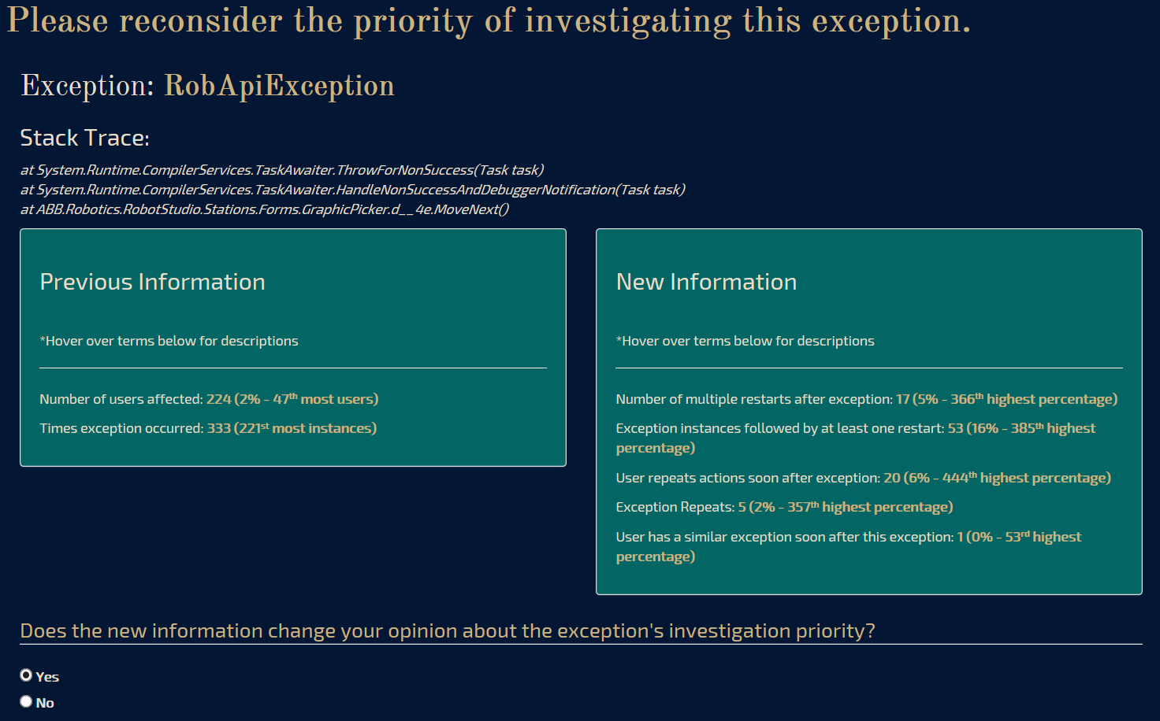

Slide 15
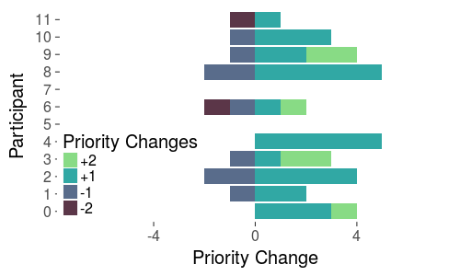
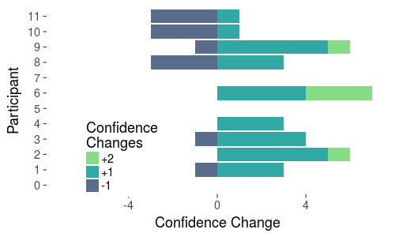
Participants changed their priority 30.6% (44/144) of the time after accounting for the behavior metrics

Slide 16
No priority changes were due to new metrics reinforcing old or information in stack traces
For 67 out of 100 no priority changes were because participants felt that the new information reinforced their original assessment
22 of the 100 were because of information in the exception type and stack traces, which the metrics did not take into account
“NullReference exceptions are always programming errors and should be fixed immediately”

Slide 17
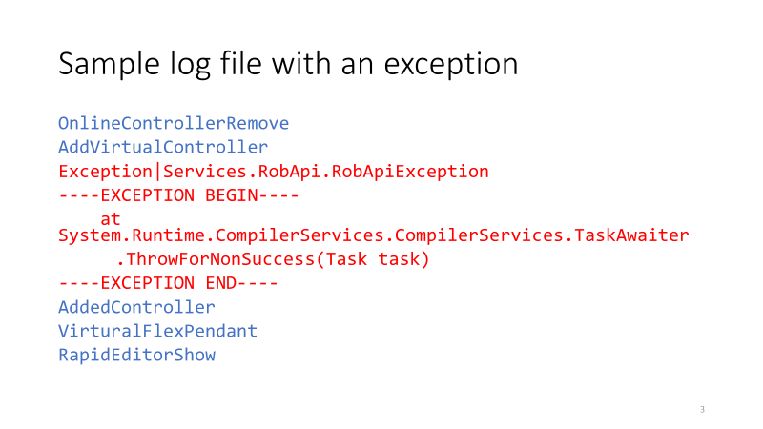
Questions

Slide 18
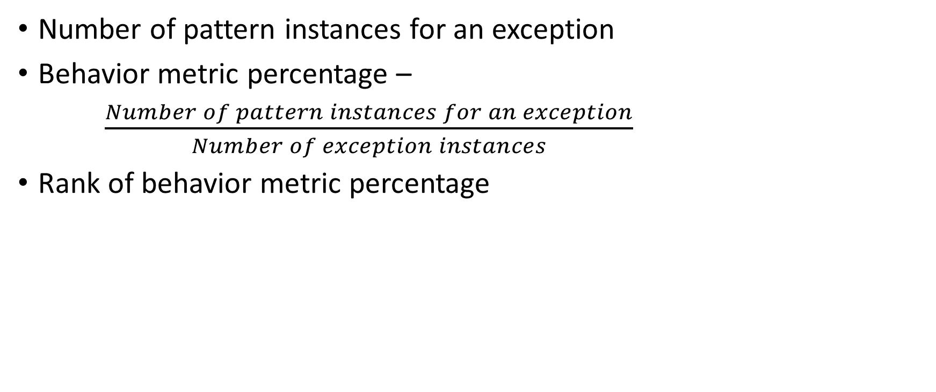
Behavior Metrics
Number of pattern instances for an exception
Behavior metric percentage –
$\frac{Number of pattern instances for an exception}{Number of exception instances}$
Rank of behavior metric percentage

