Slide 1
Evaluating the Flexibility of the Java Sandbox
By: Zack Coker, Michael Maass, Tianyuan Ding, Claire Le Goues, and Joshua Sunshine
Notes:
Maybe add a basic description of the sandbox before the motivation section. And then motivate the study more instead of the tool. Why do we want to see if people are using the sandbox correctly?
At some point, go back through slides and remove unnecessary titles

Slide 2
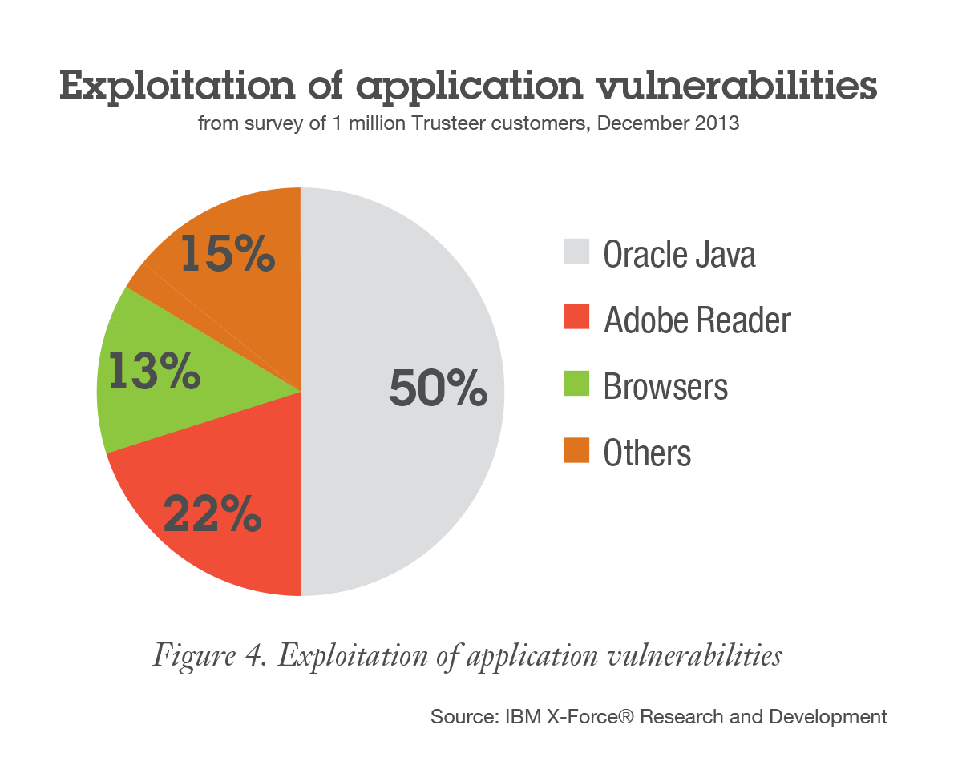
Motivation
Kaspersky Security Bulletin 2014
Notes:
This side should hint at what you want messages you want to get across to the audience, or you should break it into another slide which covers the benefits of our approach (mabye new slide 4). Consider the headlines from a previous presentation.

Slide 3

Java Sandbox
Untrusted Java Applications
Notes:
But Java has a sandbox to encapsulate untrusted applications from the rest of the computer

Slide 4
How is the Java sandbox actually used?
Li Gong, the primary designer of the Java
security architecture stated he didn’t know how extensively the “fined grained access control mechanism” (i.e. the Java sandbox) is used.
[ACSAC 2009 Keynote]

Slide 5
Importance of investigating how security tools are used in practice
Design more intuitive security mechanisms
Possible language features
Differentiate between malicious and benign code

Slide 6
Sandbox Example
Sandboxed
Application
Socket
connect(“internal.auth:80”)
checkConnect(“internal.auth”, 80)
SecurityManager
checkPermission(...)
Policy
AccessController
implies(...)
Allowed?


✗SecurityException
✓ Do Nothing

Slide 7
Turn off Sandbox Example
Sandboxed
Application
System.setSecurityManager(null)
Allowed?


✗SecurityException
Sandbox
Removed

Slide 8
Study
In this work, we investigated how benign open source Java programs interact with the Java sandbox to:
Characterize sandbox interactions
Detect malicious applications
Understand developer difficulties with the sandbox
Notes:
May need to change the last bullet later

Slide 9
Research Question
How do benign open source Java applications interact with the security manager?

Slide 10
Possible Answers
Four non-disjoint possibilities for all benign applications:
Benign applications never disable the security manager.
Benign applications never weaken a set security manger
Benign applications do not change a set security manager
Benign applications never modify the security manager if a self protecting security manager is set.

Slide 11
Not Self-protecting Permissions
Risky Permissions
RuntimePermission(“setSecurityManager")
ReflectPermission(“suppressAccessChecks")
RuntimePermission(“createClassLoader")
SecurityPermission(“setPolicy")
FilePermission(“<<ALL FILES>>", “write, execute")
RuntimePermission(“accessClassInPackage.sun")
SecurityPermission(“setProperty.package.access")

Slide 12
Methodology
Collect large corpus of benign Java applications that use or interact with the security manager.
Static analysis to trace where the Security Manager was set and initialized
Manual code inspection (two annotators, check for agreement).
Dynamic Analysis to verify sandbox interactions
Goal: completely understand how benign applications interact with the security manager.
Notes:
Say rigorous

Slide 13

Qualitas Corpus
Notes:
Qualitas Corpus: 24 out of 112 Programs

Slide 14
Security Manager Interaction Classification
Type of Benign Interaction | Qualitas Corpus | GitHub | Total
Sets a self-protecting manager | 6 | 1 | 7
Changes set manager | 5 | 3 | 8
Supports being sandboxed | 10 | 3 | 13
Interacts only in unit tests | 3 | 5 | 8
28/36 (78%) never change the sandbox settings once the settings are initially set

Slide 15
Possible Answers
Four Possibilities:
Benign applications never disable the security manager.
Benign applications never weaken a set security manger
Benign applications do not change a set security manager
Benign applications never modify the security manager if a self protecting security manager is set.

Slide 16
Research Question Evaluation
Benign applications do disable the security manager.
Benign applications do weaken a set security manger
Benign applications do change a set security manager
Benign applications never modify the sandbox if a self protecting security manager is set.

Slide 17

Examples of Disabling the Security Manager
package jtimelag; public class JTimelag { public static void main(String[] args) {
System.setSecurityManager(null);
Fenetre fen = new Fenetre(); fen.setVisible(true); } }
Notes:
Make diagram for system.exit

Slide 18

Not Sandboxed Requirement
"//TODO Hack so that when the classloader loading the fwk is created we don't have funny permissions. This should be revisited."
[ ]

Slide 19
Eclipse
JVM

Slide 20
Eclipse
Ant
JVM

Slide 21
Enforcing Architectural Constraints
Eclipse
System.exit()
Ant
JVM

Slide 22


Weakening the Security Manager?
Permission List
Forbidden
List
vs.
Notes:
Using the sandbox as a blacklist instead of a whitelist (stating what is allowed instead of what is not allowed). Look up what Freemind allowed or didn’t allow.

Slide 23
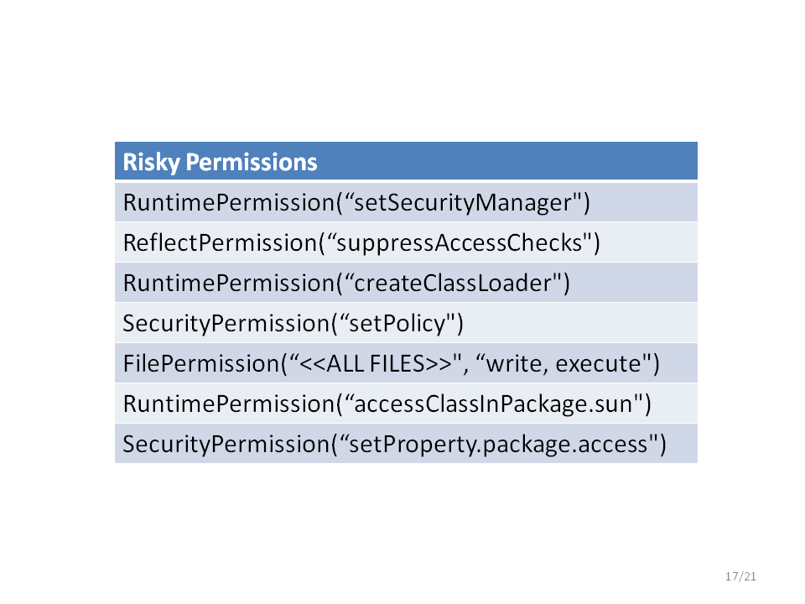
<permissions>
<grant class=”java.security.AllPermission”/>
<revoke class=“java.util.PropertyPermission”/>
<permissions>
[https://ant.apache.org/manual/Types/permissions.html]

Slide 24
Takeaways from empirical study
Applications interact with the sandbox for non security related reasons
Harder to design exploit mitigations
Sandbox complexity and flexibility leads to insecurity
A majority of applications in the dataset (78%) never change the security manager if a self-protecting security manager is set

Slide 25
Empirical validation
Can we differentiate benign and malicious applications?

Slide 26
Detection Rules
Privilege Escalation Rule: If a self-protecting security manager is set, a class cannot load a more privileged class.
Security Manager Rule: Once a self-protecting security manager is set, the manager cannot change

Slide 27
Validation Results
CVE-ID | Privilege Escalation | Security Manager
2011-3544 | Attack Succeeded | Attack Blocked
2012-0507 | Attack Blocked | Attack Blocked
2012-4681 | Attack Succeeded | Attack Blocked
2012-5076 | Attack Succeeded | Attack Blocked
2013-0422 | Attack Blocked | Attack Blocked
2013-0431 | Attack Blocked | Attack Blocked
2013-1488 | Attack Succeeded | Attack Blocked
2013-2423 | Attack Succeeded | Attack Blocked
2013-2460 | Attack Blocked | Attack Blocked
2013-2465 | Attack Succeeded | Attack Blocked
Notes:
Say to exlude JNTI exploits

Slide 28
Conclusion – Importance of Investigating Security Tools
Improve security mechanisms: Java’s flexibility and complexity leads to misuse.
Possible language features: People use the security manager for non-security reasons, such as preventing sub-applications from exiting; Java would benefit from supporting these features separately.
Differentiate malicious and benign code: a language-level tool that notices when privilege escalation/weakening of security manager occurs could catch future exploits.

Slide 29
Motivation
Kaspersky Security Bulletin 2014
Average cost of data breach for a company: $3.5 million – Ponemon Institute (2014)
Notes:
This side should hint at what you want messages you want to get across to the audience, or you should break it into another slide which covers the benefits of our approach (mabye new slide 4). Consider the headlines from a previous presentation.

Slide 30
Java Exploits
First find a vulnerable entry point
Compromise system security
Turn off the sandbox
System.setSecurityManager(null)
Notes:
Change this to pictures later. This is just an outline at the moment

Slide 31

Backwards Compatibility Tests
6 Java Web Start applications
Notes:
Dacaop contains 14 programs

Slide 32
System.setSecurityManager(new
AntSecurityManager (originalSM,
Thread.currentThread()));
703 // ... execute Ant ...
723 finally {
724 // ...
725 if (System.getSecurityManager() instanceof
AntSecurityManager ) {
726 System.setSecurityManager(originalSM);
727 }
Notes:
Replace with diagram for System.exit behavior

Slide 33
Importance of investigating how security tools are used in practice
Design more intuitive security mechanisms
Possible language features
Differentiate between malicious and benign code

Slide 34


Slide 35
Conclusion
Developers use the sandbox for many reasons, not all security related
Harder to design exploit mitigations
Sandbox complexity and flexibility leads to insecurity
Applications which set a self-protecting security manager can be further protected

Slide 36
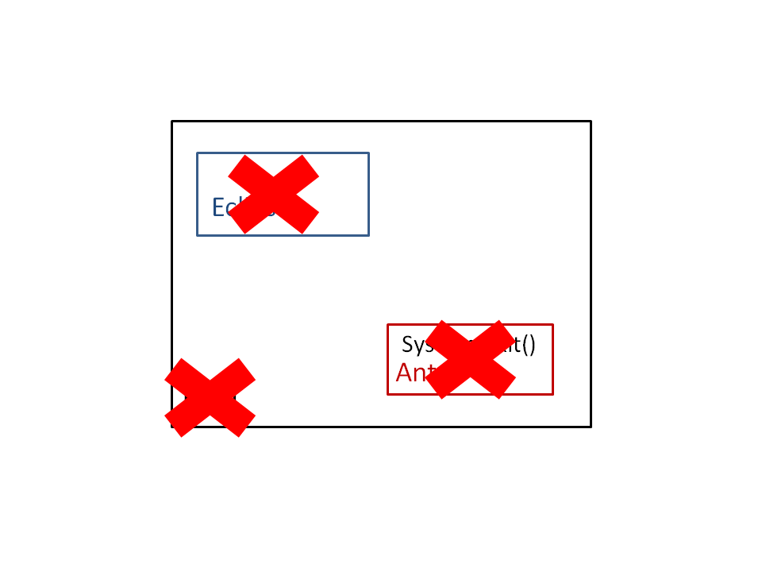
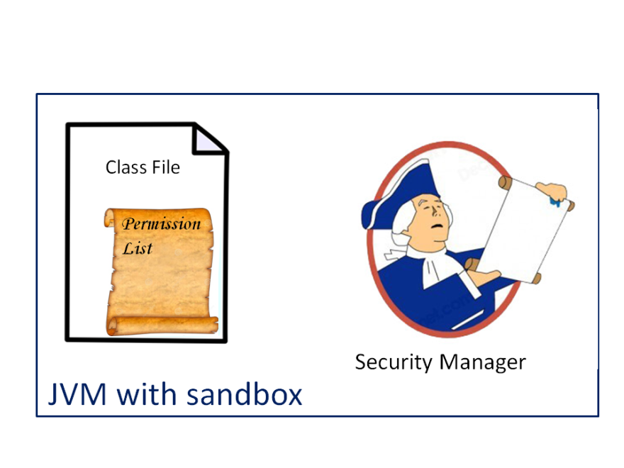
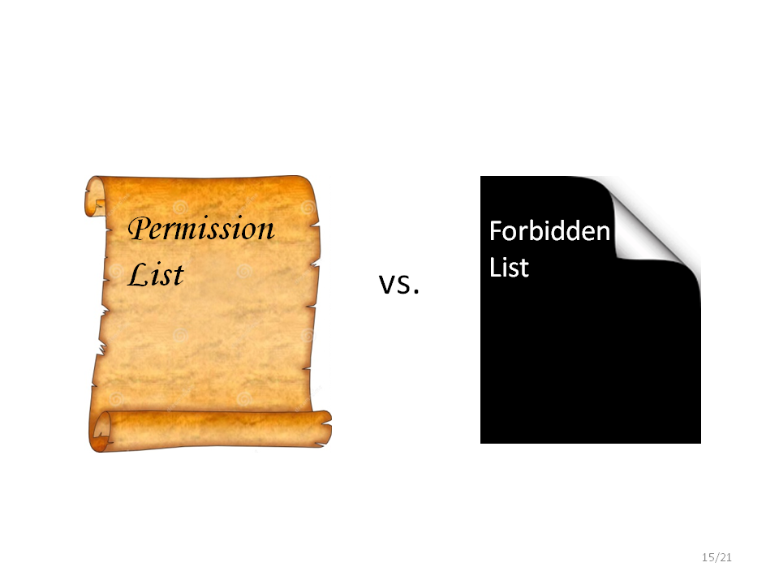

Slide 37


Jar File
Permission List
Security Manager
JVM with sandbox
Notes:
Emphasize the Security Manager!!!

