Slide 1
SASS: Self-Adaptation using Stochastic Search
Zack Coker, David Garlan,
Claire Le Goues
School of Computer Science
Carnegie Mellon University
Notes:
Hello, my name is Zack Coker and I’ll be presenting SASS: Self-Adaptiation using Stochastic Search.
https://www.hpi.uni-potsdam.de/giese/public/selfadapt/exemplars/
Position Paper accepted to SEAMS 2015 (10th International Symposium on Software Engineering for Adaptive and Self-Managing Systems)

Slide 2

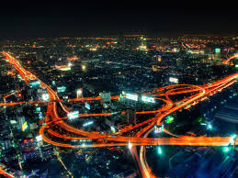
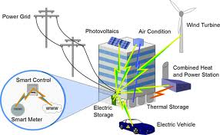

Smart Grids
Smart Traffic Systems
Smart Buildings
Smart Farms
Notes:
The goal is to get the vision of big problems into the audience’s head, not really focus on DARPA’s achievements.

Slide 3
Stochastic Search
Deterministic
Stochastic
Goal
Already Searched

Slide 4
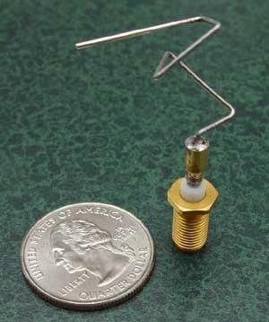
Stochastic Search
Notes:
Stochastic Search is composed of search techniques which use randomness to explore the search space, such as genetic programming, hill climbing, simulated annealing, and ant colony optimization. There has been a lot of recent interest in applying stochastic techniques to self-adaptive systems but we believe there is greater use for these techniques than has been presented in recent work. Specifically, we believe that stochastic techniques provide a promising solution to a goal of SEAMS, which is to scale to self-adaptive systems with a large number of inter-related tactics. Due to combinatorial explosion in these situations, creating recovery plans can become a challenge. We believe stochastic techniques provide a promising solution to this problem and demonstrate a solution with 3 example expirements.

Slide 5

Goal
Already Searched

Slide 6
Stochastic Search
B. H. C. Cheng, A. J. Ramirez, and P. K. McKinley, “Harnessing evolutionary computation to enable dynamically adaptive systems to manage uncertainty”
G. G. Pascual, M. Pinto, and L. Fuentes, “Run-time adaptation of mobile applications using genetic algorithms”
P. Zoghi, M. Shtern, and M. Litoiu, “Designing search based adaptive systems: A quantitative approach”
M. Harman, Y. Jia, W. B. Langdon, J. Petke, I. H. Moghadam, S. Yoo, and F. Wu, “Genetic improvement for adaptive software engineering (keynote)”

Slide 7
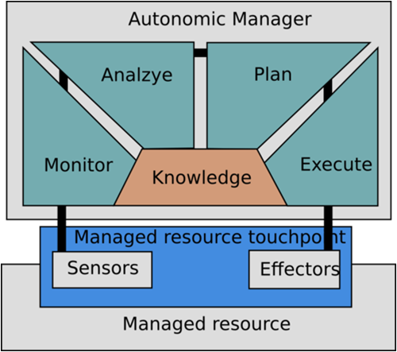
Self-Adaptive System
Notes:
I do agree, however, that the problem of searching multi-dimensional adaptation spaces in the presence of multiple, qualitative, and inter-dependent qualities is a central problem for SEAMS and that stochastic search techniques is a promising option

Slide 8
Self-Adaptive System
Offline
Runtime
Notes:
I do agree, however, that the problem of searching multi-dimensional adaptation spaces in the presence of multiple, qualitative, and inter-dependent qualities is a central problem for SEAMS and that stochastic search techniques is a promising option

Slide 9
Self-Adaptive System
Offline
Runtime
Notes:
I do agree, however, that the problem of searching multi-dimensional adaptation spaces in the presence of multiple, qualitative, and inter-dependent qualities is a central problem for SEAMS and that stochastic search techniques is a promising option

Slide 10
Requirements for Stochastic Techniques
Possible Solution Creation
Randomly create a tree of tactics
Objective Function
Example: -20 responseTime_{norm} – cost_{norm} + quality_{norm} – time_{norm}
Use PRISM to evaluate the score of each final state in the plan and the probability of reaching each final state
Notes:
To apply stochastic techniques to plan generation, we need a way to compare generated plans. PRISM, a probabilistic model checker, provides way to perform an independent plan evaluation. If a Markov chain, which represents the transitions in the plane, and a utility function, which provides a way to score a state, are both provided to PRISM, then PRISM can sum the score of each final state times the probability of reaching that state to give a total score for the plan.

Slide 11
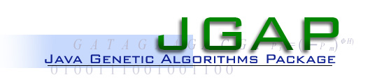





Evaluate
Discard
Plan
Possible Initial Plan
Response Time
Cost
Quality
Time
Plan
Plan
Plan
Plan
Plan
Plan
Plan
Plan
Plan
Mutate
Final Result

Slide 12
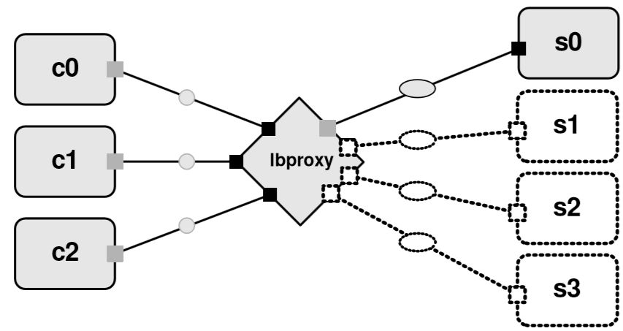
ZNN.com

Slide 13





Self-Adaptive System
System Monitor

Slide 14
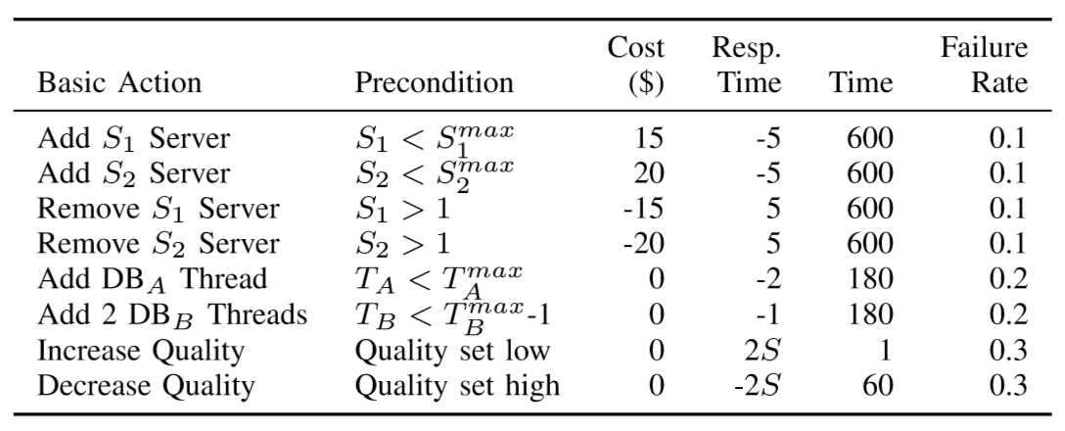
Proof of Concept

Slide 15
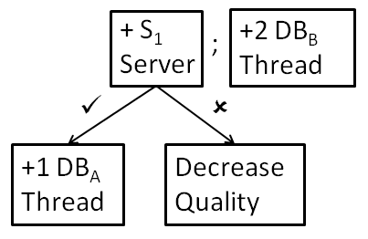
Plans
[(if (add-server(1))
(add-database-thread(A,1))
(decrease-quality))),
add-database-thread(B,2)]

Slide 16
Plans

Slide 17
Experiments
Improving a bad plan
Show that subpar inputs do not cause subpar results
Comparing different utility functions
Understand how changes in the utility function affects plans
Planning with similar utility functions
Can plans be used to create new plans for a similar goal?

Slide 18
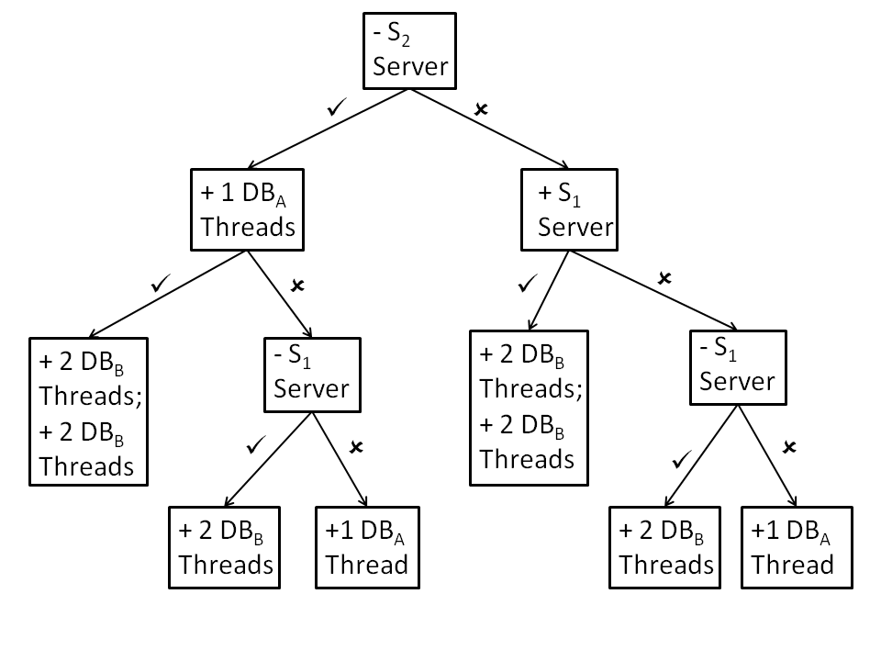
Improving a Bad Plan
Utility Function: -20 responseTime_{norm}
– cost_{norm} + quality_{norm} – time_{norm}
Initial Plan:

Slide 19
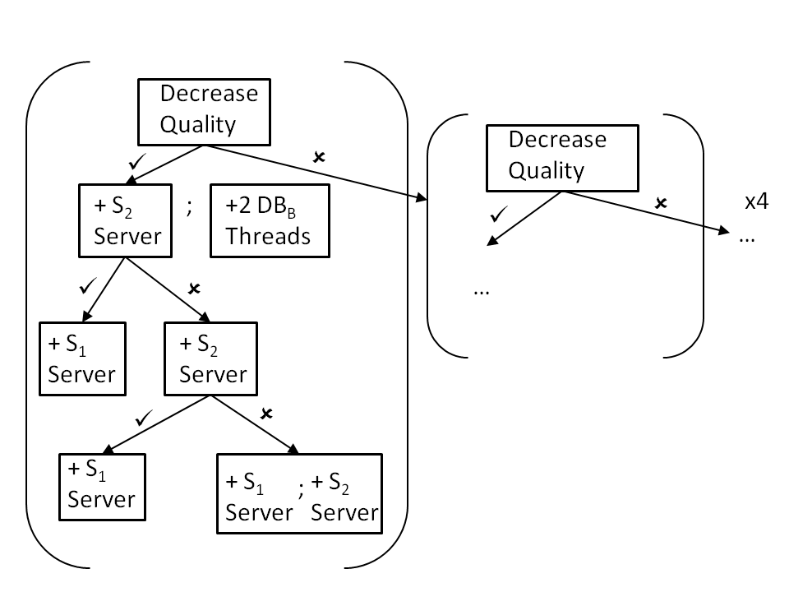
Improving a Bad Plan
Results:

Slide 20
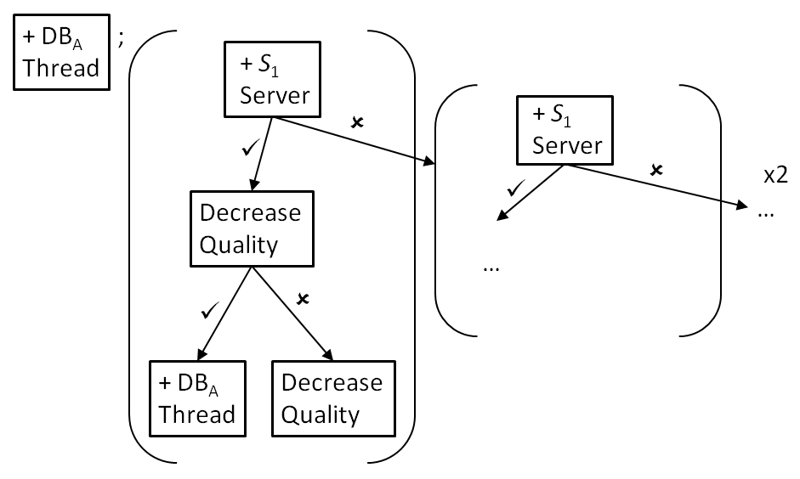
Comparing Utility Changes
Utility Function : -10 responseTime_{norm}
– cost_{norm} + quality_{norm} – time_{norm}
Results:

Slide 21
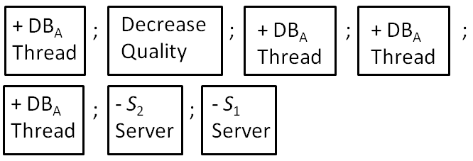
Comparing Utility Changes
Utility Function : -2 responseTime_{norm}
– 2 cost_{norm} + quality_{norm} – time_{norm}
Results:

Slide 22
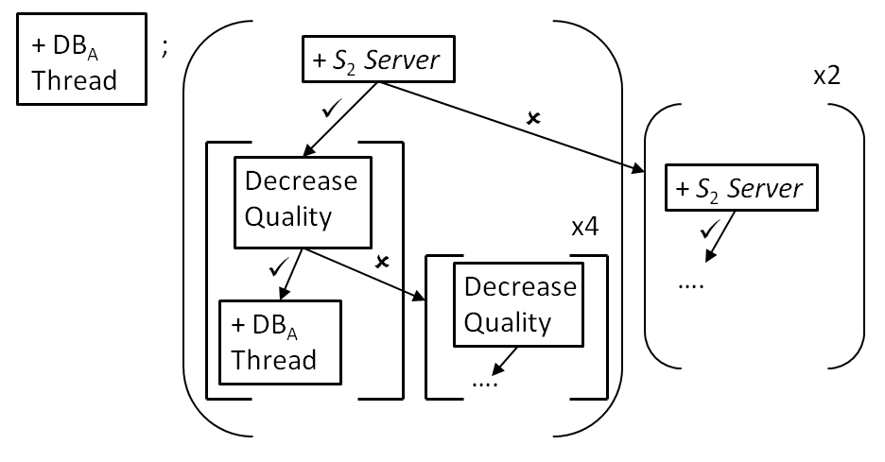
Planning with Similar Utility Functions
Utility Function: -10 responseTime_{norm}
– cost_{norm} + quality_{norm} – time_{norm}
Results:

Slide 23




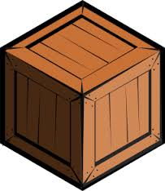
x 50,000
Persian Gulf
Notes:
The goal is to get the vision of big problems into the audience’s head, not really focus on DARPA’s achievements.

Slide 24
Experiment Conclusions
The planner can handle erroneous user provided plans
The planner can handle multiple objectives
The planner can provide unexpected knowledge about the search space
The planner can use information from previously generated plans to make new plans

Slide 25
Future Ideas
Test the planner on a system with more tactics
Compare to deterministic planners
Incorporate feedback from the system monitor
If adaption fails, is it likely to fail again?
Partially effective adaptations – timing issues
Adapting similar plans to a new situation
Catalogue when stochastic techniques are effective
Improve human trust in plans/ stochastically generated plans

Slide 26
Summary
Stochastic search shows promise for handling the future complexity of self-adaptive systems
Demonstrate the benefits of stochastic search with a proof of concept genetic programming planner
3 experiments demonstrate the potential of our planner
There are many research problems for applying stochastic search to self adaptive systems

