Slide 1
HERNIA
GROUP 10 PRESENTATION
1.Isatou Njie GC#2431048
2.Mariama Manjang GC#2431027
3.Lovetta Fatu Kabia GC#2431091
4.Awa Fadiya GC# 2431062
5.Sainabou Njie Gc# 2431045
6.Aminata Jawara GC#2431088
7. Sainabou Humma GC#243116
8.Israel Akinola GC#2431005

Slide 2
TABLE OF CONTENT
OVERVIEW
DEFINITIONS
ATEOLOGY
DIAGRAM
PATHOPHYSIOLOGY
TYPES
SIGNS AND SYMPTOMS
INVESTIGATION
NURSING MANAGEMENT
NURSING DIAGNOSIS
COMPLICATIONS
DIFFERENTIAL DIAGNOSIS
REFERENCES

Slide 3
OVERVIEW
Hernia is a common surgical condition encountered across all age groups and demographics.
It represents a structural defect in the musculoskeletal boundaries of body cavities, most commonly the abdominal wall.
It allows normal anatomical contents to protrude outside their natural boundaries.
If left untreated, a simple hernia can progress from mild discomfort to a life-threatening acute surgical emergency.

Slide 4
DEFINITIONS
Hernia:The abnormal protrusion of a body organ or tissue through a defect, weakness, or opening in the wall of the cavity that normally contains it.
Hernial sac:An outpouching of the parietal peritoneum that encloses the herniated viscera.
Hernial orifice (defect):The anatomical weakness or opening in the fascia or muscular wall through which the sac protrudes
.Hernial contents:The organs or tissues contained within the sac, most commonly omentum or small intestine.

Slide 5
AETIOLOGY
CONGENITAL CAUSES | ACQUIRED CAUSES
Congenital weakness of the abdominal wall | Heavy lifting and strenuous physical activity
Failure of normal closure of certain anatomical structures | Chronic constipation and repeated straining during bowel movements
Developmental defects that leave areas of weakness through which abdominal contents can protrude | Pregnancy
 | Obesity
 | Ascites
 | Aging and weakening of connective tissues
 | Previous abdominal surgery
 | Trauma or injury to the abdominal wall
Key concept:
A hernia usually occurs when a weak point in the abdominal wall is exposed to increased intra-abdominal pressure, causing abdominal tissue to push through it.

Slide 6
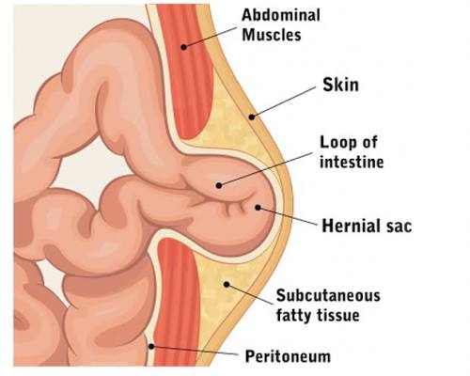
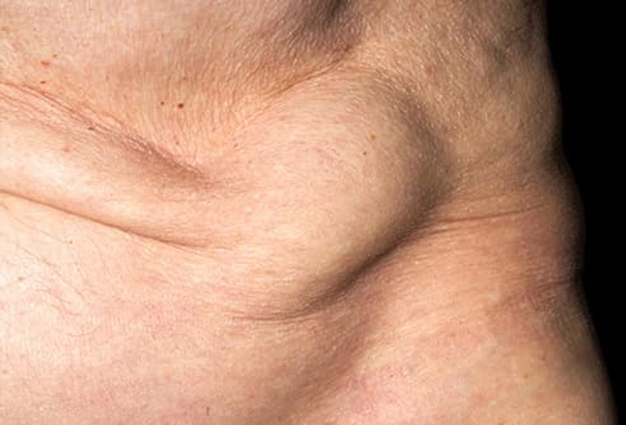
HERNIA

Slide 7
PATHOPHYSIOLOGY
Weakness or defect in abdominal wall
↓
Increase in intra-abdominal pressure
↓
Abdominal tissue/viscera pushed through the weak area
↓
Formation of hernia and visible/palpable swelling
↓
Hernia remains reducible OR becomes incarcerated
↓
Compromised blood supply → strangulation
↓
Ischaemia
↓
Tissue necrosis
↓
Possible perforation
↓
Peritonitis → sepsis/shock

Slide 8
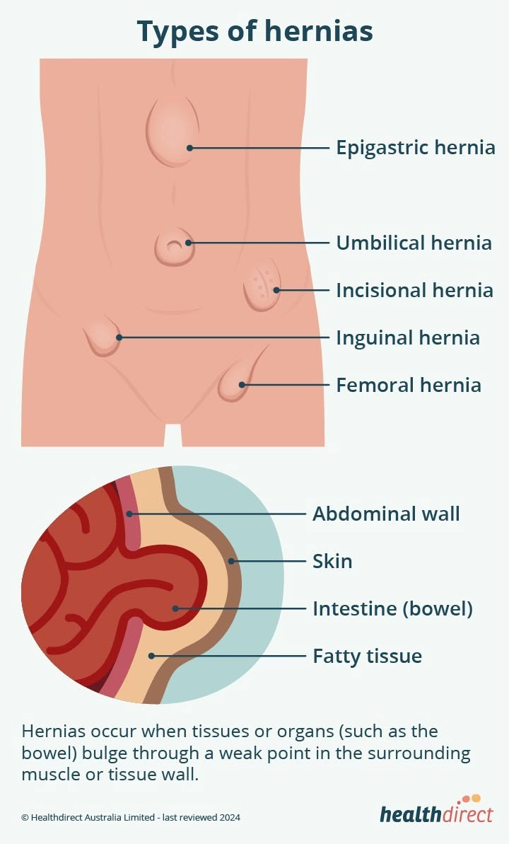
TYPE OF HERNIA
1. Inguinal hernia
2. Femoral hernia
3. Umbilical hernia
4. Incisional hernia
5. Hiatal hernia
6. Epigastric hernia
7. Spigelian hernia
8. Congenital diaphragmatic hernia

Slide 9
SIGNS AND SYMPTOMS
Visible or palpable lump/swelling in the abdomen, groin, or hernia site
Pain or discomfort, especially when lifting, coughing, sneezing, or straining
Feeling of heaviness, pressure, or dragging in the affected area
Lump becomes more prominent when standing, coughing, or straining
Lump may disappear when lying down
Tenderness over the swelling
Burning or aching sensation around the lump
Difficulty passing stool or gas in some abdominal hernias

Slide 10
INVESTIGATIONS
A. Physical examination
Examination of the swelling
Patient may be asked to cough or strain
Swelling may become more prominent
                B. Ultrasound
                Uses sound waves to produce images
                Helps identify the hernia and its contents
                Commonly used for groin and abdominal wall hernias
C. CT scan
Produces detailed images of the abdomen
Helps identify the size and location of the hernia
Can detect obstruction or strangulation
                D. MRI
                Provides detailed images of soft tissues
                Useful when diagnosis is uncertain
                Can detect small or hidden hernias
E. Blood tests
May be performed when complications are suspected
Can help detect infection or inflammation

Slide 11
NURSING MANAGEMENT
Reducing intra-abdominal pressure
Avoid activities that increase intra-abdominal pressure.
Avoid excessive straining.
Use an open-mouth technique when sneezing.
Avoid heavy lifting and straining
Patients recovering from hernia repair should avoid heavy lifting and strenuous activity during the prescribed recovery period.
Postoperative nursing care
Assess and manage pain.
Monitor the surgical wound for infection.
Monitor urinary output and difficulty voiding.
Encourage appropriate activity and mobility.
Prevent constipation and straining.
Educate the patient about wound care and activity restrictions.
Provide scrotal support where appropriate following inguinal hernia repair.
Ice packs may be used intermittently to reduce swelling where appropriate.
Encourage deep breathing and effective coughing as appropriate to prevent respiratory complications, while supporting the incision if needed.

Slide 12
NURSING DIAGNOSES
Acute Pain related to surgical incision, tissue trauma, or localized ischemia.
Risk for Infection related to surgical skin break and placement of a foreign body such as synthetic mesh.
Risk for Urinary Retention related to spinal/general anaesthesia and local trauma in the groin area.
Risk for Constipation related to postoperative immobility, opioid analgesics, and fear of incisional pain during straining.
Deficient Knowledge related to post-discharge wound care, activity limitations, and signs of complications.

Slide 13
COMPLICATIONS
Incarceration
Strangulation
Intestinal obstruction
Ischaemia
Tissue necrosis
Perforation
Peritonitis
Sepsis
Shock

Slide 14
DIFFERENTIAL DIAGNOSES
Hydrocele – accumulation of fluid around the testis causing scrotal swelling.
Lymphadenopathy – enlargement of lymph nodes that may present as a groin lump.
Lipoma – benign fatty tissue mass that may feel soft and painless.
Abscess – collection of pus causing a painful, warm and swollen area.
Varicocele – enlargement of veins around the testis producing a “bag of worms” feeling.
Undescended testis – testis that has not descended into the scrotum and may present as a groin swelling.
Saphena varix – swelling of the saphenous vein near the groin that can resemble a hernia.
Femoral aneurysm – abnormal enlargement of a blood vessel that may appear as a pulsating groin mass.

Slide 15
REFERENCES
Stabilini, C., van Veenendaal, N., Aasvang, E., et al. (2023). Update of the international HerniaSurge guidelines for groin hernia management. BJS Open, 7(5), zrad080. https://doi.org/10.1093/bjsopen/zrad080
Ansari, P. (2024). Inguinal hernia. Merck Manual Professional Edition.
Ansari, P. (2024). Hernias of the abdominal wall. Merck Manual Professional Edition.
Hassler, K. R., Saxena, P., & Baltazar-Ford, K. S. (2022). Open inguinal hernia repair. StatPearls. StatPearls Publishing.

