Slide 1
PANCREATITIS

Slide 2
GROUP 9 MEMBERS
LAMIN JOOF GC# 2431040
ISATOU MANNEH GC# 2431117
SULAYMAN K SAIDY GC#2431060
AWA CHAM GC# 2431063
OUSMAN JOOF GC#2431047
FATOUMATA H GEREW GC# 2431095
OUSMAN JATTA GC# 2431041
FATOU TOURAY GC# 2431098

Slide 3
TABLE OF CONTENT
INTRODUCTION
DEFINITION
AETIOLOGY
PATHOPYSIOLOGY
TYPES
SIGNS AND SYMPTOMS
INVESTIGATIONS
MEDICAL/NURSING MANAGEMENT
NURSING DIAGNOSIS
COMPLICATIONS
DIFFERENTIALS DIAGNOSIS
REFRENCES

Slide 4
INTRODUCTION
This is an inflammatory process of pancreas and its caused by an inciting event which damages the pancreatic parenchyma, leading to a chain reaction
Pancreatic injury causes enzymes to leak into pancreas resulting in autodigestion leading to more injury and enzyme leakage
This positive feedback cycle causes significant pancreatic edema and fat necrosis

Slide 5
DEFINITION
Pancreatitis is inflammation of the pancreas that occurs when pancreatic digestive enzymes become activated prematurely and begin damaging the pancreatic tissue.

Slide 6
AETIOLOGY
The two major causes are:
Gallstones
Excessive alcohol use
Other causes include:
Certain medications (especial sulfa group of drugs)
Abdominal trauma
High triglyceride levels
Hypercalcemia
Some infections like Mumps
Certain medical procedures Like ERCP(Endoscopic Retrograde Cholangiopancreatography)

Slide 7
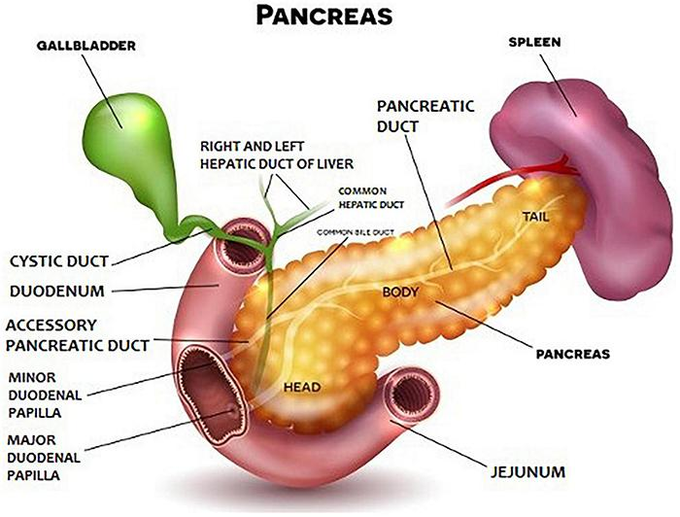
THE PANCREASE

Slide 8
PATHOPHYSIOLOGY
Initiating factors
Gallstones (most common) and/or alcohol abuse are the main causes. Other causes: hypertriglyceridemia, drugs, trauma, infections, hypercalcemia, tumors, ERCP.
2. Ductal obstruction or toxic injury
Gallstone blocks the ampulla of Vater → obstruction of pancreatic duct. Alcohol and other toxins cause direct injury to acinar cells and increase protein plugs in small ducts.
3. Premature activation of digestive enzymes
Inside the acinar cells, trypsinogen is prematurely converted to trypsin (instead of in the duodenum).Trypsin then activates other zymogens → phospholipase A2, elastase, lipase, amylase.
4. Autodigestion of the pancreas
Activated enzymes digest pancreatic tissue → inflammation, edema, and necrosis. Phospholipase Az damages cell membranes and blood vessels. Elastase destroys connective tissue; lipase causes fat necrosis.
5. Inflammatory response
Release of cytokines (IL-1, IL-6, TNF-a) → systemic inflammatory response syndrome (SIRS).Increased vascular permeability → fluid shifts, third spacing, and hypovolemia

Slide 9
TYPES
1. Acute Pancreatitis
Acute pancreatitis is a sudden and rapid swelling of the pancreas. It usually lasts for a short time. Most people get better within a few days, but severe cases can be dangerous.
2. Chronic Pancreatitis
Chronic pancreatitis is a long-term inflammation that gets worse over time. It creates permanent scar tissue in the organ. This damage stops the pancreas from making enough digestive enzymes and hormones, leading to weight loss or diabetes.

Slide 10
SIGNS AND SYMPTOMS
Severe upper abdominal (epigastric) pain
Pain may radiate to the back
Nausea and vomiting
Abdominal tenderness
Fever
Tachycardia
Abdominal distension
Reduced bowel sounds
weight loss

Slide 11
INVESTIGATIONS
Important investigations include:
Serum lipase
Serum amylase
Full blood count
Electrolytes
Liver function tests
Abdominal ultrasound
CT scan when indicated

Slide 12
NURSING MANAGEMENT
Monitor vital signs closely.
Assess pain regularly.
Administer prescribed analgesics.
Maintain IV access.
Administer IV fluids as prescribed.
Monitor intake and output.
Monitor electrolytes and blood glucose.
Manage nausea and vomiting.
Maintain nutritional support as prescribed.
Observe for complications.

Slide 13
NURSING DIAGNOSIS
Acute pain related to pancreatic inflammation.
Deficient fluid volume related to vomiting and fluid shifting.
Imbalanced nutrition: less than body requirements related to reduced intake and impaired digestion.
Nausea related to gastrointestinal and pancreatic inflammation.
Risk for unstable blood glucose level related to impaired pancreatic function.

Slide 14
COMPLICATIONS
Pancreatic necrosis
Pseudocyst
Infection
Hypotension/shock
Respiratory failure
Acute kidney injury
Sepsis
Multiple organ dysfunction

Slide 15
DIFFERENTIALS DIAGNOSIS
Peptic ulcer disease
Acute cholecystitis
Biliary colic
Appendicitis
Intestinal obstruction
Perforated viscus
Hepatitis
Mesenteric ischemia

Slide 16
REFRENCES
Hall, J. E. (2021). Guyton and Hall Textbook of Medical Physiology (14th ed.). Elsevier.
. Jameson, J. L., Fauci, A. S., Kasper, D. L., Hauser, S. L., Longo, D. L., & Loscalzo, J. (Eds.). (2022). Harrison's Principles of Internal Medicine (21st ed.). McGraw Hill.
. Lewis, S. L., Bucher, L., Heitkemper, M. M., Harding, M. M., Kwong, J., & Roberts, D. Medical-Surgical Nursing: Assessment and Management of Clinical Problems (12th ed.). Elsevier.
. Kumar, V., Abbas, A. K., & Aster, J. C. (2020). Robbins & Cotran Pathologic Basis of Disease (10th ed.). Elsevier.
. American College of Gastroenterology. (2024). Management of Acute Pancreatitis. American Journal of Gastroenterology.

