Slide 1
Sugar Pricing Forecasting
A Monte Carlo Simulation

Slide 2
Objectives
Explain the challenge of sugar price uncertainty and how market volatility affects company planning and revenue projections.
Introduce the concept of simulation-based analysis using Monte Carlo Simulation to evaluate possible future price scenarios.
Demonstrate the sugar price simulation tool developed using Monte Carlo Simulation in Excel or Web App for running simulations efficiently.
Show how simulation results can support decision-making, particularly in pricing strategy, inventory management, and financial planning.
Promote data-driven discussion and risk awareness in evaluating future sugar market conditions.

Slide 3
Challenges of Sugar Price Uncertainty
Sugar prices are highly volatile
Future prices cannot be known with certainty
Operational and financial decisions must be made in advance
Relying on a single price forecast creates risk
Price uncertainty affects business planning
A better approach is to evaluate multiple possible price outcomes

Slide 4
Monte Carlo Simulation
Definition:
A Monte Carlo simulation runs a pricing model thousands of times, each with randomly varied inputs, to produce a range of probable outcomes rather than one single prediction — capturing uncertainty that any single forecast would miss.

Slide 5
Pricing Models in Sugar Pricing Forecast using Monte Carlo
1. GBM (Geometric Brownian Motion)
- Prices wander freely with no memory of where they've been.
- Each day's price movement is purely random — yesterday's price doesn't "pull" tomorrow's price in any direction. Over time, prices can drift far from where they started, and that drift compounds.
Practical example: Think of a drunk person walking down a long hallway. They take random steps left and right, but slowly drift toward one end. They have no reason to return to the middle. The longer they walk, the farther they can end up from where they started.

Slide 6
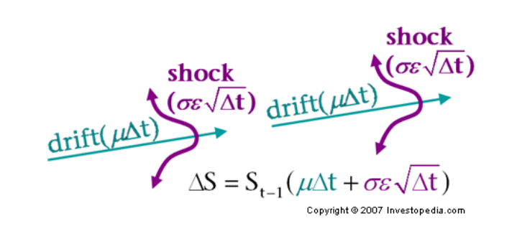
GBM (Great Brownian Motion)
Best used when you believe sugar prices are driven by long-term trends and external shocks — like oil prices, currency movements, or global demand — where there's no strong reason for prices to "snap back.“
where:
S=the stock price
ΔS=the change in stock price
μ=the expected return
σ=the standard deviation of returns
ϵ=the random variable
Δt=the elapsed time period

Slide 7
Pricing Models in Sugar Pricing Forecast using Monte Carlo
2. Mean-Reverting (Ornstein-Uhlenbeck)
Prices wander, but always get pulled back toward a long-run average.
When prices go too high, forces push them back down (more farmers plant sugar, buyers switch to substitutes). When prices go too low, the opposite happens. There's a natural gravity toward the historical average.
Practical example: Think of a dog on a leash walking with its owner. The dog can wander left and right, run ahead or fall behind — but the leash always pulls it back toward the owner. The owner is the long-run average price (your θ setting).

Slide 8
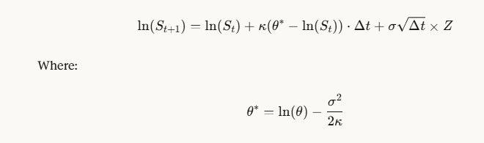
Mean-Reverting
Where:
ln(S_t) = the natural log of today's price (this is what actually mean-reverts)
κ (kappa) = how strongly prices are pulled back to the average (the leash strength)
θ (theta) = the long-run average price the model gravitates toward
θ* = the adjusted long-run mean (a small mathematical correction to θ)
σ = volatility (same as GBM)
Δt = size of one time step (1/12 for monthly steps)
Z = random shock, drawn fresh at each step
Best used for mill-gate sugar prices specifically, because agricultural commodity prices tend to behave this way — production and demand naturally correct extreme prices over time

Slide 9
Conclusions and Recommendations
 | GBM | Mean-Reverting
Short horizon (< 2 yrs) | ✅ Fine | ✅ Fine
Long horizon (3–10 yrs) | ⚠️ Can drift too far | ✅ More realistic
You believe prices correct themselves | ❌ | ✅
You believe prices trend indefinitely | ✅ | ❌

Slide 10
Summary
Sugar Price Monte Carlo Risk Model(Predictive AI Type) is capable to:
Identify the percentage of potential risk on sugar price based on Price Distribution at Horizon("Price Distribution at Horizon" generally refers to how the price of an asset, commodity, or service is distributed or forecasted over a specific future time period (the "horizon"). Depending on the context, this term applies to financial modeling, energy pricing, or supply chain management.” )
Predict the Sugar price in the future
This Montecarlo Risk Model is very useful for sugar mills and sugar traders to promote data-driven discussion and risk awareness in evaluating future sugar market conditions and decision-making, particularly in pricing strategy, inventory management, and financial planning.

Slide 11
Sugar Pricing Monte Carlo Simulation
Web App
https://sugarpriceriskmodel.streamlit.app/

Slide 12
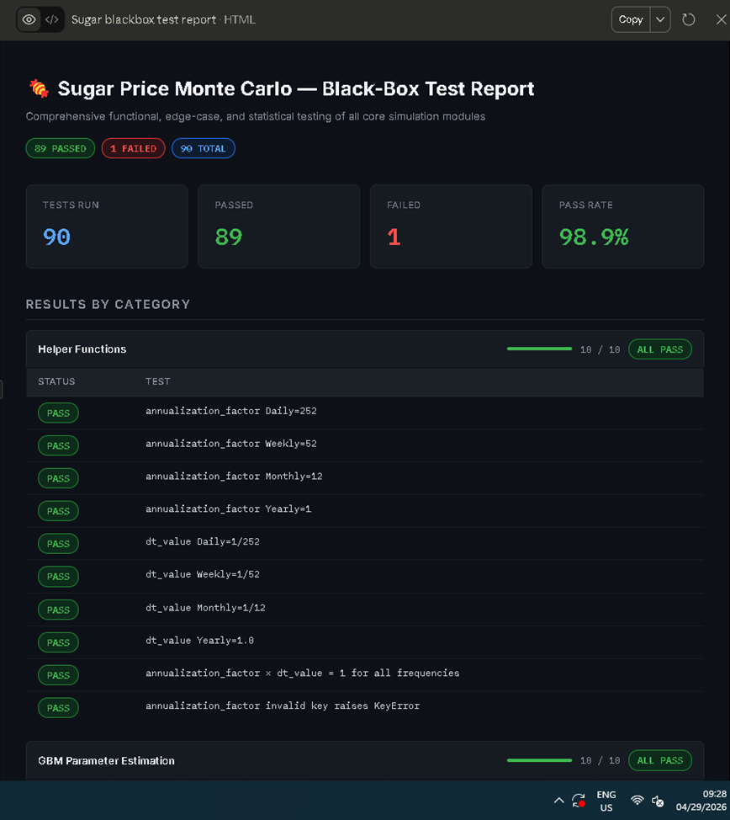
BLACK BOX TESTING

Slide 13
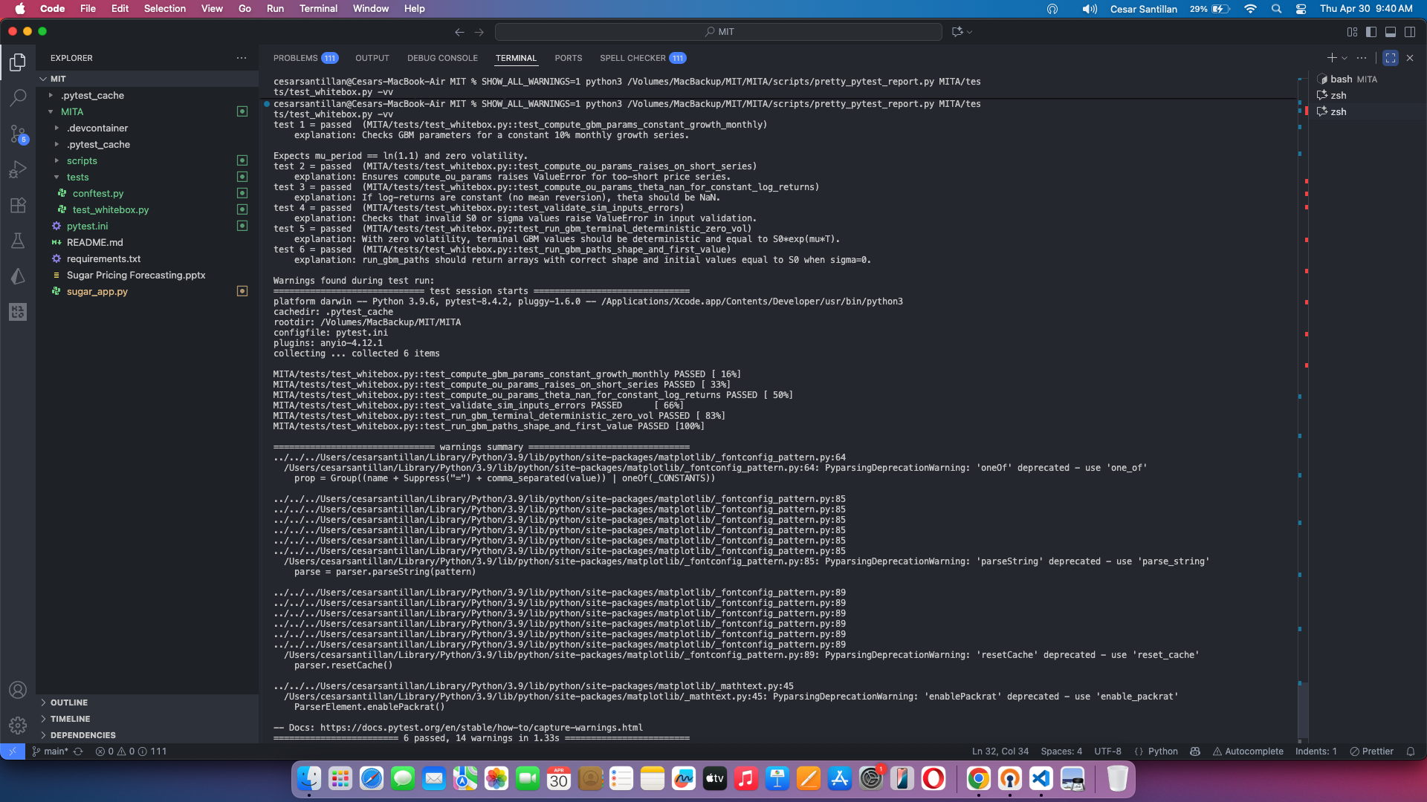
WHITE BOX TESTING

Slide 14
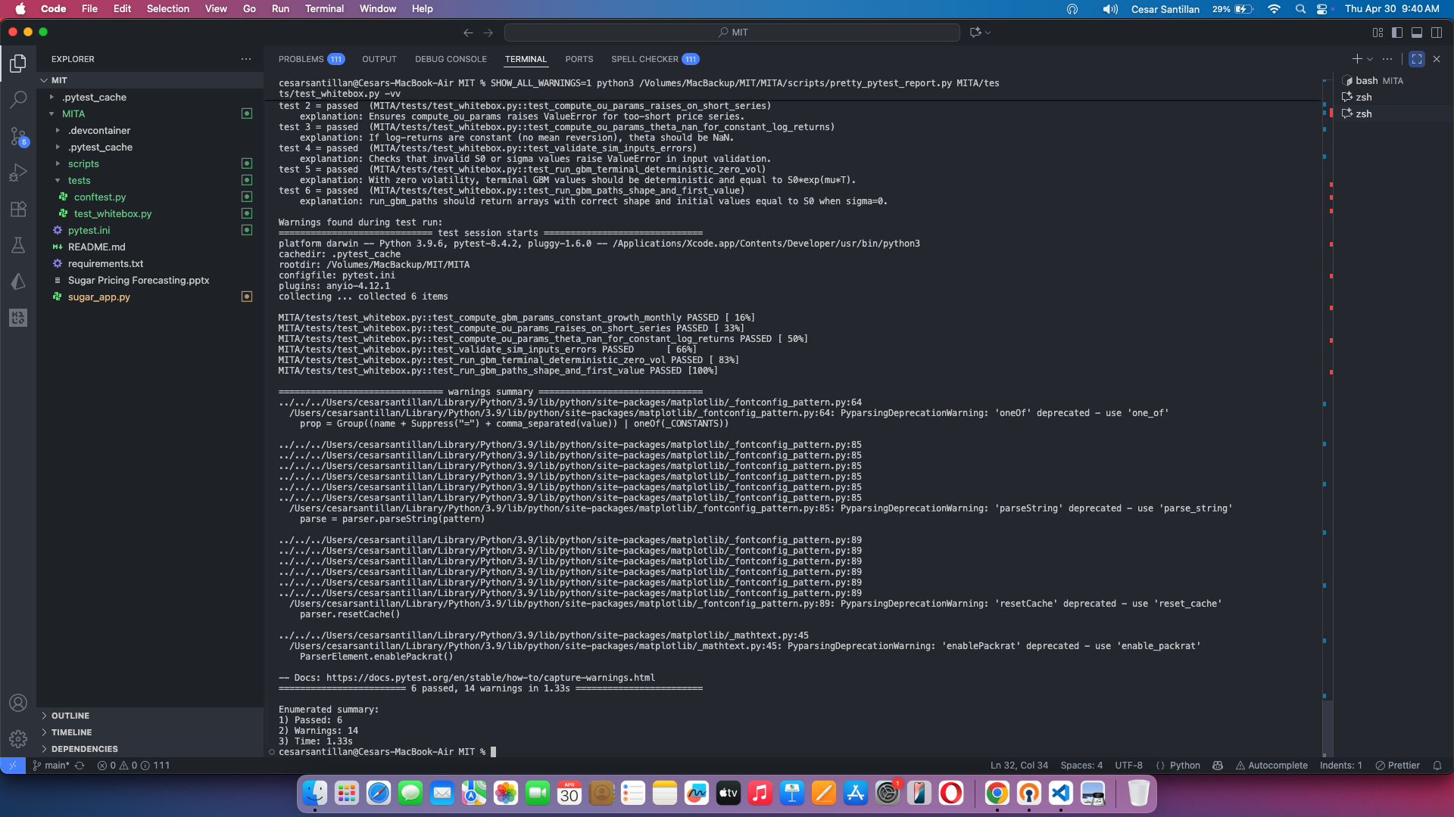
WHITE BOX TESTING

Slide 15
THANK YOU FOR YOUR ATTENTION

