Slide 1






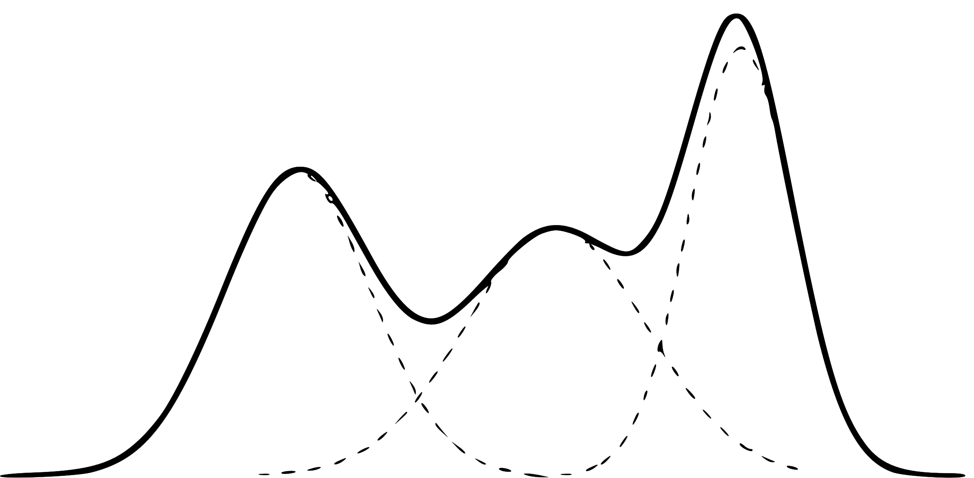







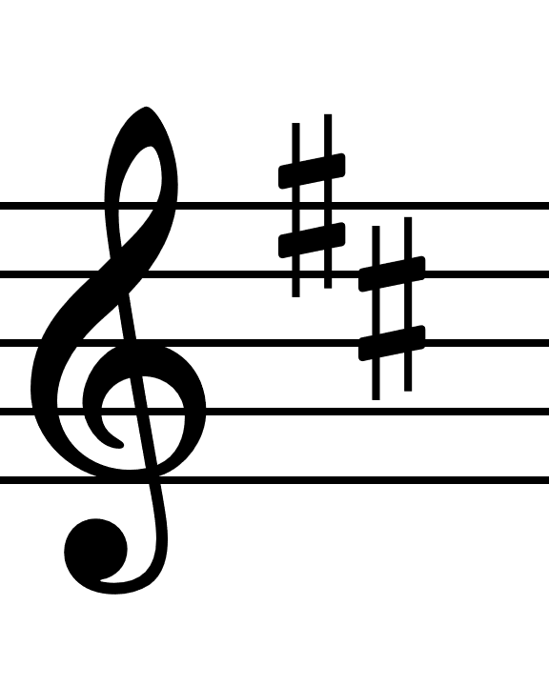
Previous Note Played
(root of search tree)
UCT: 0.6
UCT: 1.1
UCT: 0.4
UCT Selection
LSTM
RNN
MDN
π
GMM Action Space
The action space for a leaf node is generated
μ
σ
Expansion: A new child node is sampled from the action space and added.
A potential musical continuation is simulated using MDRNN predictions
…
…
The final simulated branch is extracted
The branch is assessed on how well it matches the prior musical context
…
0.64
This assessment is combined into a single heuristic score
The heuristic score is backpropagated up the tree, updating visit counts and UCT scores

