Slide 1



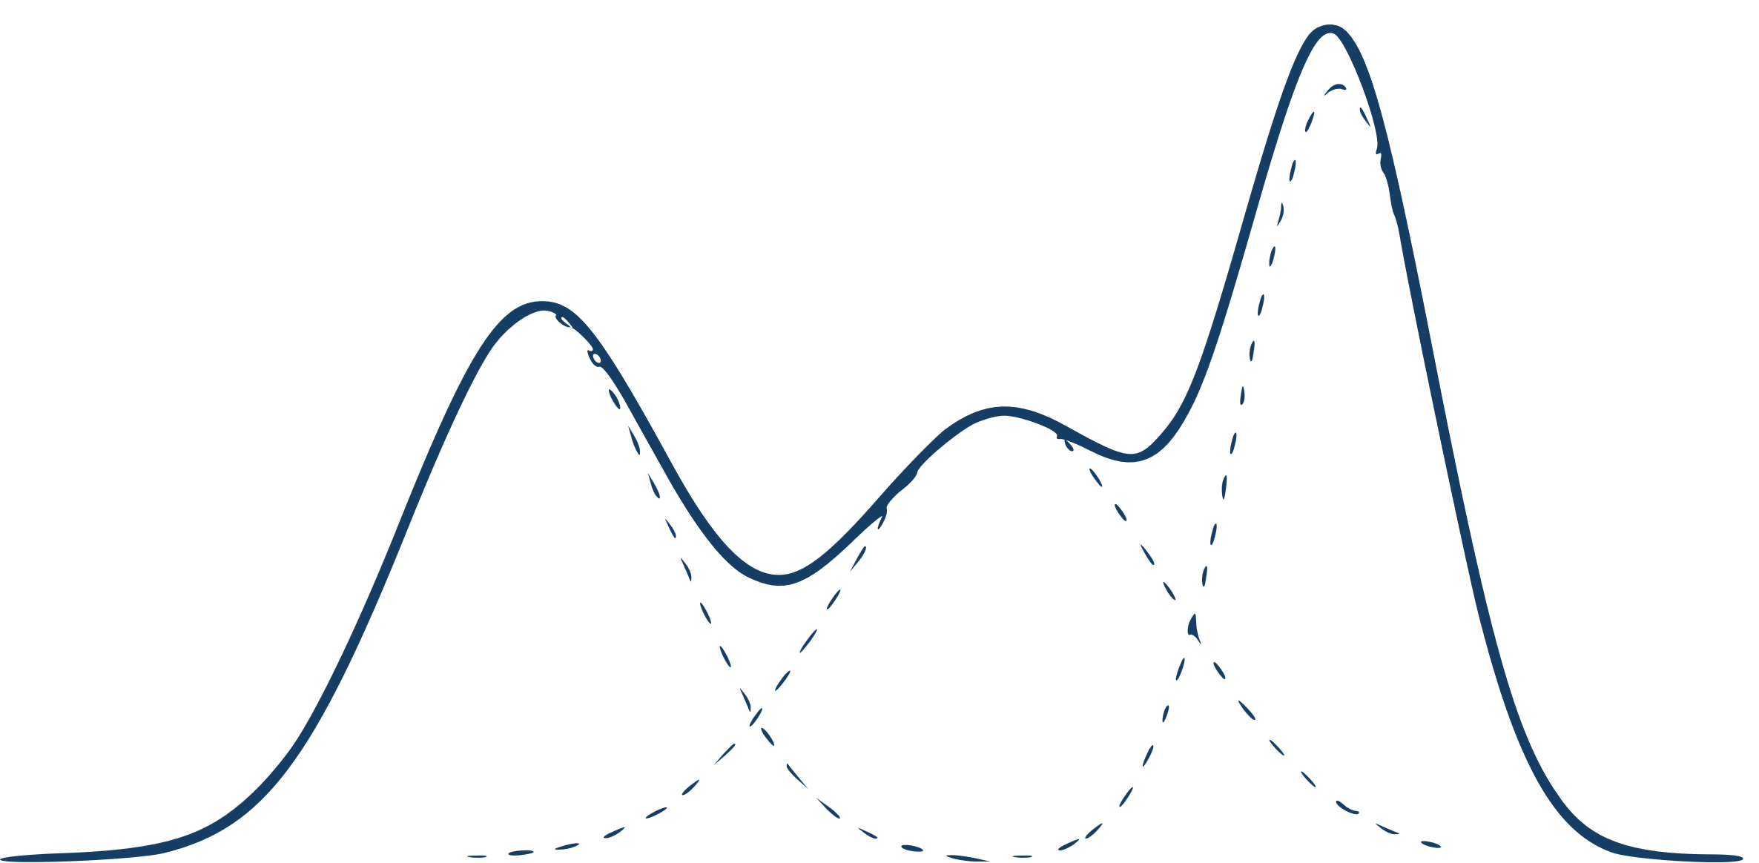


Musical Context
Gaussian Mixture Model
Stochastic
Sampling
Note
Choice
LSTM
RNN
Mixture Density Network
π
μ
σ

