Slide 1




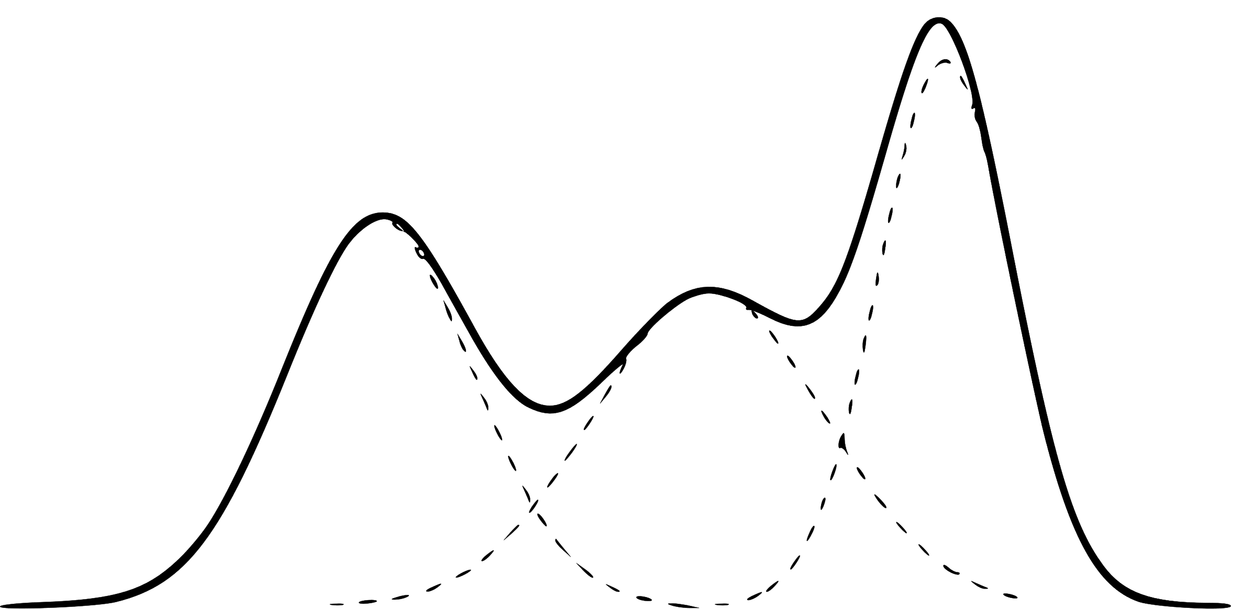



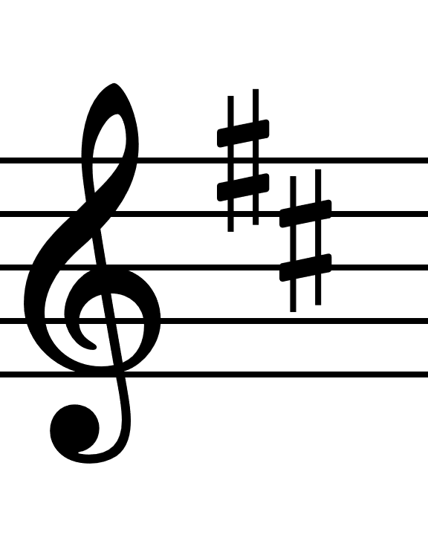









MDRNN-IMPSY
Musical Context
Mixture Density Recurrent Neural Network
Stochastic
Sampling
A neural network provides multiple predictions of valid notes to play
next, with probabilities for each
Output is selected stochastically
Surely there’s a better way!
Gaussian Mixture Model
Recurrent
Neural
Network
Mixture Density Network
Random selection is arbitrary
Instead, viable musical continuations are searched
Adherence to the established musical structure is checked
And predictions are guided toward options which maintain this structure
?
?
?
?
MCTS-IMPSY
Musical Context
Parameter Calculation
MDRNN generates multiple options
Important parameters of the piece
are determined from previous context
MCTS looks for musical options which maintain these parameters
Prediction Tree
MDRNN
Tree Search
Heuristic

