Slide 1

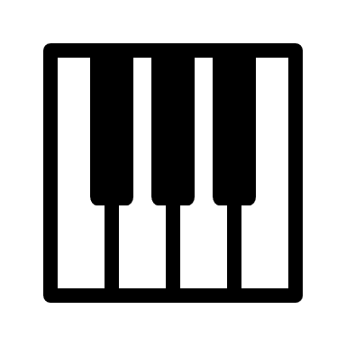

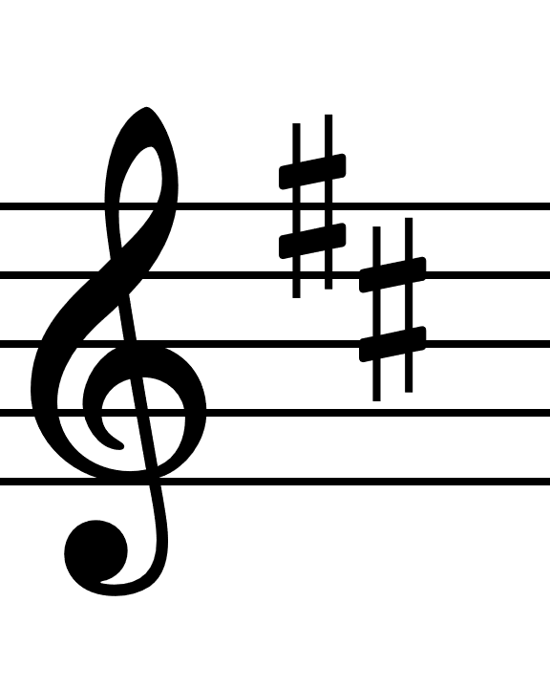



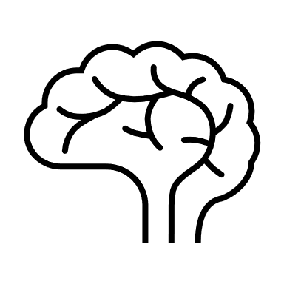






Control Gesture
Musical Note
Human stops playing
Musical Context
Musical Parameters
Human starts playing
Neural Network
Prediction Tree
Heuristic
Musical Note
Control Gesture Prediction

