Slide 1




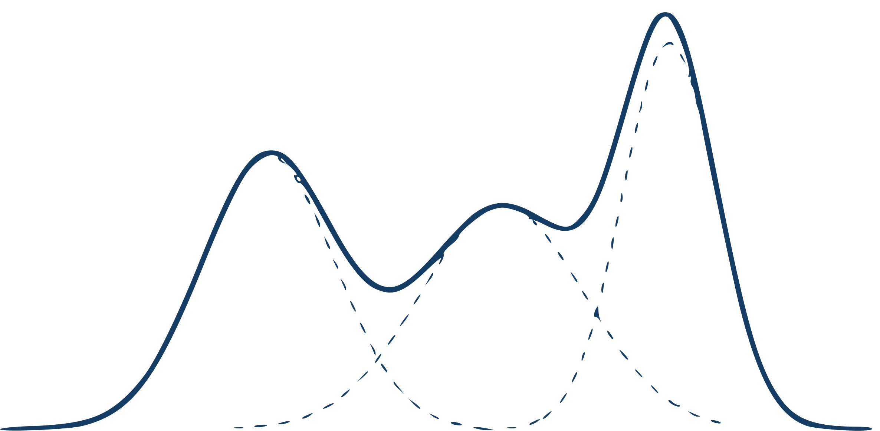



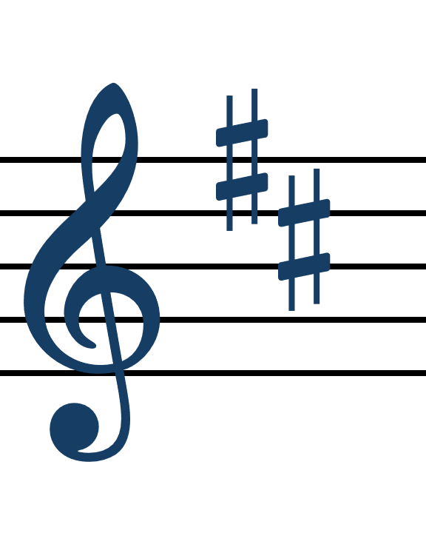







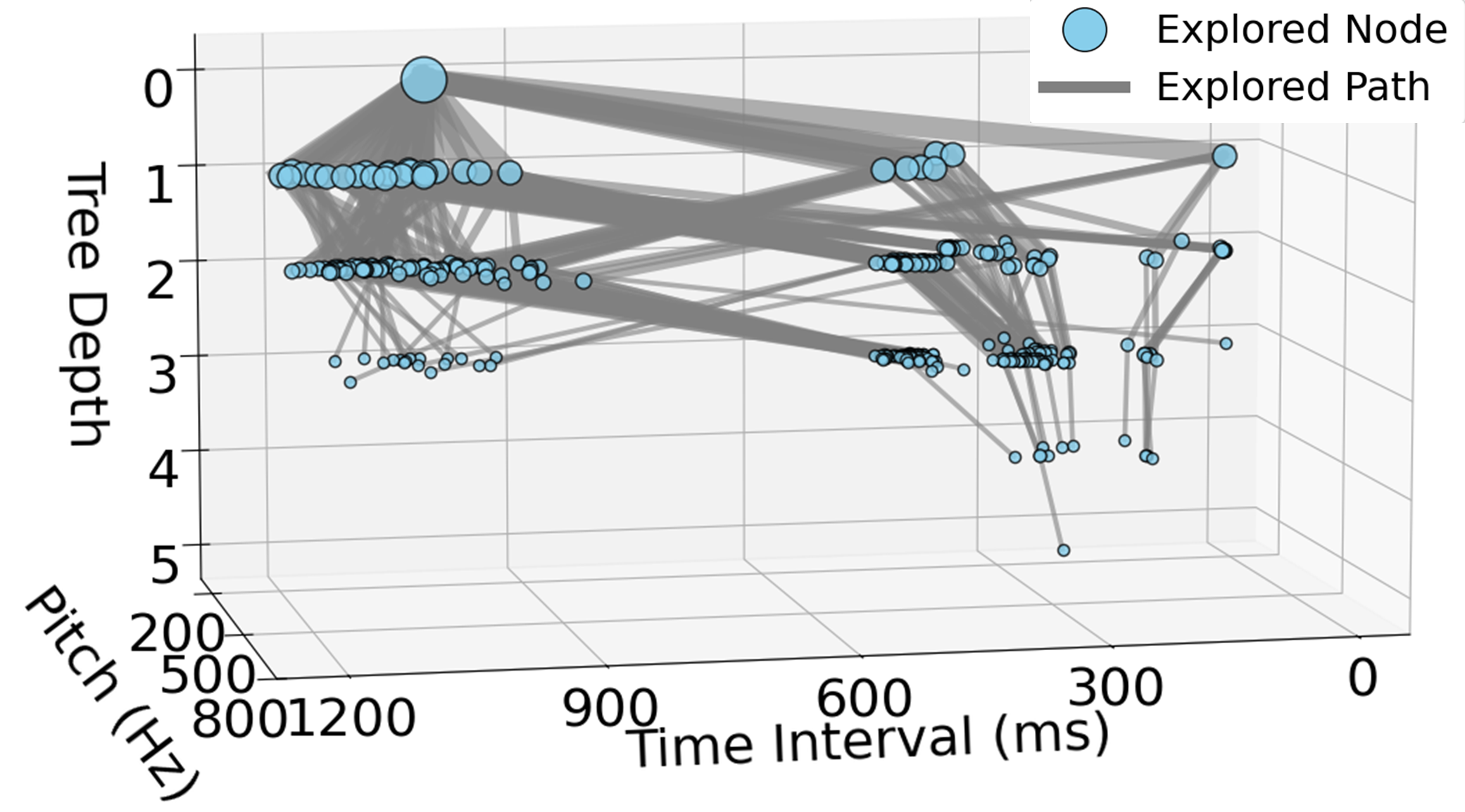
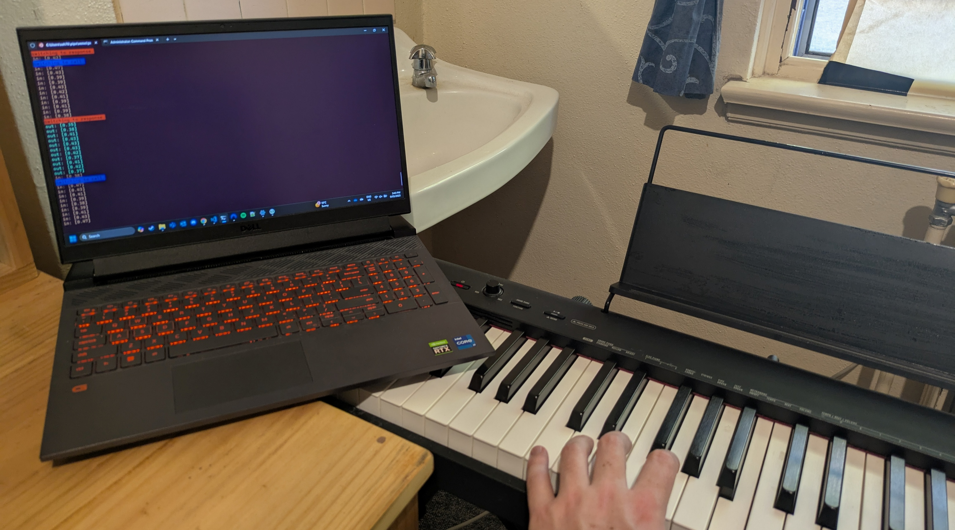
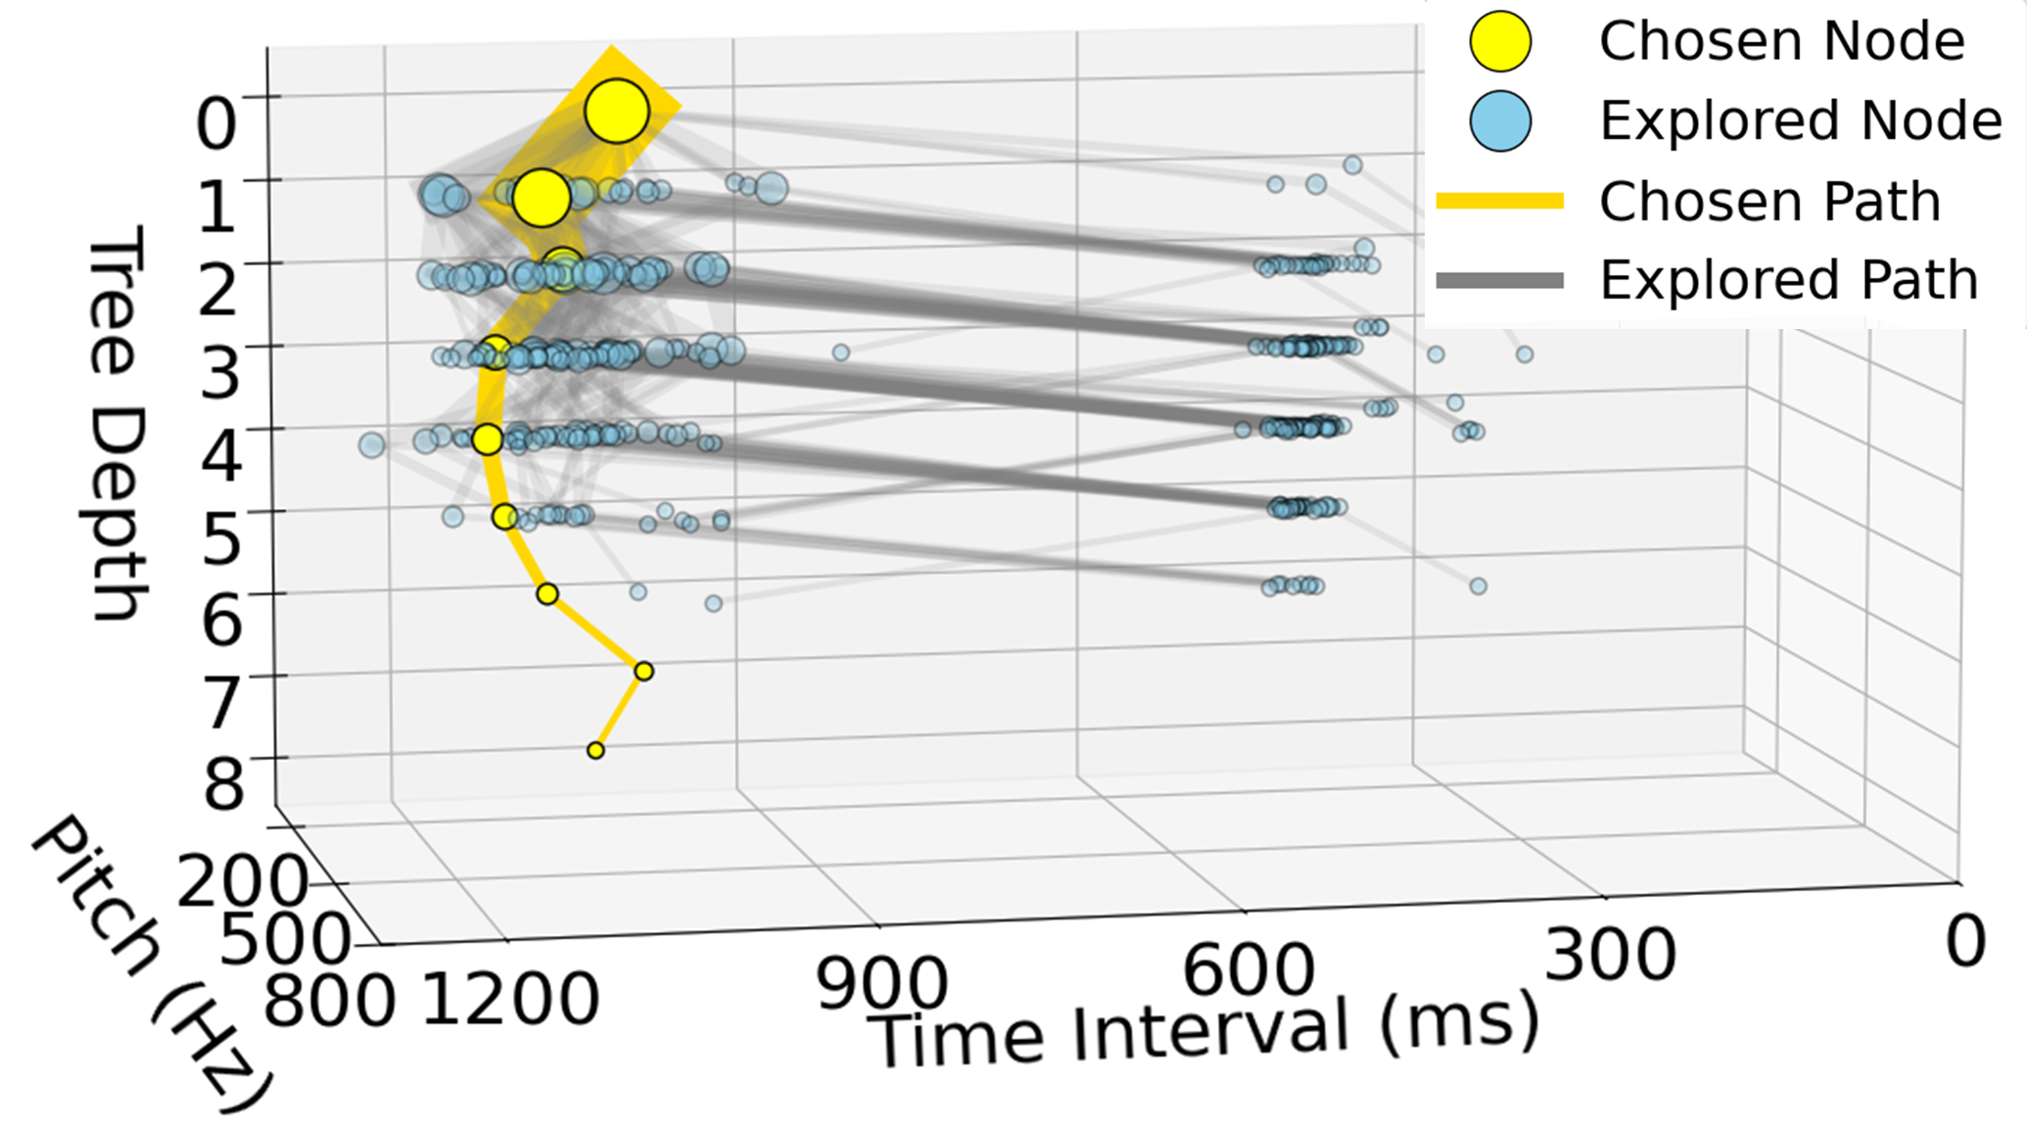
Beyond Stochastic Selection: Guiding Musical Predictions with Monte Carlo Tree Search
Scott Howsam, Charles Martin
Prior Prediction System
Musical Context
Mixture Density Recurrent Neural Network
Stochastic
Sampling
Note
Choice
A neural network provides multiple predictions of valid notes to play
next, with probabilities for each
Output is selected stochastically
Surely there’s a better way!
Recurrent
Neural
Network
Mixture Density Network
Gaussian Mixture Model
Random selection is arbitrary
We instead search future options
Assessing adherence to the broader musical structure
And hence generate better predictions
?
?
?
?
Our Prediction System
Musical Context
Parameter Calculation
Note
Choice
Our method is closer to humans
MDRNN generates multiple options
Important parameters of the piece
are generated from previous context
Search for the best match to these
MDRNN
Prediction Tree
Tree Search
Heuristic
System Design
Results
Music has multiple valid continuations, not one ‘correct’ next note
Therefore, AI musical prediction systems output a range of valid options
To avoid stochastic selection, we create a Monte Carlo Search Tree of viable future musical sequences, and use a heuristic to rank them
This heuristic is based on ‘rules’ humans implicitly use for prediction, such as tempo, key, and rhythm
The first figure below shows a tree of musical paths with no guidance
The second shows the same tree guided by a heuristic aiming to maintain long time intervals
This heuristic is arbitrary, but displays the power these heuristics can have on the search process
Firstly, we evaluated the accuracy of our prediction system against a state-of-the-art published system on 11,142 unseen notes across 15 improvisations. While not every parameter improved performance for every improvisation, on average the heuristic improved accuracy by over 30%.
We also wished to maintain the creativity, originality, and human-like nature of the outputs. For this, a qualitative analysis of multiple improvisation sessions with the AI (an example of which is shown in the figure below) revealed that our method did not sacrifice creativity. It provided a better collaborative improvisational experience than previous methods.
No heuristic guidance, all predictions use short notes
Conclusion
Integrating Monte Carlo Tree Search into musical prediction systems improves their performance significantly in multiple metrics
Multiple future work avenues seem very promising, including a UI for further user control, and many alternative heuristics
With heuristic guidance toward long notes, a viable option is found

