Slide 1


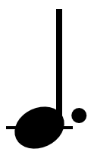

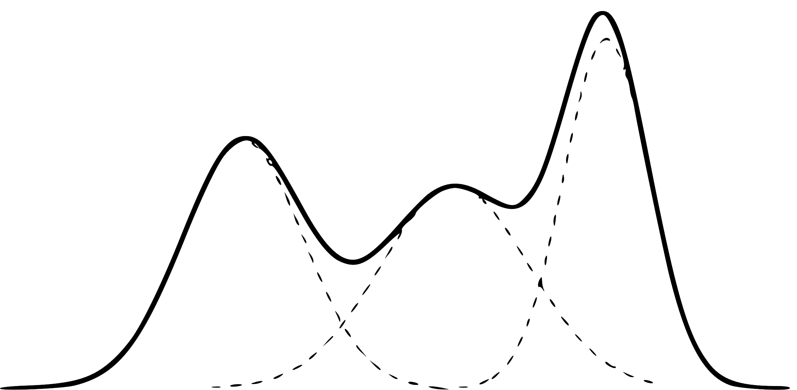

Node visits: 8
Progressive Widening Triggered (N_{z} = kn^{α})
(k=5, α=0.5)
GMM Action Space
Current Child Nodes
Disqualified:not unique
Child node candidates are sampled from the action space
Unique, but similar
…
Unique
Disqualified:not unique
The most unique candidate is added as a new child
If no unique option is found, no child is added.

