Slide 1

Energy 2013
Supervisor: Rody Kersten
Group members:
Jascha Neutelings
Dorus Peelen
Marc Schoolderman
02-12-13
GiPHouse confidential

Slide 2
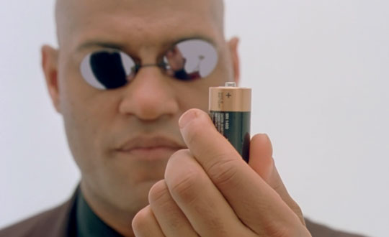
Energy
02-12-13
GiPHouse confidential
12/2/13
GiPHouse confidential

Slide 3
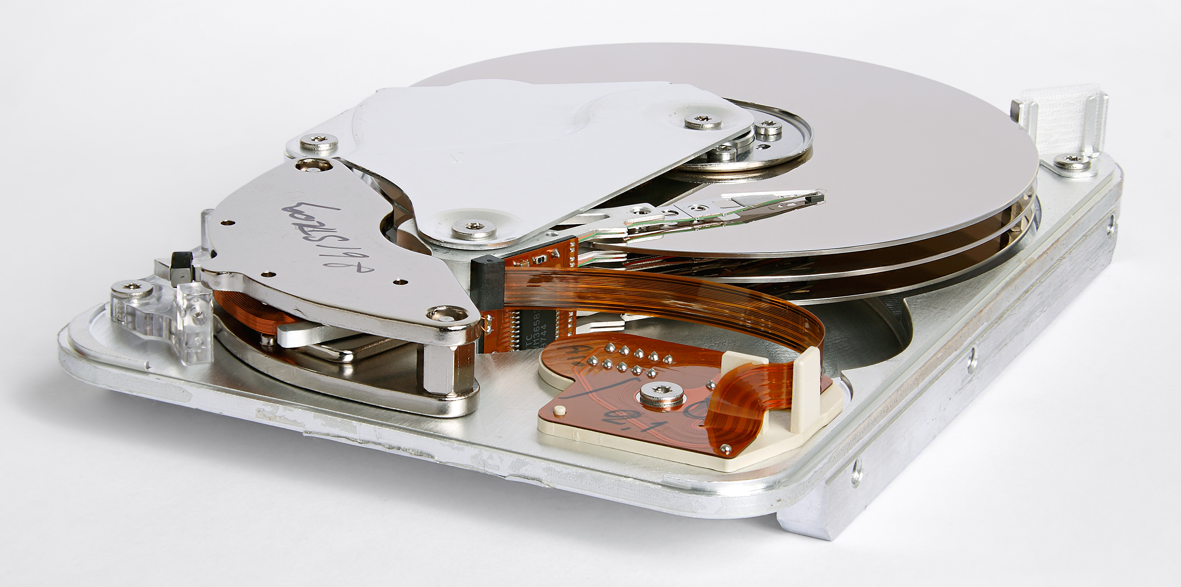
How to save energy?
hard drive on
repeat
await data
write data
until done
hard drive off
02-12-13
GiPHouse confidential

Slide 4
How to save energy?
hard drive on
repeat
await data
write data
until done
hard drive off
repeat
await data
hard drive on
write data
hard drive off
until done
02-12-13
GiPHouse confidential

Slide 5
Project aim
“A Hoare Logic for Energy Consumption Analysis”
(FOPARA 2013)
ECALOGIC
  Formal language
  Automatic analysis
02-12-13
GiPHouse confidential

Slide 6
Challenges faced
“A Type System for Energy Consumption Analysis”
  Highly unfinished paper at start of project
  Devil is in the details
  Written with manual verification in mind
How to create components?
02-12-13
GiPHouse confidential

Slide 7
Technical design
Lexer
Parser
Semantic analysis
Energy analysis
Components
02-12-13
GiPHouse confidential

Slide 8
Technical design
Lexer
Parser
Semantic analysis
Energy analysis
Components
02-12-13
GiPHouse confidential

Slide 9

Object oriented + functional programming
Built on top of JVM
Libraries used:
  ScalaTest
  Lift Web Framework
02-12-13
GiPHouse confidential

Slide 10
Achievements
Pitfalls identified in original paper
Original requirements already met
  Beware of academics!
Improvements implemented
http://tiny.cc/ecalogic
02-12-13
GiPHouse confidential

Slide 11
Achievements
Pitfalls identified in original paper
Original requirements already met
  Beware of academics!
Improvements implemented
http://tiny.cc/ecalogic
?
02-12-13
GiPHouse confidential

