Slide 1
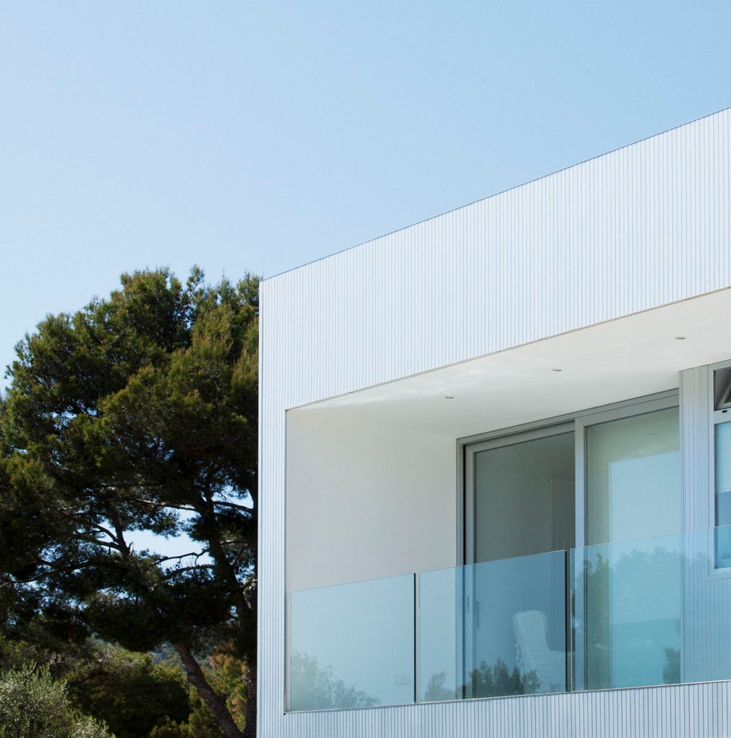
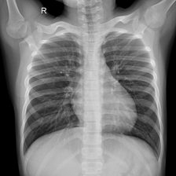
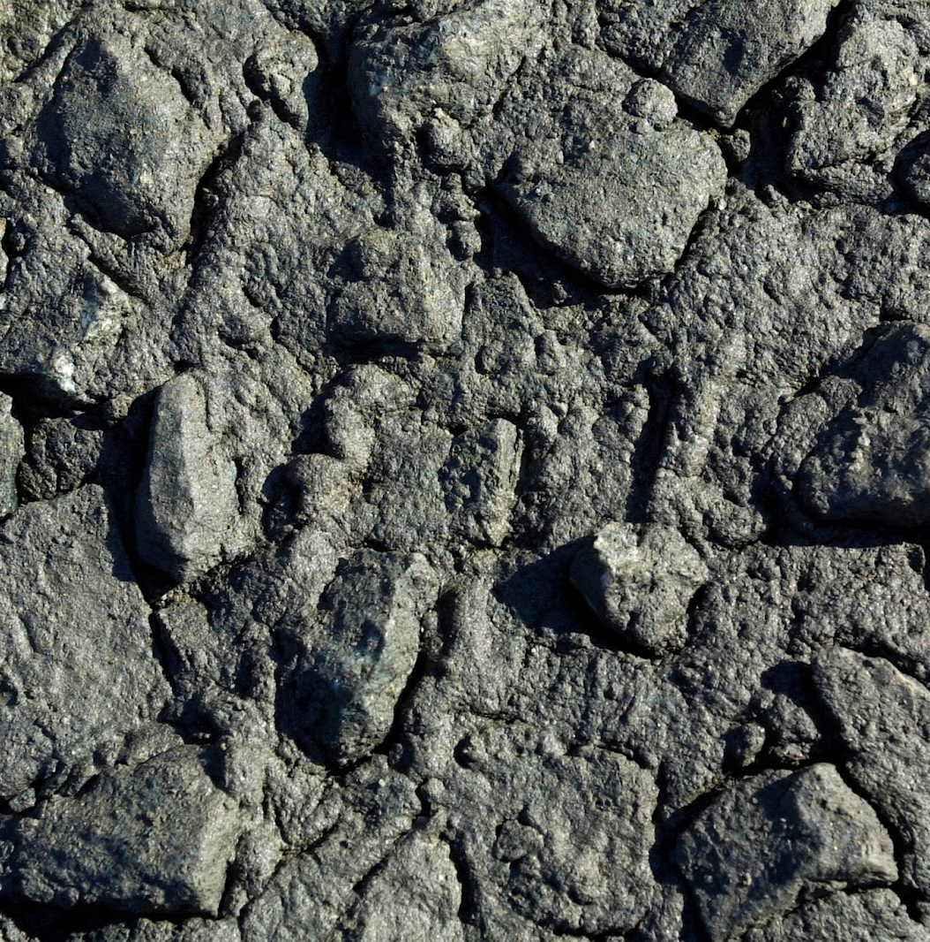
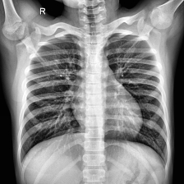
Applied Machine Learning
Pneumonia Classification on Children’s Chest X-Ray Images
Anneke Catherine Naseef S6490662
Marcus Harald Olof Persson S5343798
Ignacio Jacob Uroz Rodríguez S5118913
Julian Wilbert Sprietsma S5096219
Notes:
Julian

Slide 2
Agenda
01
Introduction
02
Preprocessing
03
Training & Results
04
Professionalism
05
Extras and Insights
06
Demo
Notes:
Julian 1. How your model can be used to address a problem (introduction) Optionally: what you wanted to find out with your project 2. Why your project has novelty
3. How you preprocessed your data Highlight: how you train/test/validate split
4. Which model(s) you chose to implement a. Include hyperparameter tuning and regularization
5. How your model(s) performed (results) a. Evaluate whether there is overfitting b. Use relevant metrics c. Compare your model against the baseline properly
6. What you did to make your project professional
7. Which extras you did that may boost your grade
8. Insights you gained from the project as related to the problem at hand

Slide 3
Introduction
Notes:
1 minute.

Slide 4
Context
1
Patient presents (pneumonia) symptoms.
2
Physician takes x-ray.
3
X-ray is inputted into application.
4
App outputs diagnosis/confidence measure.
5
Results used in diagnostics.
Notes:
Annie
Pneumonia in children as global issue.
Bacterial pneumonia / Viral pneumonia

Slide 5
Novelty
1. From Binary to Distinction
2. Exploring Condensation
Typically, yes/no pneumonia.
Distinguishing bacterial and viral pneumonia overlap allows for proper treatment.
Can we achieve as good of a performance with a smaller model?
Not just train on raw images, but on image data.
3. Cheaper Applications
4. Attacking Imbalance
Child pneumonia mortality is highest in low-resource areas.
A cheaper solution that solves the same problem is beneficial.
Bacterial pneumonia dominates our dataset.
Augmentation and class weights allows for generalisation without new data.
Notes:
Julian

Slide 6
Chosen Models
Baseline 3-layer CNN
LightGBM as an Alternative
Pretrained ResNet-18
What?
2 Convolution, 1 Fully Connected.
Why?
Serve as a baseline to measure to compare performance of models.
What?
Gradient-boosted decision tree model.
Why?
Explore if a fast, classical method can rival deep learning.
What?
Training on a new layer and classifier head.
Why?
Leverage transfer learning from strong pretrained features.
Notes:
Julian
CNN
Baseline
Tuned Learning rate and weight decay
ResNet18
A CNN with pre-trained weights
Tuned Learning rate and weight decay
LightGBM
Gradient boosting network
Tree based algorithms
Tuned Learning rate, number of leaves and max depth

Slide 7
Preprocessing
Notes:
2.5 minutes

Slide 8
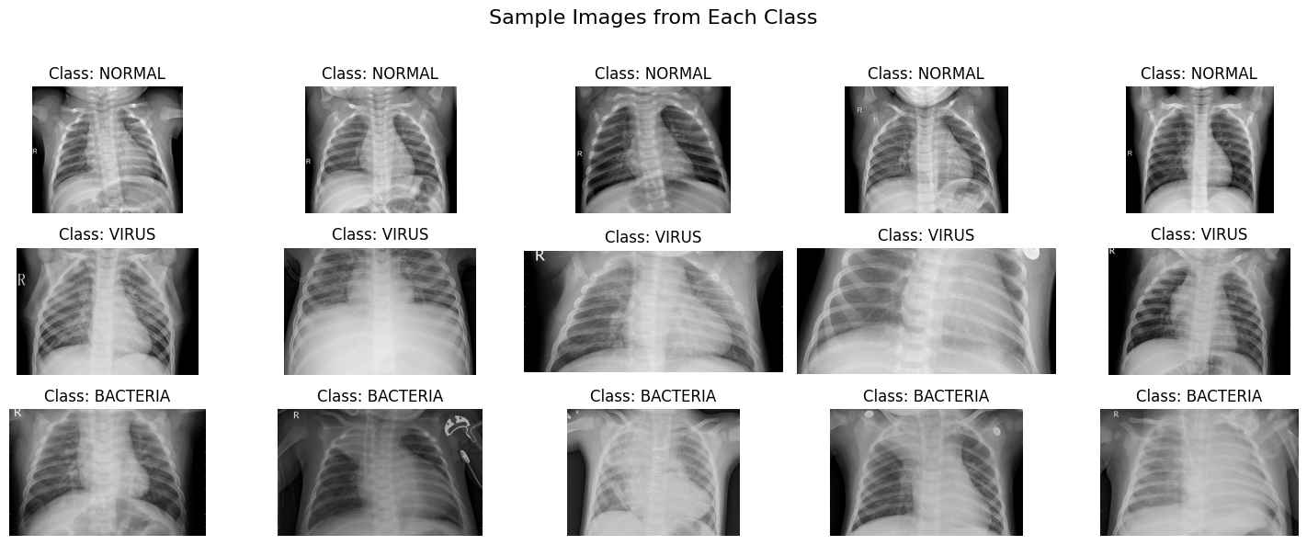
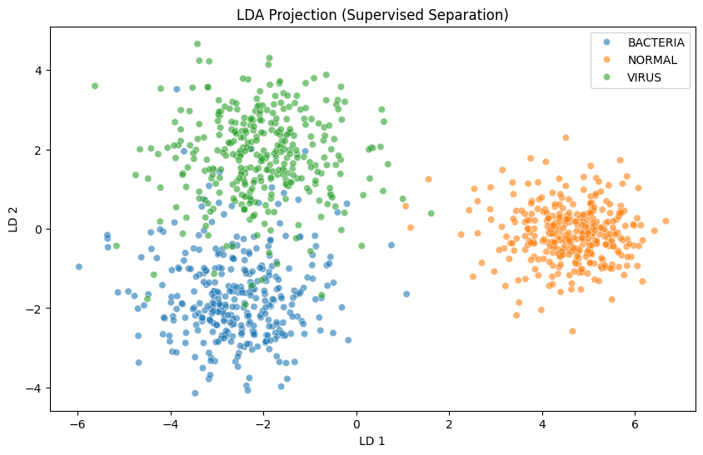
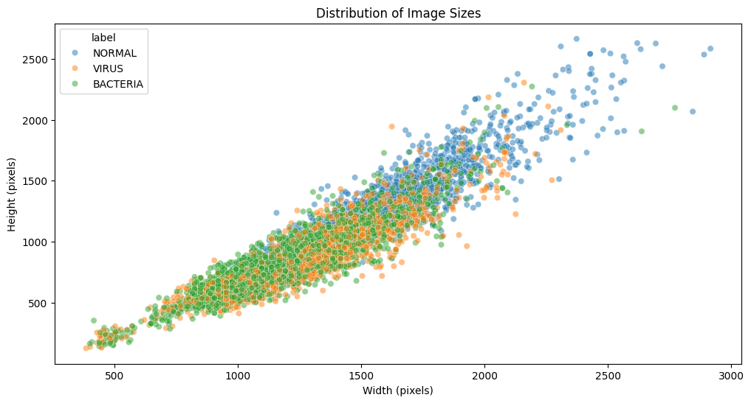
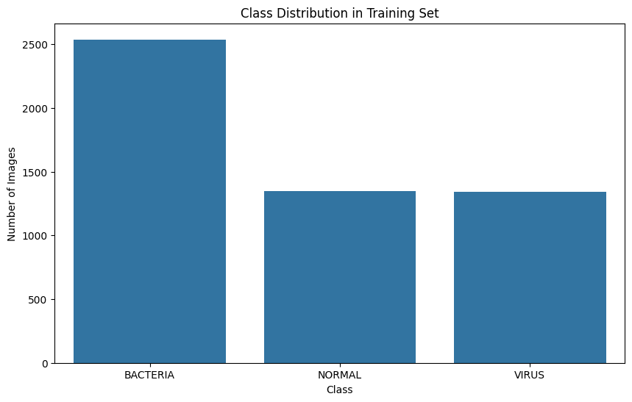
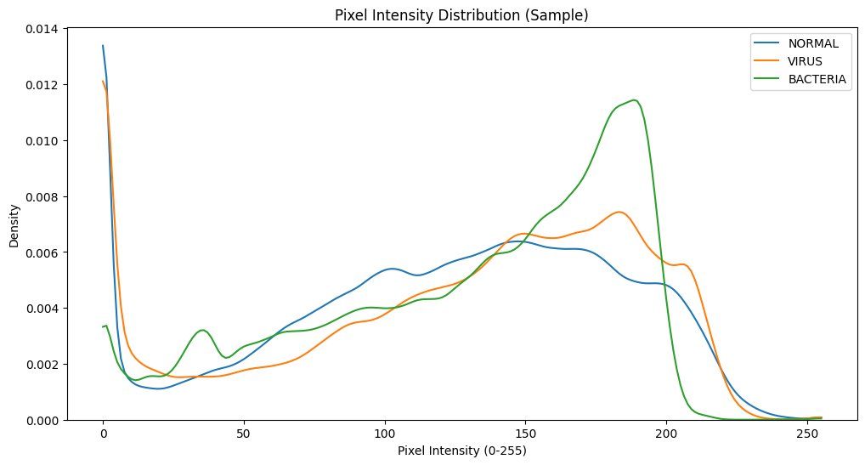
Beautiful. Raw. Messy.
Notes:
Marcus

Slide 9
PyTorch Pipeline…
1. Lung Region Extraction
2. Resize Standardisation
What? Contour mapping to isolate the lungs.
Why? Remove irrelevant borders and background for model focus.
What? Rescale images to a fixed size.
Why? Address inconsistent dimensions, and requirement for uniform input in batching.
3. Contrast Enhancement
4. Normalisation
What? CLAHE to apply adaptive histogram equalisation.
Why? Normalise brightness/contrast differences from different X-rays.
What? Scale pixel values to a consistent range.
Why? Stabilization and training speedup.
Notes:
Annie
Per split (train/test):
Bounding Box Extraction
Extract Lung Region
Resizing Standardisation
Contrast Enhancement
Contrast Limited Adaptive Histogram Equalization (CLAHE)
Normalisation
Data augmentation applied while setting up dataset for training (training set (copy) only
Slight rotations, zooms, brightness/contrast shifts and shearing to add robustness and address class imbalance somewhat.
Unmodified training set used as validation set

Slide 10
Extended With the LightGBM Pipeline!
5. Downsampling
6. Normalise to NPArray
What? Shrink the processed image further.
Why? Keep tabular feature count small enough for a tree-based model.
What? Project pixel values into a [0, 1] scaled array.
Why? Consistent scale for computing features.
7. Extract Features
Ending: Data Augmentation
What? Compute pixel statistics and HOG features.
Why? Capture structural texture at lower dimensionality instead of raw pixels.
What? Slight rotations, zooms, contrast shifts.
Why? Robustness and class balancing.
Notes:
Annie
HOG = Histogram of Oriented Gradients
Requires pytorch pipeline (without normalisation and data augmentation) to run first
Per split(train/test):
Resizing standardisation
Downsampling to reduce tabular dimensions
Normalised pixel values projected into numpy array
Extract statistics and HOG features
HOG instead of pixels -> reduced dimensionality & captured structural textures
Data augmentation (training set only)
Same as for pytorch
copy, processed separately in the same way (as above) to prevent data leakage in cross-validatio

Slide 11
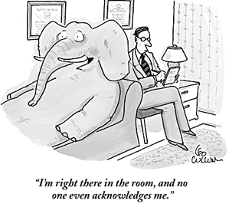
But What About Data Leakage?!
Assumption: Kaggle dataset does not suffer from data leakage.
Residual Risk: Multiple x-rays of the same patient?
Issue: Raw data is just train/test.
Train set is split 80/20 train-validation.
Validation set does not contain any augmented data.
Preprocessing is done per image, not as a general whole.
Bonus: LightGBM pipeline has both non-augmented and augmented datasets
Data Leakage
dataset
vibe coder
Notes:
Marcus
Train set is split 80/20 train-validation -> stratified

Slide 12
Training & Results
Notes:
Marcus
2.5 minutes.

Slide 13
Hyperparameter Tuning & Training
Grid Search & 5-fold Stratified K-fold Cross-validation.
Selection Metric: Macro-F1 for tracking class balance.
Early Stopping: 3 epochs.
Model | Hyperparameters | Range
CNN/ResNet-18 | Learning Rate | 1e-4, 1e-3, 1e-2
 | Batch Size | 16, 32
 | Weight Decay | 0, 1e-4
LightGBM | Learning Rate | 0.01, 0.05, 0.1
 | Number of Leaves | 15, 31, 63
 | Maximum Depth | 4, 6, Unlimited (-1)
Notes:
Julian
Dataset provided with train/test split
Stratified K-fold validation
-> 5-fold validation (80/20 train/val split) (random state of 42)
-> grid search to exhaust possible hyper-parameters
-> unbalanced classes in training set
In short: grid search tunes three structurally different models reproducibly, and stratified 5-fold CV gives each candidate config a low-variance macro-F1 estimate that stays valid despite your class imbalance.
Macro f1 score used for multiclass classification.
These are conventional default-centered ranges (each grid is "below default / default / above default"), chosen to be wide enough to expose over- vs under-fitting without exploding the search. And they did their job: across the board, tuning selected the conservative, lower-capacity, more-regularized end of every range — exactly what you'd predict for a small, class-imbalanced medical dataset.

Slide 14
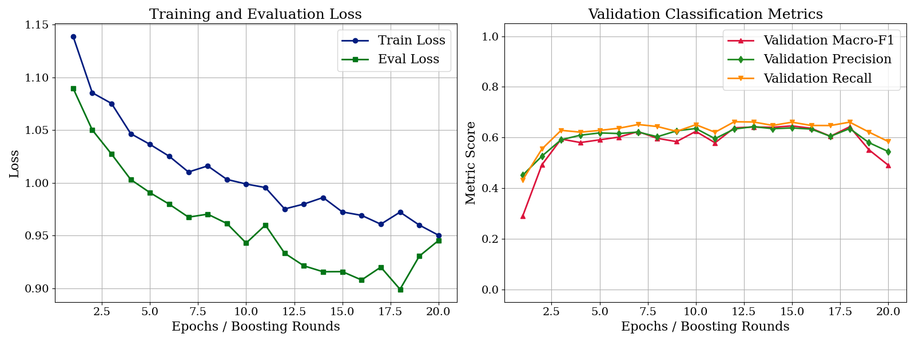
CNN
Learning Rate = 0.0001; Batch Size = 16; Weight Decay = 0.0001
Max Epochs = 20
Notes:
Nacho
On the validation set, loss reported 0.899, macro-f1 score 0.642, precision 0.635, and recall 0.660. On the testing set, loss reported 0.958, macro-f1 score 0.660, precision 0.661, and recall 0.662
Train and validation loss stay relatively close
Performance is limited.

Slide 15
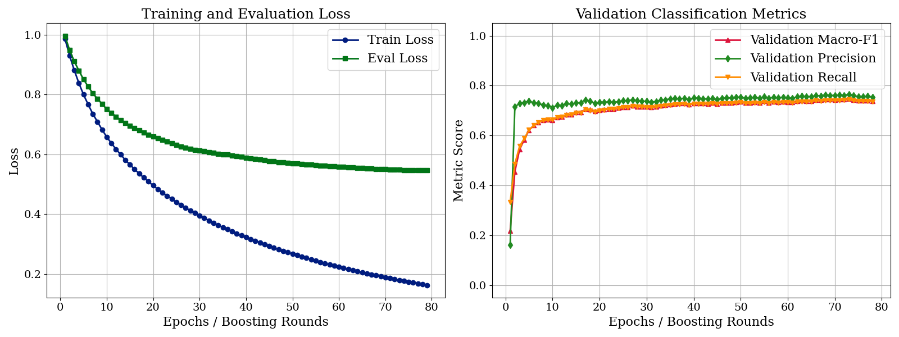
LightGBM
(Learning Rate = 0.1; Number of Leaves = 15; Maximum Depth = Infinite)
Max Epochs = 150
Notes:
Nacho
On the validation set, macro-f1 score reported 0.740, precision 0.756, and recall 0.737. On the testing set, macro-f1 score reported 0.770, precision 0.790, and recall 0.773.
Clear improvement over baseline CNN
Overfitting visible: early stopping

Slide 16
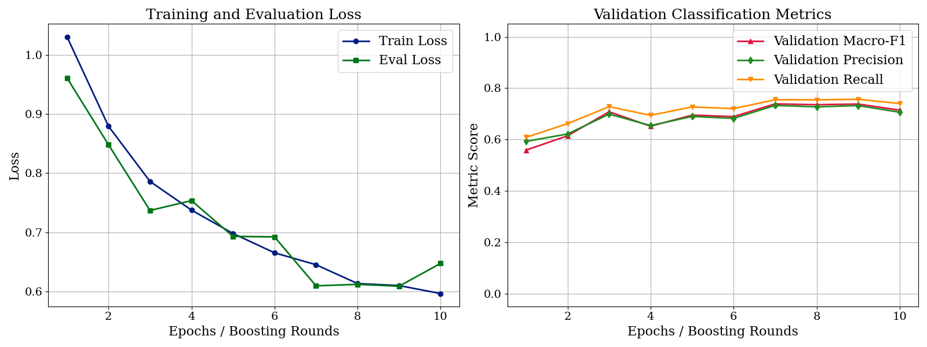
ResNet-18
(Learning Rate = 0.0001; Batch Size = 32; Weight Decay = 0.0001)
Max Epochs = 10
Notes:
Nacho
On the validation set, loss reported 0.609, macro-f1 score 0.738, precision 0.732, and recall 0.757. On the testing set, loss reported 0.507, macro-f1 score 0.831, precision 0.833, and recall 0.829.
Lowest test loss: 0.507
Transfer learning improved performance compared to baseline CNN

Slide 17
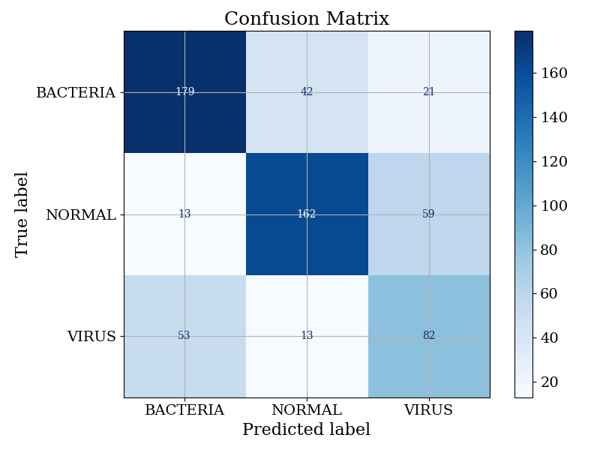
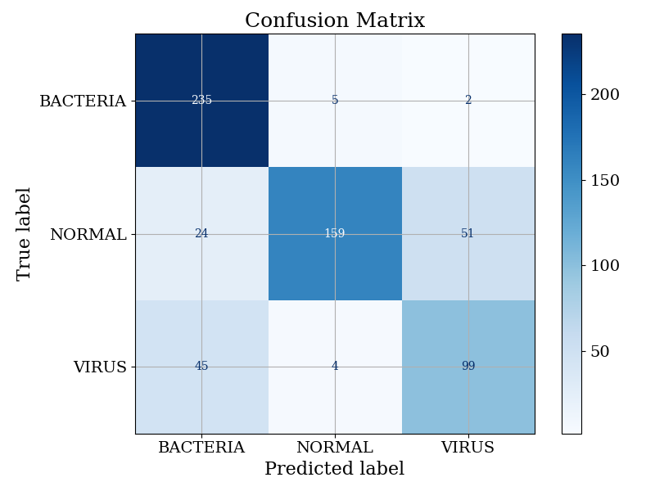
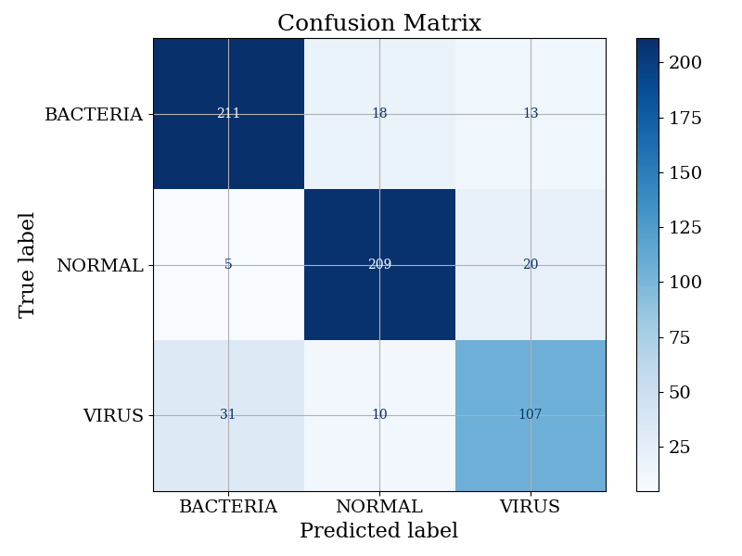
Confusion Matrices
CNN
LightGBM
ResNet-18
All three models confuse the two infectious classes and under-detect the minority VIRUS class; ResNet-18 best mitigates this, while LightGBM's high BACTERIA score reflects a majority-class bias rather than balanced skill, even after data augmentation.
Notes:
Nacho

Slide 18

professionalism
Final_final_version_2_final_v3.pdf
Notes:
1 minute.

Slide 19
Professionalism
Fully Documented Clear Code
Detailed README
Pre-Commit Hooks
uv Package Management
Tensorboard for Monitoring
Local Configs to Hide Secrets
Logging Everywhere
Unit Tests With GitHub Actions
Pull Request Practices
Weekly Meetings at the Friday Lab
Command Line Interface (CLI)
Sync With Overleaf for Quick Access
Notes:
Nacho

Slide 20
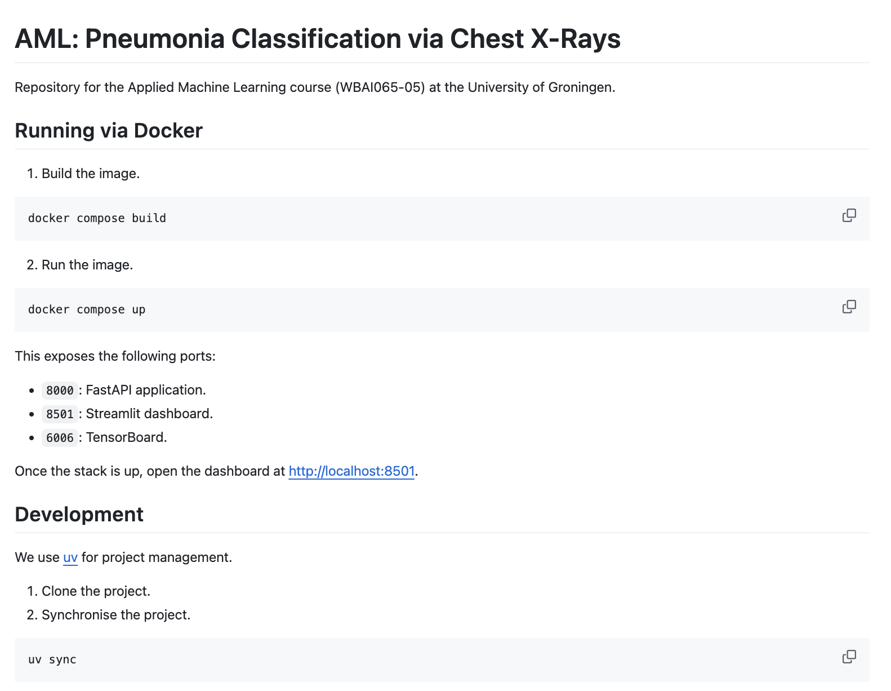
Notes:
Nacho

Slide 21
Extras and Insights
Notes:
1 minute.

Slide 22
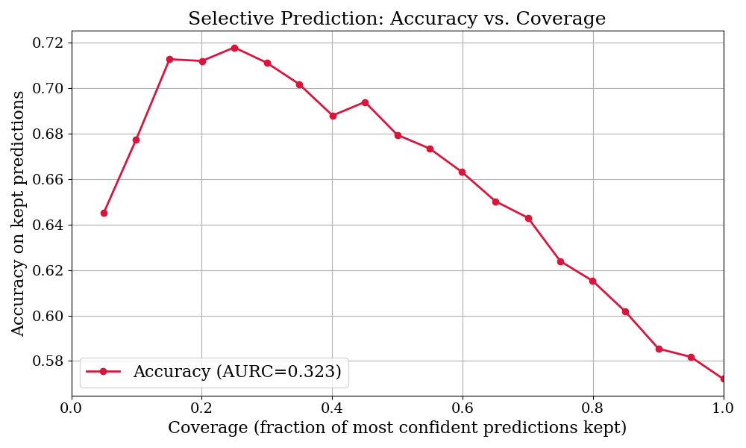
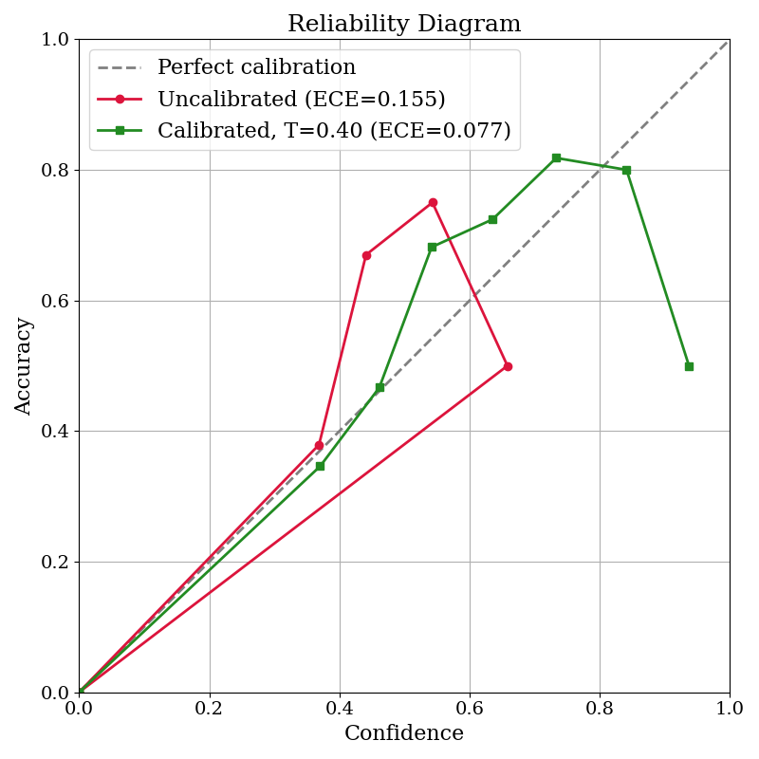
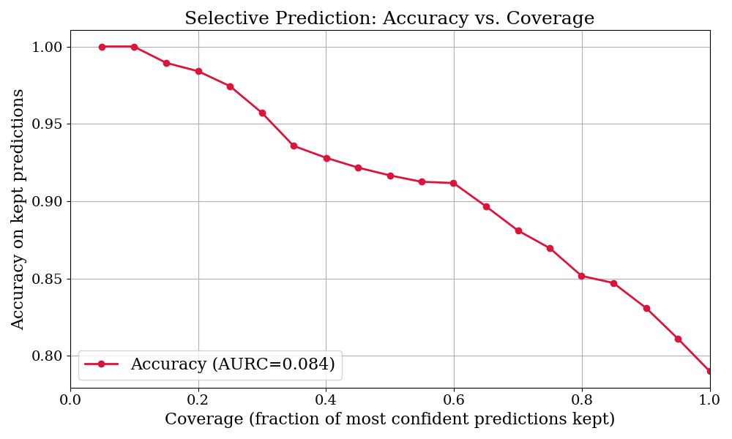
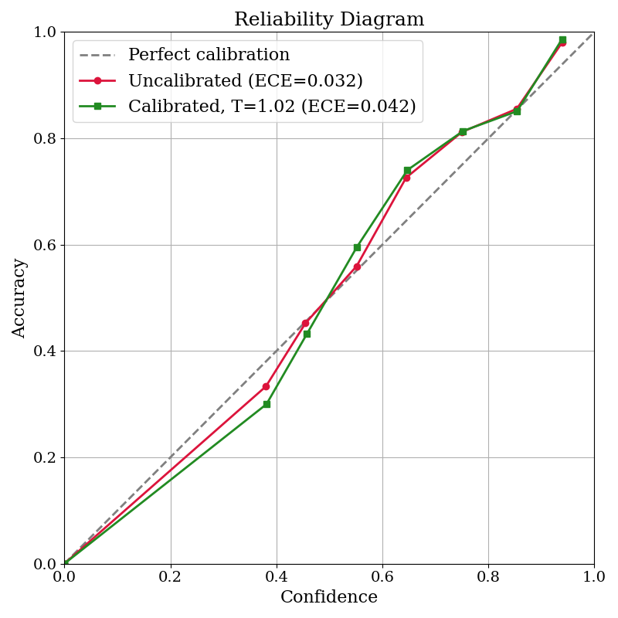
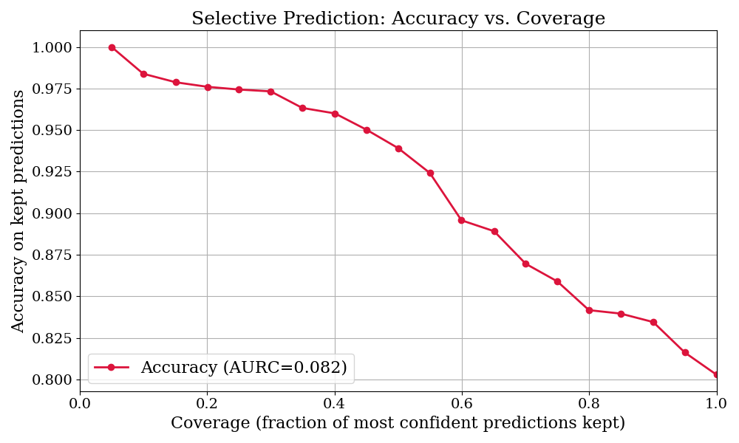
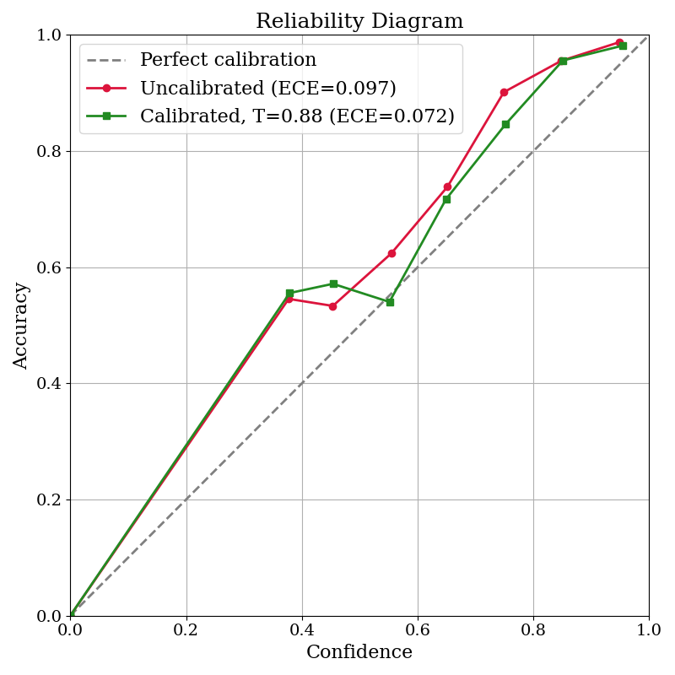
Uncertainty Quantification
Calibration: Temperature scaling scored by ECE.
Selective Prediction: Confidence-based Abstention (AURC).
Metrics: ECE, Brier, NLL, Entropy
Most Underconfident: CNN
Best Calibrated: LightGBM
Best Selective Prediction: ResNet-18
CNN
LightBM
ResNet-18
Notes:
Marcus
Same hyperparameters.
F1/precision/recall say how accurate; Brier and NLL fold accuracy and confidence into one score; ECE isolates calibration; entropy is the per-prediction uncertainty signal; AURC (area under the risk-coverage curve) measures whether that signal is useful for abstaining. The first set is standard classification; the rest are the bonus UQ layer.
CNN is the baseline — overconfident (T=0.40), AURC 4× worse; LightGBM & ResNet tie on accuracy (~0.80).
LightGBM was already calibrated out of the box (T≈1.02) — temperature scaling barely moved it.
"The reliability diagram checks if the confidences are honest; the selective-prediction curve checks if they're useful — i.e. whether ranking by confidence actually lets us trade coverage for accuracy."
Points below the line mean overconfident — it claimed more certainty than it earned; above means underconfident. The number is ECE, the average distance from that diagonal, lower is better. The red line is the raw model, the green is after temperature scaling.

Slide 23
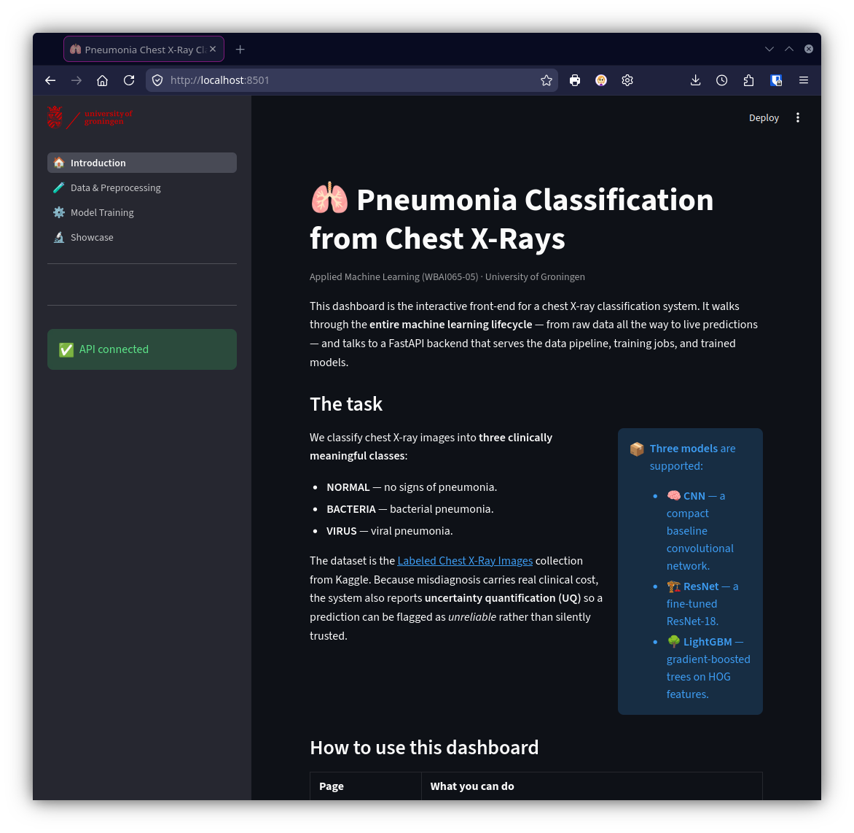
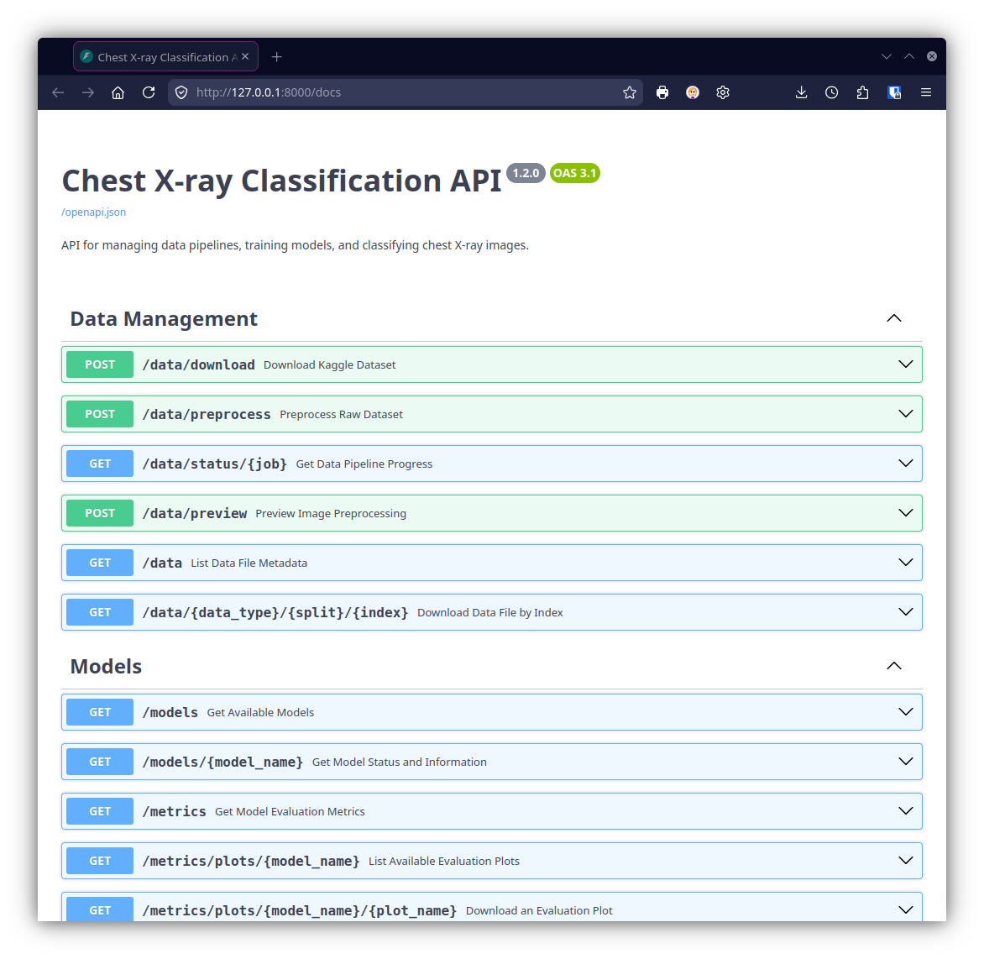
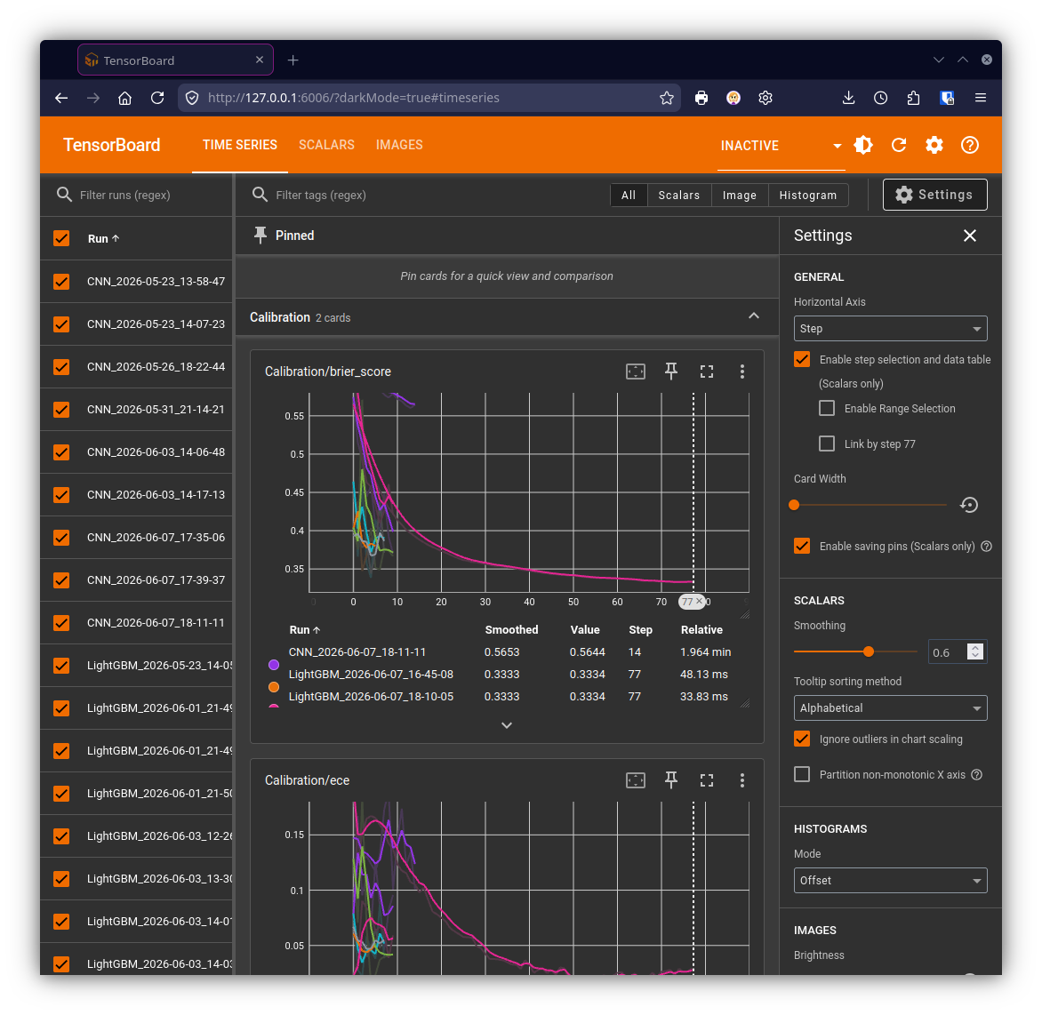

Containerisation
Frontend: Streamlit
Backend: FastAPI
Monitoring: Tensorboard
Notes:
Julian

Slide 24
Insights
1
Bacterial against viral pneumonia is difficult from overlap.
2
We can frame “Pneumonia vs. Healthy” for 2 Stages.
3
Accuracy ≠ calibration.
4
VIRUS is the minority and bottleneck, capping F1.
5
The dataset is a big contributor.
Notes:
Nacho
1. Bacterial vs. viral pneumonia is the hard part; spotting "normal" is comparatively easy. (teammate's)
Every model's errors cluster in the VIRUS↔BACTERIA cells. On VIRUS cases the best models still misroute ~30% to BACTERIA (ResNet: 46 of 148; LightGBM: 45 of 148), while NORMAL is recovered cleanly.
2. Frame the system as "pneumonia vs. healthy" first, fine-grained type second. (teammate's)
The healthy/diseased boundary is reliable; the bacteria/virus split is where confidence drops — worth surfacing as two stages rather than one 3-way call.
3. Accuracy and calibration are not the same thing — the best model is the most overconfident. (new)
ResNet is most accurate but worst-calibrated (ECE 0.184, temperature 0.74 = not the best confidence); LightGBM is the most trustworthy out-of-the-box (ECE 0.032). Temperature scaling cuts ResNet's ECE to 0.119, and its low AURC (0.066) means deferring the least-confident cases to a radiologist sharply raises accuracy — useful for a clinical tool. The overfitting is the trade-off, but unfortunately our dataset is just too small.
4. VIRUS is the minority class and the bottleneck — it caps macro-F1. (new)
It has the fewest test cases (~148 vs. ~240 BACTERIA / ~234 NORMAL) and the lowest per-class recall everywhere. Because macro-F1 weights classes equally, fixing VIRUS recall is the single biggest lever on the headline score — a case for targeted augmentation or class weighting.
5. We're data-limited, not capacity-limited. (new)
LightGBM's train loss falls to ~0.16 while eval plateaus near ~0.55 (early-stopped at epoch 79) — a wide generalization gap, and the from-scratch CNN never gets traction. The ceiling looks like data quantity/quality, so more or better-curated X-rays should pay off more than a bigger model.

Slide 25
Demo
Notes:
2 minutes.
Marcus

Slide 26

Demo (Backup)
Notes:
2 minutes.

Slide 27
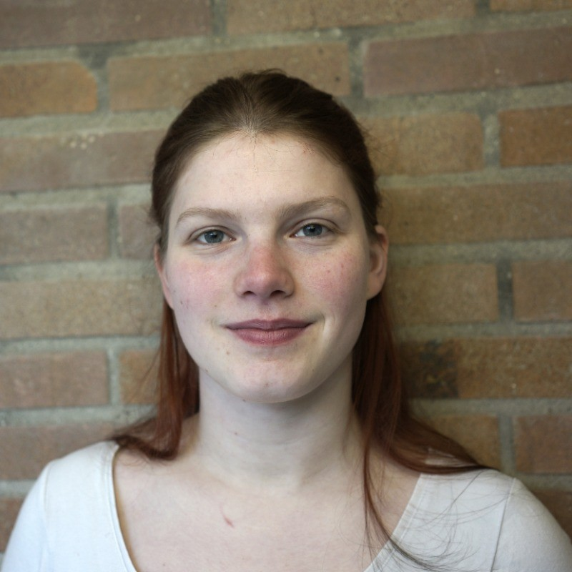
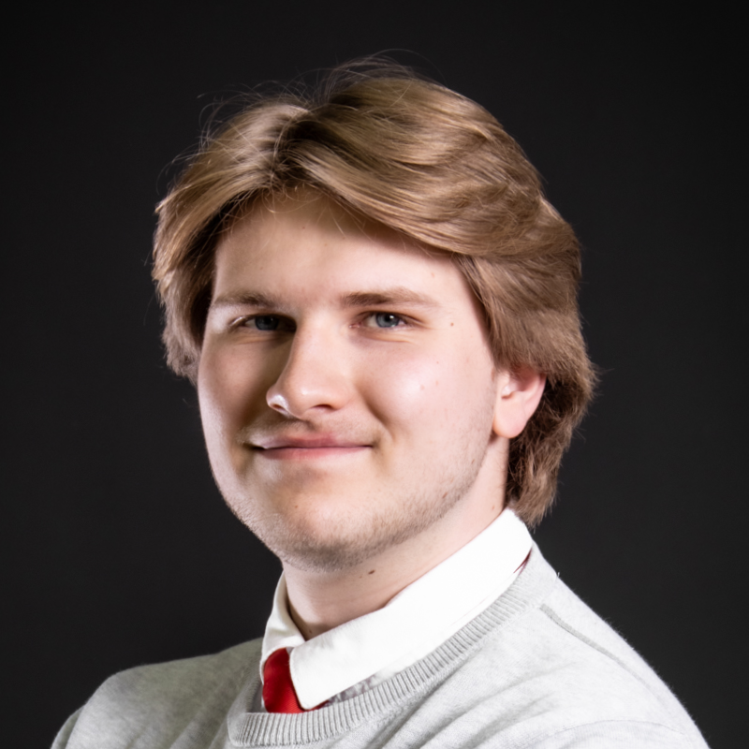


Thank You!
/anneke-c-naseef
/marcusper
/ignacio-uroz
/julian-sprietsma

