Slide 1


Kiwi PyCon 2016
Dunedin

Slide 2
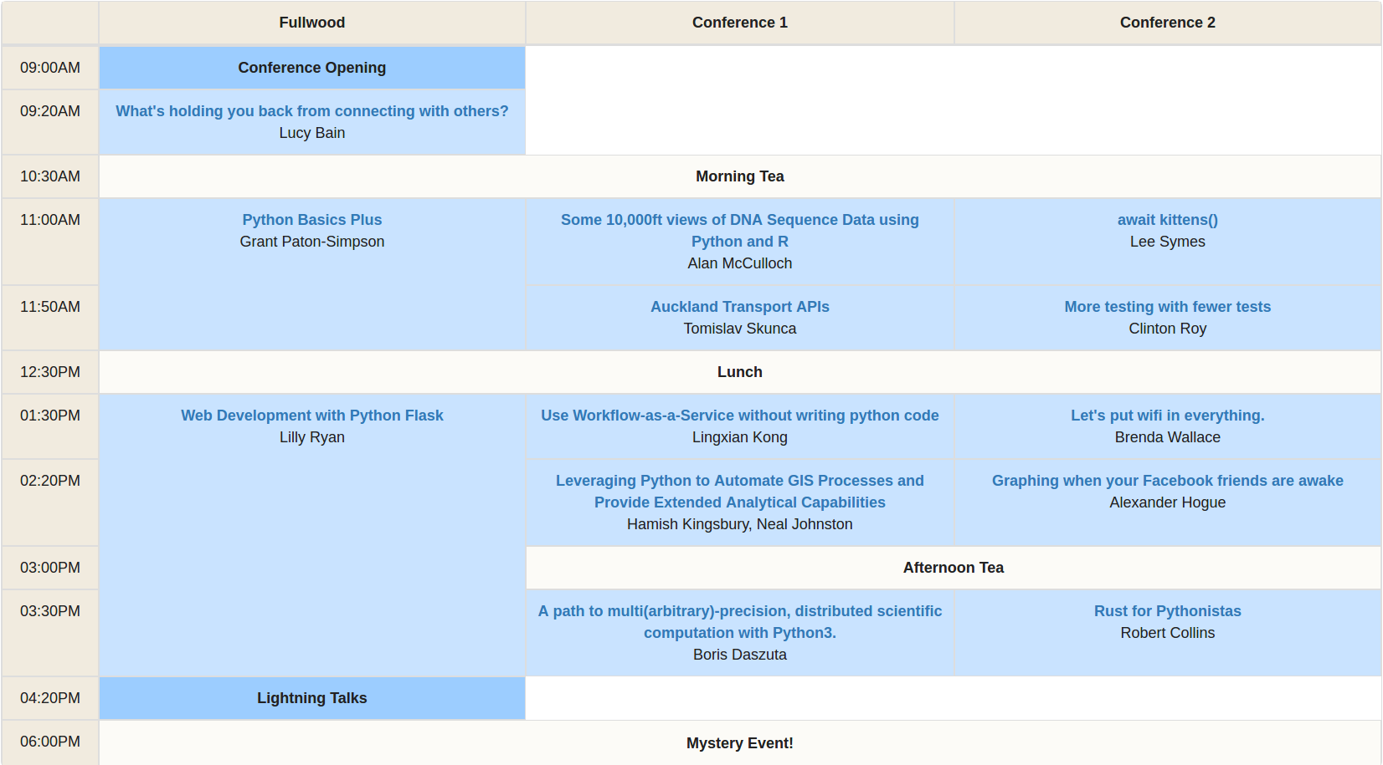
Schedule Fri 9th

Slide 3
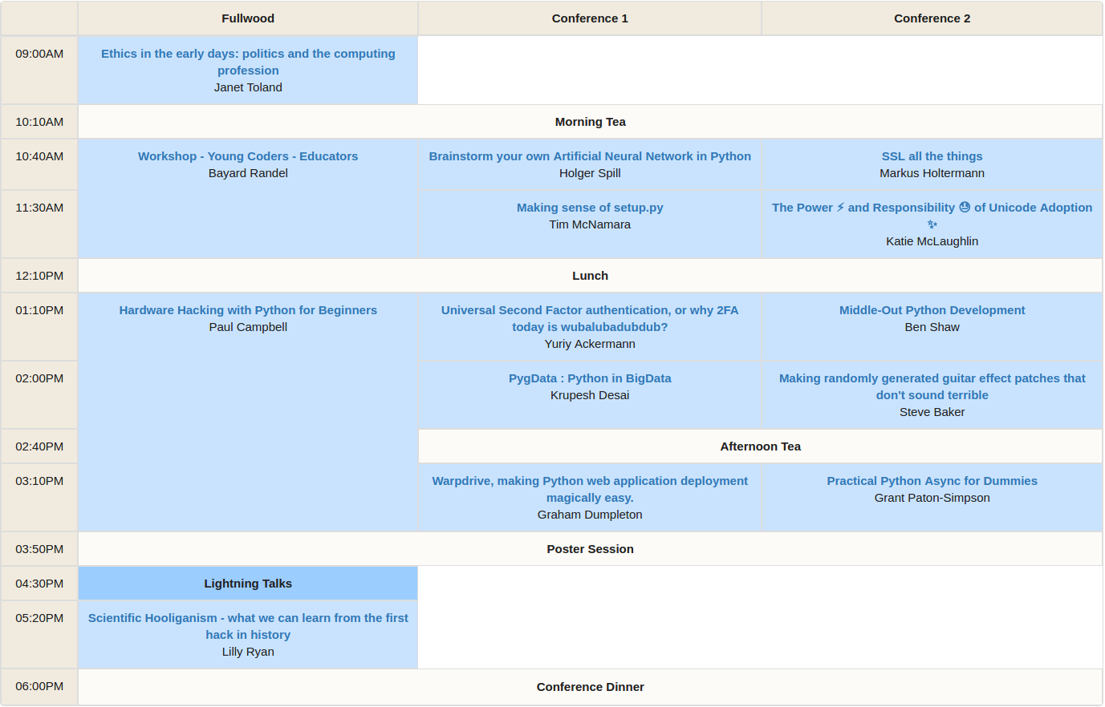
Schedule Sat 10th

Slide 4
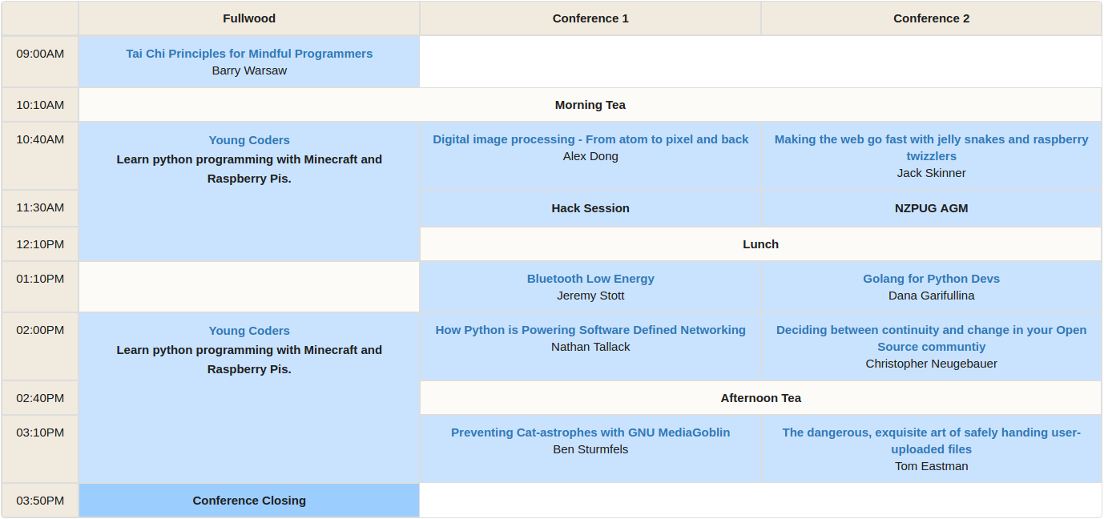
Schedule Sun 11th

Slide 5




Thanks to our Sponsors

Slide 6













Thanks to our Sponsors

