Slide 1
Deconvolution Networks
Pattern Recognition & Machine Learning Laboratory
Jinha Lim, Aug 8, 2021

Slide 2
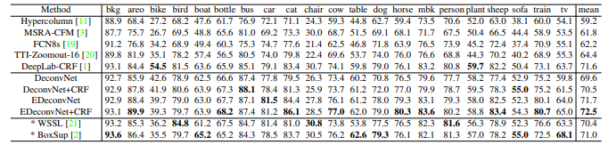
Learning Deconvolution Network for
semantic Segmentation
Motivation
Network has a predefined fixed-size reception feild
Detailed structures of an object are often lost or smoothed
Cause by label is too coarse and deconvolution procedure is overly simple
Approach
Deconvolution network
CNN architecture designed to generate large output
Enables dense output score prediction
Instance-wise prediction
Inference on object proposals, then aggregate
Enables recognition of objects with multiple scales
Evaluation
PASCAL VOC 2012 segmentation benchmark
contains 1456 test images and 20 object categories

Slide 3
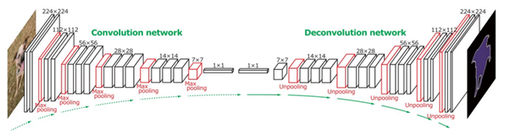
Introduction
CNN (Convolutional Neural Network)
A multi-layered feed-forward neural network, made by stacking many hidden layers on top of each other in sequence
The hidden layers are typically covolutional layers follwed by activation layers, some of them followed by pooling layers
Deconvolution Network
The operation inverse to convolution\
Also known as upsampling process
synonymous with expansion, on a sequence of smaples of a signal or other continuous function, produces an approximation of the sequence that have been obtained by sampling the signal at a higher rate
Designed to remove or reverse the blurring present in microscope images included by the limited aperture of the objective

Slide 4
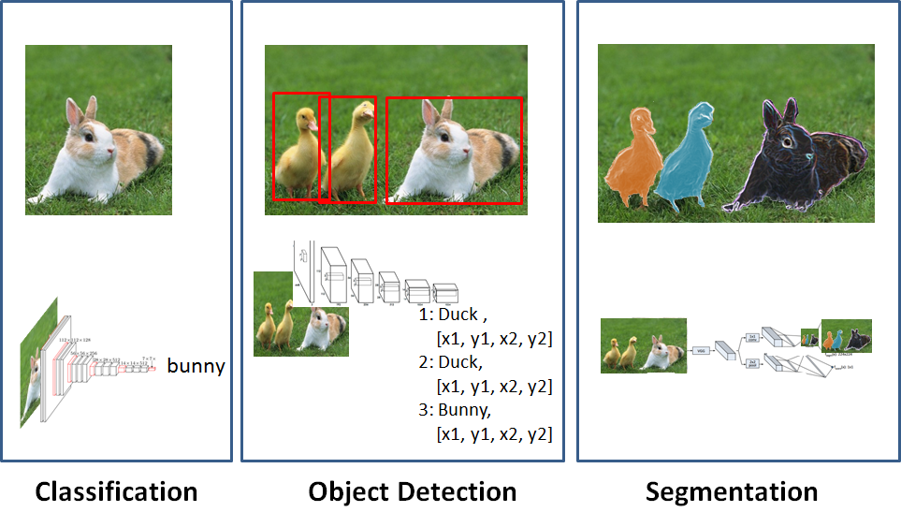
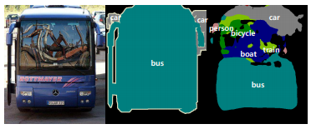
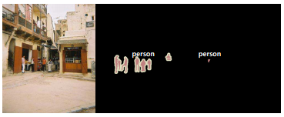
Motivation
Image segmentation
Classification: labeling one image as whole
Detection: separating different object and boxing each objects
Segmentation: recognition of objects in the image with pixel level detail
Limitation of Fully Convolutional Network (FCN)
Idea as to design network as stack of convolutional layers to make predictions to all at once
To maintain size of input, exponential parameter was required
Skip architectrue: suggests to skip some layer and feeds the output of one layer as the inpuut to the net layer as well as some other layer

Slide 5
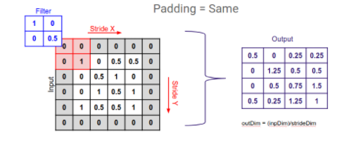
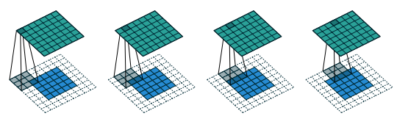
Methods (1/3)
Padding
Padding works by extending the area of which CNN processes an image
The kernel is the neural filter which moves accross the image, scanning each pixel and converting the data into different format size
Padding is added to the frame of the image to allow for more space for kernel to cover the image
Figure downsampling using padding method
Figure convolving a 3 x 3 kernel over a 5 x 5 input using full padding and unit strides

Slide 6
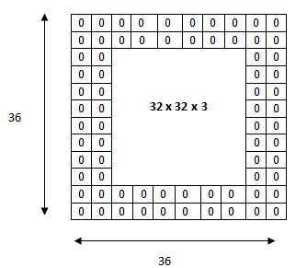
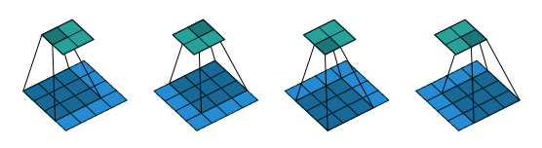
Methods (2/3)
Stride
Parameter of the neural network's filter that modifies the amount of movement over the image or video
If a neural network's stride is set to 1, the filter move one pixel, or unit, at a time
The size of filter affects the encoded output volume, stride is often set to a whole integer
Figure applying 5 x 5 x 3 filters to a
32 x 32 x 3 input volume
Figure Convolving a 3 × 3 kernel over a 4 × 4 input using unit strides

Slide 7
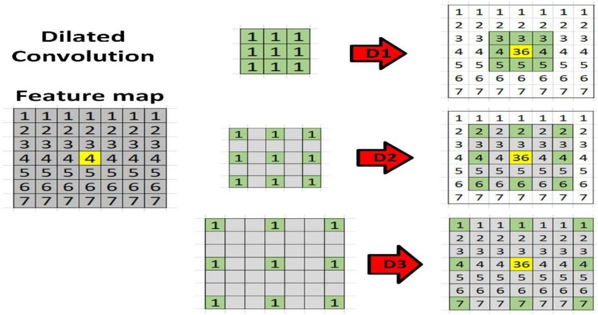
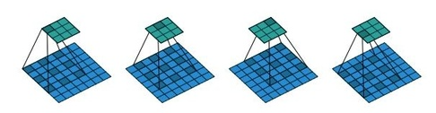
Methods (3/3)
Dilation
Defines a spacing between the values in a kernel
A 3x3 kernel with a dilation rate of 2 will have the same field of view as a 5x5 kernel, while only using 9 parameters
Delivers a wider field of view at the same computational cost
Figure Convolving a 3 × 3 kernel over a 7 x 7 input with a dilation factor of 2

Slide 8
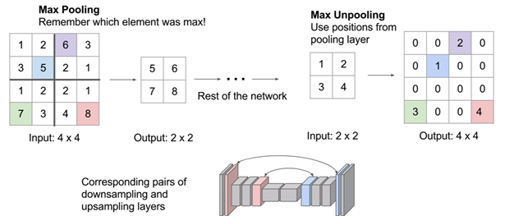
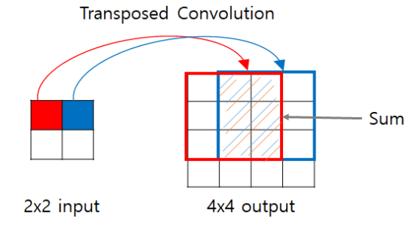
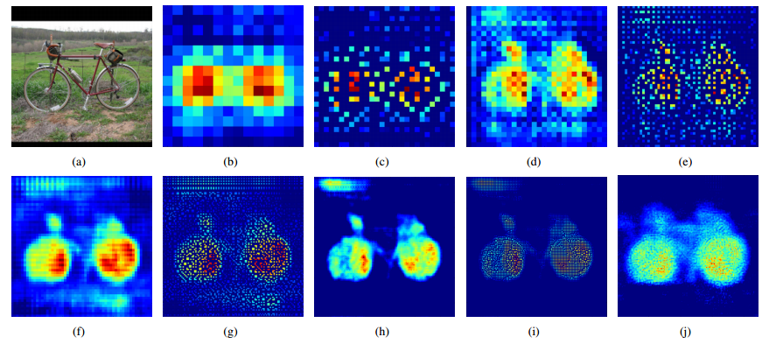
DeepConvNet
Unpooling
Max Pooling
remembers which element was max
restores the element using positions from pooling layer
reduces information loss compared to Bed of Nails unpooling
Deconvolution
Output of unpooling layer is enlarged, yet sparse activation map
Deconvolution layers densify the sparse activations obtained by unpooling through convolution-like operations with multiple learned filters

Slide 9
Implementations
Experiment
Dataset
Employed PASCAL VOC 2012 segmentation dataset for training
Training data construction
Two-stage training strategy and separate training dataset in each stage
Annotated object in training images, and extended the box 1.2 time larger to include local context around the object
CRF (Conditional random field) as post processing
post processing enhances accuracy by approx 1%
On second stage, each training example was extracted from object proposal, where all relevant calss labels are used for annotation
Evaluation
Adopt com6 evaluation protocol that measures scores based on Intersection over Union (IoU) between ground truth and predicted segments
Improved further performance through an ensemble with FCN-8s
imporves IoU about 10.3% and 3.1% point with respect to FCN-8s and DeconvNet

Slide 10
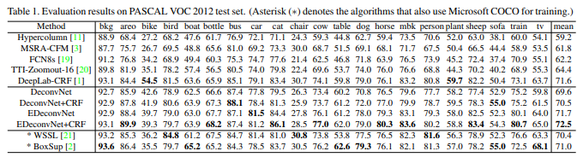
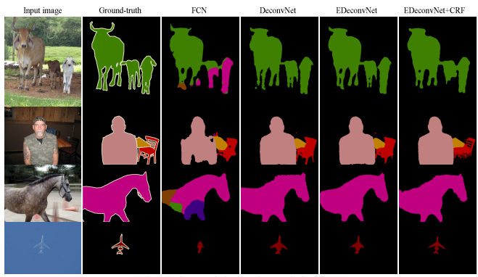
Results

Slide 11
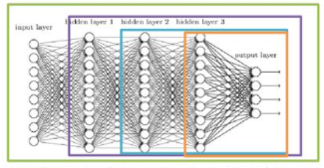
Stress points
Two stage training
Two stage training is not critical
DeconvNet can be trained well with single stage training
Two stage's performance is better
According to the research, validation accuracy of two stage training is higher than single stage training
Based on previous experiments, this margin could make big difference in mean IOU score
Batch Normalization
Normalizing output of every layer to standard Gaussian distribution
Without Batch Normalization, DeconvNet stuch in local mnima
Maximum segmentation Accuaracy:
With Batch Normalization: 92.61 (0.18 loss)
W/O Batch Normalization: 62.41 (0.59 loss)

Slide 12
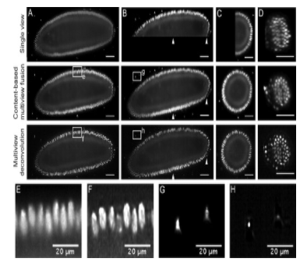

Conclusion
Effects of the research
Practical to sharpen images that suffer from fast motion or jiggles during caturing
Effective method of enhancing the resolution and contrast of the optical microscope
Improves the resoulution and contrast of the fused image compared to content-based multiview fusion
For instance, fluorescent beads that are ideally collapsed to single intense points can be restored by deconvolution method
Future Direction
Data augmentation: MSCOCO
Enhance performance on training set
Make network more flexible
Critical point
Dropout does not work in DevconNet

