Slide 1
Visual Representaion 1
Pattern Recognition & Machine Learning Laboratory
Geon-jun Yang
Aug. 10th, 2021

Slide 2
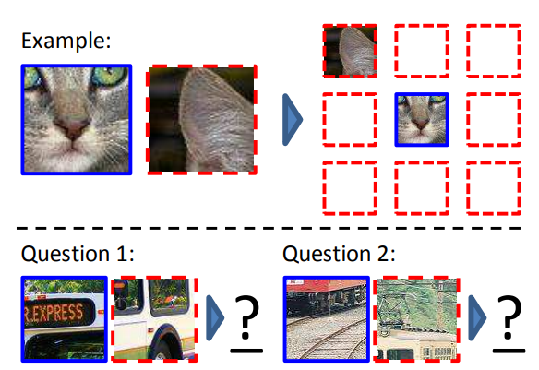
Unsupervised Visual Representation Learning by Context Prediction [C. Doersch et al., 2015] (1/4)
Introduction
Unsupervised learning
Limitation of supervised learning
Human annotation required
Self-supervised learning
Text domain
Context : powerful source of automatic supervision
Corpus Feature vector Predict words
Convert unsupervised problem into self-supervised one
Self-supervised learning for image
Process
Sample random pairs of patches
Provide two patches to network
Train to guess the position of the patches
Contribution
Good for object detection & unsupervised object discovery / visual data mining
Generalizes across images
Instance-level supervision
Types of object detection
C. Doersch, A. Gupta, and A. Efros, “Unsupervised Visual Representation Learning by Context Prediction ," ICCV, 2015.

Slide 3
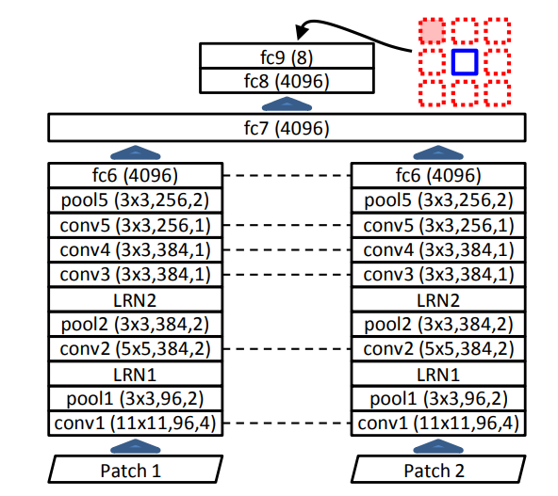
Unsupervised Visual Representation Learning by Context Prediction [C. Doersch et al., 2015] (2/4)
Learning visual context prediction
Architecture
Late-fusion architecture
A pair of conv net that process separately
Must predict relative position of patches
Feed two input patches through conv layers
Produce output that assigns a probability
Feature embedding for individual patches
Semantic reasoning
Avoiding trivial solutions
Extract the desired information
Use high-level semantic not texture or boundary
Include gap between patches
Randomly jitter each patch location
Chromatic aberration
Lens focuses light at different wavelengths
Conv net can learn to localize a patch relative to the lens itself
Detecting the separation between green and magenta
Projection
Color dropping
Architecture for pair classification
C. Doersch, A. Gupta, and A. Efros, “Unsupervised Visual Representation Learning by Context Prediction ," ICCV, 2015.

Slide 4
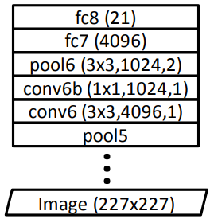
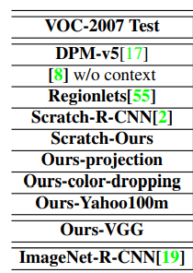
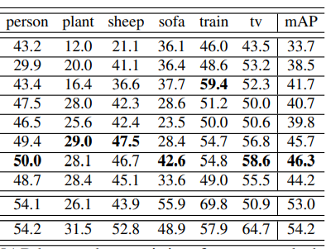
Unsupervised Visual Representation Learning by Context Prediction [C. Doersch et al., 2015] (3/4)
Experiments
Nearest neighbors
Use normalized correlation
Repeat the experiment using fc7 & fc6
Fc7: feature from AlexNet trained on ImageNet
Fc6: feature from authors’ architecture without training
In a few cases, untrained ConvNet does reasonably well
Object detection
None of unsupervised pre-training provide such a performance boost
Adopt R-CNN pipeline
Use only one stack
Resize the conv layer 227x227
Reduce dimensionality to 1024
5% better than training from scratch
8% below label supervision
Architecture for Pascal VOC detection
Results on VOC-2007
C. Doersch, A. Gupta, and A. Efros, “Unsupervised Visual Representation Learning by Context Prediction ," ICCV, 2015.

Slide 5
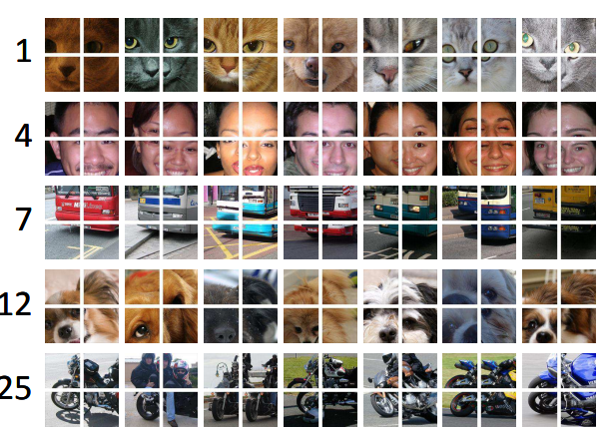
Unsupervised Visual Representation Learning by Context Prediction [C. Doersch et al., 2015] (4/4)
Visual data mining
Definition
Collect images that depict the same semantic objects
Dataset visualization, image search
Connect visual data to unstructured data
Method
Sample four adjacent patches from an image
Find the top 100 images
Use geometric verification
Rank the different constellations
Accuracy on the relative prediction task
Improve the representation
Analyze classification performance on pretext task
Sample 500 random images from Pascal VOC
Accuracy of 38.4%
Pretext task is difficult
Large fraction of patches within each image
The task is almost impossible
Object cluster discovered by algorithm
C. Doersch, A. Gupta, and A. Efros, “Unsupervised Visual Representation Learning by Context Prediction ," ICCV, 2015.

