Slide 1
Tacotron1, 2
Pattern Recognition & Machine Learning Laboratory
Hyeon-Woo Bae
Aug. 11, 2021

Slide 2
Tacotron: Towards End-to-End Speech Synthesis [Y. Wang et al., 2017] (1/5)
Goal
Presenting end-to-end text-to-speech (TTS) system that can be trained on <text, audio> pairs
Motivation
Complexity of modern text-to-speech (TTS) designs
Previous system consists of multiple stages, such as a text analysis frontend, an acoustic model and an audio synthesis module
Contribution
Alleviates the need for laborious feature engineering
Easily allows for rich conditioning on various attributes, such as speaker or language, or high-level features like sentiment
Conditioning can occur at beginning of the model
Single model is likely to be more robust than a multi-stage model
Error of multi-stage model can compound
Y. Wang et al., “Tacotron: Towards End-to-End Speech Synthesis,” in Interspeech, 2017

Slide 3
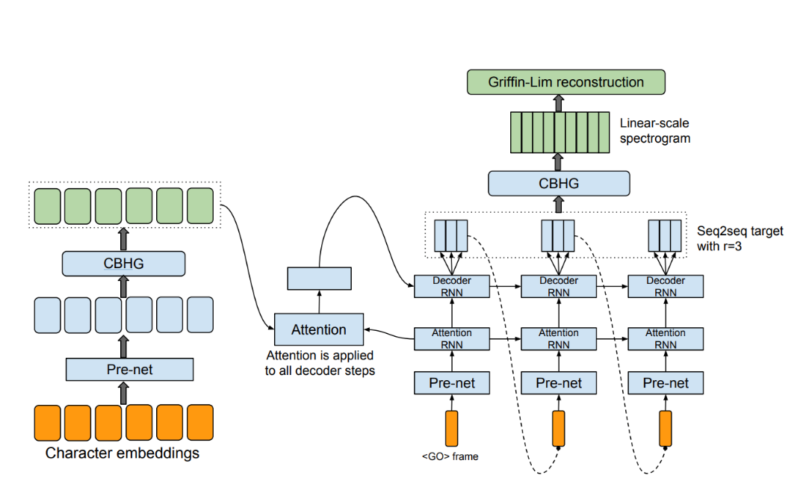
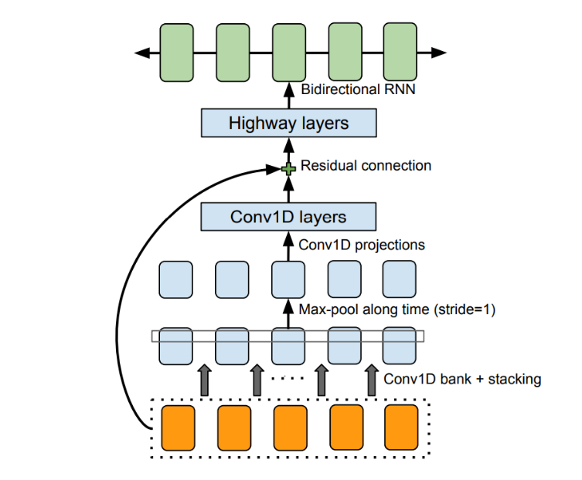
Tacotron: Towards End-to-End Speech Synthesis [Y. Wang et al., 2017] (2/5)
Model Architecture
CBHG (1-D Convolutional Bank + Highway network + bidirectional GRU) Module
Bank of 1-D convolutional filters
Convolving input sequence
Highway networks
Extract high-level features
Bidirectional gated recurrent unit (GRU)
Extract sequential features from both forward and backward context
Architecture of Tacotron
Architecture of CBHG Module
Y. Wang et al., “Tacotron: Towards End-to-End Speech Synthesis,” in Interspeech, 2017

Slide 4
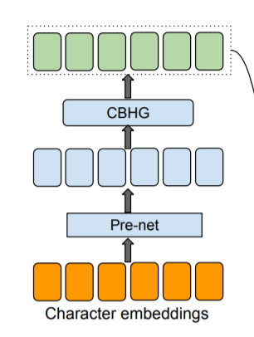
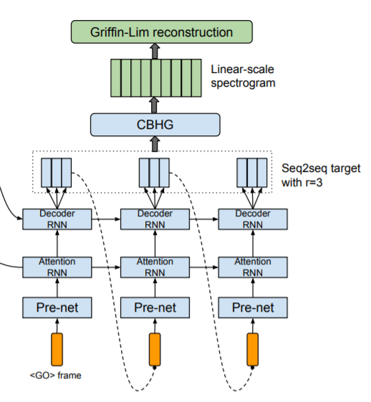
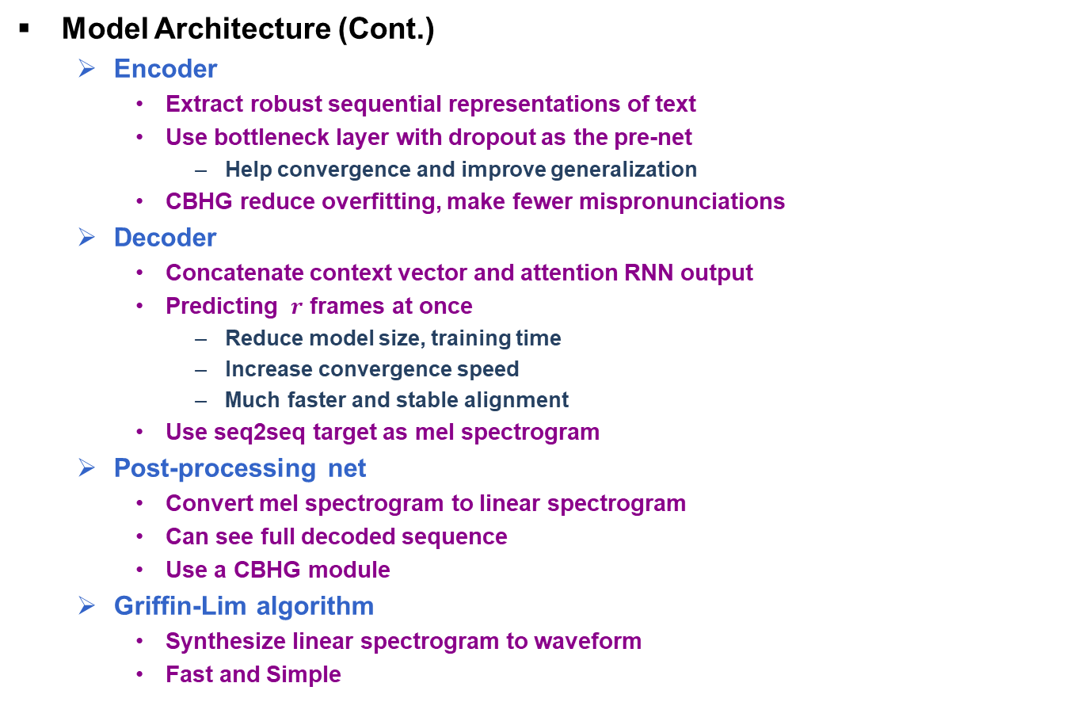
Tacotron: Towards End-to-End Speech Synthesis [Y. Wang et al., 2017] (3/5)
Model Architecture (Cont.)
Encoder
Extract robust sequential representations of text
Use bottleneck layer with dropout as the pre-net
Help convergence and improve generalization
CBHG reduce overfitting, make fewer mispronunciations
Decoder
Concatenate context vector and attention RNN output
Predicting $r$ frames at once
Reduce model size, training time
Increase convergence speed
Much faster and stable alignment
Use seq2seq target as mel spectrogram
Post-processing net
Convert mel spectrogram to linear spectrogram
Can see full decoded sequence
Use a CBHG module
Griffin-Lim algorithm
Synthesize linear spectrogram to waveform
Fast and Simple
Architecture of Encoder
Architecture of Decoder
Y. Wang et al., “Tacotron: Towards End-to-End Speech Synthesis,” in Interspeech, 2017

Slide 5
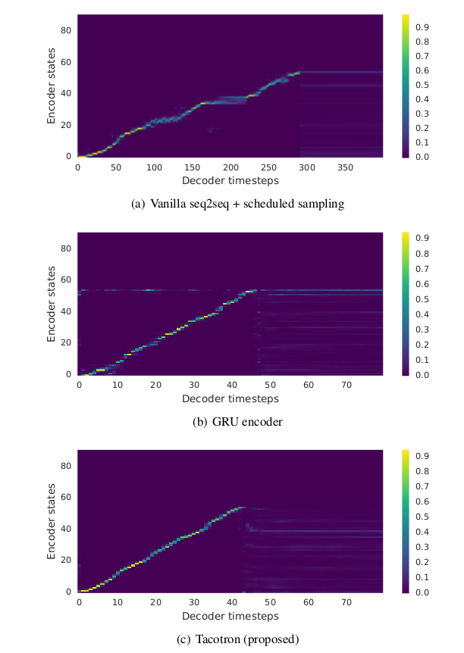
Tacotron: Towards End-to-End Speech Synthesis [Y. Wang et al., 2017] (4/5)
Experiment
Training data set
Internal North American English dataset, contains about 24.6 hours of speech data spoken by a professional female speaker
Ablation analysis
No pre-net and post-processing net
Attention tends to get stuck for many frames before moving forward
Bad speech intelligibility
CBHG encoder replaced by GRU encoder
GRU encoder is noisier
Noisy alignment leads to mispronunciations
CBHG encoder reduces overfitting and generalizes well
Attention alignment of
Vanilla seq2seq+scheduled sampling
Attention alignment of
GRU encoder
Attention alignment of
Tacotron
Y. Wang et al., “Tacotron: Towards End-to-End Speech Synthesis,” in Interspeech, 2017

Slide 6
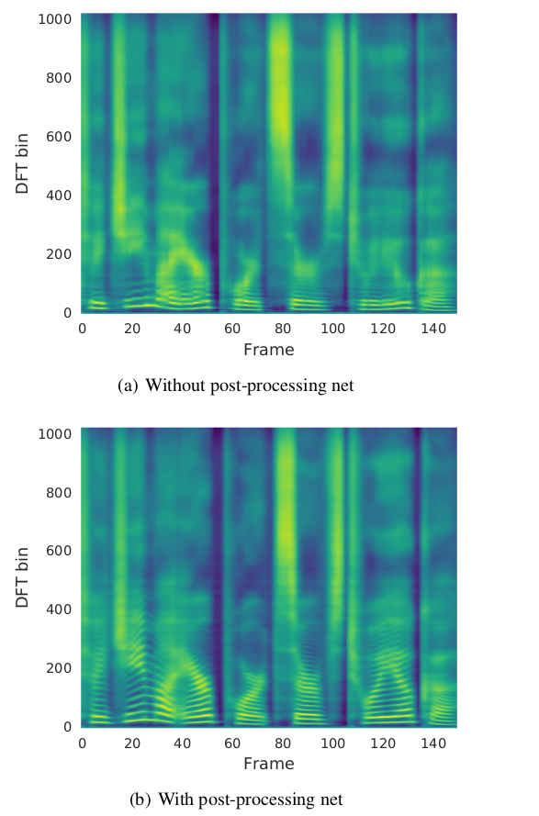

Tacotron: Towards End-to-End Speech Synthesis [Y. Wang et al., 2017] (5/5)
Result
Benefit of using post-processing net
Prediction from the post-processing net contains better resolved harmonics and high frequency formant structure
Mean opinion score test
Asked to rate the naturalness of the stimuli in a 5-point Likert scale score
Tacotron achieves an MOS of 3.82
Tacotron outperforms the parametric system
Spectrogram
without post-processing net
Spectrogram
with post-processing net
5-scale mean opinion score
evaluation
Y. Wang et al., “Tacotron: Towards End-to-End Speech Synthesis,” in Interspeech, 2017

Slide 7
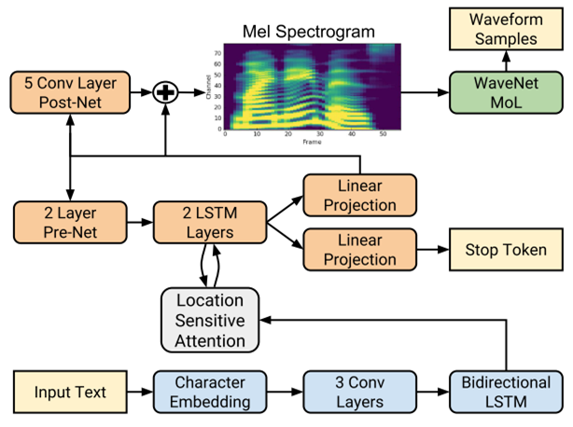
Natural TTS Synthesis by Conditioning WaveNet on Mel Spectrogram Predictions [J. Shen et al., 2018] (1/4)
Goal
Presenting end-to-end text-to-speech (TTS) system that can be trained on <text, audio> pairs
Motivation
Complexity of modern text-to-speech (TTS) designs
Previous system consists of multiple stages, such as a text analysis frontend, an acoustic model and an audio synthesis module
Contribution
Modify architecture of Tacotron 1
Using LSTM instead of CBHG module
Using location-sensitive attention instead of additive attention mechanism
Using modified WaveNet vocoder instead of Griffin-Lim algorithm
Architecture of Tacotron 2
J. Shen et al., “Natural TTS Synthesis by Conditioning WaveNet on Mel Spectrogram Predictions.” in ICASSP, 2018

Slide 8
Natural TTS Synthesis by Conditioning WaveNet on Mel Spectrogram Predictions [J. Shen et al., 2018] (2/4)
Model Architecture
Encoder
Convert character sequence into a hidden feature representation
Input characters are represented using character embedding
Output of final convolutional layer is passed into a single bidirectional LSTM
Attention
Use location-sensitive attention
Add attention weights from previous decoder time steps to additive attention mechanism
Reduce potential failure mode where some subsequences are repeated or ignored by decoder
Decoder
Predict a mel spectrogram one frame at a time from the encoded input sequence
Concatenation of LSTM output and the context vector is projected through a linear transform to predict the target spectrogram frame
Stop token prediction is used to determine when to terminate generation
WaveNet vocoder
Modified version of the WaveNet architecture
Can invert a mel spectrogram instead of linguistic condition
J. Shen et al., “Natural TTS Synthesis by Conditioning WaveNet on Mel Spectrogram Predictions.” in ICASSP, 2018

Slide 9
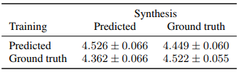

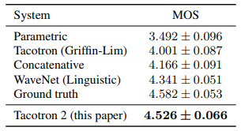
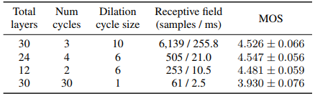
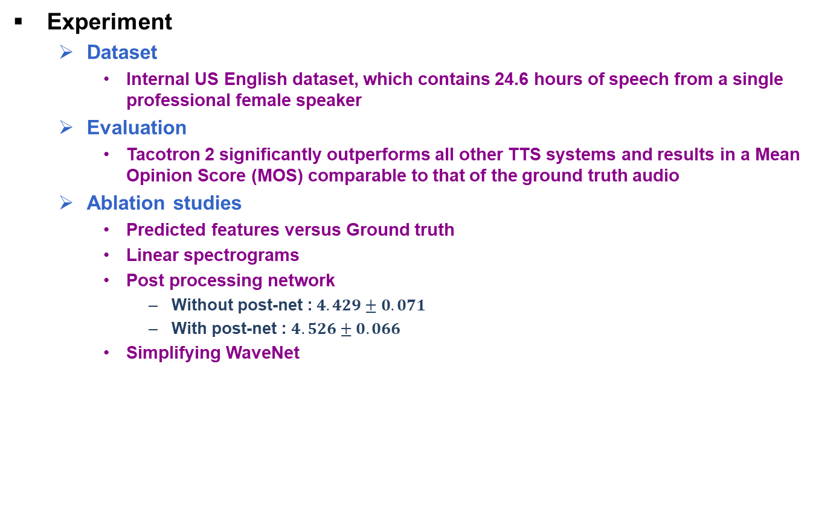
Natural TTS Synthesis by Conditioning WaveNet on Mel Spectrogram Predictions [J. Shen et al., 2018] (3/4)
Experiment
Dataset
Internal US English dataset, which contains 24.6 hours of speech from a single professional female speaker
Evaluation
Tacotron 2 significantly outperforms all other TTS systems and results in a Mean Opinion Score (MOS) comparable to that of the ground truth audio
Ablation studies
Predicted features versus Ground truth
Linear spectrograms
Post processing network
Without post-net : $4.429±0.071$
With post-net : $4.526±0.066$
Simplifying WaveNet
Comparison of evaluated MOS for WaveNet
Comparison of evaluated MOS for Griffin-Lim vs. WaveNet
MOS evaluations of TTS systems
WaveNet with various layer
and receptive field sizes
J. Shen et al., “Natural TTS Synthesis by Conditioning WaveNet on Mel Spectrogram Predictions.” in ICASSP, 2018

