Slide 1
Visual Representation 2
Pattern Recognition & Machine Learning Laboratory
Tae-jin Woo
Aug 11, 2021

Slide 2
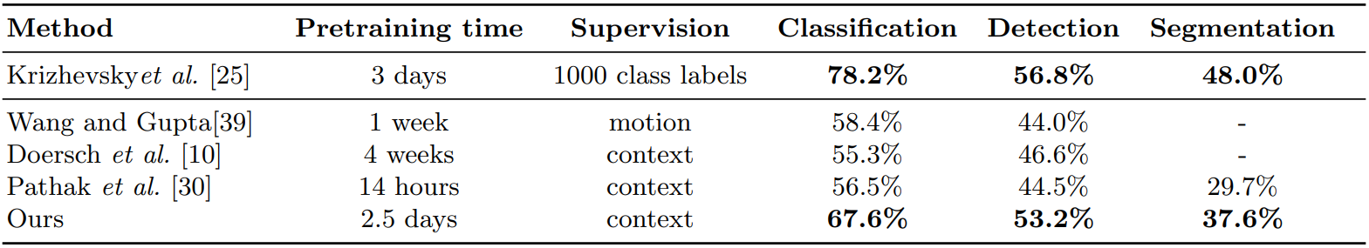
Unsupervised Learning of Visual Representations by Solving Jigsaw Puzzles [M. Noroozi et al., 2016] (1/7)
Goal
Providing image representation learning without human annotation
Achieving encouraging performance comparable to supervised learning
Motivation
Learning features of object parts and their correct spatial arrangement
By training a network to solve pretext task
Obtained features can be transferred to classification and detections tasks
Contribution
Achieving State-of-the-Art (SOTA) in self-supervised learning method
Building a CNN that can be trained to solve jigsaw puzzles as a pretext task
Introduced Context-Free Network (CFN) to maintain the compatibility
CFN has fewer parameters than AlexNet
Results on PASCAL VOC 2007 detection and classification
M. Noroozi, P. Fabaro, “Unsupervised Learning of Visual Representations by Solving Jigsaw Puzzles”, ECCV, 2016.

Slide 3
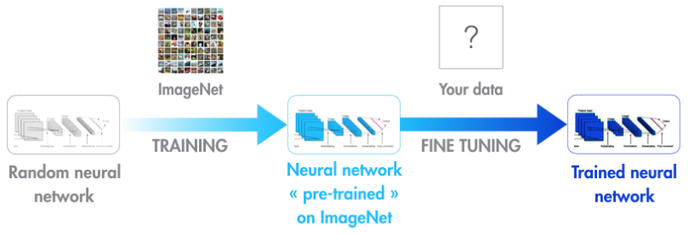
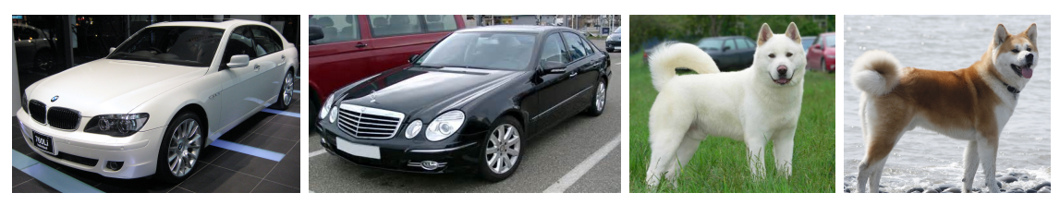
Unsupervised Learning of Visual Representations by Solving Jigsaw Puzzles [M. Noroozi et al., 2016] (2/7)
Self-supervised learning
Concept
Learning features of data through pretext task with unlabeled data
Learning supervision itself
Progress transfer learning of pre-trained model for downstream task
Both freezing pre-trained weights and fine-tuning are possible
Fewer labeled data would be used for transfer learning
Pros and cons
Pros
Enable learning with unlabeled data
Possible to get general features before fine-tuning of several downstream tasks
Cons
Lower performance than supervised learning in computer vision field
Example of self-supervised learning 1
Example of self-supervised learning 2
M. Noroozi, P. Fabaro, “Unsupervised Learning of Visual Representations by Solving Jigsaw Puzzles”, ECCV, 2016.

Slide 4
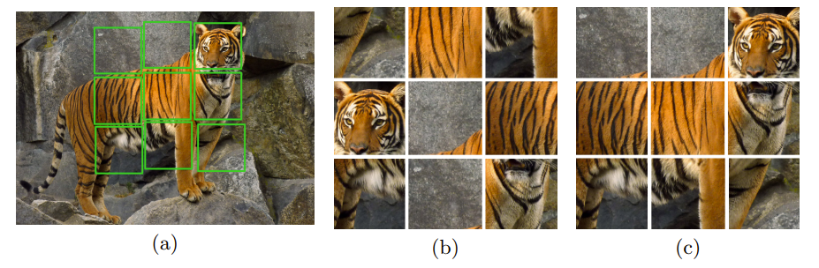
Unsupervised Learning of Visual Representations by Solving Jigsaw Puzzles [M. Noroozi et al., 2016] (3/7)
Pretext task
Concept
Pre-designed problems for networks to solve
Visual features are learned through pretext task
Jigsaw puzzle reassembly problem is introduced in this paper
Only for efficient feature extracting applied to downstream tasks
Jigsaw puzzle
Solving the puzzle requires a good understanding of object features
Representative and distinguishable features of object part will be learnable
How to solve
(a) Image from which the tiles (marked with green lines) are extracted
(b) A puzzle obtained by shuffling the tiles
(c) Reassemble and determine the relative positions
Learning image representations by solving Jigsaw puzzles
M. Noroozi, P. Fabaro, “Unsupervised Learning of Visual Representations by Solving Jigsaw Puzzles”, ECCV, 2016.

Slide 5
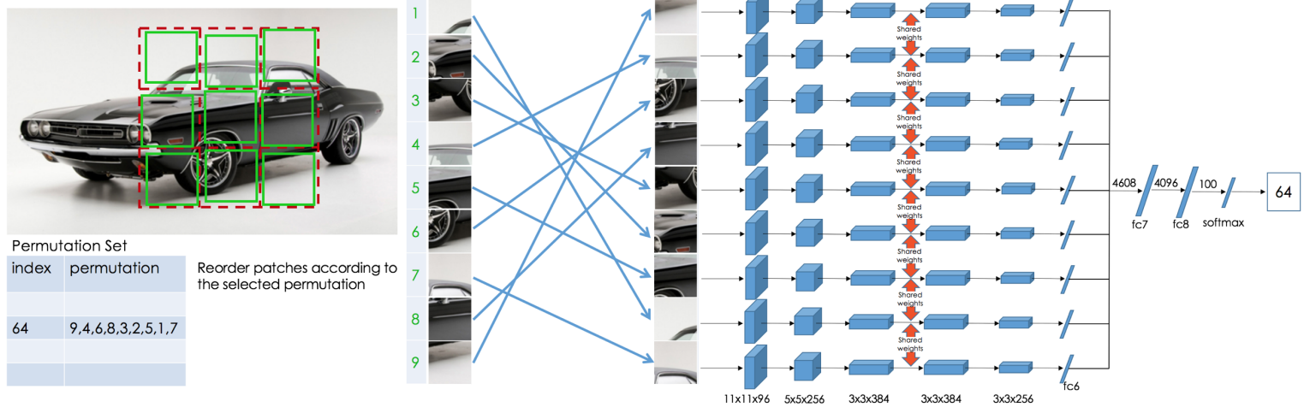
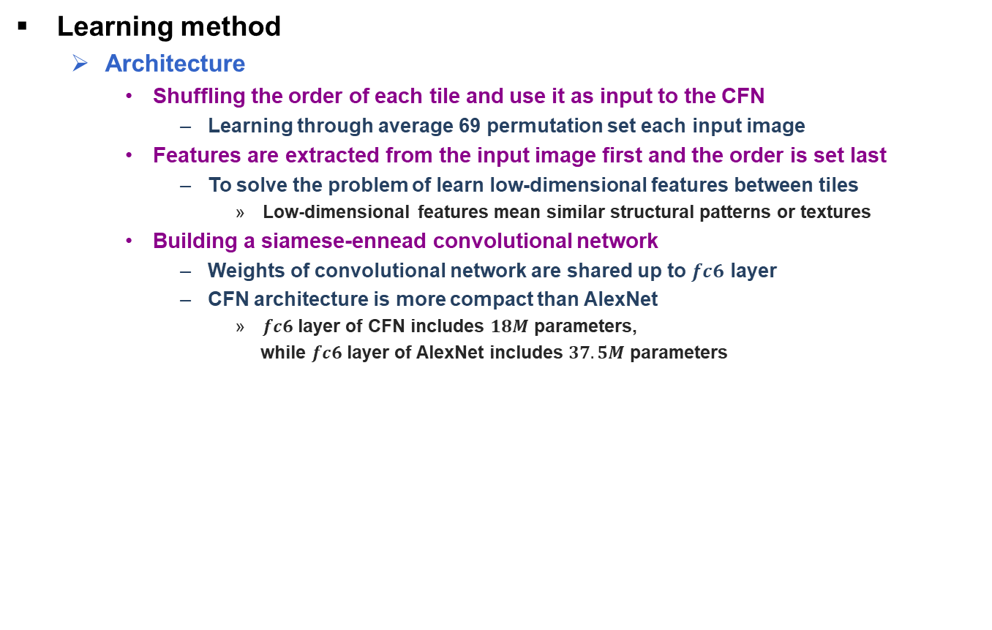
Unsupervised Learning of Visual Representations by Solving Jigsaw Puzzles [M. Noroozi et al., 2016] (4/7)
Learning method
Architecture
Shuffling the order of each tile and use it as input to the CFN
Learning through average 69 permutation set each input image
Features are extracted from the input image first and the order is set last
To solve the problem of learn low-dimensional features between tiles
Low-dimensional features mean similar structural patterns or textures
Building a siamese-ennead convolutional network
Weights of convolutional network are shared up to $fc6$ layer
CFN architecture is more compact than AlexNet
$fc6$ layer of CFN includes $18M$ parameters,
while $fc6$ layer of AlexNet includes $37.5M$ parameters
Context-Free Network
M. Noroozi, P. Fabaro, “Unsupervised Learning of Visual Representations by Solving Jigsaw Puzzles”, ECCV, 2016.

Slide 6
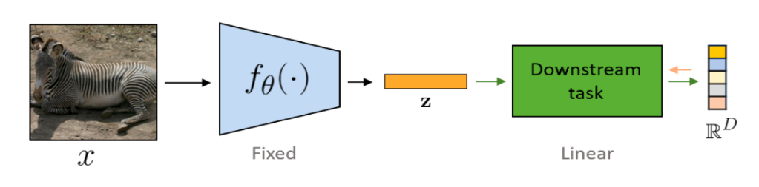
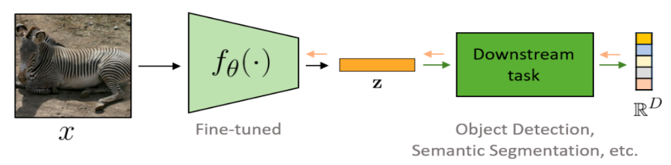
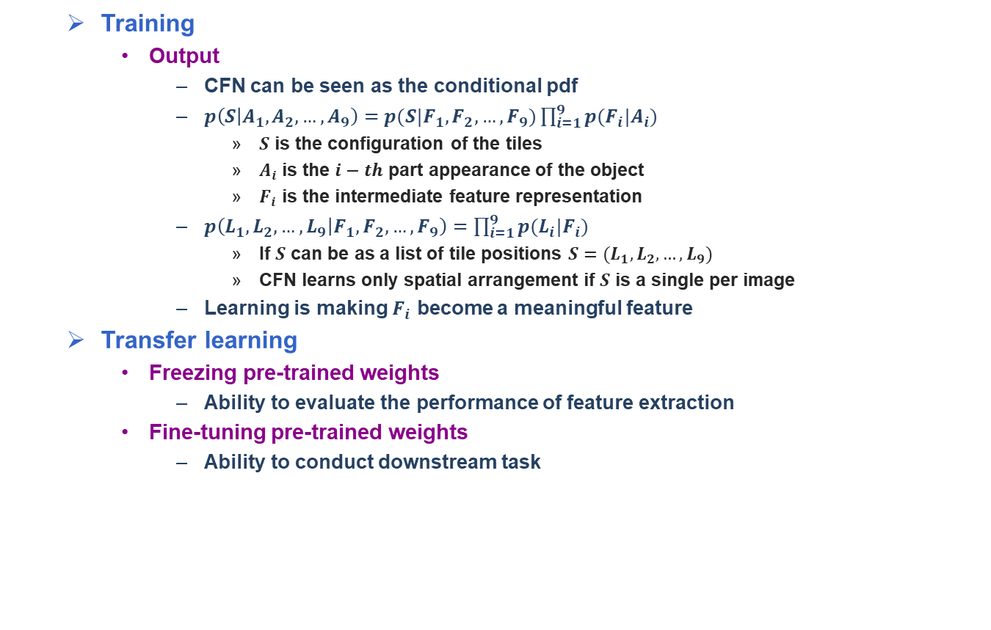
Unsupervised Learning of Visual Representations by Solving Jigsaw Puzzles [M. Noroozi et al., 2016] (5/7)
Training
Output
CFN can be seen as the conditional pdf
$p\left(S | A_{1},A_{2},…,A_{9}\right)=p(S|F_{1},F_{2},…,F_{9})\prod_{i=1}^{9}{p(F_{i}|A_{i})}$
$S$ is the configuration of the tiles
$A_{i}$ is the $i−th$ part appearance of the object
$F_{i}$ is the intermediate feature representation
$p\left(L_{1},L_{2},…,L_{9} | F_{1},F_{2},…,F_{9}\right)=\prod_{i=1}^{9}{p(L_{i}|F_{i})}$
If $S$ can be as a list of tile positions $S=(L_{1},L_{2},…,L_{9})$
CFN learns only spatial arrangement if $S$ is a single per image
Learning is making $F_{i}$ become a meaningful feature
Transfer learning
Freezing pre-trained weights
Ability to evaluate the performance of feature extraction
Fine-tuning pre-trained weights
Ability to conduct downstream task
Transfer learning with fixed pre-trained weights
Transfer learning with fine-tuning pre-trained weights
M. Noroozi, P. Fabaro, “Unsupervised Learning of Visual Representations by Solving Jigsaw Puzzles”, ECCV, 2016.

Slide 7
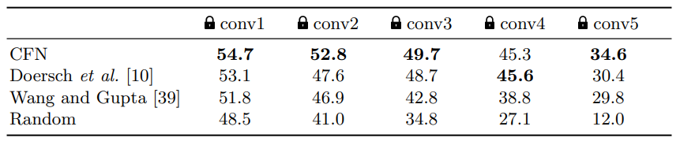
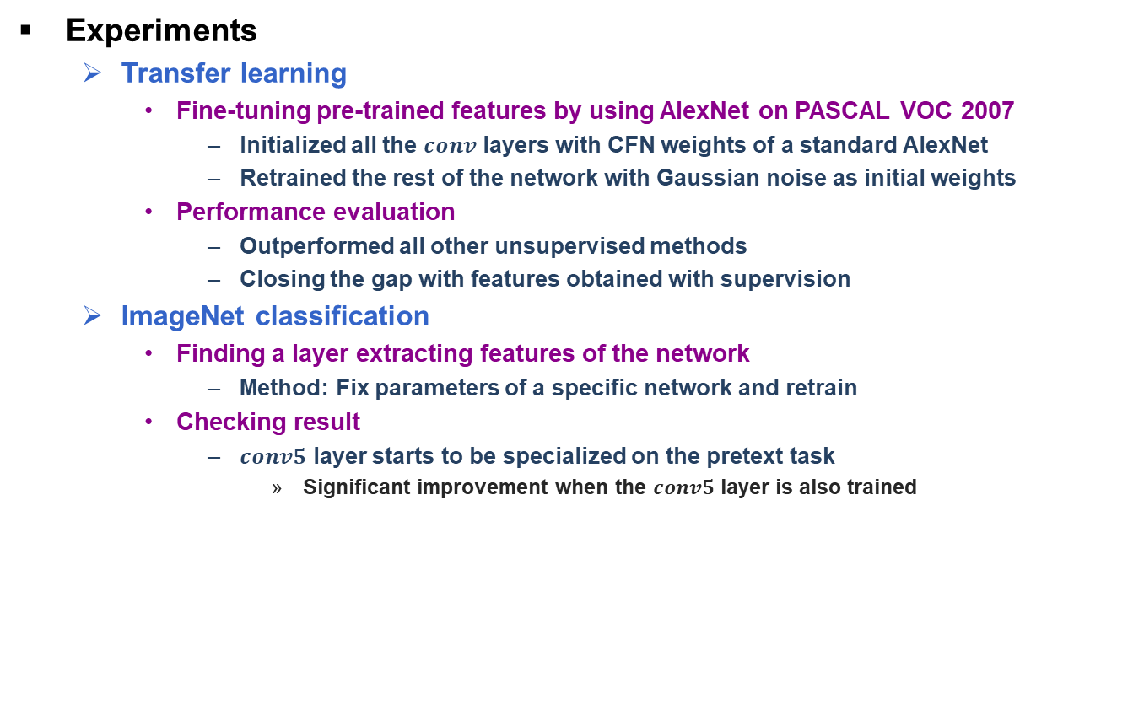
Unsupervised Learning of Visual Representations by Solving Jigsaw Puzzles [M. Noroozi et al., 2016] (6/7)
Experiments
Transfer learning
Fine-tuning pre-trained features by using AlexNet on PASCAL VOC 2007
Initialized all the $conv$ layers with CFN weights of a standard AlexNet
Retrained the rest of the network with Gaussian noise as initial weights
Performance evaluation
Outperformed all other unsupervised methods
Closing the gap with features obtained with supervision
ImageNet classification
Finding a layer extracting features of the network
Method: Fix parameters of a specific network and retrain
Checking result
$conv5$ layer starts to be specialized on the pretext task
Significant improvement when the $conv5$ layer is also trained
Results on PASCAL VOC 2007 detection and classification
Comparison of classification results on ImageNet 2012
M. Noroozi, P. Fabaro, “Unsupervised Learning of Visual Representations by Solving Jigsaw Puzzles”, ECCV, 2016.

Slide 8
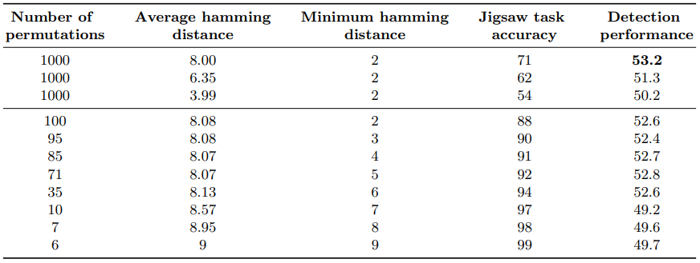
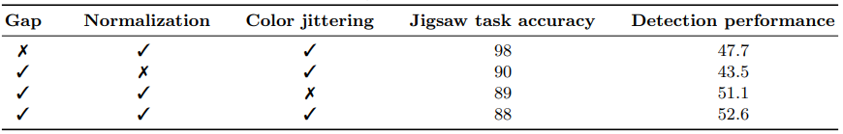
Unsupervised Learning of Visual Representations by Solving Jigsaw Puzzles [M. Noroozi et al., 2016] (6/7)
Ablation studies
Permutation set
Cardinality
Performance of the downstream task increased as the permutation set increased
Average hamming distance
The higher distance, the higher the performance of the downstream task
Preventing shortcuts
Low level statistics
Solution: Normalized pixel mean and standard deviation independently
Edge continuity
Solution: Making 21 pixel gap between tiles by selecting tiles randomly
Chromatic aberration
Solution: Use resize, 30% of greyscale input images, and color jittering
Results on PASCAL VOC 2007 detection and classification
M. Noroozi, P. Fabaro, “Unsupervised Learning of Visual Representations by Solving Jigsaw Puzzles”, ECCV, 2016.

