Slide 1
CycleGAN
Pattern Recognition & Machine Learning Laboratory
Geon-jun Yang
Aug. 12th, 2021

Slide 2
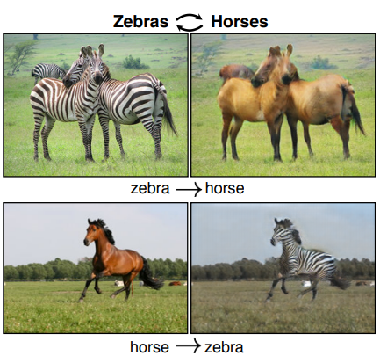
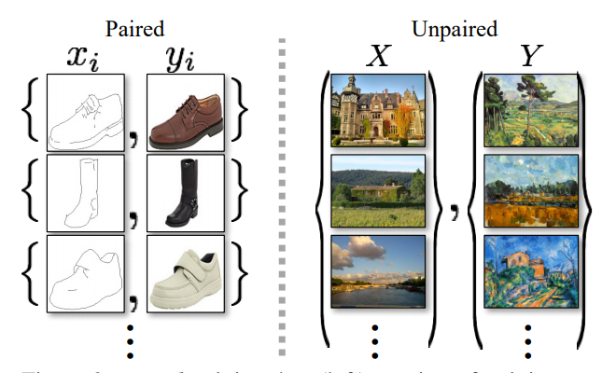
Unpaired Image-to-Image Translation using Cycle-Consistent Adversarial Networks [J. Zhu et al., 2017] (1/5)
Goal
Image-to-image translation without paired train data
Motivation
Obtaining paired training data is difficult and expensive
Assume there is underlying relationship between the domains
Method
Translation should be cycle consistent
Add a cycle consistency loss
Combine with adversarial losses
Example of CycleGAN
Types of datasets
J. Zhu, T. Park, P. Isola and A. Efros, “Unpaired Image-to-Image Translation using Cycle-Consistent Adversarial Networks," ICCV, 2017.

Slide 3
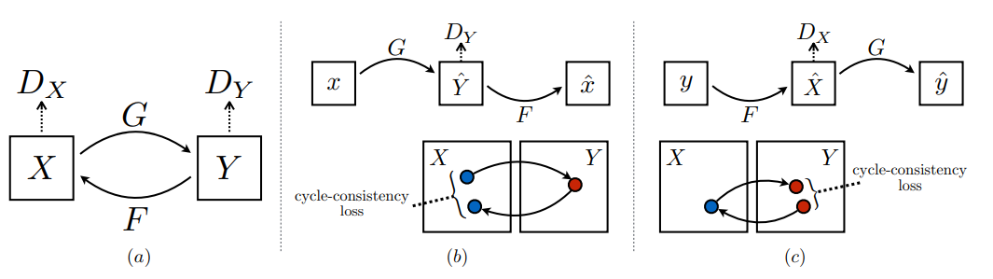
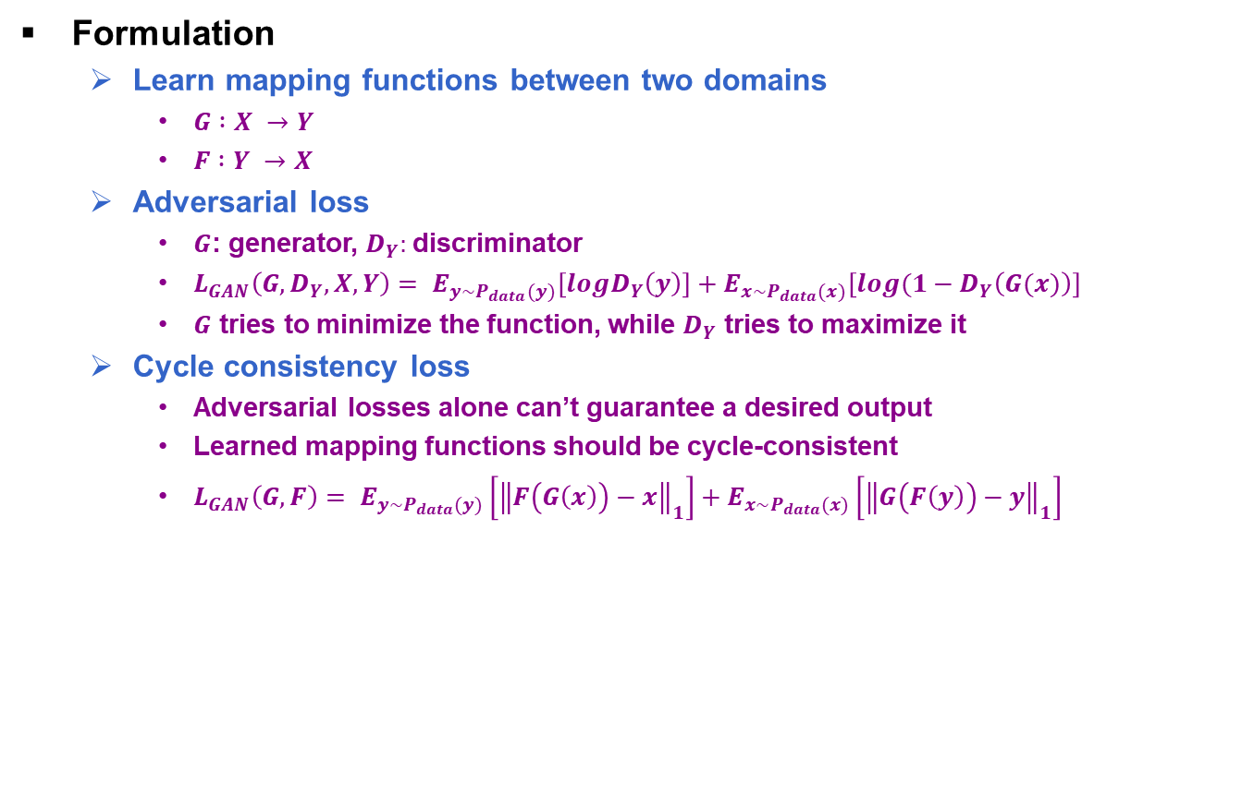
Unpaired Image-to-Image Translation using Cycle-Consistent Adversarial Networks [J. Zhu et al., 2017] (2/5)
Formulation
Learn mapping functions between two domains
$G :X →Y$
$F :Y →X$
Adversarial loss
$G$: generator, $D_{Y}:$discriminator
$L_{GAN}\left(G, D_{Y}, X, Y\right)= E_{y\sim P_{data}(y)}\left[logD_{Y}\left(y\right)\right]+E_{x\sim P_{data}(x)}\left[log(1−D_{Y}\left(G(x)\right)\right]$
$G$ tries to minimize the function, while $D_{Y}$ tries to maximize it
Cycle consistency loss
Adversarial losses alone can’t guarantee a desired output
Learned mapping functions should be cycle-consistent
$L_{GAN}\left(G, F\right)= E_{y\sim P_{data}(y)}\left[{\left\|F\left(G\left(x\right)\right)−x\right\|}_{1}\right]+E_{x\sim P_{data}(x)}\left[{\left\|G\left(F\left(y\right)\right)−y\right\|}_{1}\right]$
formulations
J. Zhu, T. Park, P. Isola and A. Efros, “Unpaired Image-to-Image Translation using Cycle-Consistent Adversarial Networks," ICCV, 2017.

Slide 4
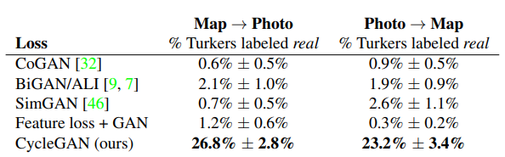
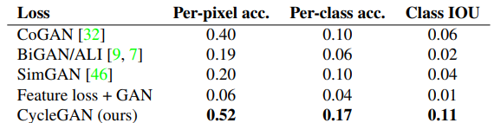
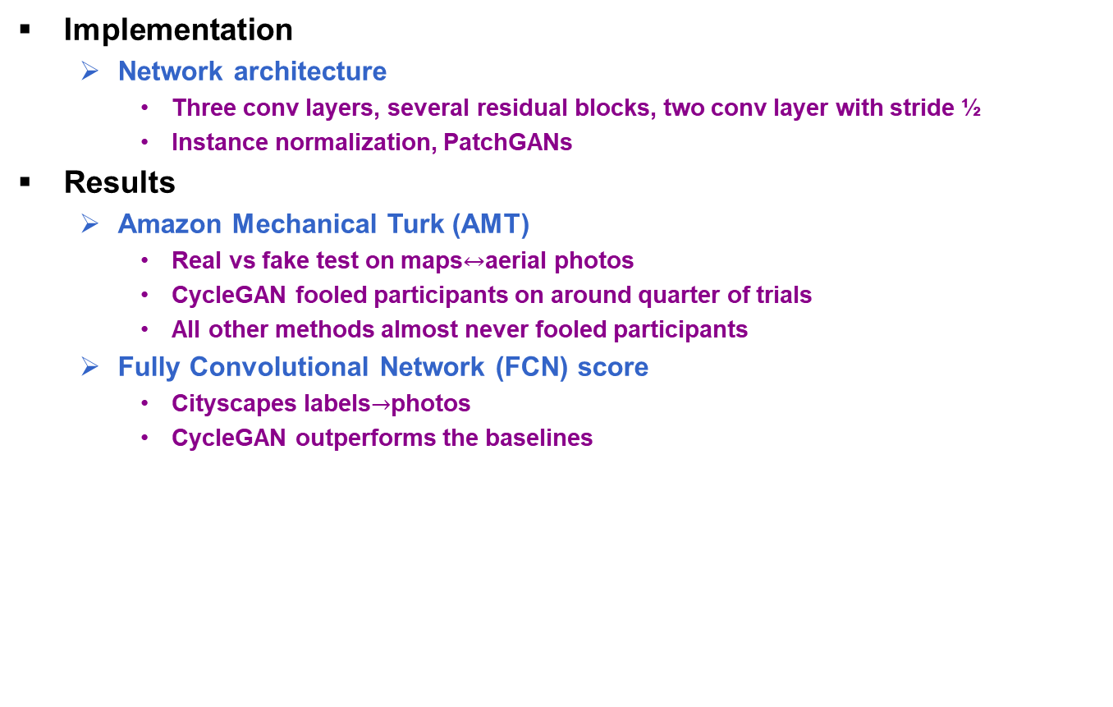
Unpaired Image-to-Image Translation using Cycle-Consistent Adversarial Networks [J. Zhu et al., 2017] (3/5)
Implementation
Network architecture
Three conv layers, several residual blocks, two conv layer with stride ½
Instance normalization, PatchGANs
Results
Amazon Mechanical Turk (AMT)
Real vs fake test on maps$↔$aerial photos
CycleGAN fooled participants on around quarter of trials
All other methods almost never fooled participants
Fully Convolutional Network (FCN) score
Cityscapes labels$→$photos
CycleGAN outperforms the baselines
Table 1 Real vs fake test
Table 2 FCN-scores on cityscapes
J. Zhu, T. Park, P. Isola and A. Efros, “Unpaired Image-to-Image Translation using Cycle-Consistent Adversarial Networks," ICCV, 2017.

Slide 5
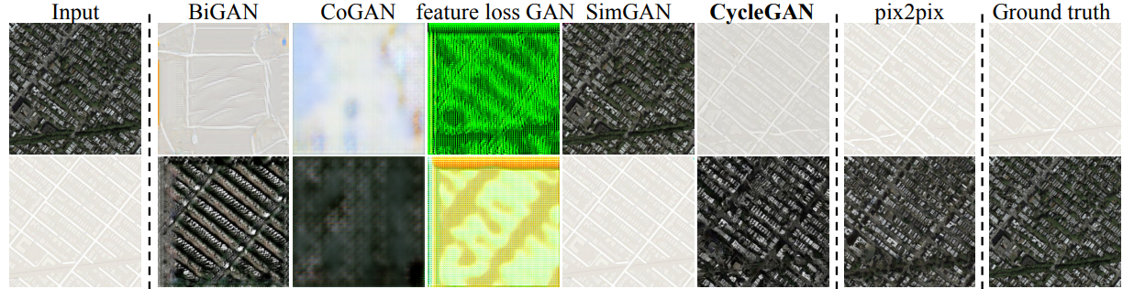
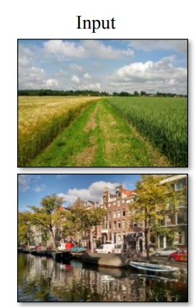
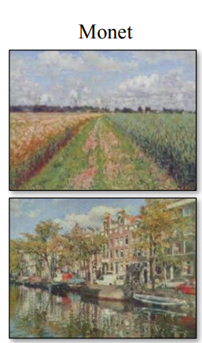
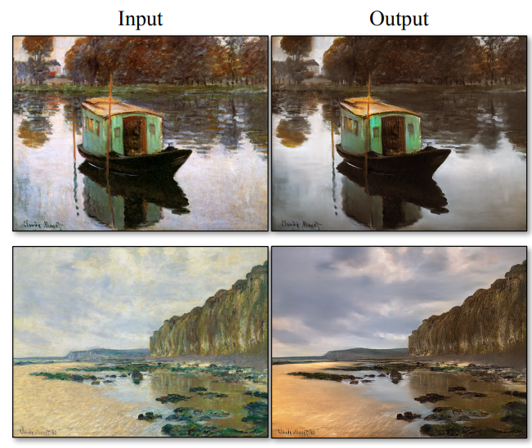
Unpaired Image-to-Image Translation using Cycle-Consistent Adversarial Networks [J. Zhu et al., 2017] (4/5)
Photos$↔$Google Maps
Photo to artistic style of Monet
Paintings to photographic style
J. Zhu, T. Park, P. Isola and A. Efros, “Unpaired Image-to-Image Translation using Cycle-Consistent Adversarial Networks," ICCV, 2017.

Slide 6
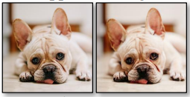
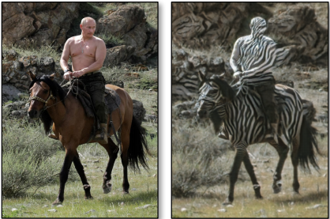
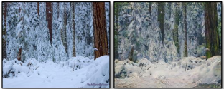

Unpaired Image-to-Image Translation using Cycle-Consistent Adversarial Networks [J. Zhu et al., 2017] (5/5)
Limitations and Discussion
Tasks that require geometric changes
dog$→$cat transfiguration
Caused by generator architectures
Distribution characteristics of training datasets
ImageNet dataset doesn’t contain images of a person riding a horse
Lingering gap between the results
Paired training data and unpaired datasets
dog$→$ cat
winter $→$ summer
horse $→$ zebra
J. Zhu, T. Park, P. Isola and A. Efros, “Unpaired Image-to-Image Translation using Cycle-Consistent Adversarial Networks," ICCV, 2017.

