Slide 2
Azure’s Next Generation Compute Platform
3-618
Mark Russinovich
CTO, Microsoft Azure
Microsoft
@markrussinovich

Slide 3
Agenda
Azure Resource Manager
Virtual Machine, Storage and Networking APIs
Service Fabric

Slide 4
Azure Resource Manager

Slide 5
Resource Groups
Containers of multiple resource instances
Each resource instance has a resource type
Resource types are defined by resource providers
Every resource must exist in one and only one resource group
RESOU
R
CE G
R
OUP

Slide 6
Resource Group: Management Container
Lifecycle: deployment, update, delete, status
Grouping: metering, billing, quota, UX (portal, PowerShell, CLI)
Access Control: scope for RBAC permissions
Identity: resources can talk to each other

Slide 7
Resource Group Lifecycle
Question:
Should these resources be in the same group or a different one?
Answer:
Do they have common lifecycle and management?

Slide 8
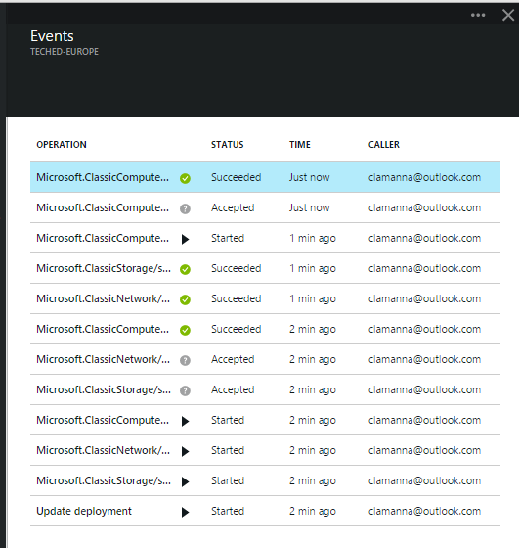
Resource Group Manager Services
Centralized auditing of operations
Simple tagging and grouping of resources
Consistent access control (e.g. RBAC)

Slide 9
Resource Templates
Template:
Website
Azure DB
Declarative, model based specification of resources and their configuration, code, and extensions
Idempotent
Consistent deployment
Source file, checked-in
Parameterized input/output
DEPENDS ON SQL
SQL Azure
Web App
SQL
C
ONFIG

Slide 10
Template Execution
Execution engine builds a state machine
dependsOn and reference() establish dependencies
App Insights
After Website Completes
After App Service Plan Completes
Once All Complete
Web
Site
Alert Rule
Start
App Service Plan
End
Auto Scale Setting
MS Deploy PKG

Slide 11
Demo: Resource Group Templates

Slide 12
Template Sections
Parameters: user input for the template
Variables: allows model reuse and “mappings” (e.g. different image based on region)
Resources: models all the resources in the resource group
Outputs: captures information from the execution (e.g. DNS name for the created blog)

Slide 13
Template DSL
Functions are delimited by “[{dsl keyword}]”
E.g. “name”: “[concat(‘foo’, parameters(‘p1’))]
Basic functions:
concat() -- “[concat(‘foo’,’bar’)]” = foobar
variable() – “[variable(‘foo’)]” = variables “foo” value
reference() – “[reference(‘VM1’). IpAddress]”
parameters() – “[parameters(‘blogName’)]”

Slide 14
Virtual Machine, Storage and Networking APIs

Slide 15
Resource Group Supported Resources
Websites
SQL Azure DB
Redis Cache
40+ other resource types
v1 Virtual Machines, Network, Storage
Announcing: Preview of v2 Virtual Machines, Network, Storage

Slide 16
What’s New About the v2 Resource Providers?
v1:
Not fully integrated: no RBAC, tagging, templates
Clunky network modelling
v2:
Fully integrated into Resource Manager
Revamped control plane with asynchronous, parallel operations
Network resource types are separate from compute
Part of Azure-consistent private cloud

Slide 17
Demo: Consistent Virtual Machine Resource Group Templates

Slide 18
Open Choice at Every Layer
Web Apps
Mobile
Apps
Media
Vertical compute PaaS
App Service
Batch
General Compute PaaS
Apprenda, CloudFoundry
Jelastic, Marathon
Service Fabric
(VMs and Containers)
Cluster Orchestration
SCALR, RightScale,
Mesos, Swarm
VM Extensions
IaaS and IaaS+
VMs and VM Scale Sets
Infrastructure
Azure-Consistent Private Cloud
Azure Public Cloud

Slide 19


Announcing: Future VM Scale Sets: “Next-Gen Worker Role”
Fast and identical VM creation with elastic autoscale
Stateless and persistent disks
Windows and Linux platform and custom images
Image-based OS patching
Ideal for clusters
VM Code
VM Code
Backup
Extension
Monitoring
Extension
VM Code
…
VM Code
…
Backup
Extension
Monitoring
Extension
VM Code
Backup
Extension
Monitoring
Extension
…
Runtime and Extension API
…
Backup
Extension
Monitoring
Extension
…
Runtime and Extension API
Backup
Extension
Monitoring
Extension
VM Agent
Runtime and Extension API
VM Agent
Runtime and Extension API
VM Agent
Runtime and Extension API
VM Agent
VM Agent

Slide 20
Open Choice at Every Layer
Web Apps
Mobile
Apps
Media
Vertical compute PaaS
App Service
Batch
General Compute PaaS
Apprenda, CloudFoundry
Jelastic, Marathon
Service Fabric
(VMs and Containers)
Cluster Orchestration
SCALR, RightScale,
Mesos, Swarm
VM Extensions
IaaS and IaaS+
VMs and VM Scale Sets
Infrastructure
Azure-Consistent Private Cloud
Azure Public Cloud

Slide 21


Managed IaaS (Iaas+)
Declarative and imperative injection of code and configuration into VMs
Configuration (PS, DSC, Chef, …)
Management (A/V, DR, Backup, Patching …)
Security (disk encryption, WAF, …)
…
VM Code
Backup
Extension
…
Monitoring
Extension
Runtime and Extension API
VM Agent
Infrastructure

Slide 22
Open Choice at Every Layer
Web Apps
Mobile
Apps
Media
Vertical compute PaaS
App Service
Batch
General Compute PaaS
Apprenda, CloudFoundry
Jelastic, Marathon
Service Fabric
(VMs and Containers)
Cluster Orchestration
SCALR, RightScale,
Mesos, Swarm
VM Extensions
IaaS and IaaS+
VMs and VM Scale Sets
Infrastructure
Azure-Consistent Private Cloud
Azure Public Cloud

Slide 23
Demo: Announcing: Mesosphere DCOS on Azure

Slide 24
Service Fabric

Slide 25
Open Choice at Every Layer
Web Apps
Mobile
Apps
Media
Vertical compute PaaS
App Service
Batch
General Compute PaaS
Apprenda, CloudFoundry
Jelastic, Marathon
Service Fabric
(VMs and Containers)
Cluster Orchestration
SCALR, RightScale,
Mesos, Swarm
VM Extensions
IaaS and IaaS+
VMs and VM Scale Sets
Infrastructure
Azure-Consistent Private Cloud
Azure Public Cloud

Slide 26
Microsoft Azure Service Fabric A platform for reliable, hyperscale, microservice-based applications
Microservices
High Availability
Data Partitioning
Service Fabric
Health Monitoring
Container Orchestration & lifecycle management
Hybrid Operations
Self-healing
Simple programming models
High Density
Rolling Upgrades
Low Latency
Placement Constraints
Replication & Failover
Stateful services
Fast startup & shutdown
Load balancing
Hyper-Scale
Automated Rollback
Windows
Server
Linux
Windows
Server
Linux
Azure
Hosted Clouds
Windows
Server
Linux
Private Clouds

Slide 27
Service Fabric Capabilities
Application deployment services:
Rolling update with rollback
Strong versioning
Side-by-side support
Leadership election
Name service for discovery of applications
Partitioning support
Load balancing and placement constraints
Consistent state replication framework
Reliable distributed key/value and collections
…

Slide 28
Example Cloud Services Built On Service Fabric
Service | Description
Azure Database | Scale-out relational database
Azure DocumentDB | No-SQL store for JSON documents Integrated with O365
Azure Power BI | BI Pro Data Analysis Services
Azure Networking | Regional Network Manager (RNM) for cross cluster/DC VNET
Azure Compute and Networking | Resource Providers for Compute (CRP), Networking (NRP), Storage (SRP)
Event Hubs | Streaming messaging and event processing
Service Bus | Service Bus Resource Provider (SBRP)
Intune | Unified management of PCs and devices on the cloud.
Bing Cortana | Personal assistant
In production for five years
We’re giving you the same bits we run!

Slide 29

Service Fabric Microservice Management
App1
App2

Slide 30
Service Fabric Microservices
A microservice is whatever you want it to be:
ASP.NET
node.js, Java VMs
Arbitrary .exe
Stateless microservices
A microservice that has state where the state is persisted to external storage, such as Azure databases or Azure storage
e.g. Existing web (ASP.NET) and worker role applications
Stateful microservices
Reliability of state through replication and local persistence
Reduces the complexity and number of components in traditional three-tier architecture

Slide 31
Service Fabric Programming Models
Applications composed of microservices
Reliable Services API
Reliable Actors API
Service Fabric
Health Monitoring
Container Orchestration & lifecycle management
High Availability
Hybrid Operations
Data Partitioning
Self-healing
Simple programming models
High Density
Rolling Upgrades
Low Latency
Placement Constraints
Replication & Failover
Stateful services
Fast startup & shutdown
Load balancing
Hyper-Scale
Automated Rollback
Azure
Private Clouds

Slide 32


Reliable Services API
Build stateless services using existing technologies such as ASP.NET
Build stateful services using reliable collections
Manage the concurrency and granularity of state changes using transactions
Communicate with services using the technology of your choice
e.g. WebAPI and WCF
Reliable Collections
Multi machine
Multi threaded
Replicated (HA)
Persistence
Asynchronous
Transactional
Collections
Single machine
Single threaded
Concurrent Collections
Single machine
Multi threaded
ReliableDictionary<T>
ReliableQueue<T>

Slide 33
Demo: Stateful Counting

Slide 34
Microservice Partitioning
Services can be partitioned for scale-out
You can choose your own partitioning scheme
Service partitions are stripped across machines in the cluster
Node 100
Node 101
Node 102
Node 103
Node 104
Node 105
P1
P2
P3
S
S
S
S
S
S
P4
S
S
S
S
S

Slide 35
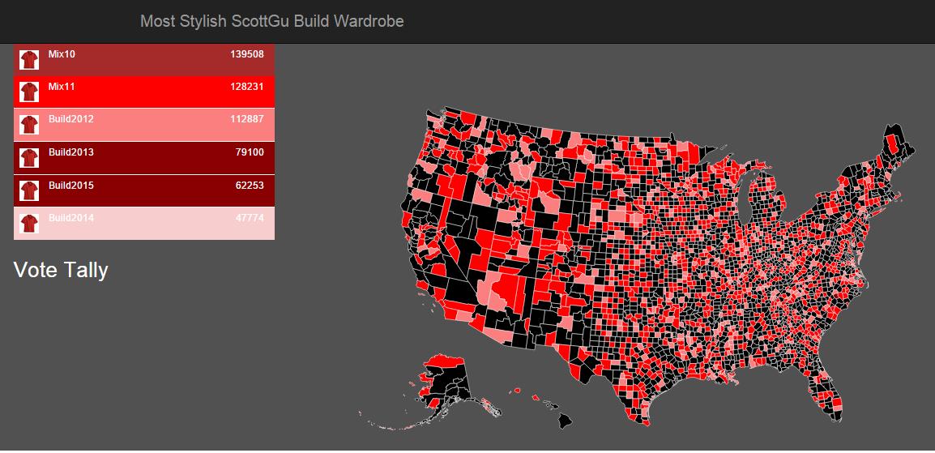
Voting App
Web Viewer
National Service
Votes
Candidates
Get state
Queries
aggregate
Get state
Query
Get state
Get state
County Service
Voter Service
Voter Service
votes
Votes
County Service
generate vote
Voter Service
generate vote
aggregate
Votes
generate vote
Voter Service
County Service
aggregate
generate vote
Votes
aggregate

Slide 36
Demo: High-Throughput Voting Application

Slide 37
Service Fabric Programming Models
Applications composed of microservices
Reliable Services API
Reliable Actors API
Service Fabric
Health Monitoring
Container Orchestration & lifecycle management
High Availability
Hybrid Operations
Data Partitioning
Self-healing
Simple programming models
High Density
Rolling Upgrades
Low Latency
Placement Constraints
Replication & Failover
Stateful services
Fast startup & shutdown
Load balancing
Hyper-Scale
Automated Rollback
Azure
Private Clouds

Slide 38
Reliable Actors API
Build reliable stateless and stateful objects with a virtual actor programming model
Suitable for applications with multiple independent units of state and compute
Automatic activation management
Automatic state management and turn based concurrency (single threaded execution)

Slide 39
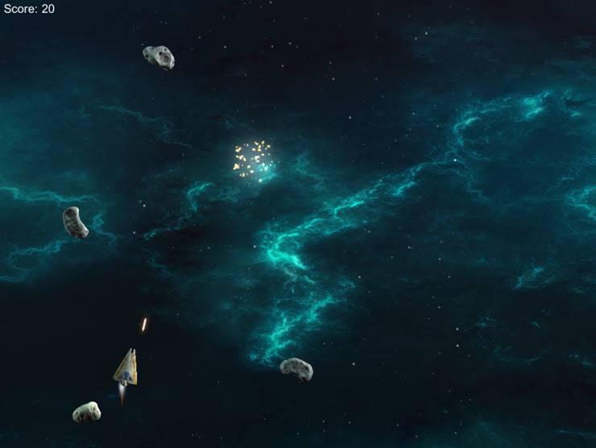
Actoroids
Gateway
You are destroyed
Ship
Turn
Ships
Asteroids
Bolts
Scores
Velocity
Health
Position
Name
Fire!
Accelerate/brake
Join a session
makes all kinds of decisions
move
Get state
commands
Get state
You are launched
Get state
Get state
You are destroyed
You hit something
Asteroid
Get state
Bolt
Velocity
Position
IsEvil?
Velocity
Decay
Position
evil? chase(): move()
move

Slide 40
Demo: Actor-Based Online Game

Slide 41
Video: OSIsoft and Service Fabric

Slide 42
Service Fabric Roadmap
Developer SDK available today:
Languages:
Now: C++, C#
Future: others
Operating systems:
Now: Windows
Future: Linux and Windows
Containers:
Now: Job objects
Future: containers
Integration with Azure:
Now: standalone SDK
Future: resource provider for simplified cluster management
http://aka.ms/servicefabric

Slide 43
Open Choice at Every Layer
Web Apps
Mobile
Apps
Media
Vertical compute PaaS
App Service
Batch
General Compute PaaS
Apprenda, CloudFoundry
Jelastic, Marathon
Service Fabric
(VMs and Containers)
Cluster Orchestration
SCALR, RightScale,
Mesos, Swarm
VM Extensions
IaaS and IaaS+
VMs and VM Scale Sets
Infrastructure
Azure-Consistent Private Cloud
Azure Public Cloud

Slide 44
Azure Compute Continuum
IaaS
PaaS
VMs /
VM Scale Sets
VM Extensions
Service Fabric /
Batch
Web Apps/
App Service
Ultimate
Control
Rapid
Development

Slide 45
Conclusion and Session Guide
It’s an exciting time to be a developer!
Resource Manager:
2-659 - Azure Resource Manager
Virtual machines:
2-646 - Introduction and What’s New in Azure IaaS
2-688 - Azure Virtual Machines Deep-Dive
Containers:
2-683 - Thinking in Containers: Building a Scalable, Next-Gen Application with Docker on Azure
2-704 - Windows Server Containers: What, Why, and How
Service Fabric:
2-640 - Microsoft Azure Service Fabric Architecture
2-700 - Building Resilient, Scalable Services with Microsoft Azure Service Fabric

Slide 46
Resources
Improve your skills by enrolling in our free cloud development courses at the Microsoft Virtual Academy.
Try Microsoft Azure for free and deploy your first cloud solution in under 5 minutes!
Easily build web and mobile apps for any platform with AzureAppService for free.

