Slide 2
Windows Server Containers: What, Why, and How
Mathew John & Taylor Brown (@taylorb_msft)
Program Managers for Containers and Hyper-V
Microsoft Operating System Group
2-704

Slide 3
Here we go….
Know
Gain
Learn
enough about containers to be dangerous
insights on where you would use containers
what Microsoft
is doing with containers

Slide 4
Datacenter inflection points
Containers - DevOps
Services – IaaS, PaaS, SaaS
Infrastructure hosting – early cloud
Machine Virtualization
Physical Machines

Slide 5
Why are people doing this?
Well, money, mostly, but if you ignore that part…
Increased portability. We have been consistently standardizing on the layer before it to build tools, systems, ecosystems of systems….

Slide 6



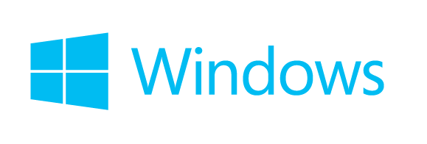
Container Ecosystem
Container Run-Time
Container Images
Image Repository
Linux

Slide 7

Demo

Slide 8
Containers Offer
Fast Iteration
Resource Controls
Rapid Deployment
Defined State Separation
Immutability

Slide 9

Making Them Ideal For
Distributed Compute
Database
Web
$$f\left(x\right)$$
Scale Out
Tasks

Slide 10
Digression: Docker Host platform evolution
From do-it-all server images to little, teeny, very specialized.
Windows Server is, in this case, matching exactly that need as well.

Slide 11
Container Operating System Environments
Nano Server
Server Core
Highly Optimized
Highly Compatible
Born in the cloud applications
Traditional Applications

Slide 12








Microsoft’s Container Run-Times
Windows Server Container
EASY TO IMPLEMENT
MORE
MOBILITY
HIGHLY AUTOMATED
SECURE
SCALABLE AND ELASTIC
EFFICIENT
Hyper-V Container
SHARED HOSTING
EASY TO IMPLEMENT
MORE
MOBILITY
HIGHLY AUTOMATED
SECURE
SCALABLE AND ELASTIC
EFFICIENT
MULTI-TENANCY

Slide 13

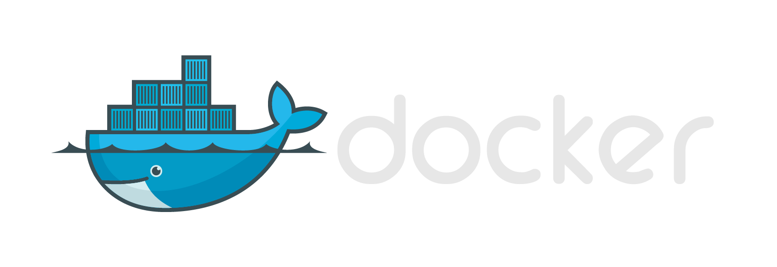





Modern App Development, Flexible Isolation
Windows Container Images
Container Run-Times
Container Management
Docker
Hyper-V Container
PowerShell
Application
Framework
Application
Framework
Others
Windows Server Container
Write once, deploy anywhere

Slide 14




Deploying Containers
Hyper-V
Container(s)
Windows Server
Container(s)
Requires Hyper-V Hypervisor
Hyper-V
Virtual Machine(s)
Physical Machine

Slide 15
Deploying Containers
Hyper-V
Container(s)
Windows Server
Container(s)
Requires Hyper-V Hypervisor
Virtual Machines
Physical Machine

Slide 16




The right
tools for you.
Container Management
PowerShell
Docker
Others
Container Technologies
Development Environments
Linux
Microsoft Cloud
Azure
On Premises
Service Provider
Others…

Slide 17
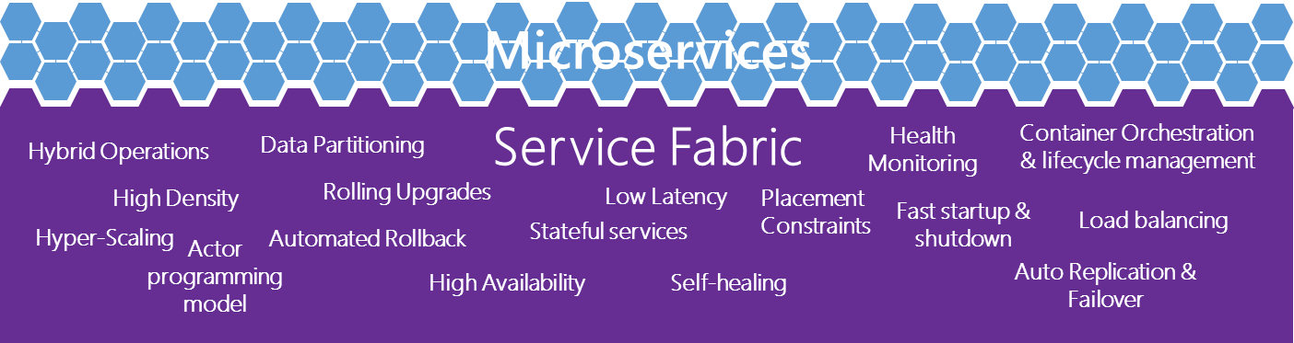
The right
tools for you.
Virtual Machines
Linux
Development Frameworks
and Languages
Service Fabric
Go
Perl
PHP
Phython
Node
JavaScript
.Net
C++
Ruby
Win32
Java
Microsoft Cloud
Container Technologies
Azure
On Premises
Service Provider
Linux

Slide 18
In conclusion
Know
Gain
Learn
enough about containers to be dangerous
insights on where you would use containers
what Microsoft
is doing with containers

Slide 19
What’s Next?
Preview of Windows Server Containers – this summer.
Preview of Hyper-V Containers – planned for this year
How can you stay up to date?
Follow taylor on Twitter @taylorb_msft
Windows Container’s site goes live on Monday
https://msdn.microsoft.com/virtualization/windowscontainers
http://aka.ms/windowscontainers

