Slide 1

Futuristic
Design
Net 0
Comfortable
Sustainable
Recyclable
Recyclable
Secure
Safe
Modern

Slide 2
Our Philosophy
We promise to make secure safe and sustainable house designed designed for the environment and for You.

Slide 4
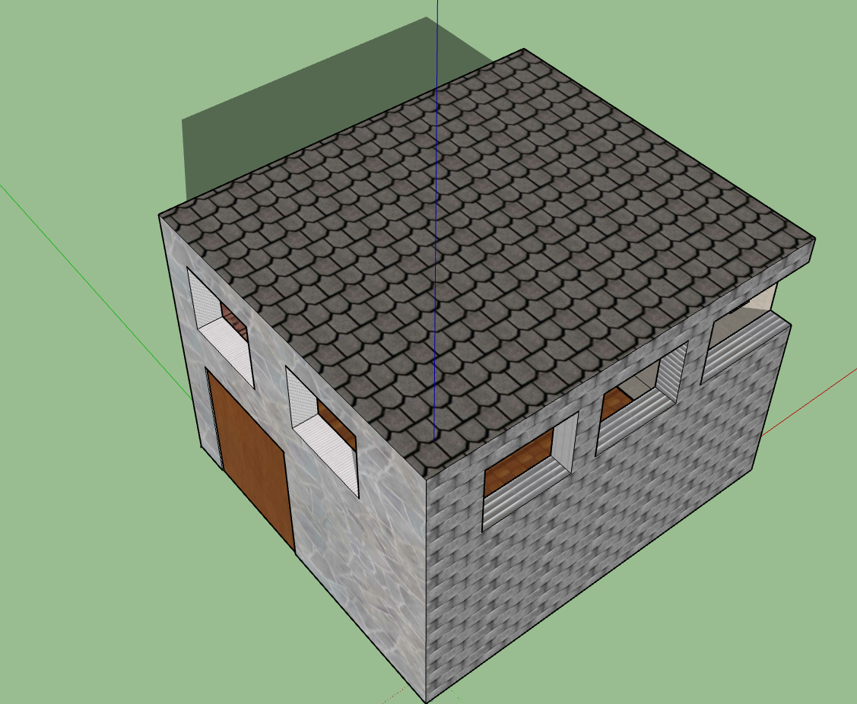
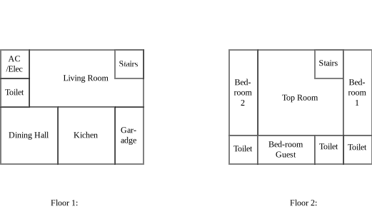
Our Designs
We promise to make secure safe and sustainable house designed designed for the environment and for You.

