Slide 1
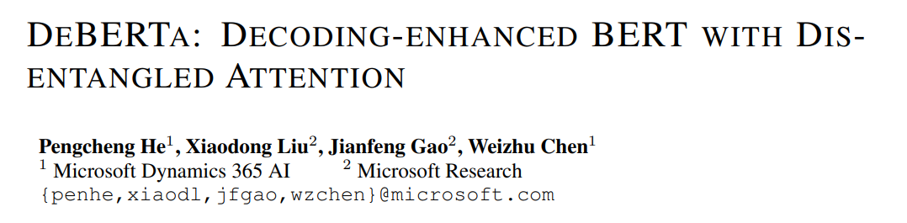

Slide 2

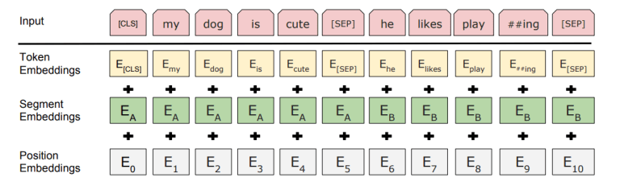
1 Introduction
1.1 Motivation
Relative informations is very important
Another way to use position information: Disentangled Attention
Notes:
In BERT, each word in the input layer is represented by a vector, which is the sum of its word (content) embedding and position embedding. This method simply adds content and positional information, making it difficult to effectively separate the two.
This, in turn, affects the model's ability to capture relationships between words. For complex contexts and long texts, capturing the relative positional relationships between words is particularly important.

Slide 3


Slide 4

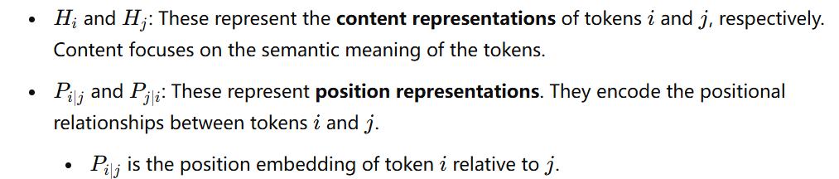
2 DeBERTa
2.1 Disentangled Attention Score

Slide 5
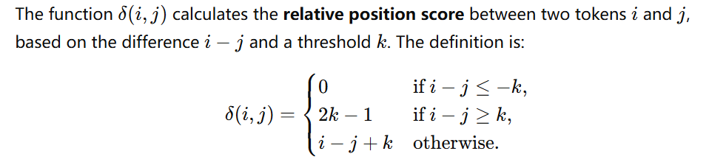
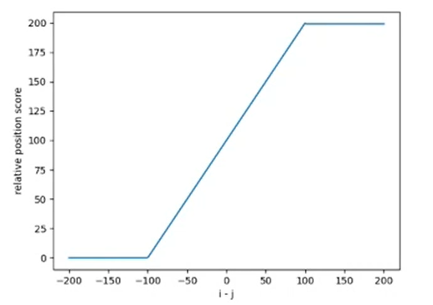
2 DeBERTa
2.1 Relative Distance
k represents the maximum relative distance that the model will explicitly consider.
k=100

Slide 6
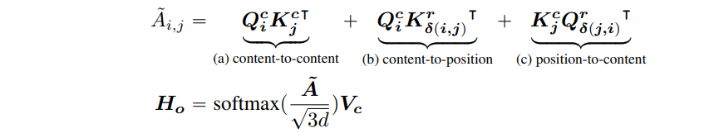
2 DeBERTa
2.1 Disentangled Attention
Notes:
A~： 综合的注意力分数矩阵。
ddd： 表示向量的维度。缩放因子 3d\sqrt{3d}3d​ 用于稳定梯度，避免数值过大影响训练。
VcV_cVc​： 内容向量的值（Value Content），用于生成最终的输出向量 HoH_oHo​
A~: The combined attention scores (content-to-content, content-to-position, and position-to-content).
Content-to-Content: Standard attention mechanism focusing on semantic meaning.
Content-to-Position: Captures how token meaning relates to its relative position.
Position-to-Content: Captures how relative position influences token meaning.

Slide 7
Sometimes relative distance is not enough
Example:
“a new store opened beside the new mall”
“a new [MASK] opened beside the new [MASK]”
Both “store” and “mall” follow “new” with the same relative positions.
Similar local context, but very different syntactic roles
We need absolute positions

Slide 8
Where to include absolute positions?
BERT includes absolute positions in the input
DEBERTA’s inputs use relative positions
DEBERTA includes absolute positions in the “Enhanced Mask Decoder” component

Slide 9
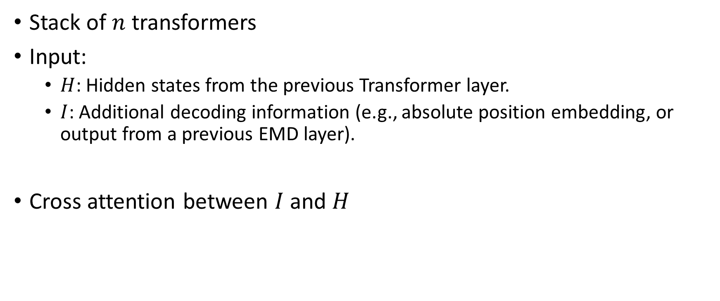
3 Enhanced Mask Decoder

Slide 10
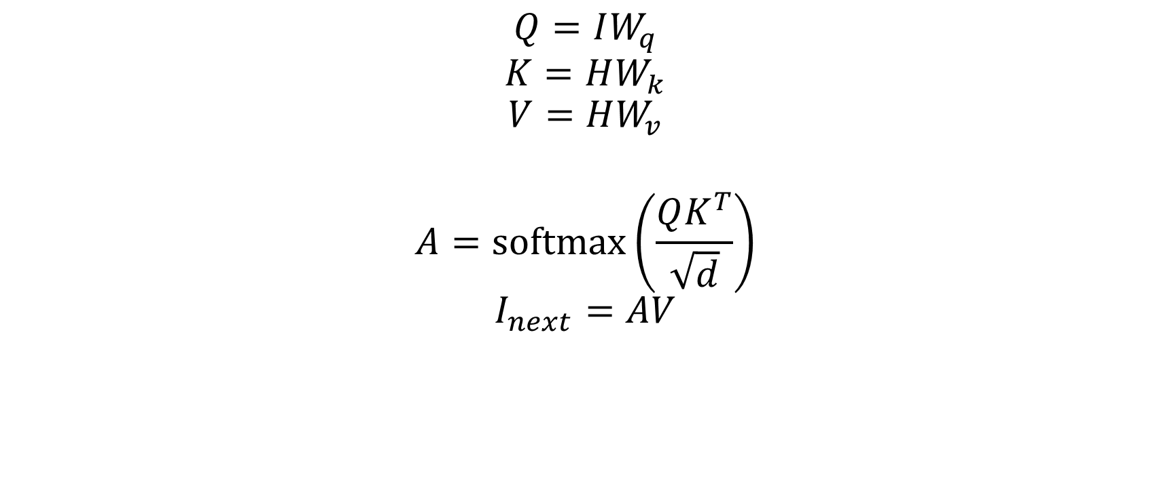
3 Enhanced Mask Decoder

Slide 11
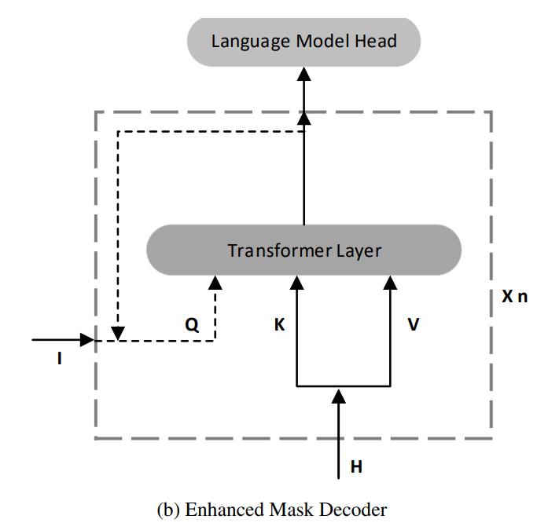
3 Enhanced Mask Decoder

Slide 12
Why Enhanced Mask Decoder?
Empirically lead to better results
DEBERTA outperforms RoBERTa-Large even with half the training data on a wide range of NLP tasks
Removing EMD from DEBERTA results in significantly worse performance
EMD is more flexible it can be used to introduce other useful information, other than positions

Slide 13
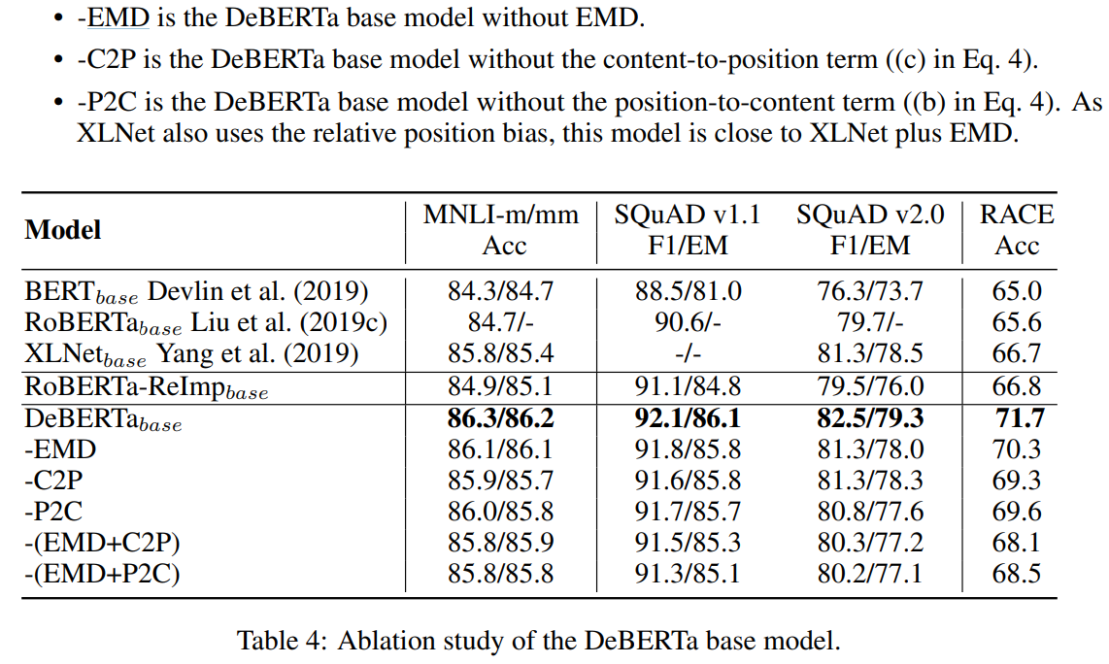
Ablation study

Slide 14
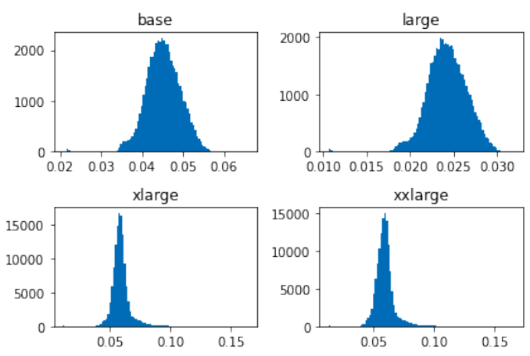
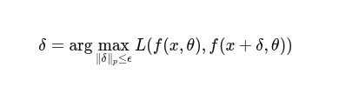
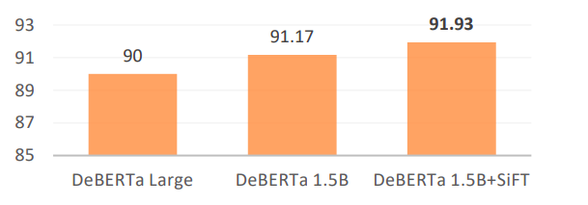


4 SiFT - Scale Invariant Fine Tuning
Virtual Adversarial Training
Regularization method for improving models robustness
Unstable when applied to large models
SiFT
Add a normalization layer to the embeddings, and apply perturbation to normalized embeddings
Fig. The distribution of the variance of word embeddings of different models
Fig. Performance on GLUE Dev

Slide 15
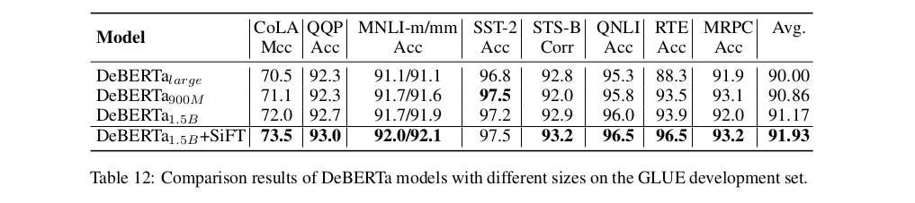
Comparison Results

Slide 16
Summary
Techniques to improve model performance
Disentangled Attention to improve position encoding in transformers
Enhanced Mask Decoder to overcome ambiguity issue with MLM
Scale Invariant Fine-tuning to solve instability issue with adversarial training on large models

Slide 17
Thank You

