Slide 1

Mental Health In Tech
Prepared by
Nicholas Bergfeld
Courtney Charles
Jenn Collins
Ellen Hendricks

Slide 2
Business Objectives
Research Questions
What is the respondent demographics of those employees in tech that maybe facing mental illness in the tech world? We can take a close look at age, gender, and treatment in the dataset.
What is the prevalence of mental illness of employees in tech? We can analyze tech company, and family history the dataset.
Is there stigma placed on tech vs other employees that admit their mental health status
on the job? We can take a look at obs consequence, mental health interview,
anonymity, and tech company in the dataset.
Are employees more likely willing to discuss mental health with other employees or their
supervisor? We can look at coworkers, supervisor, and treatment in the dataset.
What are the availability of resources and support to those that are dealing with mental
health on the job? We can look at the benefits, wellness program, and leave
dataset.

Slide 3
The Total Cost of Hiring an Employee
Unfortunately, it’s very difficult to pinpoint a precise amount of money it takes to hire a new employee. However, there are some general guidelines to make an educated guess.
• As stated in a study by the National Association of Colleges and Employers, hiring an employee in a company with 0-500 people costs an average of $7,645.
• Another study by the Society for Human Resource Management states that the average cost to hire an employee is $4,129, with around 42 days to fill a position.
• According to Glassdoor, the average company in the United States spends about $4,000 to hire a new employee, taking up to 52 days to fill a position.
If you’re replacing someone instead of filling a new position, stakes get even higher. Another research by SHRM states that it takes up to 50-60% of an employee’s annual salary to find a direct replacement. Turnover can be quite costly, summing up to a total of 90-200% of an employee’s annual salary.

Slide 4
Hypotheses
Does the “culture” of the company and attitude of the employee influence the likelihood of an employee seeking help for a mental health issue?
- Null hypotheses would be that the culture doesn’t influence the likelihood of an employee seeking help.
Culture includes things like self employed or not, number of employees, willingness to discuss mental health issue with coworkers or supervisors, etc.
Do more employees seek treatment in the US vs not the US?
- Null hypotheses would be that country is not a factor in whether an employee seeks treatment or not.
Within the US, does the state play any part in the likelihood of an employee seeking treatment or not?
- Null hypotheses would be that they state does not play a part.

Slide 5
Tech Industry Outlook
A growing number of HR professionals recognize that early detection and treatment of mental illness often can prevent a crisis and reduce employers’ health care costs down the road. They are developing programs and plans to provide more support for their employees with psychiatric disorders—similar to the help they provide those with physical injuries or ailments.

Slide 6
Data Set

Slide 7
Data Set

Slide 8
Visualizations

Slide 9
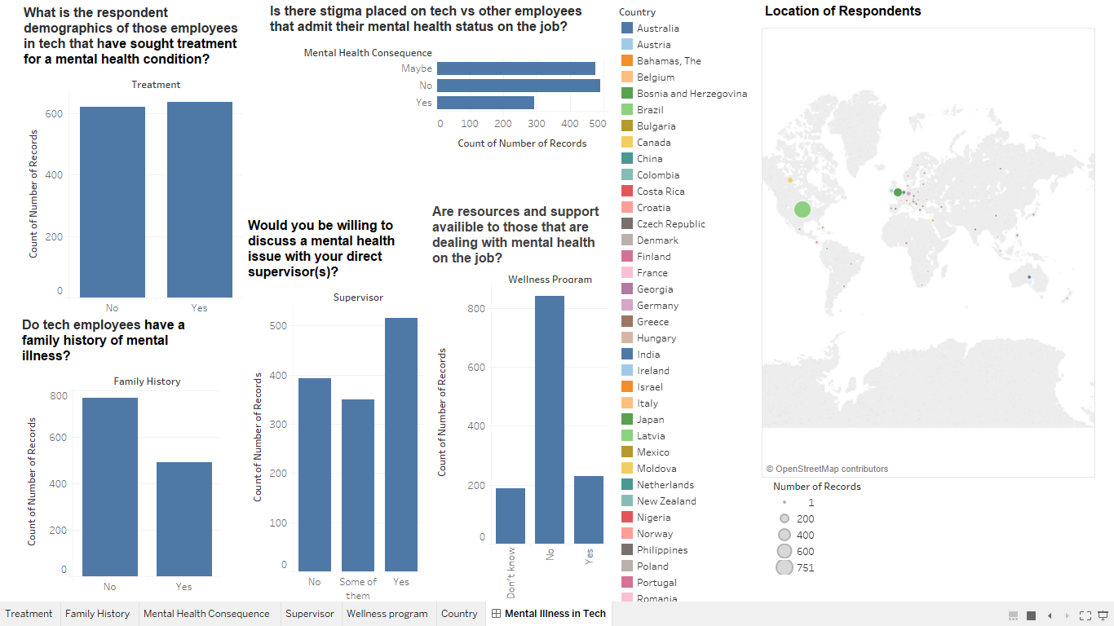

Slide 10
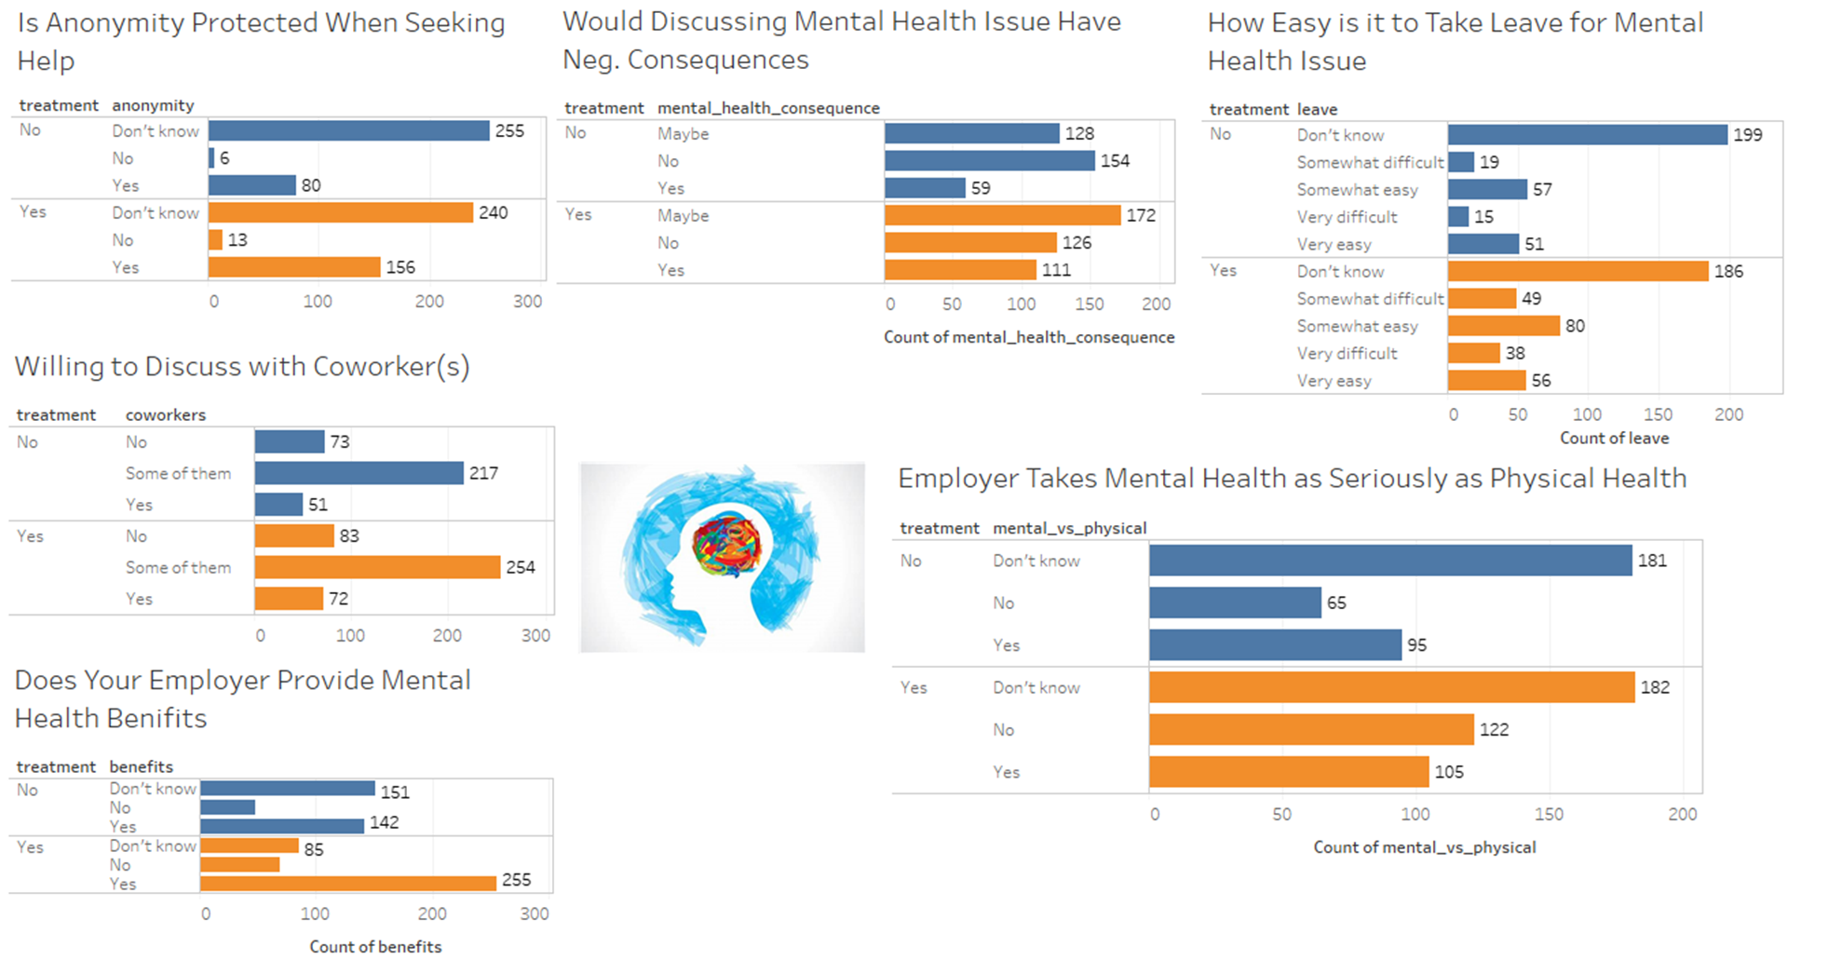

Slide 11
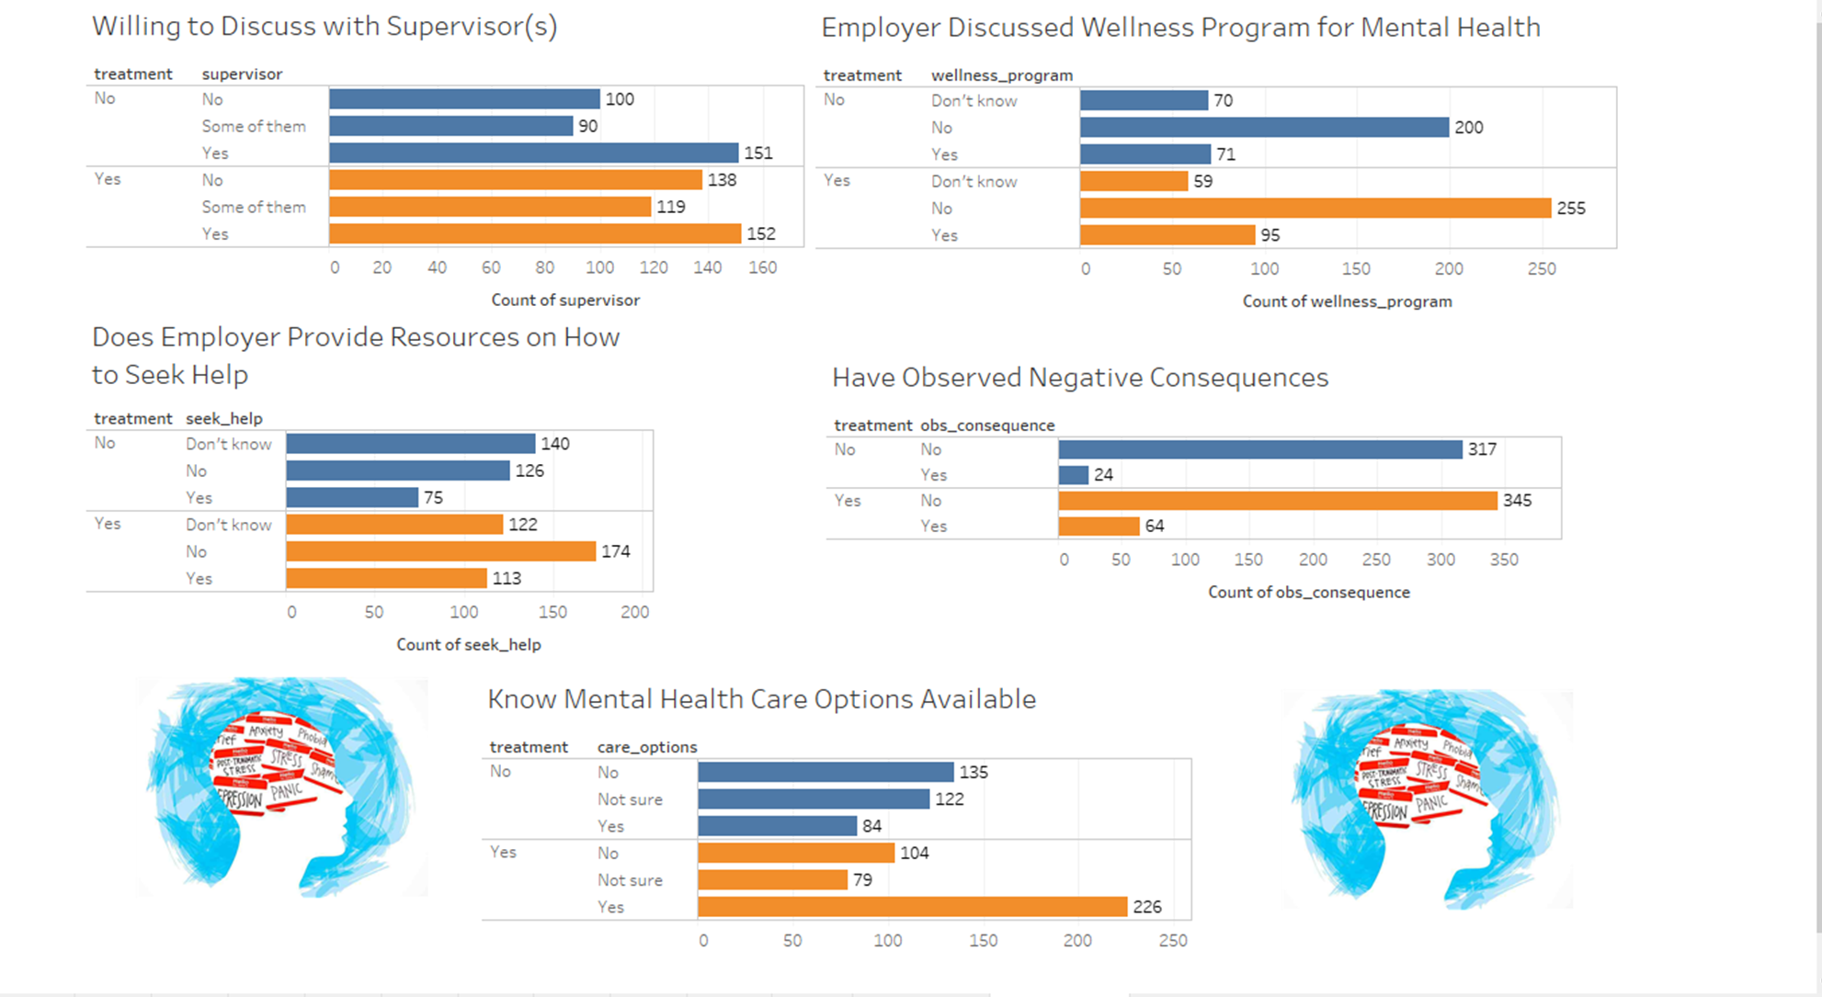

Slide 12
Data Challenges/Limitations
More recent data on positive work environments who have addressed the issue of mental health in tech jobs would have given us more of a comparison of 2014 compared to recent years. We believe that people are more open to talking about mental health in recent years since the stigma is down tremendously. Also, data on government policy to accommodate those with mental health in the workplace would be good to analyze.

Slide 13
Machine Learning
Data Preparation
Model Training
Flask App
Python
HTML

Slide 14
Technology Stack
*Tableau
*Machine Learning
*Python

Slide 15
Data Sources
Source: (survey.csv)
https://www.kaggle.com/osmi/mental-health-in-tech-survey/home
https://www.shrm.org/hr-today/news/hr-magazine/Pages/1014-mental-health.aspx

