Slide 1
Titanic Analysis
Ellen Hendricks

Slide 2
Figuring out how to do this
Googled the different approaches (KNN, SVM, Decision Tree), went over activities, etc.
The Titanic data was very different from those examples.
Found a solution tutorial (https://www.kaggle.com/startupsci/titanic-data-science-solutions). This REALLY helped. Plus it is very detailed and the data analysis was excellent.

Slide 3
My Analysis Approach
The tutorial included every column in the original data set except Passenger ID, Ticket, and Cabin.
I decided to also drop the Name, Fare, and Embarked. The title was extracted from the name and binned. (tutorial only). Fare was also binned
For both the SibSp and Parch columns were combined into IsAlone column. Also the Age column was binned.
So the resulting columns I used are Sex, Age, IsAlone, and Pclass.
One last point, there are several blank age rows. The tutorial filled them in with a guessed age. I analyzed the data with those rows removed and with guesses filled in.

Slide 4
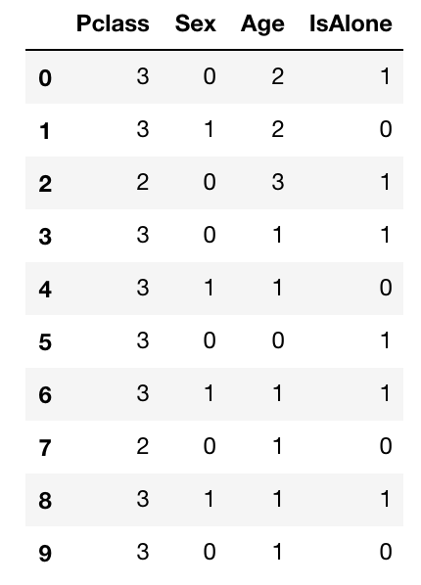
Resulting Data Example

Slide 5
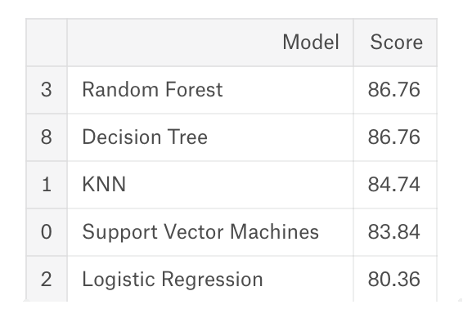
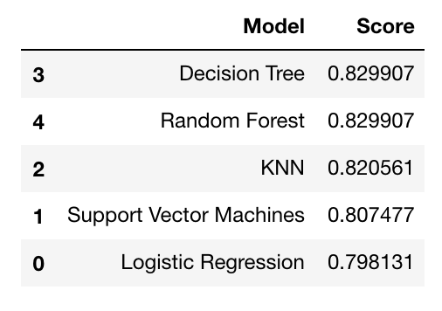
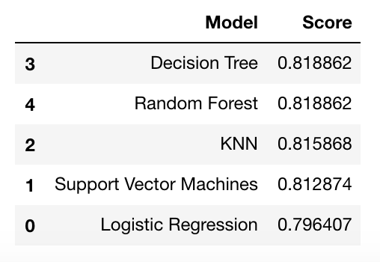
Results
Tutorial Results
Blank Ages Removed
Blank Ages Guessed
Note: The tutorial code to bin the ages didn’t give a bin value for 64+ and was writing the age value
in the field vs a bin value. I added the 5th bin and all the scores were lower. All the scores were slightly
higher for Blank Ages Guessed without the 5th bin (!?) for the decision tree models.
(Because it was then an odd number of bins?)

Slide 6
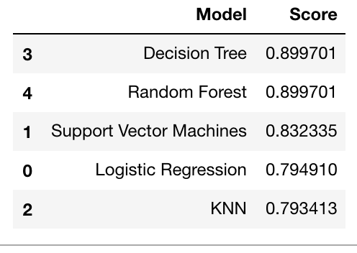
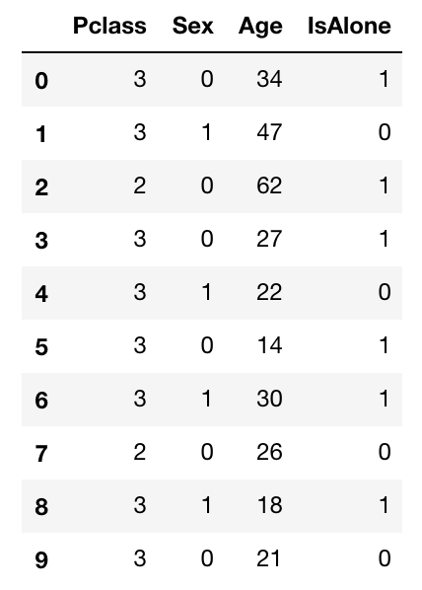
Interesting Accident
Tutorial Results
Guessed Ages but NOT binned!
Non-binned Input Data

Slide 7
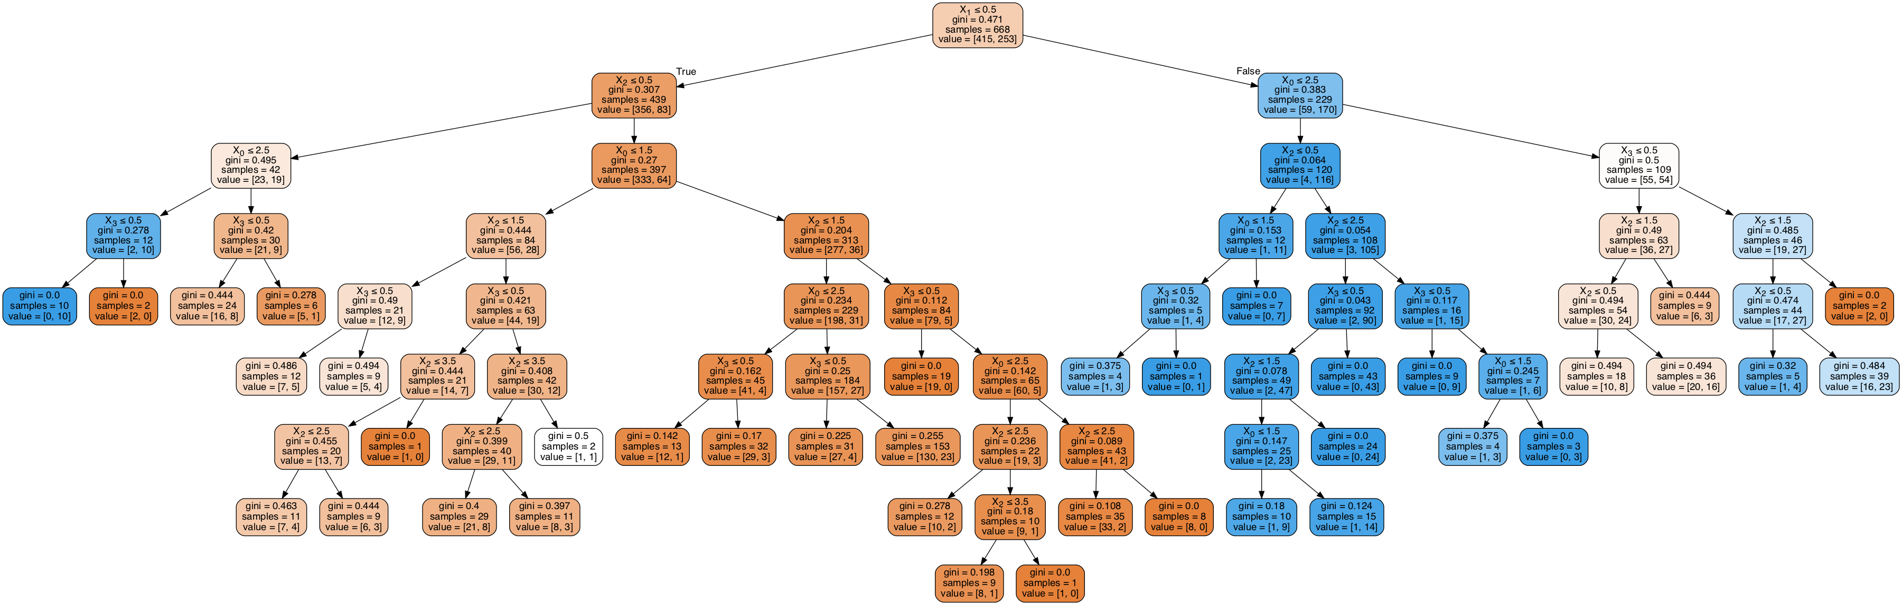
Plot of the Decision Tree (With 5 Age Bins)

Slide 8
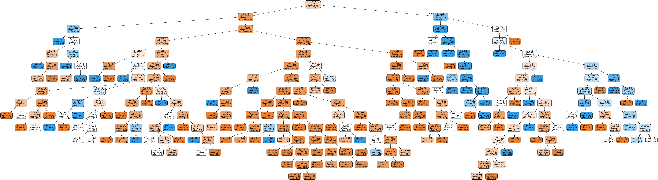
Plot of the Decision Tree Model (Without Age Bins)

