Slide 1
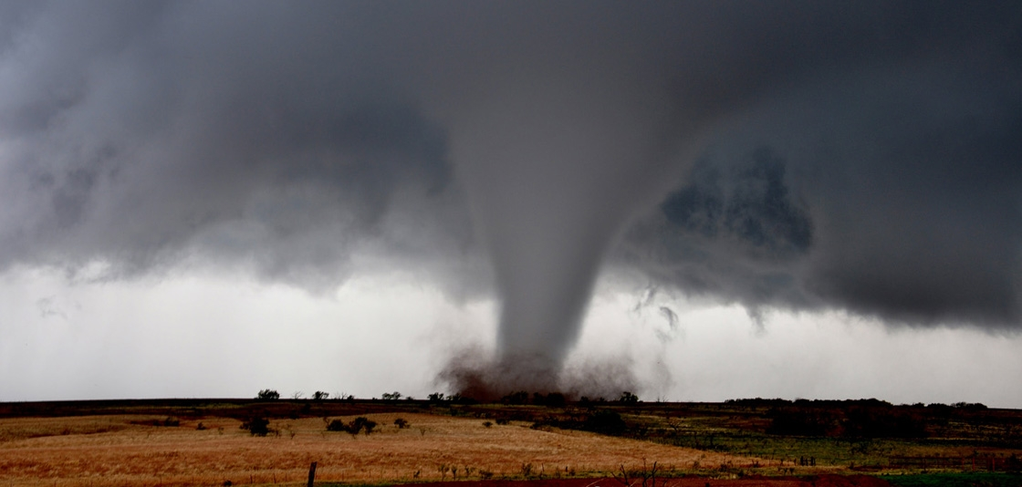

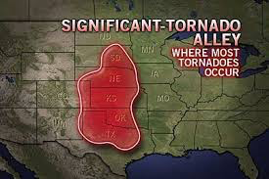
Tornado Alley Shift

Slide 2
Business Objectives:
Provide tornado data, by 1) frequency, 2) occurrence, and 3) intensity across the United States intended to reveal a shift in “tornado alley”.
Extend further information about recent tornado information sourced from other sites.

Slide 3
DATA SOURCE: NOAA WEBSITE (HTTPS://WWW.NCDC.NOAA.GOV/)
Tornado data was available from 1950 to 2018. (later years had all storm events)
This data was available for download in 68 csv files.
Pandas was used to read the files and create 6 new csv files with just the tornado data and the columns we needed.
The data was then grouped into files that had the data for each decade.
These files were used to create 6 layers of each decade of tornados represented by circles where the size and color indicated the F/EF values.
A filter was added (not via Leaflet) to declutter the layers. (?????)

Slide 4
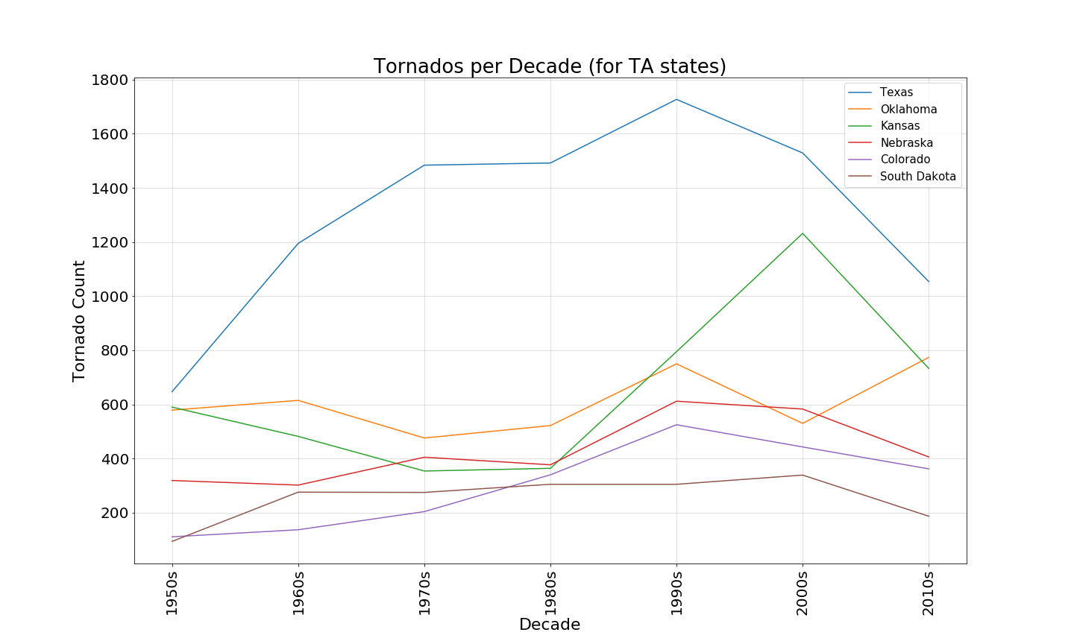
TORNADO ALLEY STATES

Slide 5
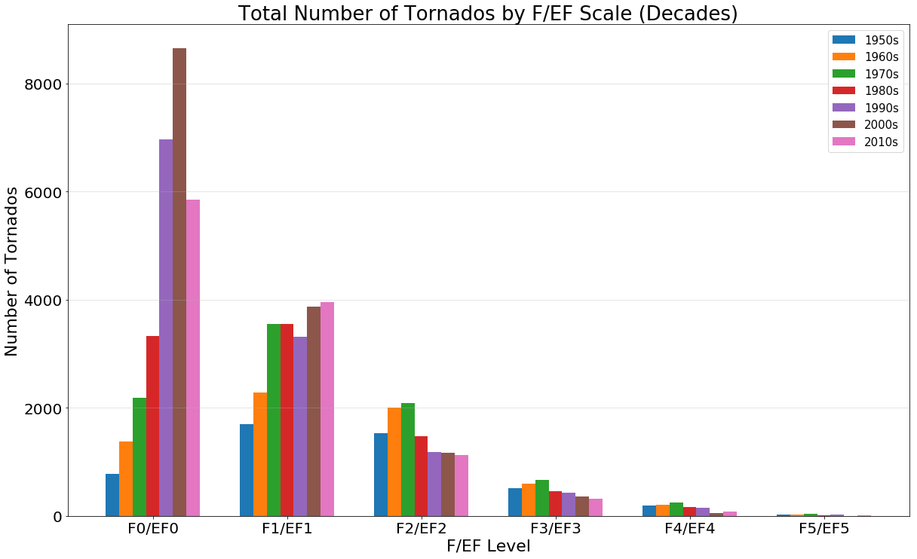
ALL TORNADOS BY F/EF VALUES (0-5)

Slide 6
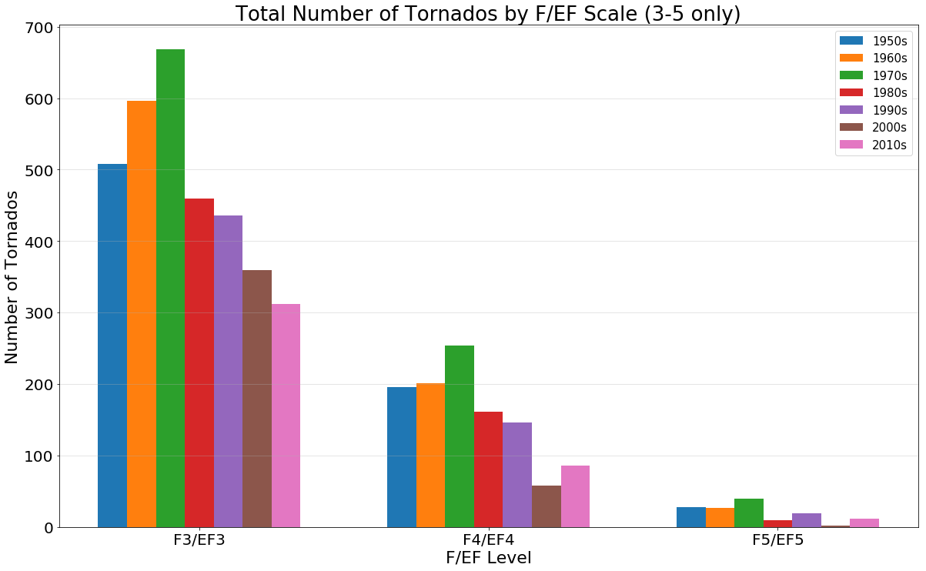
ALL TORNADOS BY F/EF VALUES (3-5)

Slide 7
DATA CLEANING
Used value_counts() Pandas function to get the totals per F/EF value, states values, etc. This function skips rows that have blanks.
The tornado rating changed from F to EF on 2/1/2007. So the “aughts” decade had both. Also, all but the aughts and teens had only F. Counting the tornados by rating had to account for this. Plus the value_counts() function would return rather than 0 when there were no entries for one of the scale values.
Functions were written to handle these special cases.
(Show code)

Slide 8
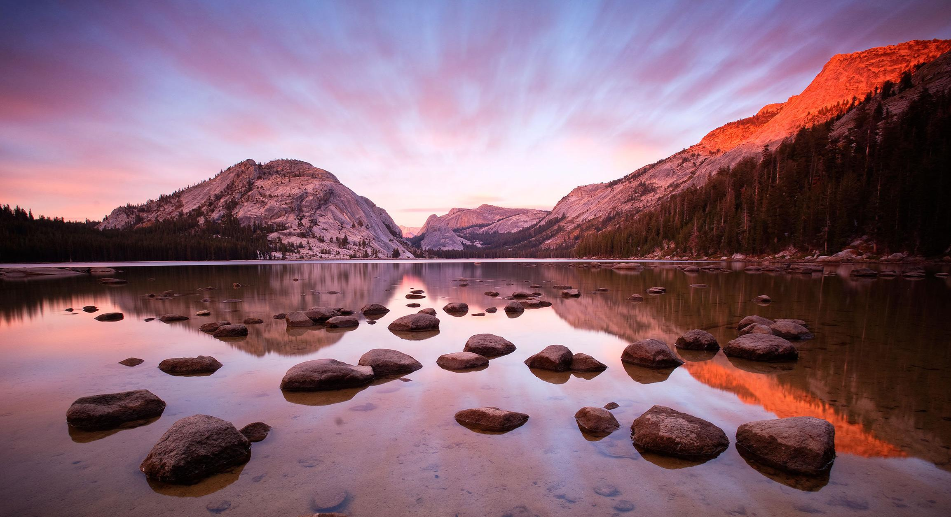
http://127.0.0.1:5000/
Gone with the wind….
Click here

Slide 9
ADDITIONAL REFERENCES
This article talks about the new tornado alleys (Dixie, Hoosier, Carolina). Also states that the reason that the scientists are saying the original ally (called Tornado Alley) is no longer the most significant is because others (mainly Dixie) are seeing more damage/injuries/deaths than in Tornado Alley. https://www.bloomberg.com/graphics/2017-dixie-alley-storms/
Near record tornados in 1982: https://journals.ametsoc.org/doi/pdf/10.1175/1520-0493%281983%29111%3C1665%3ATANRY%3E2.0.CO%3B2

Slide 10
“IS THERE A SHIFT IN TORNADO ALLEY?”
Tornado alley: “Tornado Alley is a nickname given to an area in the southern plains of the central United States that consistently experiences a high frequency of tornadoes each year. Tornadoes in this region typically happen in late spring and occasionally the early fall.”
Dixie alley: “The Gulf Coast area has a separate tornado maximum nicknamed "Dixie Alley" with a relatively high frequency of tornadoes occurring in the late fall (October through December).”
https://www.ncdc.noaa.gov/climate-information/extreme-events/us-tornado-climatology/tornado-alley

Slide 11
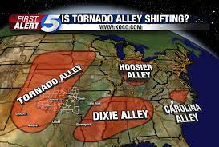

Slide 12
WHY THIS WAS OF INTEREST TO US
We were curious to find a possible correlation with temperature change and the shift of tornado alley.
Since there’s a shift, this data could be influential to creating greater awareness for the “new alley” areas:
City: Cost of rebuilding considered.
Mobile/Home builders: Fabrication of more resilient homes.
Insurance services: may provide competitive tornado coverage.

Slide 13
Avg. Temp. Data: https://climate.nasa.gov/vital-signs/global-temperature/

