Slide 1
Deliverex
David, Erkhbold, Mohamed, Syed

Slide 2
Business Problem
Deliver packages nationwide
Deliver status information for packages
Safe system to easy monitor the packages
Create the shipment without creating user accounts
Track of the package

Slide 3
Goals / Requirements
Nationwide shipping service
Create shipping order without creating user accounts
Track packages through the shipping process
Deliver packages
Inform the customer of current status of the package

Slide 4
Characteristics of the System
Flexibility: easy to add new functionalities
Maintainability: easy to maintain existing small components
Microservices Architecture: Using small services to provide a easy to change / upgrade system
Event Driven Architecture: Microservices communicate through events creating a responsive application
Stream Based Architecture: By using the power of Kafka to support our application

Slide 5
Non-functional Qualities of the System
Performance
Usability
Security
Availability
Interoperability
Maintenance
Accuracy
Fault Tolerance
Reusability
Scalability
Modularity
Monitoring
Portability

Slide 6
Business Requirements
Licensing Issues
Technological Policies
Cost
External Regulations
Third Party Support
Organization Policies

Slide 7
System architecture design

Slide 8
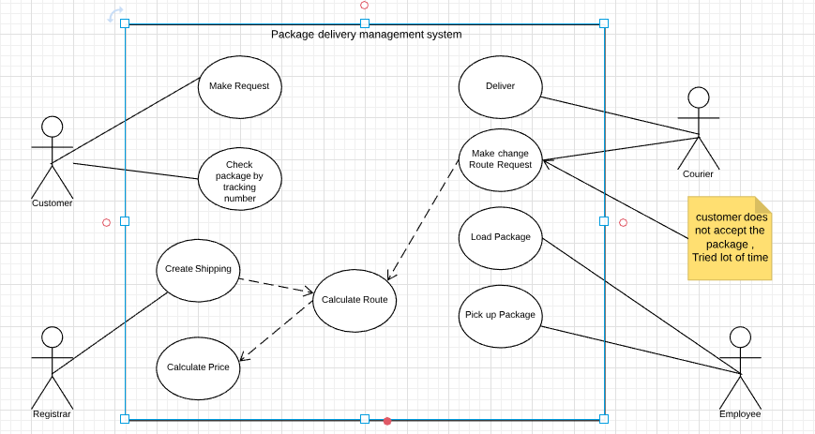
Use Case Diagram

Slide 9
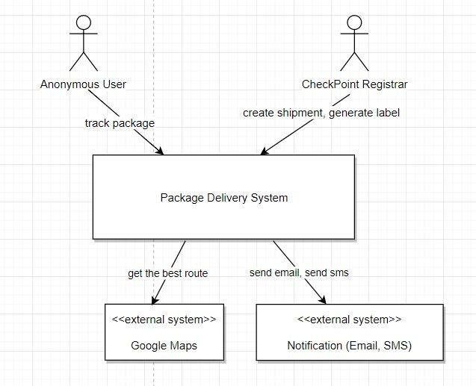
Context Diagram

Slide 10
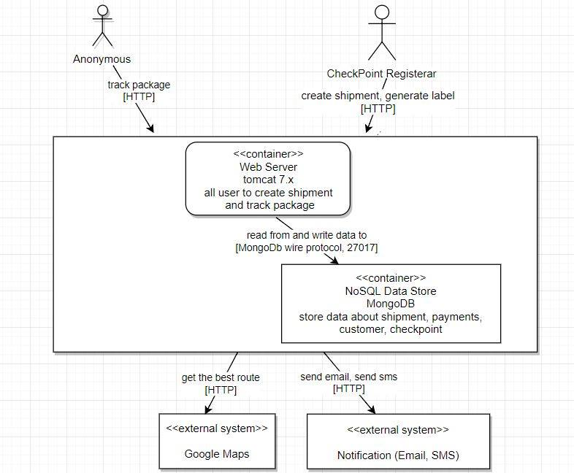
Container Diagram

Slide 11
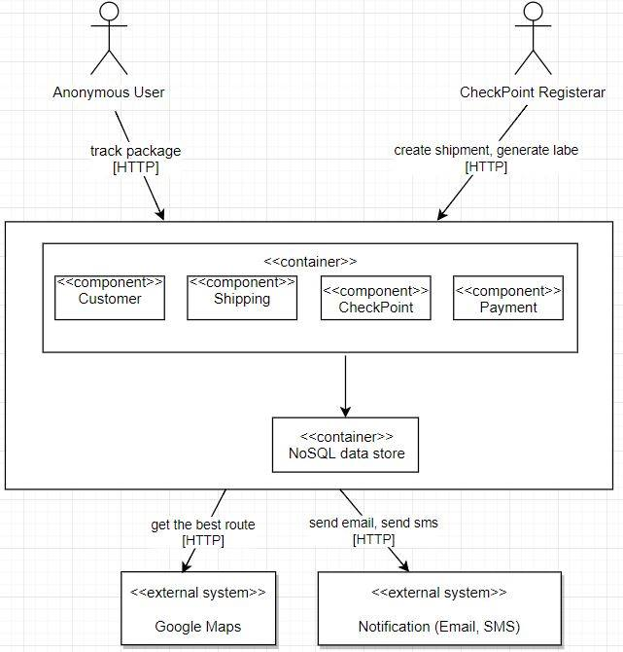
Component Diagram

Slide 12
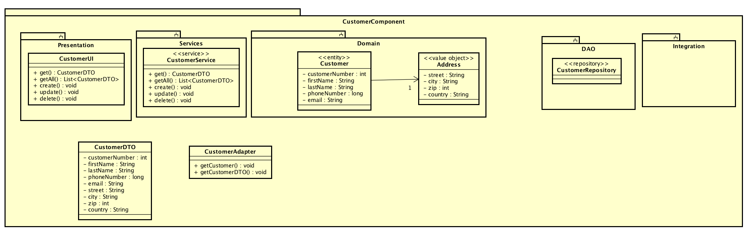
Class Diagram – Customer Component

Slide 13
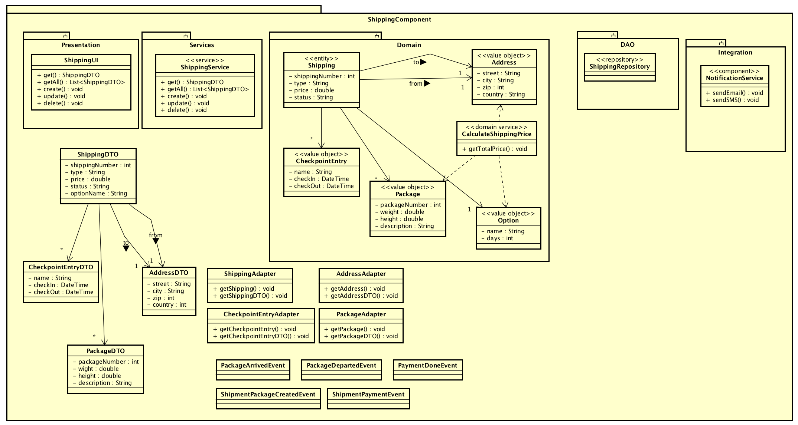
Class Diagram – Shipping Component

Slide 14
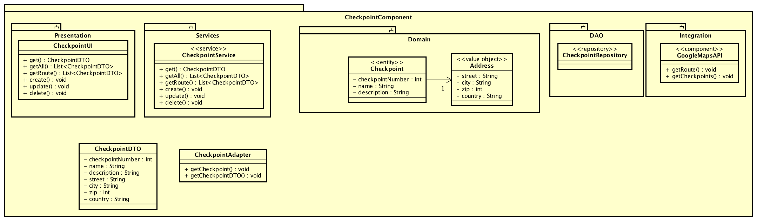
Class Diagram – Checkpoint Component

Slide 15
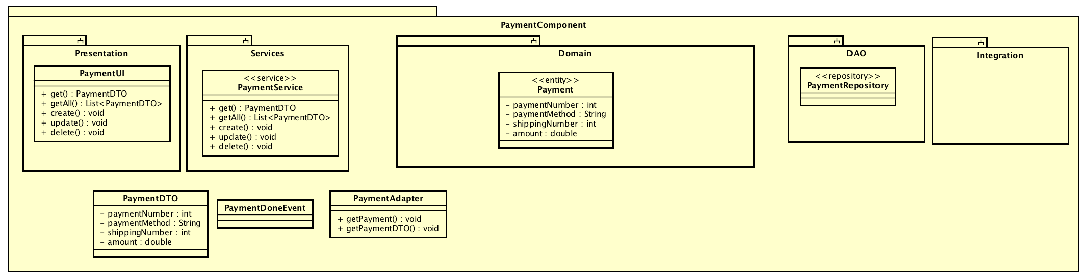
Class Diagram - Payment Component

Slide 16
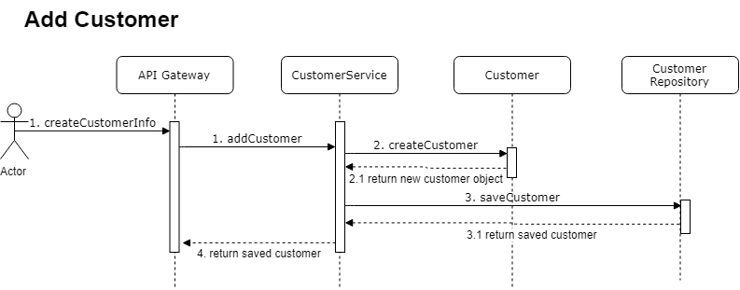
Sequence Diagram – Add Customer

Slide 17
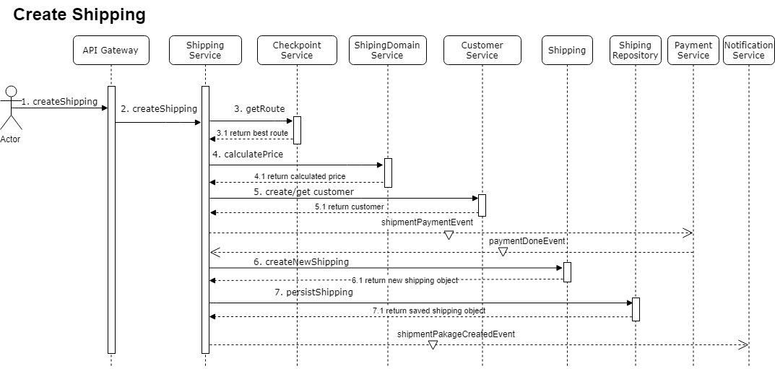
Sequence Diagram – Create Shipping

Slide 18
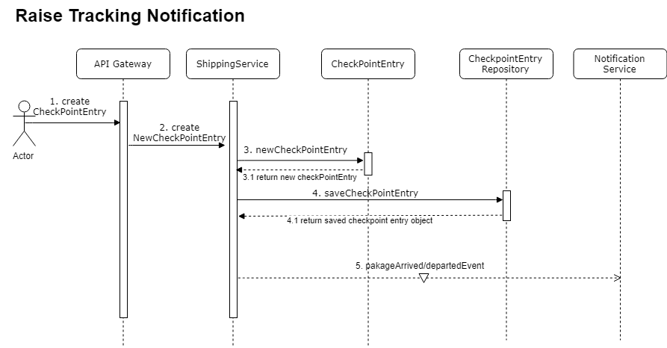
Sequence Diagram – Tracking Notification

Slide 19
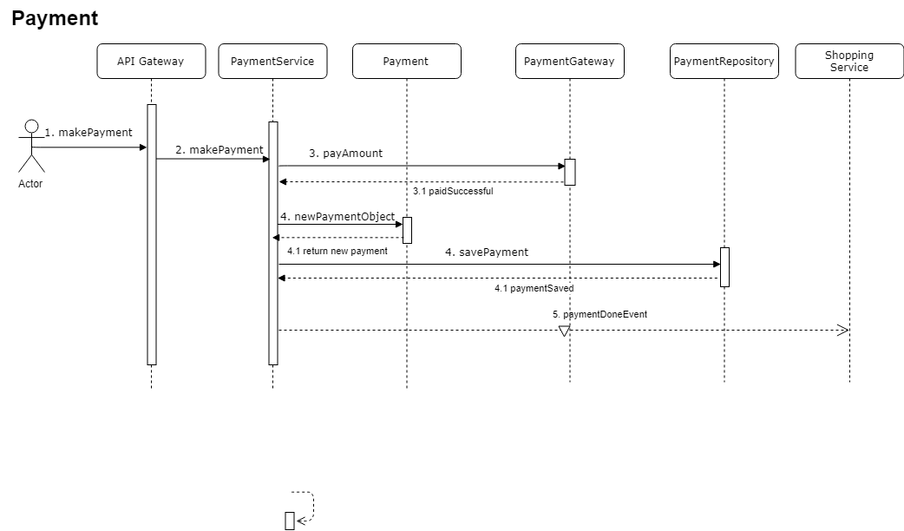
Sequence Diagram - Payment

Slide 20
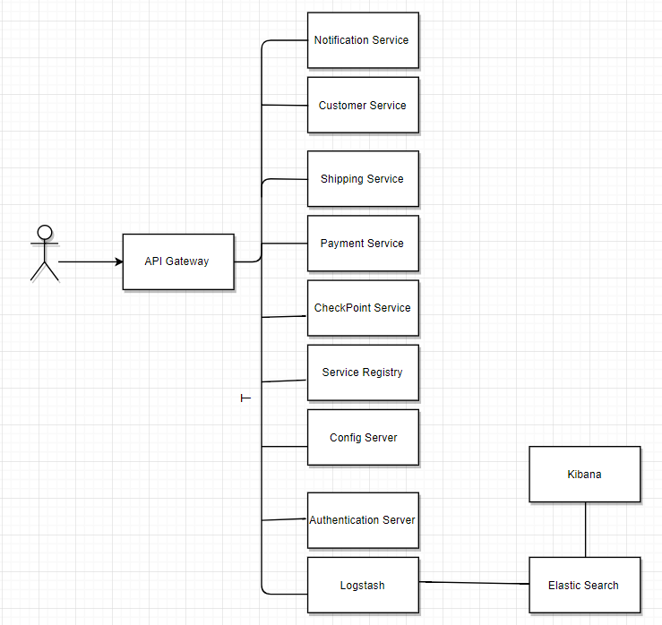
Overview

Slide 21
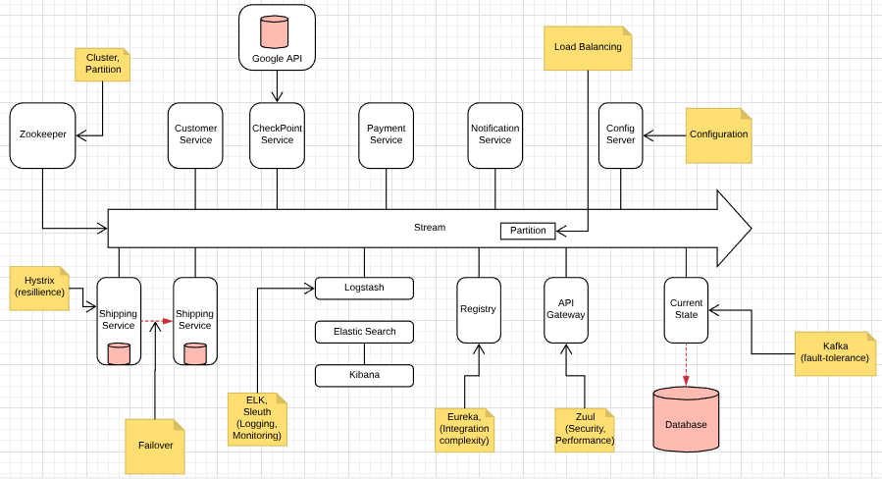
Stream Based Event Driven Architecture

Slide 22
Architectural Risks
Natural Disaster Recovery
Security
Network
Crash or Total Microservice Failure

Slide 23
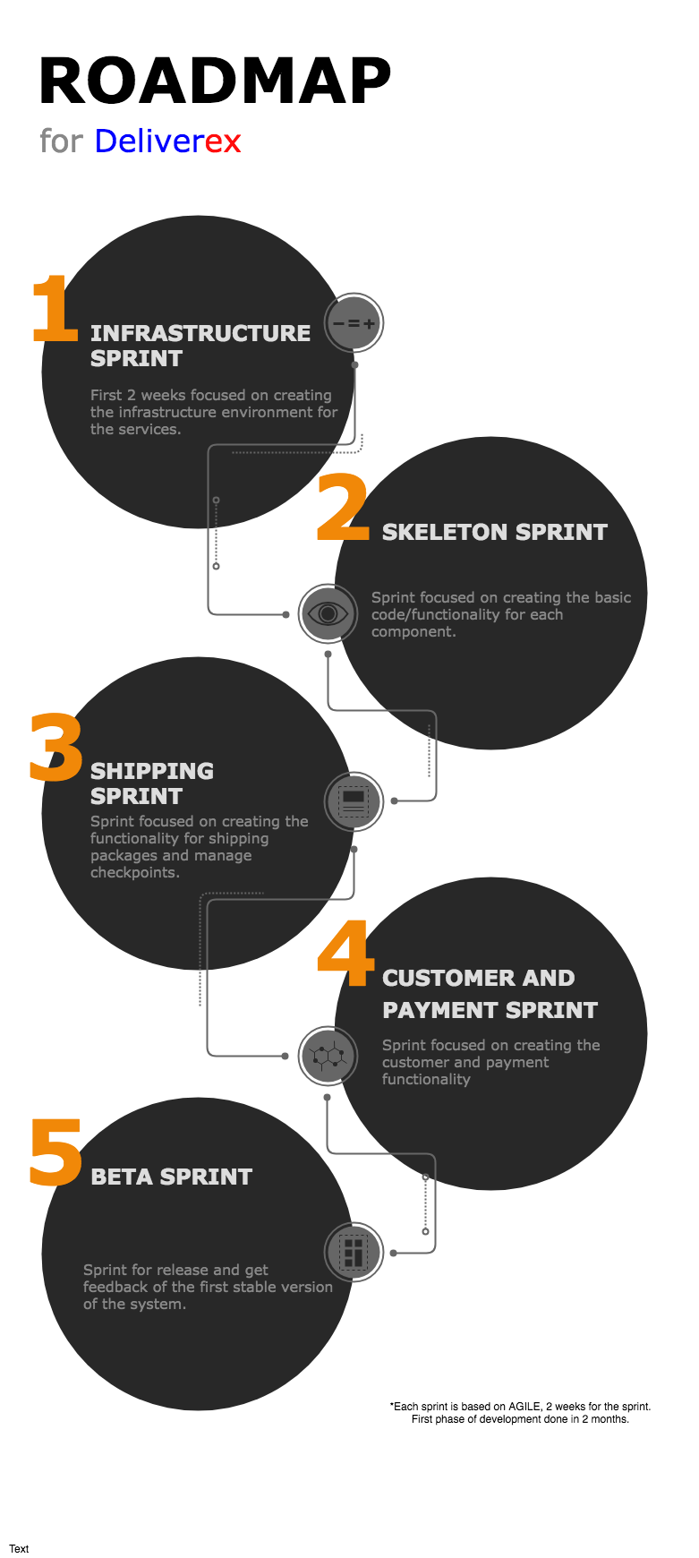
Roadmap
Agile methodology oriented
5 Sprints
Each sprint 2 weeks
First beta release 2.5 months

Slide 24
Connecting the parts of knowledge with the wholeness of knowledge
This architecture solves the problem in simplest way, but covers all the main aspects of problem domain.
Transcendental consciousness is a field of complete simplicity and all possibilities.

