Slide 1
Nirmaliswarran SR
au715521104028
Final Project
3/21/2024 Annual Review

Slide 2
PROJECT TITLE
Automated License Plate Detection
3/21/2024 Annual Review

Slide 3


AGENDA
Introduction
Overview and significance of automated license plate detection.
Need for efficient and accurate systems in various applications.
Problem Statement
Challenges of manual license plate detection.
Limitations of traditional methods in diverse conditions.
Project Architecture
Model.py and detect.py overview.
Convolutional layers and model structure.
Implementation
Data preprocessing, training, and testing.
Demonstration of detection and recognition capabilities.
Evaluation
Performance metrics assessment.
Comparison with existing methods.
Conclusion
Summary of accomplishments and findings.
Project's significance and impact.
3/21/2024 Annual Review

Slide 4

PROBLEM STATEMENT
The problem addressed by this project is the manual process of license plate detection and recognition, which is time-consuming, error-prone, and lacks scalability. Traditional methods for license plate recognition often struggle with variations in image quality, lighting conditions, and plate orientation. Additionally, they require significant manual intervention for training and tuning, limiting their effectiveness in real-world scenarios. Therefore, there is a need for an automated system that can accurately detect and recognize license plates in diverse environments, thereby improving efficiency and reliability in applications such as surveillance, parking management, and traffic monitoring.
3/21/2024 Annual Review

Slide 5

PROJECT OVERVIEW
Model Building Phase :
Constructs and trains a convolutional neural network (CNN) model for license plate recognition.
The model architecture includes convolutional layers, pooling layers, and fully layers.
Trained using labeled data to detect license plate presence and recognize characters.
Detection Phase :
Applies the trained model to input images for license plate detection and recognition.
Utilizes multiple scales for robust detection across various image sizes.
Post-processing steps refine detection results and merge duplicate detections.
3/21/2024 Annual Review

Slide 6

WHO ARE THE END USERS?
Law enforcement agencies for automatic vehicle identification.
Parking management systems for automated entry and exit of vehicles.
Toll collection systems for seamless payment processing.
Security agencies for monitoring and surveillance purposes.
Municipalities for traffic monitoring and management.
Vehicle tracking and fleet management companies.
Access control systems for secure entry and exit points.
3/21/2024 Annual Review

Slide 7
YOUR SOLUTION AND ITS VALUE PROPOSITION
The system provides a robust solution for automating license plate detection and recognition tasks.
By leveraging deep learning techniques, it offers high accuracy in detecting license plates under various conditions such as different scales, orientations, and lighting conditions.
The modular design of the code allows for easy customization and integration into existing applications or systems.
The system's ability to handle arbitrary-sized input images makes it suitable for real-world scenarios where license plates may appear at different distances or angles.
3/21/2024 Annual Review

Slide 8

THE WOW IN YOUR SOLUTION
The wow factor lies in the system's capability to accurately detect and recognize license plates in complex real-world scenarios, such as crowded traffic scenes or low-light conditions.
The use of deep learning techniques enables the system to learn complex patterns and adapt to different environments, surpassing traditional rule-based or handcrafted feature-based methods.
The efficient design of the CNN model allows for fast and real-time processing of images, making it suitable for applications requiring quick responses, such as surveillance systems or automated toll booths.
3/21/2024 Annual Review

Slide 9
MODELLING
Convolutional layers: The model architecture includes multiple convolutional layers responsible for feature extraction from input images.
Training model: This model is designed to process fixed-size windows of images during training and outputs a probability distribution for each character in the license plate along with bounding box coordinates.
Detection model: Unlike the training model, the detection model can handle arbitrarily sized inputs by sliding a window across the image, enabling the detection of license plates in various scenarios.
Bounding box coordinates: The output of the models provides bounding box coordinates for detected license plates, allowing for precise localization within the input image.
Character probability distributions: Along with bounding box coordinates, the models output probability distributions for each character in the license plate, aiding in accurate recognition.
Training process: The models are trained using labeled data, allowing them to learn the patterns and features associated with license plates and improve detection and recognition performance.
CNN architecture: The use of CNNs enables effective feature learning from image data, making the models capable of robust detection and recognition even in challenging conditions.
3/21/2024 Annual Review

Slide 10
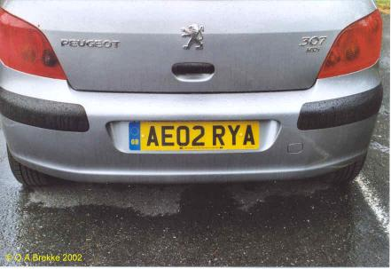
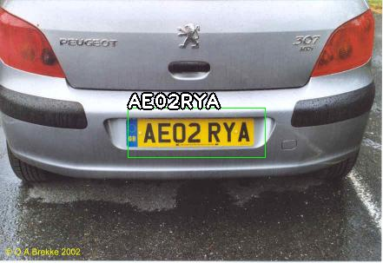
RESULTS
Input image
Output image
https://github.com/sr-nirmal/automated-license-plate-recognition.git
3/21/2024 Annual Review

