Slide 1

PSG Institute of Technology Department of Computer Sciand Applied Research Neelambur, Coimbatore - 641062 ence and Engineering
Receipt-Scan : Sustainable Spend
Team Members
• Nirmaliswarran SR- III Year CSE
• Abishek V- III Year CSE
• Lakshana R- III Year CSE
• Thanisha Shimnaz N - III Year CSE
Mentor
Dr. S. Lokesh - Associate Professor, Department of CSE
Jagan Babu - Spend Engineering, SAP Labs. Bengaluru
Tech Stack
React JS
Python/Flask
Mongo DB
OpenAI Api
PSG iTech, CSE

Slide 2
App Features
Sophisticated computer vision algorithms to accurately extract relevant information from a receipt image
Machine learning system to analyse the extracted data and assign a sustainability index to each item
User-friendly interface to present the sustainability index to consumers.
Comprehensive database of sustainability information for a wide range of products to inform the sustainability index calculation.
PSG iTech, CSE

Slide 3
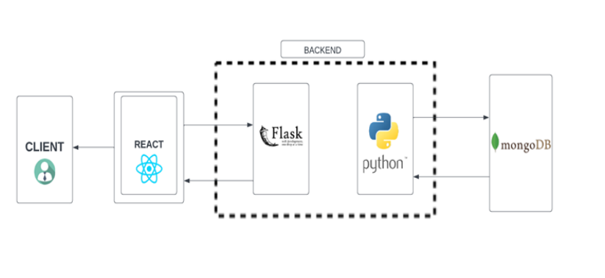
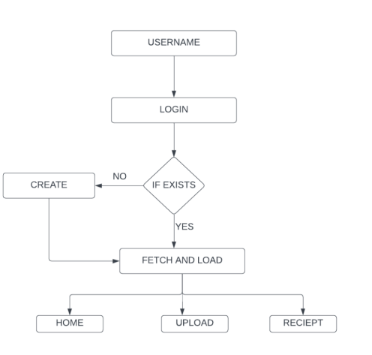
Architecture Diagram and Navigation Flow #corr
PSG iTech, CSE

Slide 4
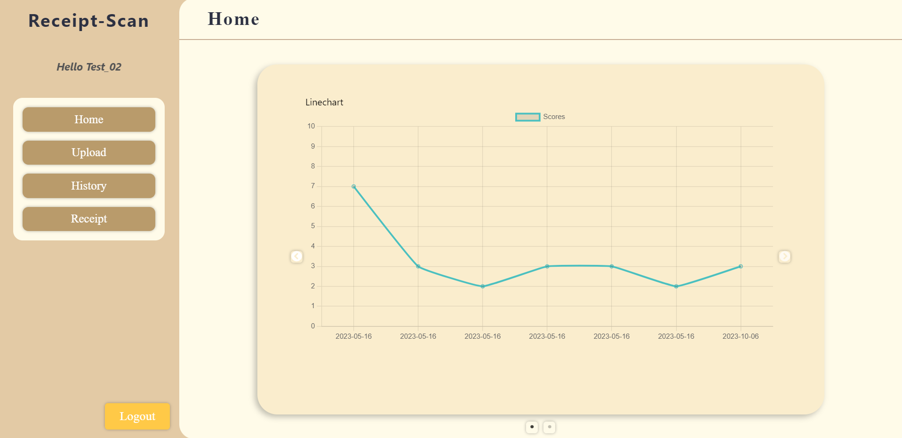
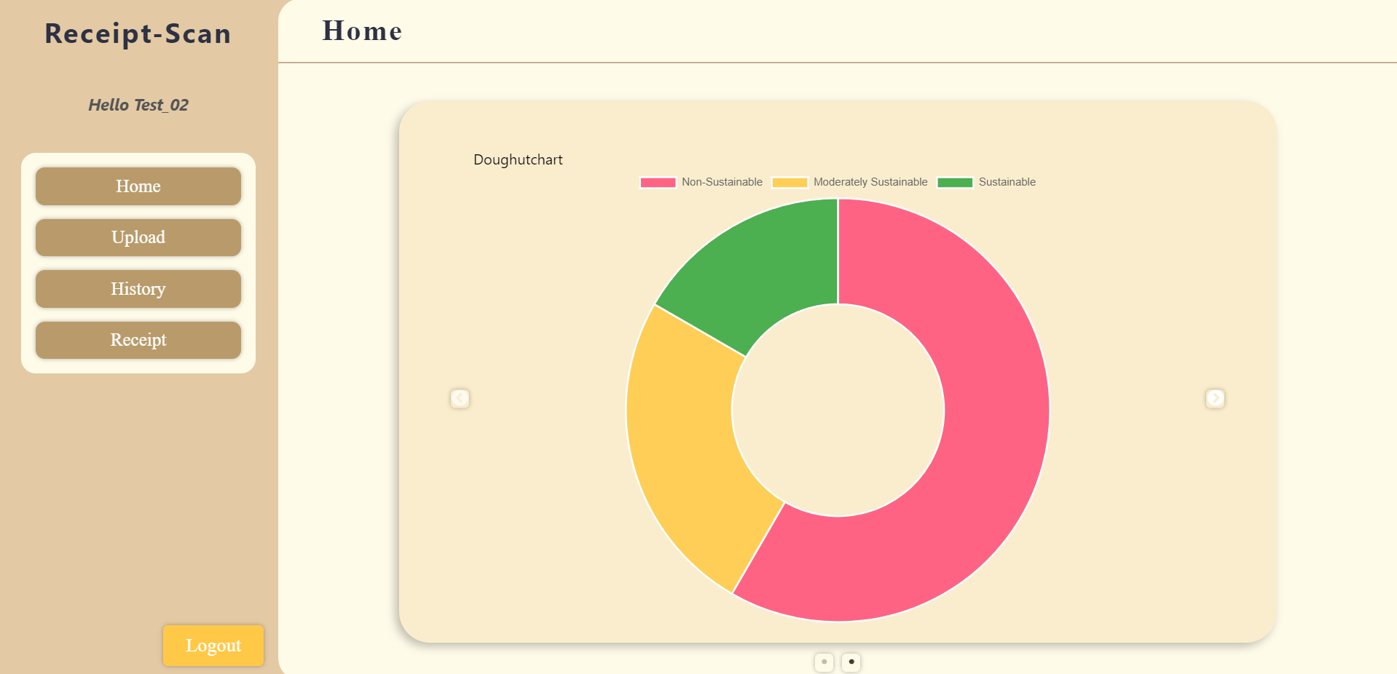
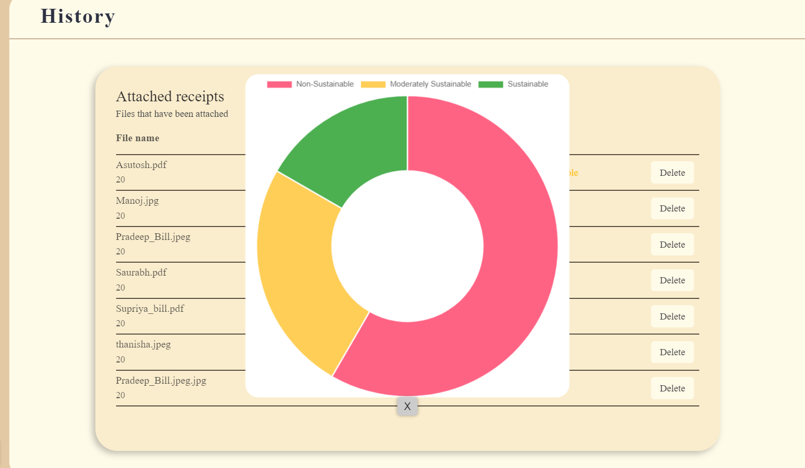
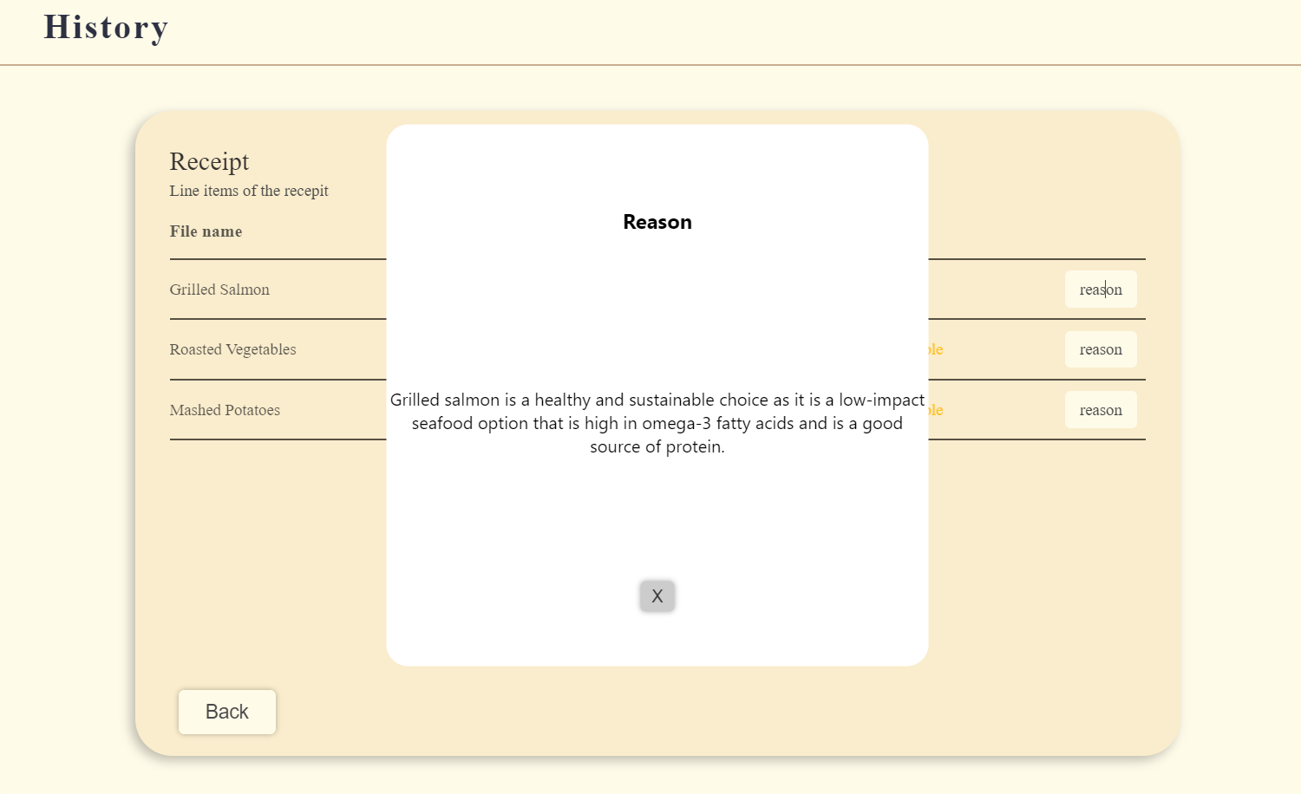
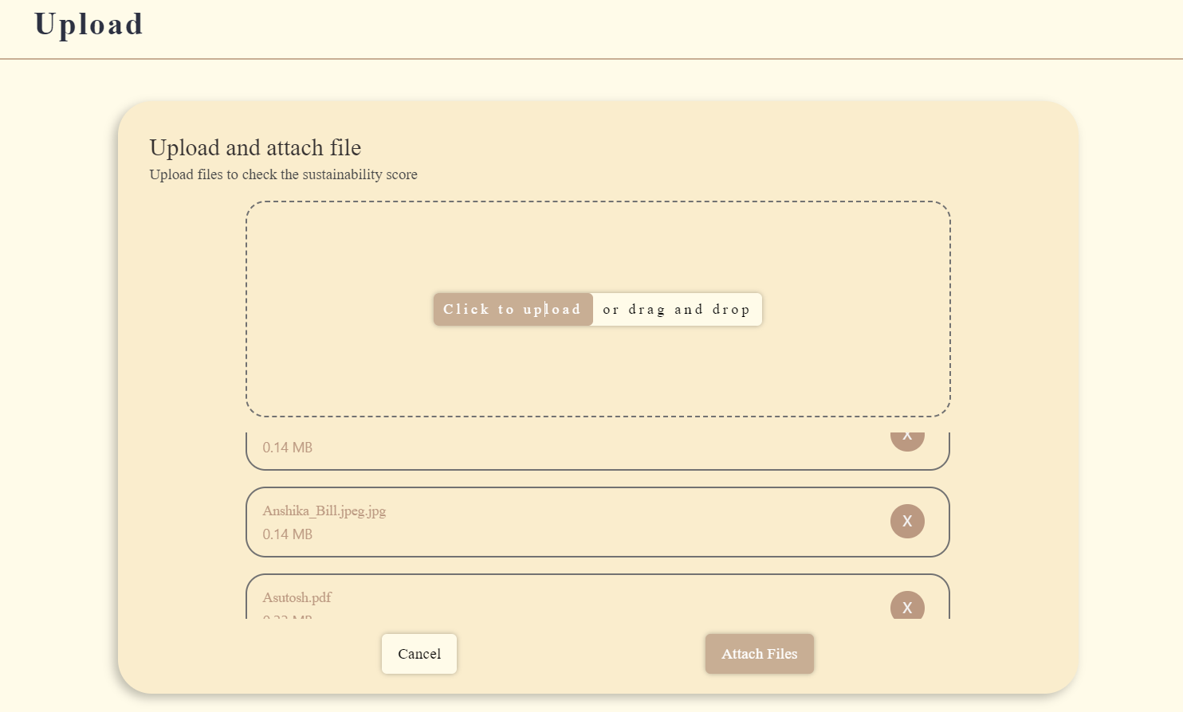
User Dashboard
PSG iTech, CSE

Slide 5
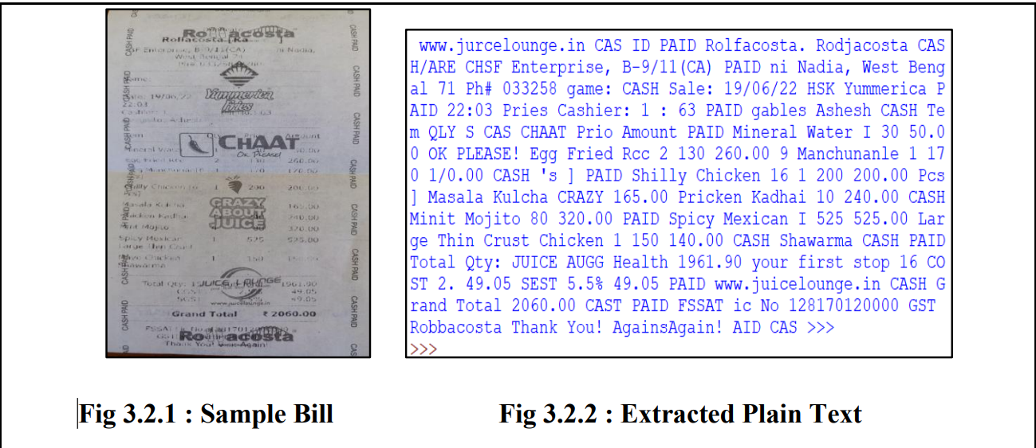
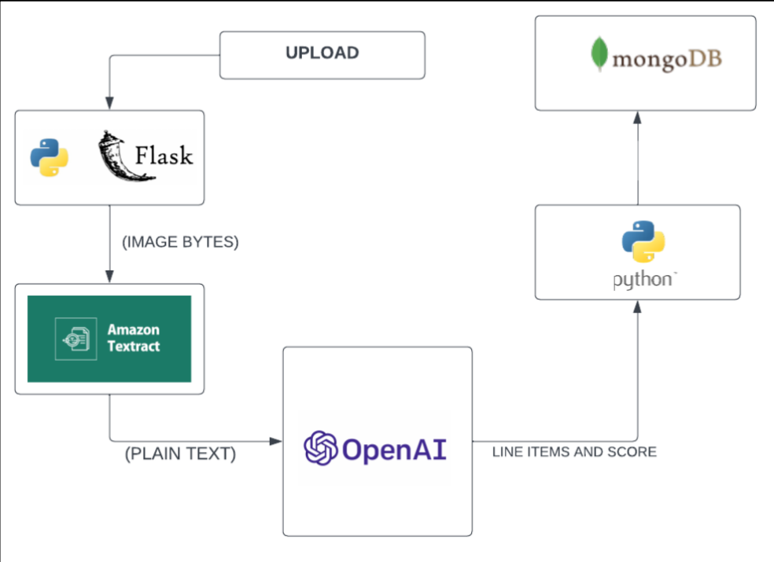

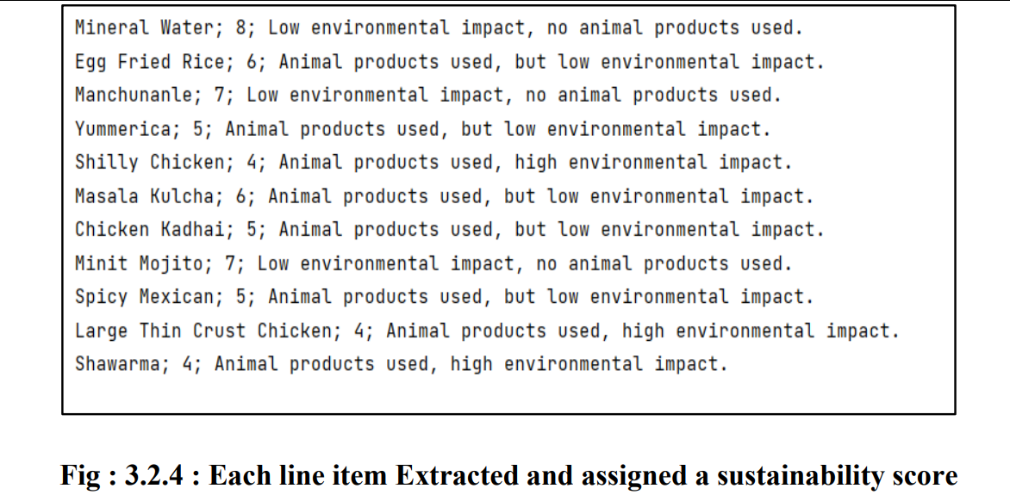
Text Extraction and Line items Assessment
PSG iTech, CSE

Slide 6
Use Cases
Learning Outcomes
The ability to accurately extract line items from receipts and assign a sustainability score to each item has the potential to help consumers make more informed decisions about their purchases and reduce their environmental impact.
The charts may include visualisations of spending patterns, retailer preferences, or sustainability metrics, depending on the available data and the user's preferences.
The flow of the application is designed to be intuitive and user-friendly, allowing users to easily upload and manage their bills and gain insights into their spending habits and sustainability impact.
Proficiency in Full Stack Development (Reactjs, Flask, Python)
Learning to inherit openAI API and Tesserat OCR
UI/UX Design(CSS, figma)
Database Integration (MongoDb-python)
PSG iTech, CSE

