Slide 1


Konkan Gyanpeeth College of Engineering, Karjat
Department of Artificial Intelligence And Data Science Engineering Year 2024-2025 / Semester III
MATH GAME
Project By :
Shubham Uttam Bakade - 50
Sahil Jayram Raut -62 Sahil Rushikant Mahadik - 59 Mohammad Sarfaraz Shaikh - 63
Guided By : MRS.K.S. YADAV

Slide 2
INDEX
Content | Pg. No.
Problem Statement | 3
Introduction | 4
Literature Survey | 5
Analysis | 6
Tecknowledge / Platform to be used | 7
System Design | 8-11
Applications | 12-13
Future Scope | 14
Reference | 15

Slide 3
Problem Statement
In today’s educational environment, math is a critical skill that is often viewed as challenging and intimidating by students. Traditional methods of learning math, such as textbooks and worksheets, can sometimes fail to engage learners, making math practice feel tedious and unmotivating.
The problem is how to create an engaging, interactive, and enjoyable way for users to practice and improve their math skills, while also providing immediate feedback and tracking progress. The solution should be accessible to learners of all ages, adaptable to different levels of difficulty, and designed to encourage consistent practice.

Slide 4
Introduction
The "Maths Quiz Game" is a web-based application developed using HTML, CSS, and JavaScript to make learning math fun and engaging. Whether you want to practice addition, subtraction, multiplication, or division, this game has you covered. It offers an interactive platform that generates random math problems, provides immediate feedback, and tracks your score—all in one simple interface.
This game simplifies math practice by combining problem-solving and learning into one seamless experience. Whether you're a student looking to improve your skills or just someone who enjoys a good challenge, the Maths Quiz Game helps you hone your mental math abilities quickly and effectively. Perfect for learners of all ages who want to sharpen their math skills in a fun and interactive way!

Slide 5
Literature Survey
Many existing educational tools focus on specific aspects of math, such as arithmetic or algebra, but often lack a unified platform for diverse skill levels. This forces users to search for multiple apps or tools tailored to their individual learning needs. Our Maths Quiz Game addresses this gap by combining various math problems (addition, subtraction, multiplication, division) into one convenient, user-friendly application.Interactive educational games have been widely recognized as effective for learning, particularly in subjects like mathematics.

Slide 6
Analysis
The Maths Quiz Game offers an engaging and interactive approach to practicing essential math skills such as addition, subtraction, multiplication, and division, all within a single platform. By integrating a variety of math problems into one convenient application, the game simplifies the learning process, providing users with immediate feedback and score tracking to enhance their math proficiency.
The primary benefit of the Maths Quiz Game is that it offers a quick and easy way to practice math problems, making it an efficient tool for learners Additionally, the game boasts a user-friendly interface that simplifies navigation..

Slide 7
Technology/Platform to be used
Programming Languages:
HTML: The structure and layout of the Maths Quiz Game are built using HTML, which provides the foundation for the web page by organizing the elements such as questions, input fields, buttons, and the scoreboard.
CSS: The game’s visual presentation and layout adjustments are handled using CSS.
JavaScript: JavaScript drives the core functionality of the game, implementing the logic for random math problem generation, user interaction, answer validation, and score tracking. It enables dynamic updates, ensuring that users get real-time feedback as they play.
Libraries:
Math.random(), CSS Flexbox/Grid, JavaScript DOM API

Slide 8
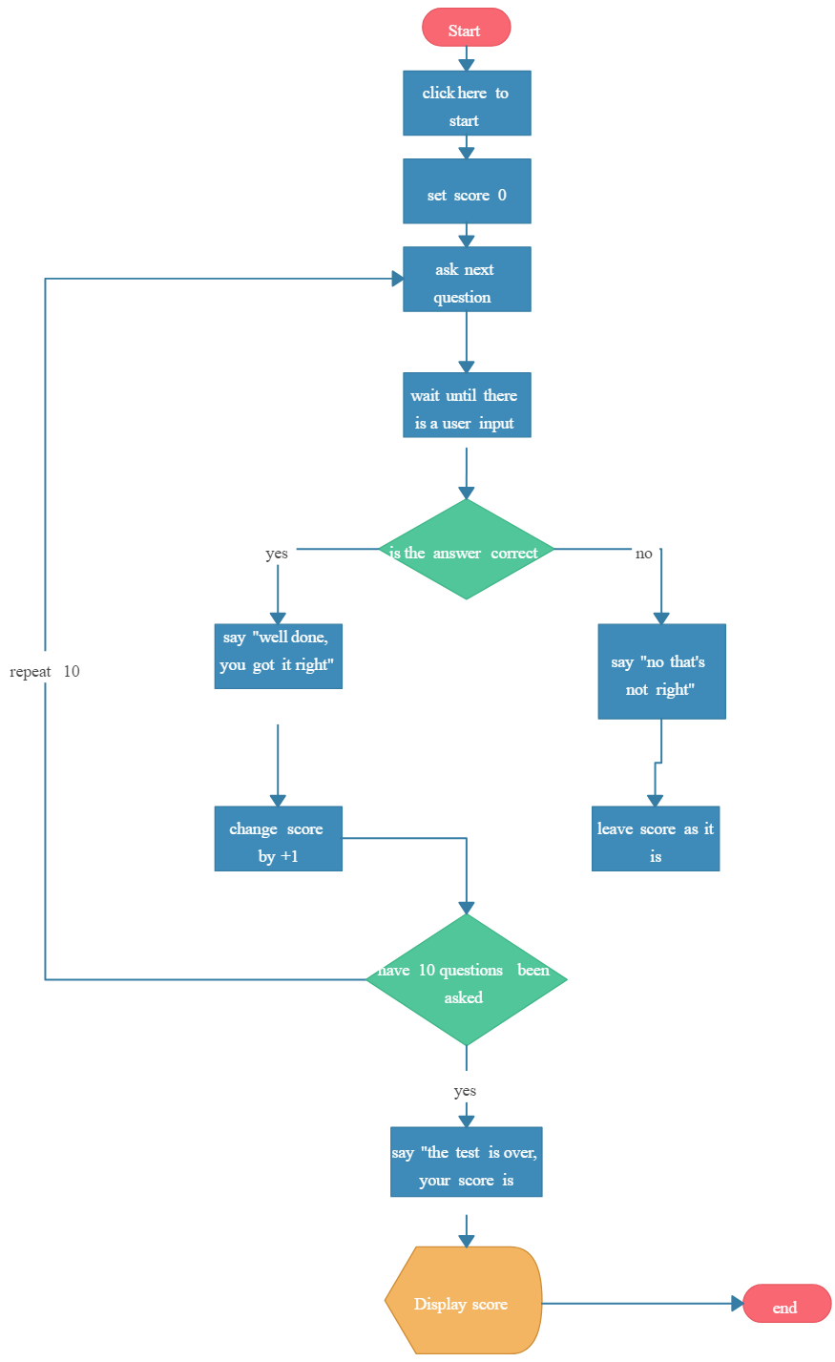
System Design
System Connectivity -

Slide 9
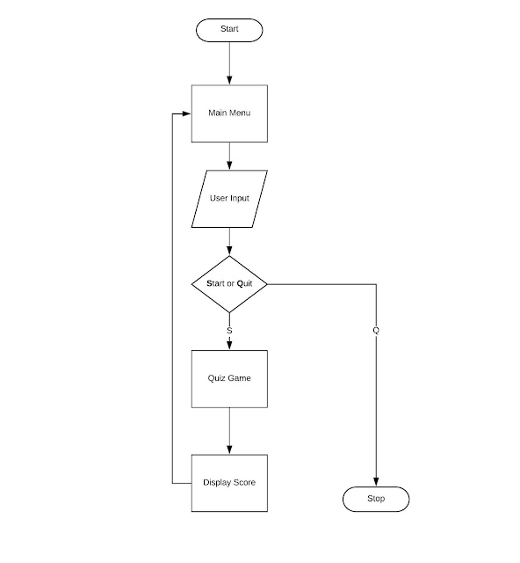
System Design
Flowchart -

Slide 10


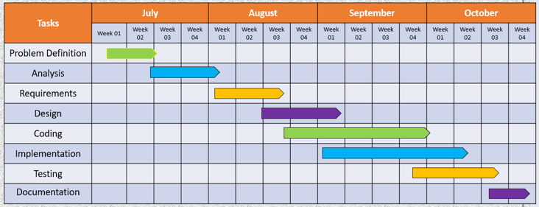
System Design
Gantt chart -

Slide 11
System Design
Algorithm -
1. Choose Difficulty Level
The user picks a difficulty level, such as easy, medium, or hard. This will determine the complexity of the questions.
2. Display Question
Show the user a math question based on the selected difficulty. For example, "What is 5 + 3?"
3. Input Answer
The user types in their answer. This is their guess for the question posed.
4. Submit Answer
The user clicks a button to submit their answer.
5. Check Answer and Provide Feedback
The app checks if the answer is correct and provides feedback. For instance, "Correct!" or "Incorrect. The correct answer is 8."
6. Show Next Question or End Quiz
The user can move to the next question, or if it's the last question, the app shows the final score and an option to restart or exit.

Slide 12
Applications
Prodigy Math Game: A fantasy-based math game that covers a wide range of math topics from 1st to 8th grade. It uses adaptive learning to tailor questions to each student's needs.
Math Games, Learn Add Multiply: This app offers a variety of math games for addition, subtraction, multiplication, and
division. It's designed for kids but can be fun for adults too.
Math Blaster: A classic game that combines math practice with space adventure. It's great for younger kids and helps build basic math skills.
Khan Academy Kids: Offers a variety of math games and activities for young children, focusing on foundational math skills.
Mathletics: An online math learning platform that provides interactive math games
and challenges for students of all ages.

Slide 13
Future Scope
Multiple Difficulty Levels:
Include levels like easy, medium, and hard, with increasingly complex math problems (e.g., algebra, geometry).
Variety of Math Problems:
Expand beyond basic operations to include fractions, decimals, algebra, etc.

Slide 14
References
1.Books:
The potential of an interactive game-based software to motivate high-achieving maths students at primary school level,By Author :-Howard Stephen,Crotty
A Case Study on 21st Century Skills Development Through a Computer Based Maths Game
By Author :- Nour Mawas,Micheal BradFord
2.Websites:
https://www.learntechlib.org/p/184325/
https://books.google.co.in/books?hl=en&lr=&id=gnJdEAAAQBAJ&oi=fnd&pg=PA287&dq=maths+quiz+game+&ots=WVReJmOuOd&sig=nr8NVD3JQU5C8v29JBEPniG6os8&redir_esc=y#v=onepage&q=maths%20quiz%20game&f=false

Slide 15
Thank You !

Slide 16
Questionnaire Session

